Slide 1
MANE 6313

Slide 2
Week 15, Module A

Slide 3
Student Learning Outcome
  Select an appropriate experimental design with one or more factors,
  Select an appropriate model with one or more factors,
  Evaluate statistical analyses of experimental designs,
  Assess the model adequacy of any experimental design, and
  Interpret model results.

Slide 4
Module Learning Outcome
Prepare an effective Response Surface Methodology Project Report

Slide 5
Overview
  Tell the story associated with Figure 11.3

Slide 6
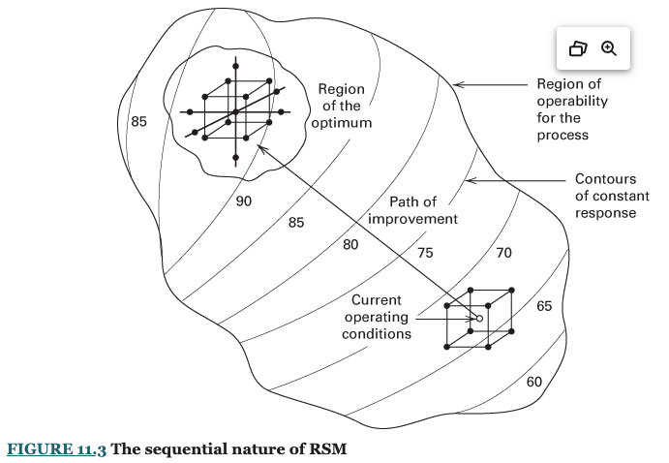
Overview of RSM Project

Slide 7
  Use rubric to guide organization of report
  Web application works exactly the same as the fractional factorial website

Slide 8
Resources
  RSM Project Assignment
  RSM Rubric
  RSM Report Guide
  RSM Web Links

