Slide 1
MANE 6313

Slide 2
Week 15, Module B

Slide 3
Student Learning Outcome
  Select an appropriate experimental design with one or more factors,
  Select an appropriate model with one or more factors,
  Evaluate statistical analyses of experimental designs,
  Assess the model adequacy of any experimental design, and
  Interpret model results.

Slide 4
Module Learning Outcome
Employ method of steepest descent (MSD) to locate the region of a minimum

Slide 5
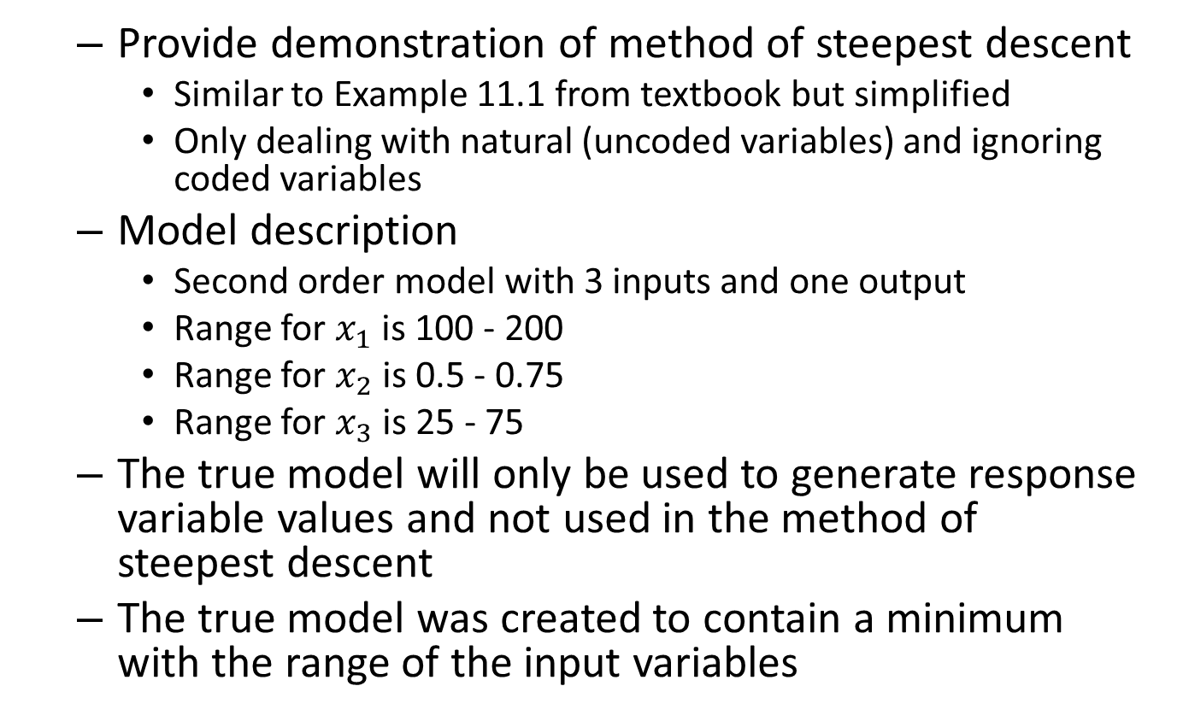
Method of Steepest Descent Demonstration
  Provide demonstration of method of steepest descent
    Similar to Example 11.1 from textbook but simplified
    Only dealing with natural (uncoded variables) and ignoring coded variables
  Model description
    Second order model with 3 inputs and one output
    Range for $x_{1}$ is 100 - 200
    Range for $x_{2}$ is 0.5 - 0.75
    Range for $x_{3}$ is 25 - 75
  The true model will only be used to generate response variable values and not used in the method of steepest descent
  The true model was created to contain a minimum with the range of the input variables

Slide 6
Steps in Steepest Descent Analysis
  First Order DOE
  Selection of Minimum Design Point
  Construction of Gradient Vector
  Gradient Vector at Minimum Point
  Selection of Step Size
  Construction of Search Path
  Implementation and Results of MSD

Slide 7
First Order DOE
  A single replicate of a $2^{3}$ full factorial was conducted around the point (110, 1.0, 30).
  The data for building the model is

Slide 8
x1 | x2 | x3 | y
100 | 0.5 | 25 | 94.575
100 | 0.5 | 35 | 82.825
100 | 1.5 | 25 | 85.625
100 | 1.5 | 35 | 74.375
120 | 0.5 | 25 | 63.875
120 | 0.5 | 35 | 51.325
120 | 1.5 | 25 | 55.125
120 | 1.5 | 35 | 43.075

Slide 9

  The fitted linear model is
$$\hat{y}=273.05−1.44x_{1}−11.20x_{2}−0.8x_{3}+0.01x_{1}x_{2}−0.004x_{1}x_{3}+0.05x_{2}x_{3}$$

Slide 10
Minimum Point
  Select a starting point for the steepest method search
  Since minimum is desired, select design point with smallest value for y
(120, 1.5, 35)

Slide 11
Gradient Vector
  The gradient vector is found by taking partial derivatives with respect to each variable
$$\begin{matrix}\frac{d\hat{y}}{dx_{1}} & =−1.44+0.01x_{2}−0.004x_{3} \\ \frac{d\hat{y}}{dx_{2}} & =−11.20+0.01x_{1}+0.05x_{3} \\ \frac{d\hat{y}}{dx_{3}} & =−0.80−0.004x_{1}+0.05x_{2}\end{matrix}$$
  Notice that the gradient vector is a function of $x_{1}$, $x_{2}$, and $x_{3}$.

Slide 12
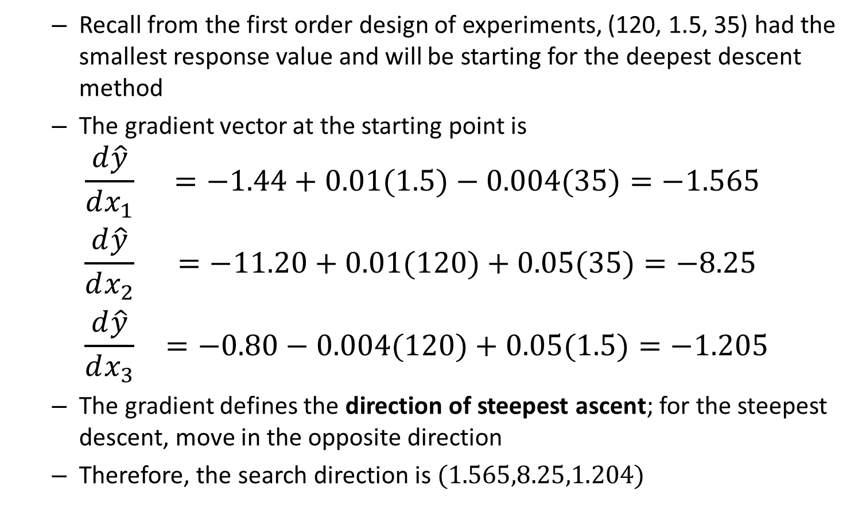
Gradient Vector at DSM Starting Point
  Recall from the first order design of experiments, (120, 1.5, 35) had the smallest response value and will be starting for the deepest descent method
  The gradient vector at the starting point is
$$\begin{matrix}\frac{d\hat{y}}{dx_{1}} & =−1.44+0.01(1.5)−0.004(35)=−1.565 \\ \frac{d\hat{y}}{dx_{2}} & =−11.20+0.01(120)+0.05(35)=−8.25 \\ \frac{d\hat{y}}{dx_{3}} & =−0.80−0.004(120)+0.05(1.5)=−1.205\end{matrix}$$
  The gradient defines the direction of steepest ascent; for the steepest descent, move in the opposite direction
  Therefore, the search direction is $(1.565,8.25,1.204)$

Slide 13
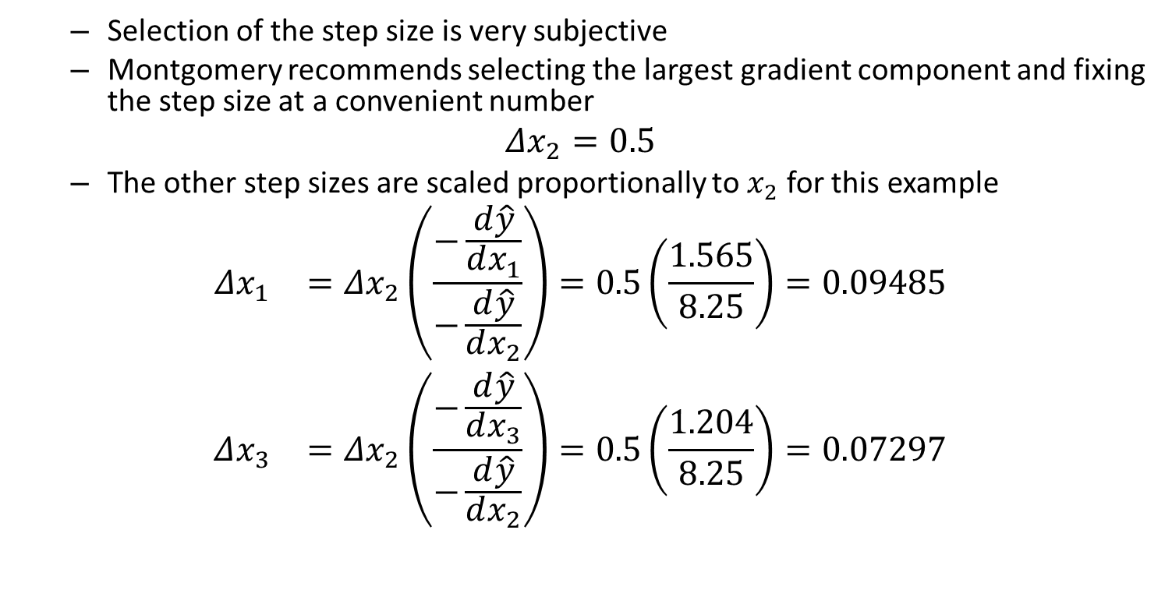
Step Size
  Selection of the step size is very subjective
  Montgomery recommends selecting the largest gradient component and fixing the step size at a convenient number
$$Δx_{2}=0.5$$
  The other step sizes are scaled proportionally to $x_{2}$ for this example
$$\begin{matrix}Δx_{1} & =Δx_{2}\left(\frac{−\frac{d\hat{y}}{dx_{1}}}{−\frac{d\hat{y}}{dx_{2}}}\right)=0.5\left(\frac{1.565}{8.25}\right)=0.09485 \\ Δx_{3} & =Δx_{2}\left(\frac{−\frac{d\hat{y}}{dx_{3}}}{−\frac{d\hat{y}}{dx_{2}}}\right)=0.5\left(\frac{1.204}{8.25}\right)=0.07297\end{matrix}$$

Slide 14
Search Path
  Combining the starting point and step size, the search path is
$$\begin{matrix}x_{1} & =120+0.09485t \\ x_{2} & =1.5+0.5t \\ x_{3} & =35+0.07297t\end{matrix}$$

Slide 15
Search Results
t | x1 | x2 | x3 | y
0 | 120 | 1.5 | 35 | 43.075
1 | 120.09485 | 2 | 35.7297 | 39.11371494
2 | 120.1897 | 2.5 | 36.4594 | 35.82161728
3 | 120.28455 | 3 | 37.1891 | 33.198707
4 | 120.3794 | 3.5 | 37.9188 | 31.24498412
5 | 120.47425 | 4 | 38.6485 | 29.96044862
6 | 120.5691 | 4.5 | 39.3782 | 29.34510052
7 | 120.66395 | 5 | 40.1079 | 29.3989398
8 | 120.7588 | 5.5 | 40.8376 | 30.12196648

Slide 16
  The minimum was found at step 6 with values (120.57,4.5,39.38)
  This value should be in the neighborhood of the minimum
  A full second-order RSM design should be build centered at (120.57,4.5,39.38)

