Slide 1
MANE 3332.01

Slide 2
Lecture 24
Agenda
Continue Chapter 9 lecture
Resume with Connect to Confidence Intervals and p-value for Case 1
Chapter 8, Case 3 Quiz (assigned 11/18/2025, due 11/20/2025)
NEW: Chapter 9, Case 1 2-sided Practice Problems (assigned 11/20/2025, due 11/25/2025)
NEW: Chapter 9, Case 1 Lower Practice Problems (assigned 11/20/2025, due 11/25/2025)
NEW: Chapter 9, Case 1 Upper Practice Problems (assigned 11/20/2025, due 11/25/2025)
Attendance
Questions?

Slide 3
Handouts
Lecture 23 Slides
Lecture 23 Slides - marked

Slide 4
Week | Tuesday Lecture | Thursday Lecture
12 | 11/18 - Chapter 9 (part 1) | 11/25 - Chapter 9, Case 1
13 | 11/25 - Chapter 9, Case 2 | 11/27 - Thanksgiving Holiday (no class)
14 | 12/2 - Chapter 9, Case 3 | 12/4 - Linear Regression
15 | 12/9 - Review Session | 12/11 - Study Day (no class)

Slide 5
The final exam for MANE 3332.01 is Thursday December 18, 2025 at 10:15 AM - 12:00 PM.

Slide 6
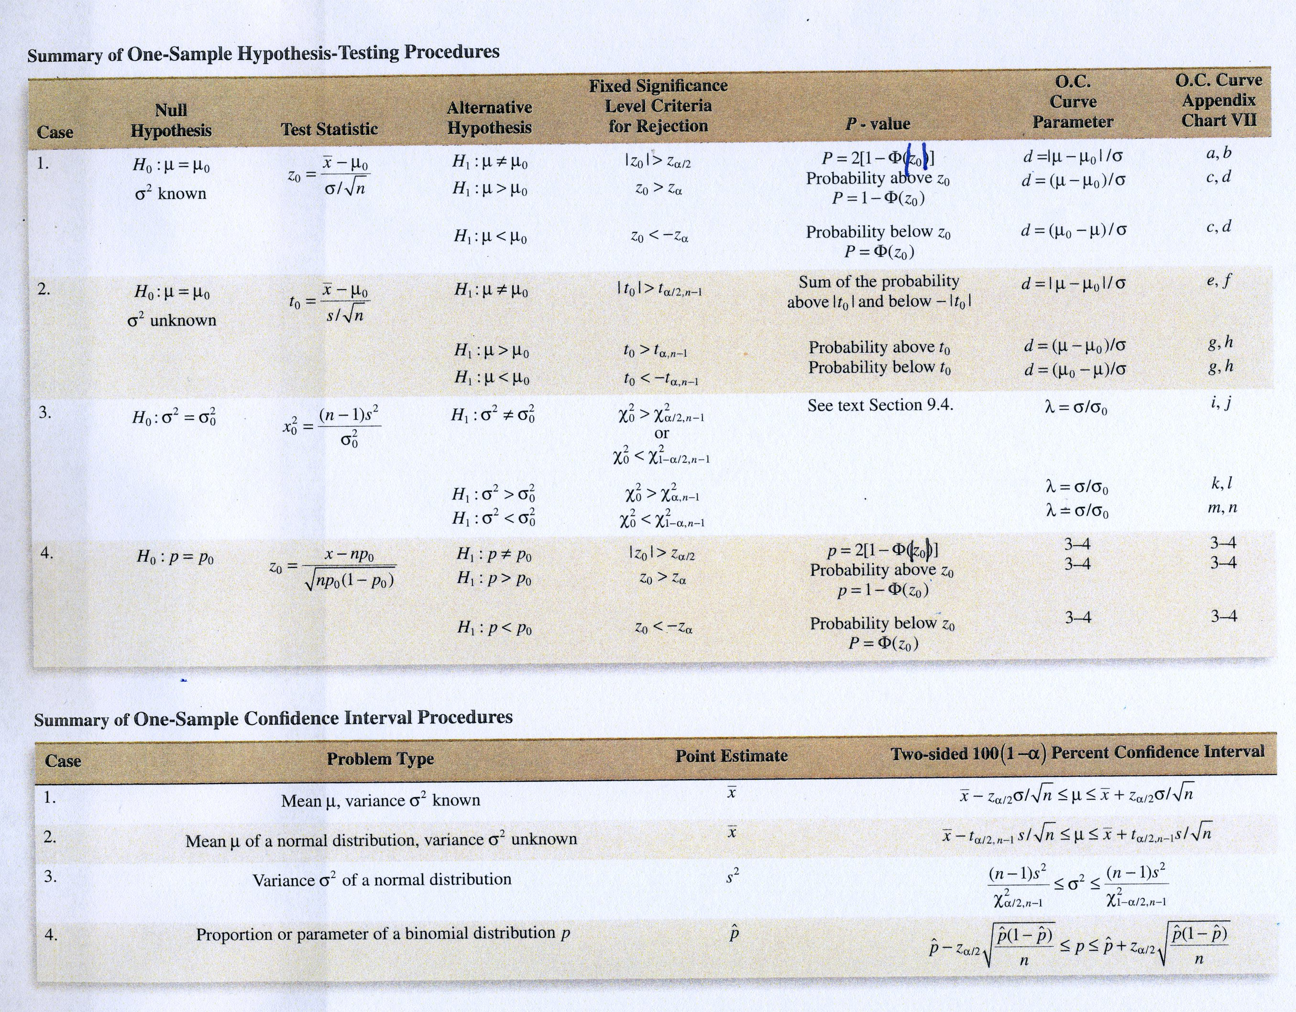

Slide 7
Introduction to Hypothesis Testing
Decision Making for a Single Sample
Inferential statistics consists of methods used to make decisions or draw conclusions about a population using information contained in a sample
Inference is divided into two major areas:
Parameter estimation (both point and interval)
Hypothesis testing

Slide 8
Overview of Statistical Hypotheses
Many engineering problems require a decision to be made regarding some statement about a parameter
The statement is called a hypothesis
The decision-making process about the hypothesis is call hypothesis testing
Statistical hypothesis testing is usually the data analysis stage of a comparative experiment
A procedure leading to a decision about a particular hypothesis is called a test of hypothesis
Testing the hypothesis involves taking a random sample, computing a test statistic from the sample data and then using the to make a decision

Slide 9
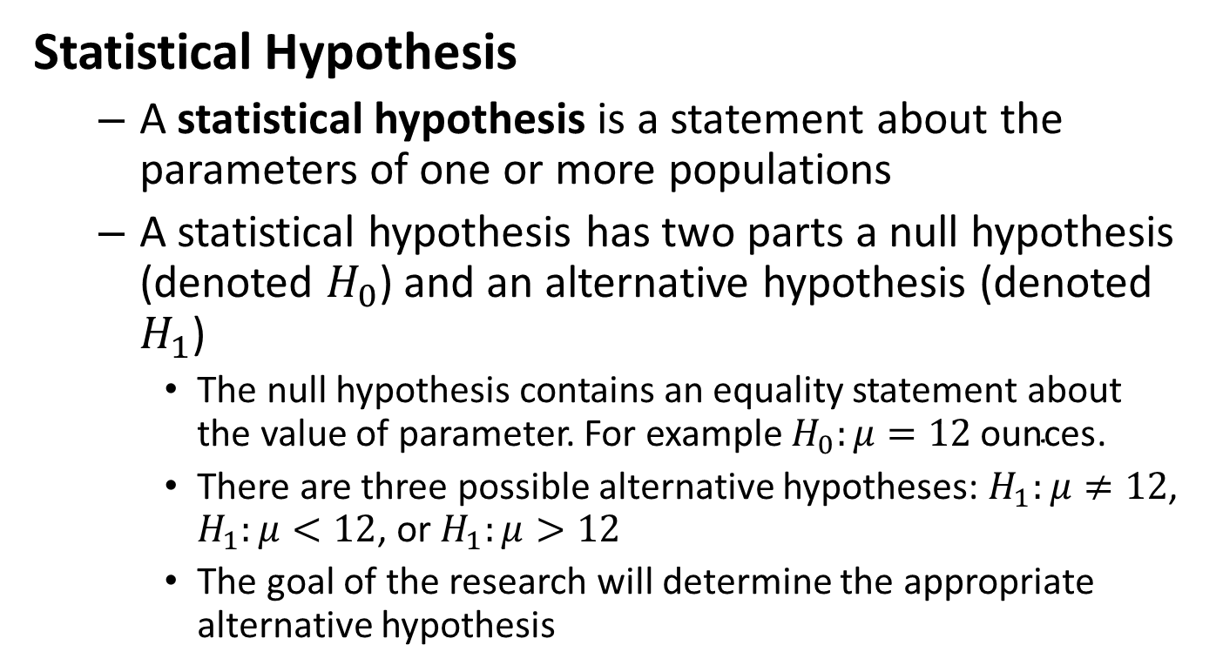
Statistical Hypothesis
A statistical hypothesis is a statement about the parameters of one or more populations
A statistical hypothesis has two parts a null hypothesis (denoted $H_{0}$) and an alternative hypothesis (denoted $H_{1}$)
The null hypothesis contains an equality statement about the value of parameter. For example $H_{0}:μ=12 \text{ounces}$.
There are three possible alternative hypotheses: $H_{1}:μ≠12$, $H_{1}:μ<12$, or $H_{1}:μ>12$
The goal of the research will determine the appropriate alternative hypothesis

Slide 10
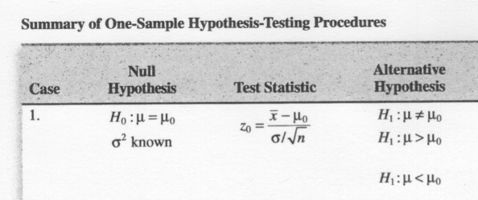

Slide 11
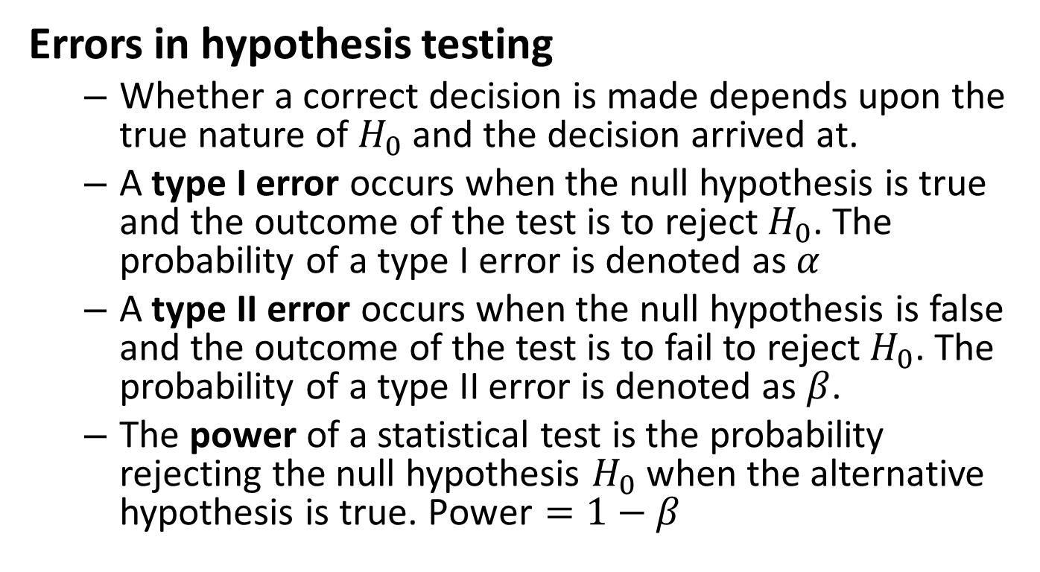
Errors in hypothesis testing
Whether a correct decision is made depends upon the true nature of $H_{0}$ and the decision arrived at.
A type I error occurs when the null hypothesis is true and the outcome of the test is to reject $H_{0}$. The probability of a type I error is denoted as $α$
A type II error occurs when the null hypothesis is false and the outcome of the test is to fail to reject $H_{0}$. The probability of a type II error is denoted as $β$.
The power of a statistical test is the probability rejecting the null hypothesis $H_{0}$ when the alternative hypothesis is true. $\text{Power}=1−β$

Slide 12
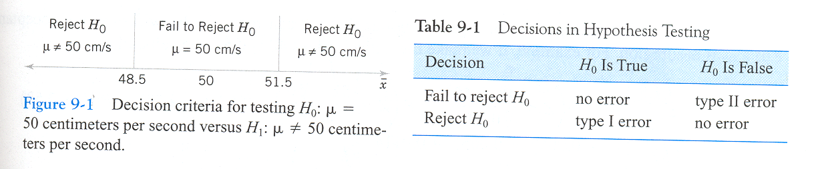

Slide 13
Error Example: Manufacturing

Slide 14
Error Example: Medical

Slide 15
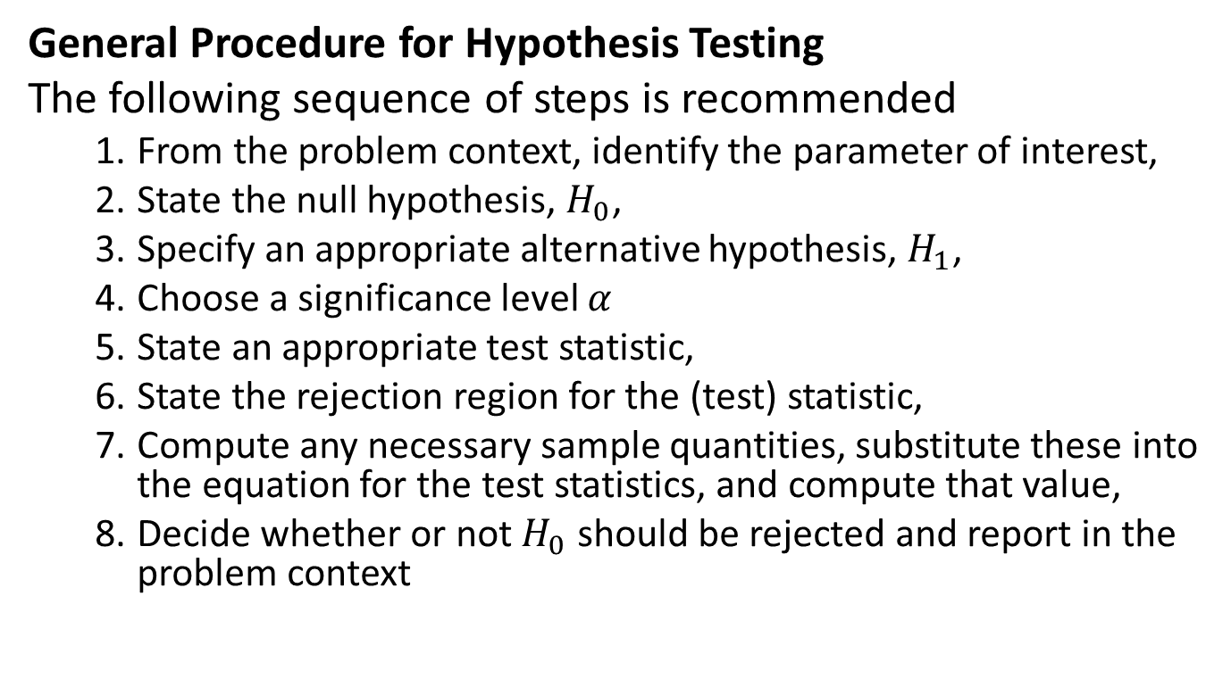
General Procedure for Hypothesis Testing
The following sequence of steps is recommended
From the problem context, identify the parameter of interest,
State the null hypothesis, $H_{0}$,
Specify an appropriate alternative hypothesis, $H_{1}$,
Choose a significance level $α$
State an appropriate test statistic,
State the rejection region for the (test) statistic,
Compute any necessary sample quantities, substitute these into the equation for the test statistics, and compute that value,
Decide whether or not $H_{0}$ should be rejected and report in the problem context

Slide 16
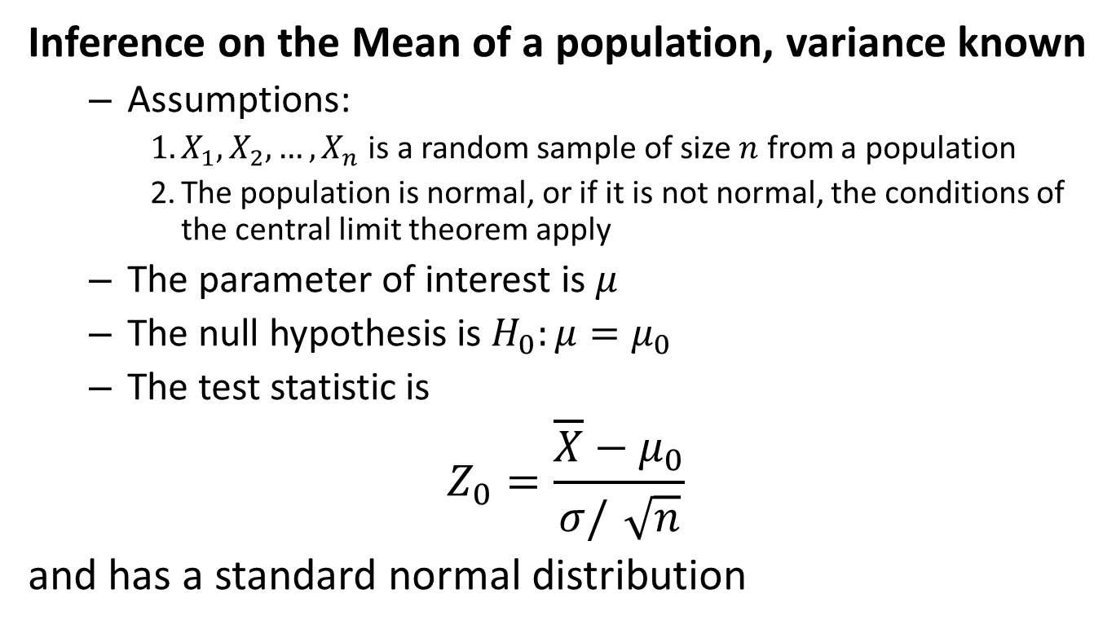
Chapter 9, Case 1
Inference on the Mean of a population, variance known
Assumptions:
$X_{1},X_{2},…,X_{n}$ is a random sample of size $n$ from a population
The population is normal, or if it is not normal, the conditions of the central limit theorem apply
The parameter of interest is $μ$
The null hypothesis is $H_{0}:μ=μ_{0}$
The test statistic is
$$Z_{0}=\frac{\overline{X}−μ_{0}}{σ/\sqrt{n}}$$
and has a standard normal distribution

Slide 17
The alternative hypotheses and corresponding critical value(s) are shown in figure 9-11 on page 209

Slide 18
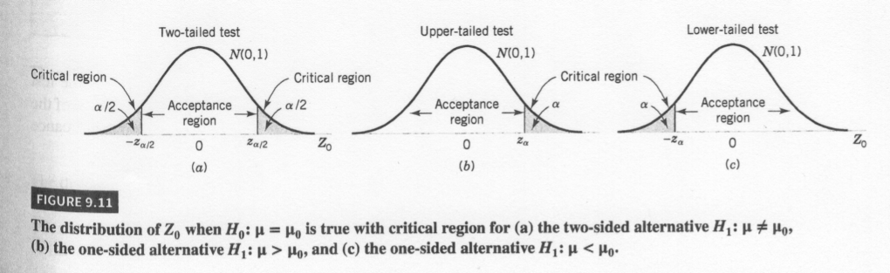

Slide 19
Summary for hypothesis test on the mean, variance known
See the material on the inside cover of your textbook

Slide 20
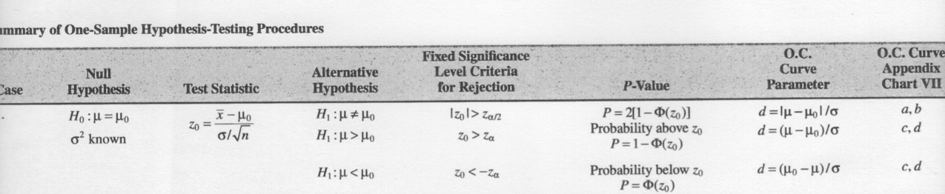

Slide 21
Problem 1

Slide 22
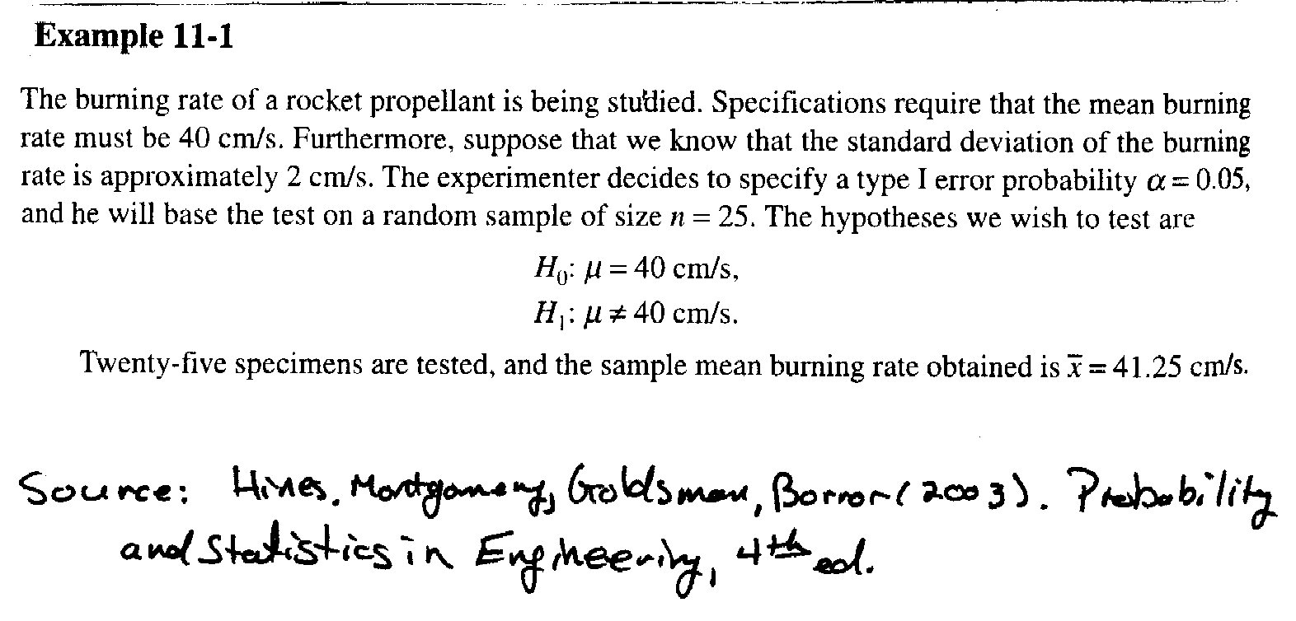

Slide 23
Problem 2

Slide 24
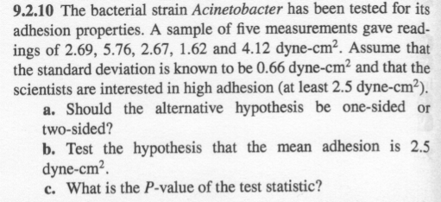

Slide 25
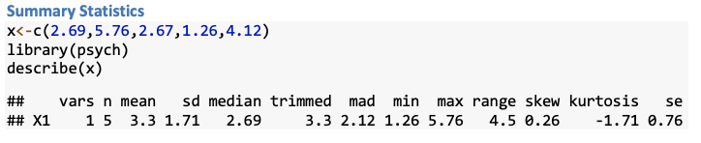

Slide 26
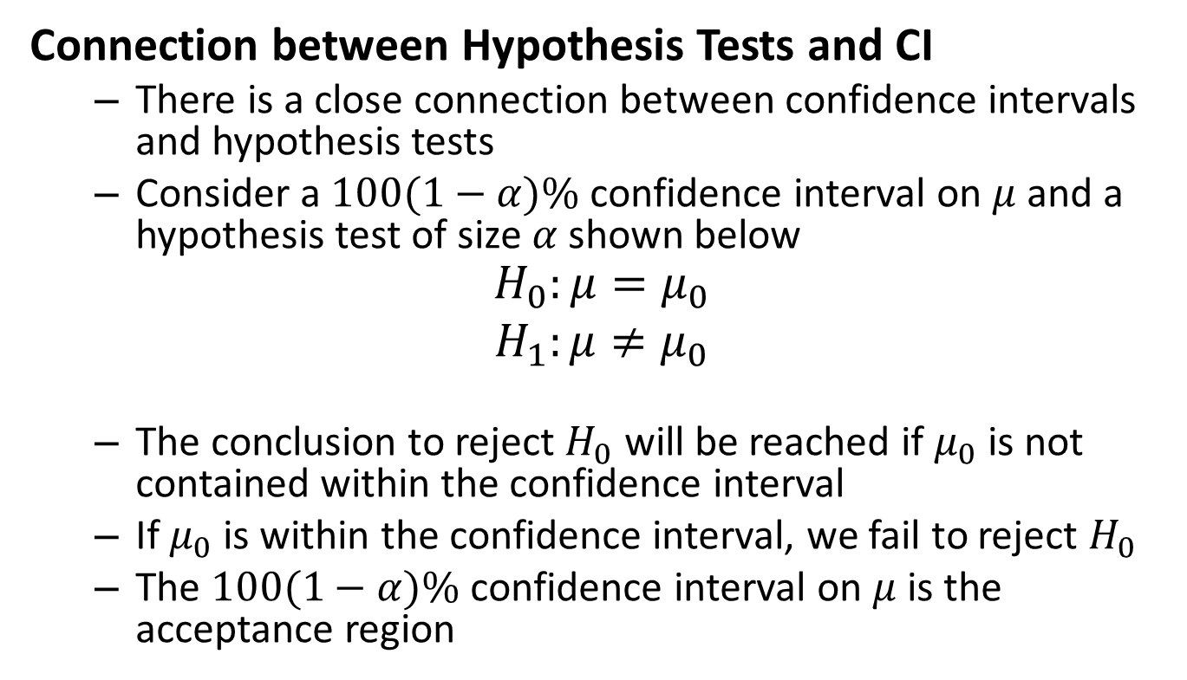
Connection between Hypothesis Tests and CI
There is a close connection between confidence intervals and hypothesis tests
Consider a $100(1−α)\%$ confidence interval on $μ$ and a hypothesis test of size $α$ shown below
$$\begin{matrix}H_{0}:μ=μ_{0} \\ H_{1}:μ≠μ_{0} \\ \end{matrix}$$
The conclusion to reject $H_{0}$ will be reached if $μ_{0}$ is not contained within the confidence interval
If $μ_{0}$ is within the confidence interval, we fail to reject $H_{0}$
The $100(1−α)\%$ confidence interval on $μ$ is the acceptance region

Slide 27
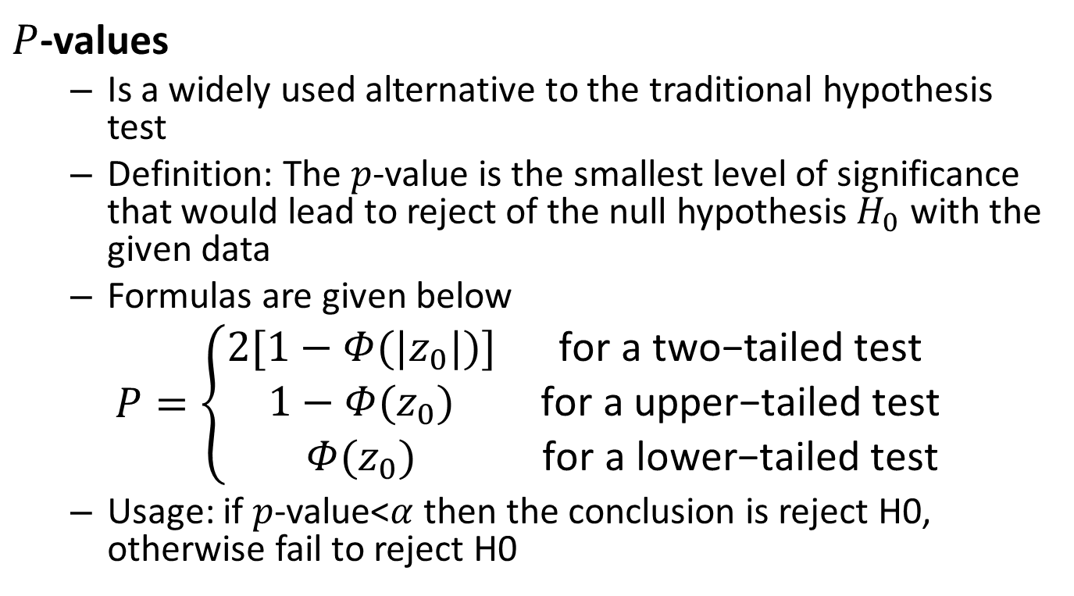
$P$-values
Is a widely used alternative to the traditional hypothesis test
Definition: The $p$-value is the smallest level of significance that would lead to reject of the null hypothesis $H_{0}$ with the given data
Formulas are given below
$$P=\left\{\begin{matrix}2[1−Φ(|z_{0}|)] & \text{for} \text{a} \text{two}\text{−}\text{tailed} \text{test} \\ 1−Φ(z_{0}) & \text{for} \text{a} \text{upper}\text{−}\text{tailed} \text{test} \\ Φ(z_{0}) & \text{for} \text{a} \text{lower}\text{−}\text{tailed} \text{test}\end{matrix}\right.$$
Usage: if $p$-value<$α$ then the conclusion is reject H0, otherwise fail to reject H0

Slide 28
Practice Problem Chapter 9, Case 1 2-sided

Slide 29
Practice Problem Chapter 9, Case 1 Lower

Slide 30
Practice Problem Chapter 9, Case 1 Upper

Slide 31
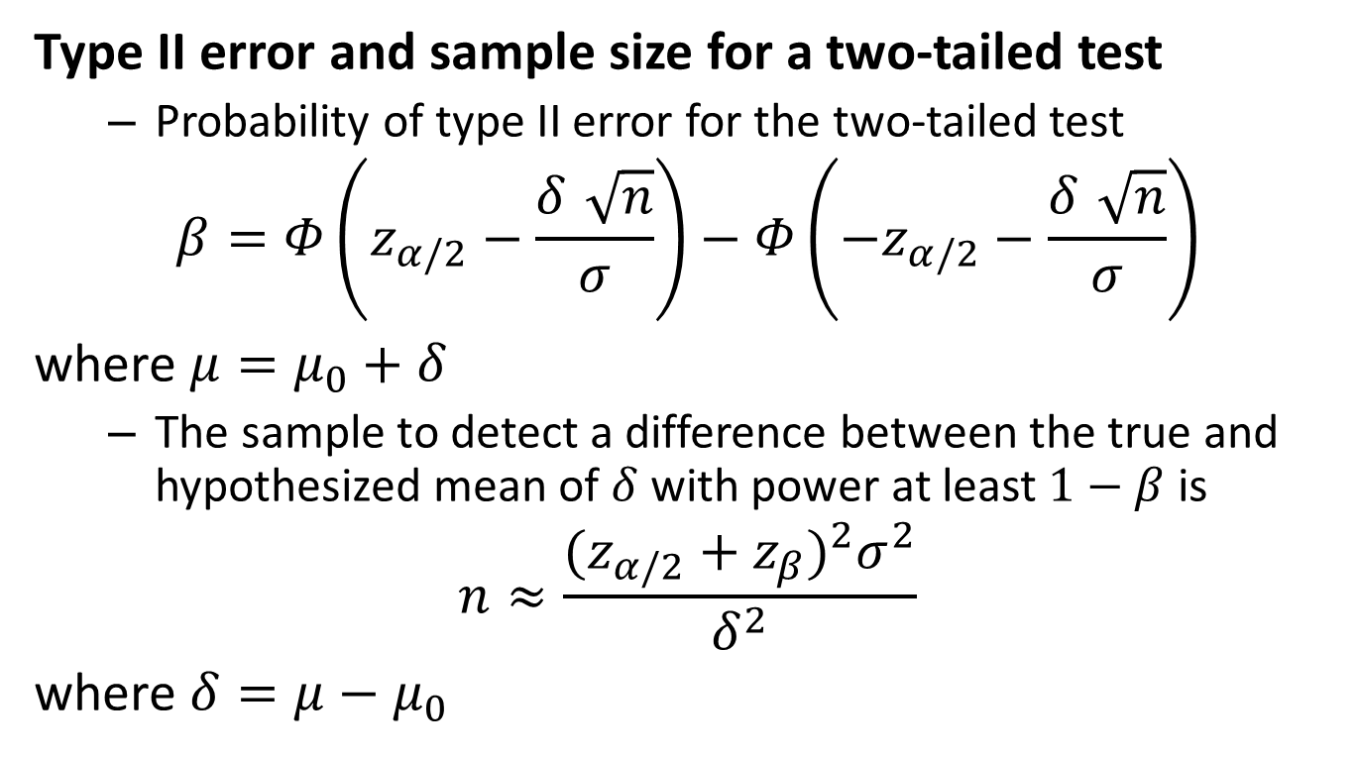
Type II error and sample size for a two-tailed test
Probability of type II error for the two-tailed test
$$β=Φ\left(z_{α/2}−\frac{δ\sqrt{n}}{σ}\right)−Φ\left(−z_{α/2}−\frac{δ\sqrt{n}}{σ}\right)$$
where $μ=μ_{0}+δ$
The sample to detect a difference between the true and hypothesized mean of $δ$ with power at least $1−β$ is
$$n≈\frac{(z_{α/2}+z_{β})^{2}σ^{2}}{δ^{2}}$$
where $δ=μ−μ_{0}$

Slide 32
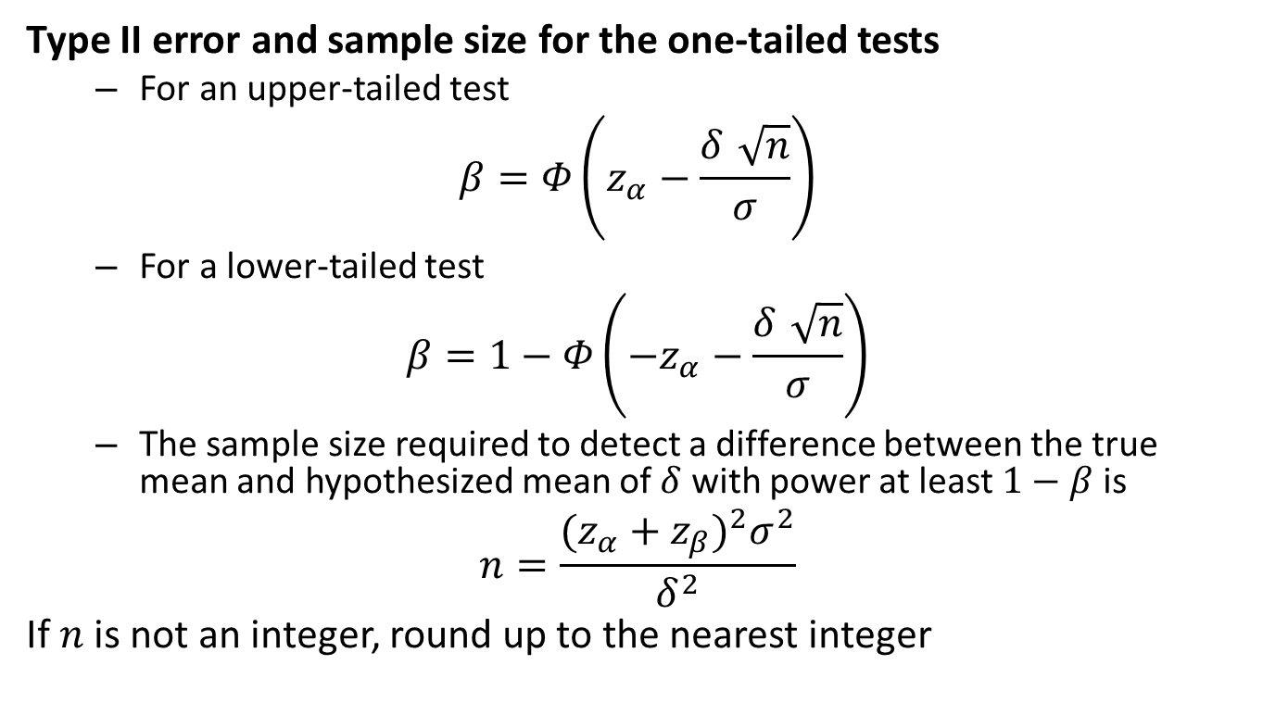
Type II error and sample size for the one-tailed tests
For an upper-tailed test
$$β=Φ\left(z_{α}−\frac{δ\sqrt{n}}{σ}\right)$$
For a lower-tailed test
$$β=1−Φ\left(−z_{α}−\frac{δ\sqrt{n}}{σ}\right)$$
The sample size required to detect a difference between the true mean and hypothesized mean of $δ$ with power at least $1−β$ is
$$n=\frac{(z_{α}+z_{β})^{2}σ^{2}}{δ^{2}}$$
If $n$ is not an integer, round up to the nearest integer

Slide 33
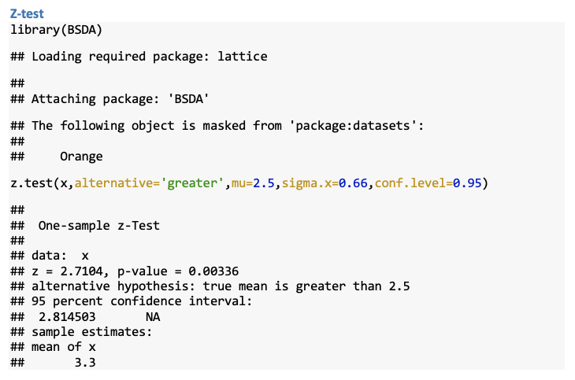
R: Chapter 9 Case 1 Hypothesis Testing

Slide 34
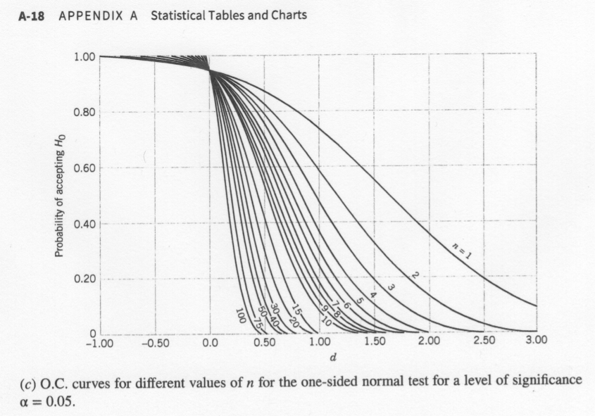
Power using OC-Curve
Find the power when the true mean value is 3.325

Slide 35
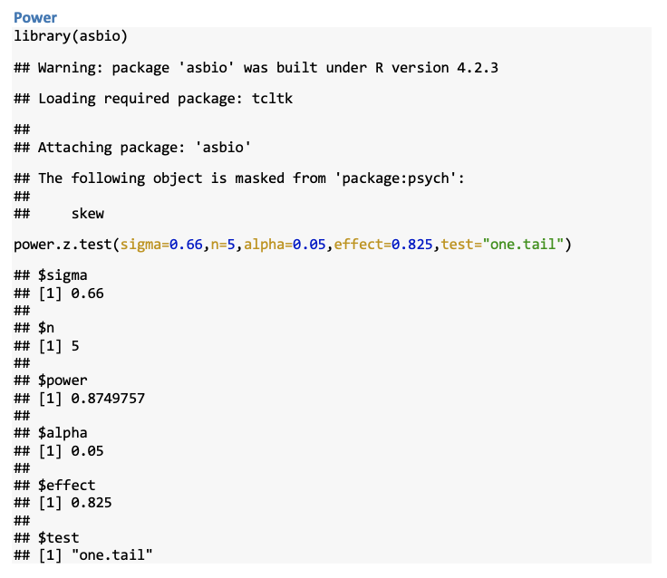
R: Chapter 9 Case 1 Power

Slide 36
Type II Error Rate and Sample Size
You will not be required to calculate or use OC-curves
You must understand the concept and be able to correctly identity type I and type II error

Slide 37
Chapter 9, Case 2
Hypothesis Test on the Mean, Variance Unknown
Much more common case than variance known
Substitute $S$ for $σ$
The test statistics is now a $t$ random variable
$$T=\frac{\overline{X}−μ_{0}}{S/\sqrt{n}}$$

Slide 38
Summary of Case 2

Slide 39
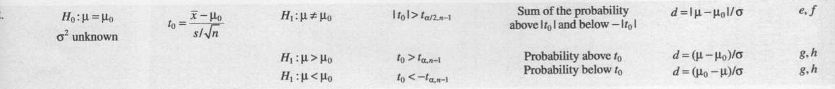

Slide 40
Problem 9.3.6

Slide 41
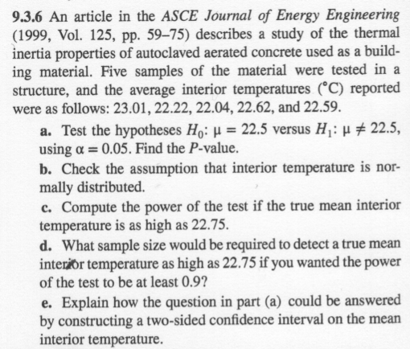

Slide 42
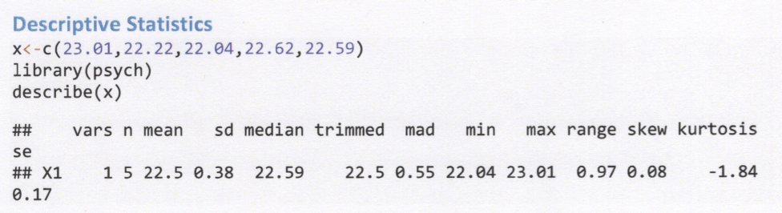

Slide 43
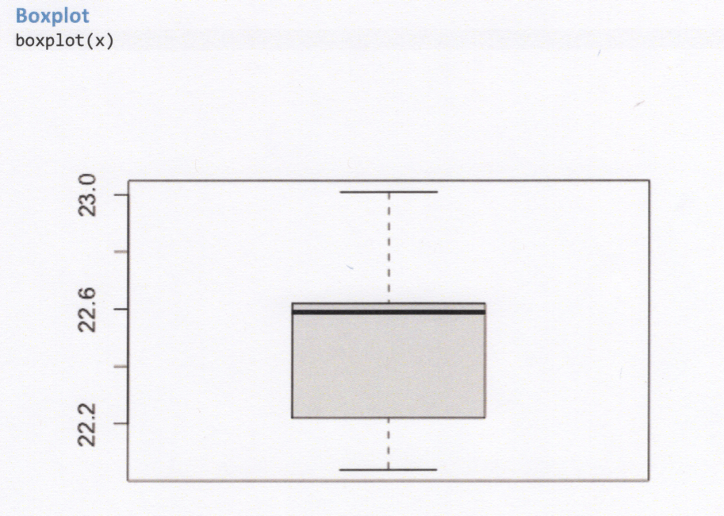

Slide 44
Classical Approach

Slide 45
Hypothesis Test Using R

Slide 46
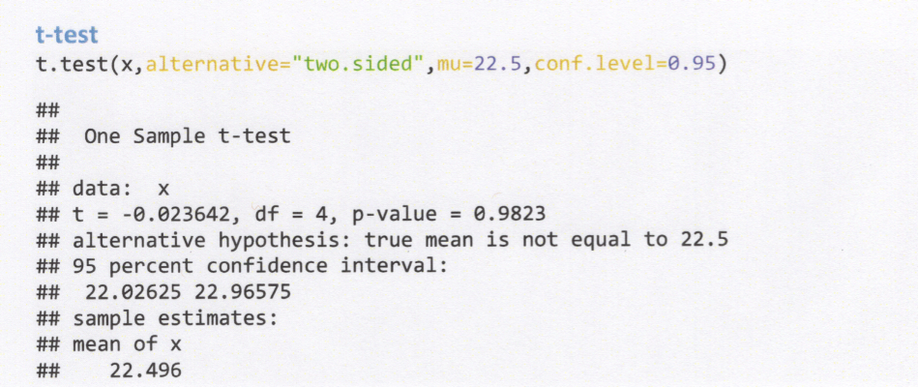

Slide 47
Normal Probability Plot

Slide 48
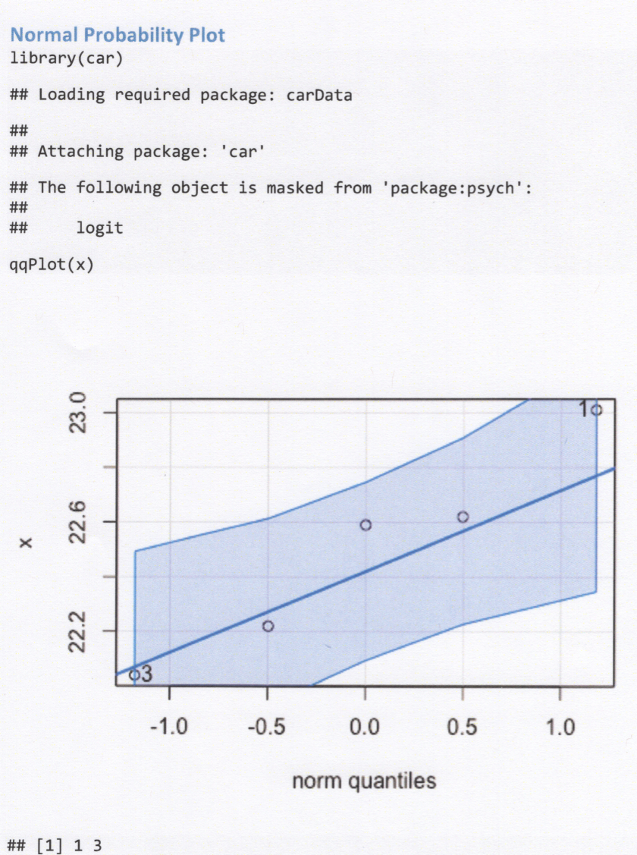

Slide 49
$P$-values
More difficult to calculate since the $t$-tables only contain a few quantiles
Can use tables to generate bounds on the $p$-value
Software will provide $p$-values

Slide 50
P-values from R

Slide 52
Power Calculations
Are much more complicated
The true distribution is now a non-central $t$
Use tables to solve (Chart VII in appendix) or software

Slide 53
Power Calculation using R

Slide 54
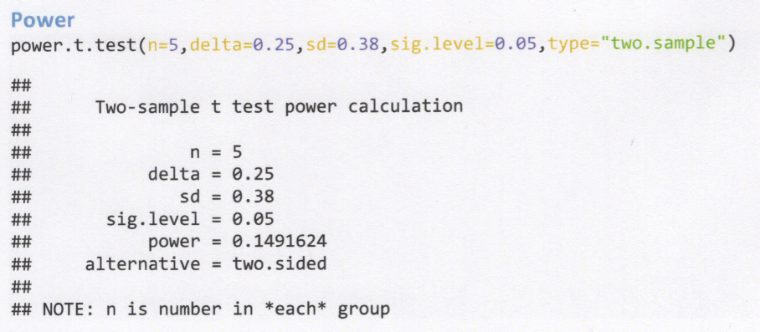

Slide 55
Sample Size using R

Slide 56
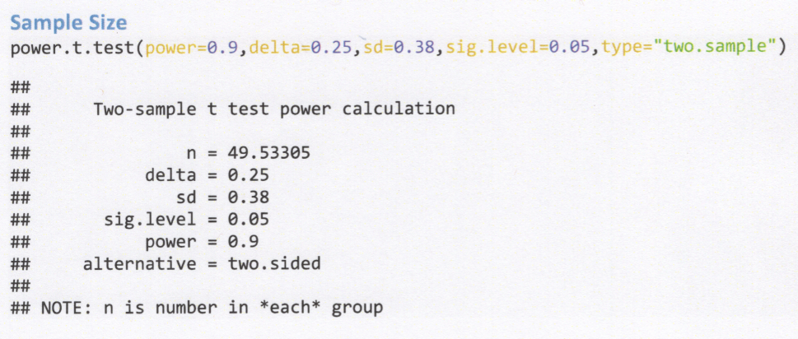

Slide 57
Chapter 9, Case 2 2-sided Practice Problems

Slide 58
Chapter 9, Case 2 Lower Practice Problems

Slide 59
Chapter 9, Case 2 Upper Practice Problems

Slide 60
Case 3. Hypothesis Test on Variance of Normal Population
The test statistics is a $χ^{2}$ random variable
$$χ_{0}^{2}=\frac{(n−1)S^{2}}{σ_{0}^{2}}$$

Slide 61
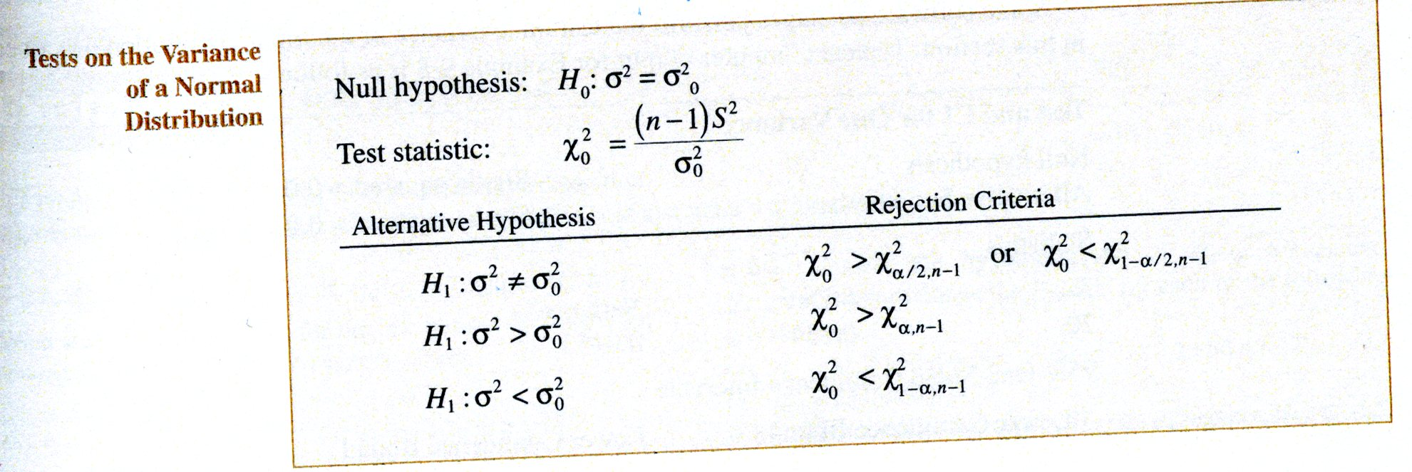

Slide 62
- The table below summarizes the three possible hypothesis tests. The rejection regions are clearly shown in Figure 9-17 on page 222

Slide 63
Figure 9-17

Slide 64
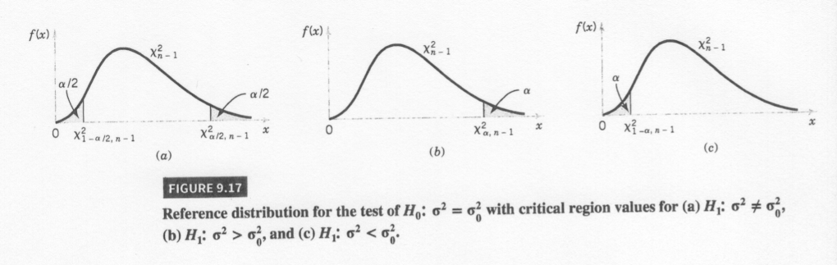

Slide 65
Test Summary
See summary in your textbook

Slide 66
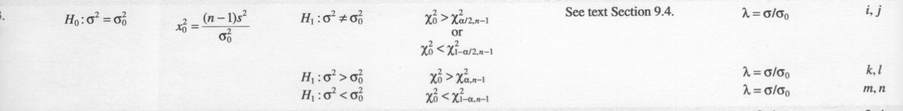

Slide 67
Problem 7.108
Problem taken from Ostle, Turner, Hicks and McElrath (1996). Engineering Statistics: The Industrial Experience. Duxbury Press.

Slide 68
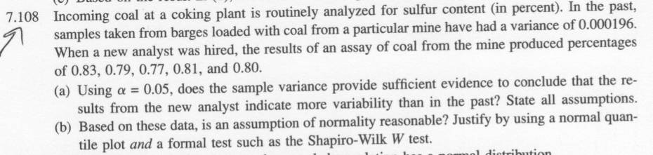

Slide 69
Statistics for Problem 7.108

Slide 70
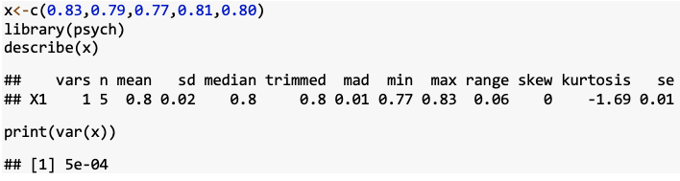

Slide 71
Classical Approach

Slide 72
Problem 7.108 Plots

Slide 73
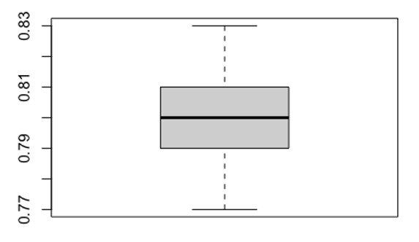

Slide 74
Problem 7.108 Plots

Slide 75
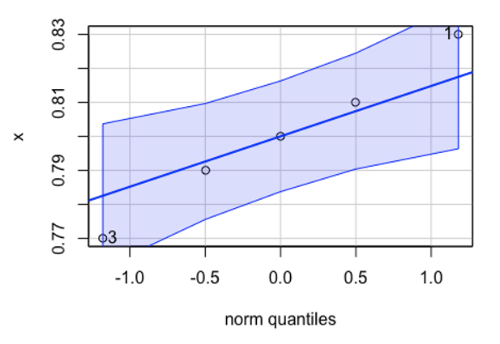

Slide 76
Problem 7.108 Shapiro-Wilks Test

Slide 77
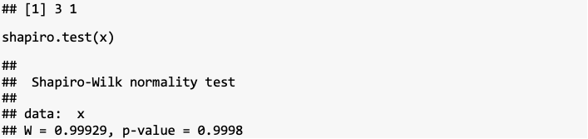

Slide 78
p-values
Very similar to the case for the mean of a normal population with variance unknown
Difficult to calculate since the $χ^{2}$-tables only contain a few quantiles
Can use tables to generate bounds on the $p$-value
Software will provide $p$-values

Slide 79
Test on Variance using R (EnvStats)

Slide 80
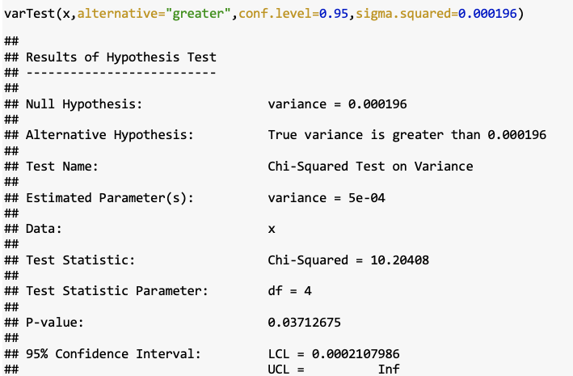

Slide 81
Power Calculations
Can be done with OC curves found in Table VIIi–n
Can be done in software such as R

Slide 82
Test on Standard Deviation
What about test on standard deviation?

Slide 83
Chapter 9, Case 3 2-sided Practice Problems

Slide 84
Practice Problem Chapter 9, Case 3 Lower

Slide 85
Practice Problem Chapter 9, Case 3 Upper

Slide 86
Case 4. Hypothesis Test on a Population Proportion
The test statistics for the hypothesis test is
$$Z_{0}=\frac{x−np_{0}}{\sqrt{np_{0}(1−p_{0})}}$$

Slide 87
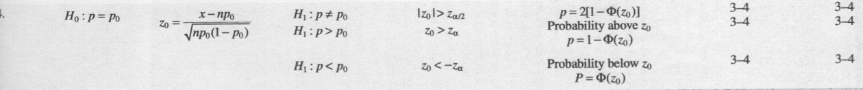

Slide 88
Problem 9.5.2

Slide 89
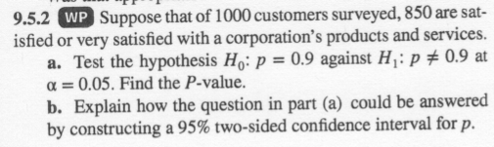

Slide 90
Problem 9.5.2 Classic Approach

Slide 91
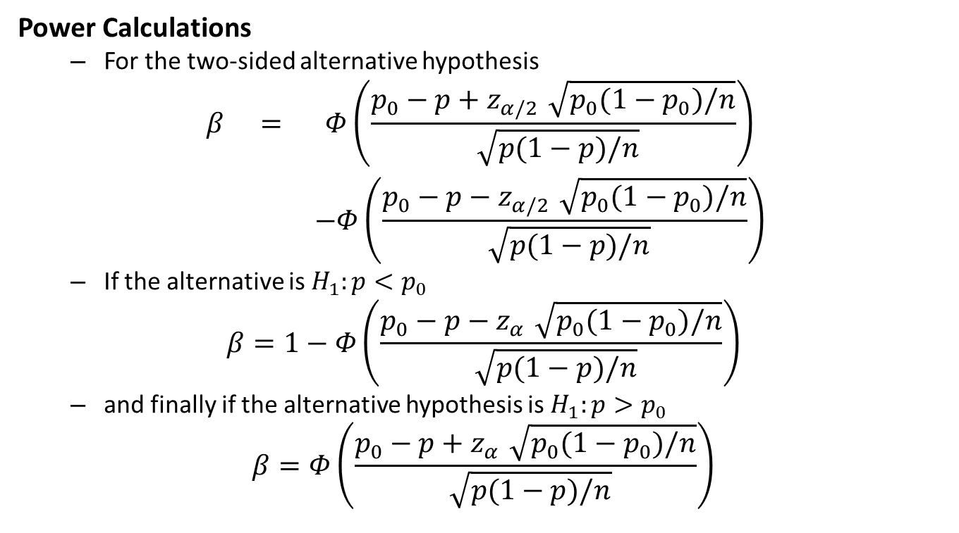
Power Calculations
For the two-sided alternative hypothesis
$$\begin{matrix}β & = & Φ\left(\frac{p_{0}−p+z_{α/2}\sqrt{p_{0}(1−p_{0})/n}}{\sqrt{p(1−p)/n}}\right) \\ & & −Φ\left(\frac{p_{0}−p−z_{α/2}\sqrt{p_{0}(1−p_{0})/n}}{\sqrt{p(1−p)/n}}\right)\end{matrix}$$
If the alternative is $H_{1}:p<p_{0}$
$$β=1−Φ\left(\frac{p_{0}−p−z_{α}\sqrt{p_{0}(1−p_{0})/n}}{\sqrt{p(1−p)/n}}\right)$$
and finally if the alternative hypothesis is $H_{1}:p>p_{0}$
$$β=Φ\left(\frac{p_{0}−p+z_{α}\sqrt{p_{0}(1−p_{0})/n}}{\sqrt{p(1−p)/n}}\right)$$

Slide 92
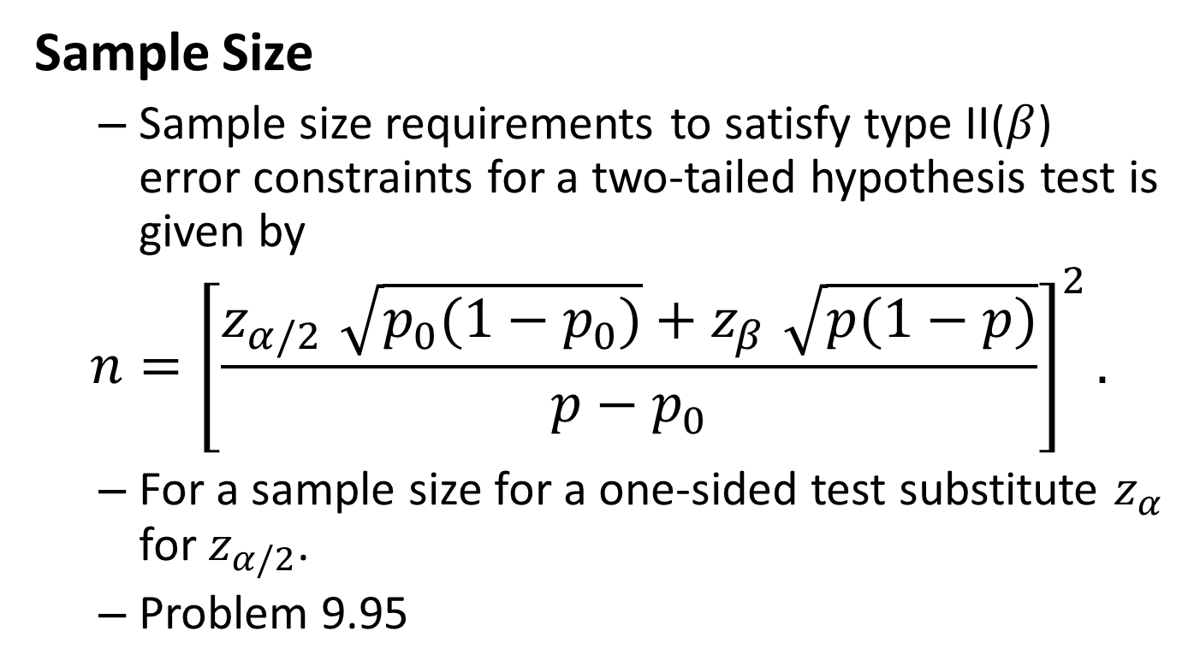
Sample Size
Sample size requirements to satisfy type II($β$) error constraints for a two-tailed hypothesis test is given by
$$n={\left[\frac{z_{α/2}\sqrt{p_{0}(1−p_{0})}+z_{β}\sqrt{p(1−p)}}{p−p_{0}}\right]}^{2}.$$
For a sample size for a one-sided test substitute $z_{α}$ for $z_{α/2}$.
Problem 9.95

Slide 93
Testing for Goodness of Fit
Material is presented in section 9-7 of your textbook
Procedure determines if the sample data is from a specified underlying distribution
Procedure uses a $χ^{2}$ distribution
Example 9-12 presents a $χ^{2}$ goodness of fit test for a Poisson example
Example 9-13 presents a $χ^{2}$ goodness of fit test for a normal example

Slide 94
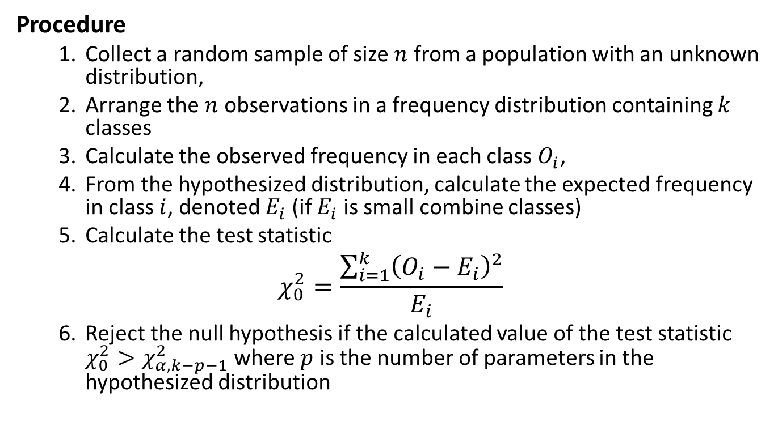
Procedure
Collect a random sample of size $n$ from a population with an unknown distribution,
Arrange the $n$ observations in a frequency distribution containing $k$ classes
Calculate the observed frequency in each class $O_{i}$,
From the hypothesized distribution, calculate the expected frequency in class $i$, denoted $E_{i}$ (if $E_{i}$ is small combine classes)
Calculate the test statistic
$$χ_{0}^{2}=\frac{\sum_{i=1}^{k}{{\left(O_{i}−E_{i}\right)}^{2}}}{E_{i}}$$
Reject the null hypothesis if the calculated value of the test statistic $χ_{0}^{2}>χ_{α,k−p−1}^{2}$ where $p$ is the number of parameters in the hypothesized distribution

Slide 95
Example 9.12, part 1

Slide 96
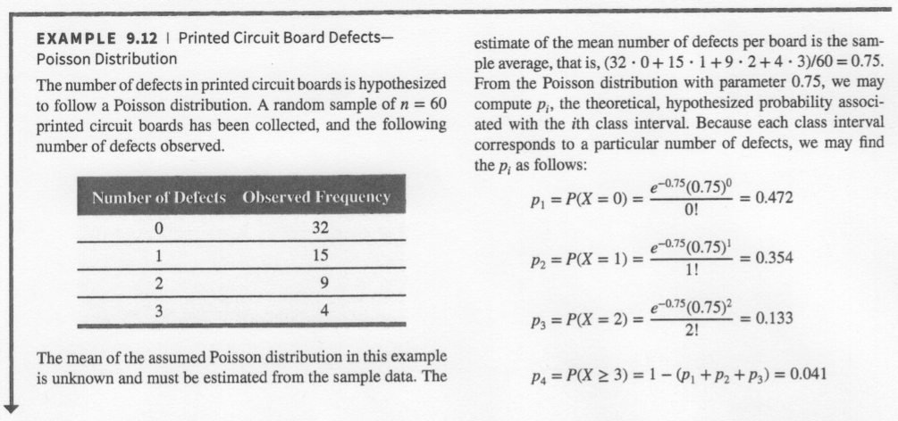

Slide 97
Example 9.12, part 2

Slide 98
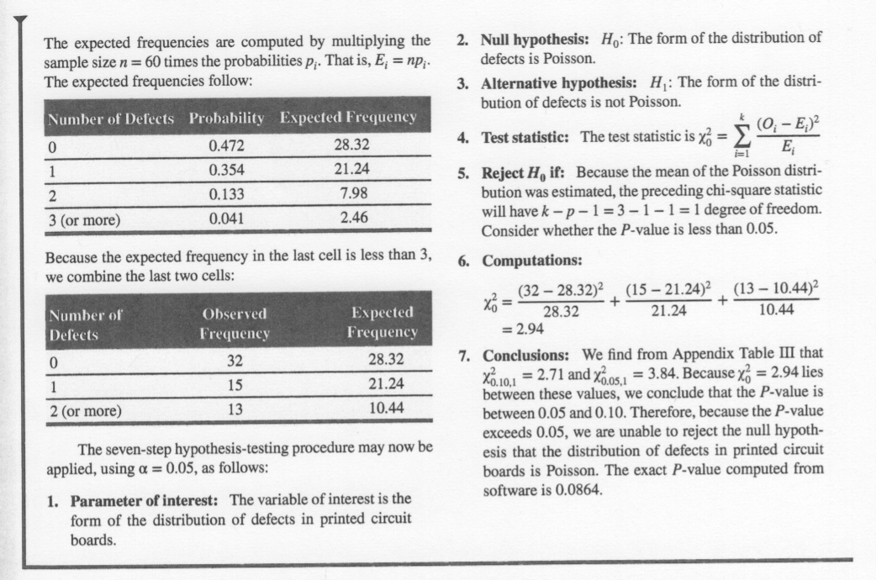

Slide 99
Chapter 9 Summary
You should be prepared to work any practice problems assigned: Cases 1-3 with three different alternatives
All other information is conceptual knowledge that can be questioned with multiple choice
Name 3 ways to test if data is from a normal distribution

Slide 100
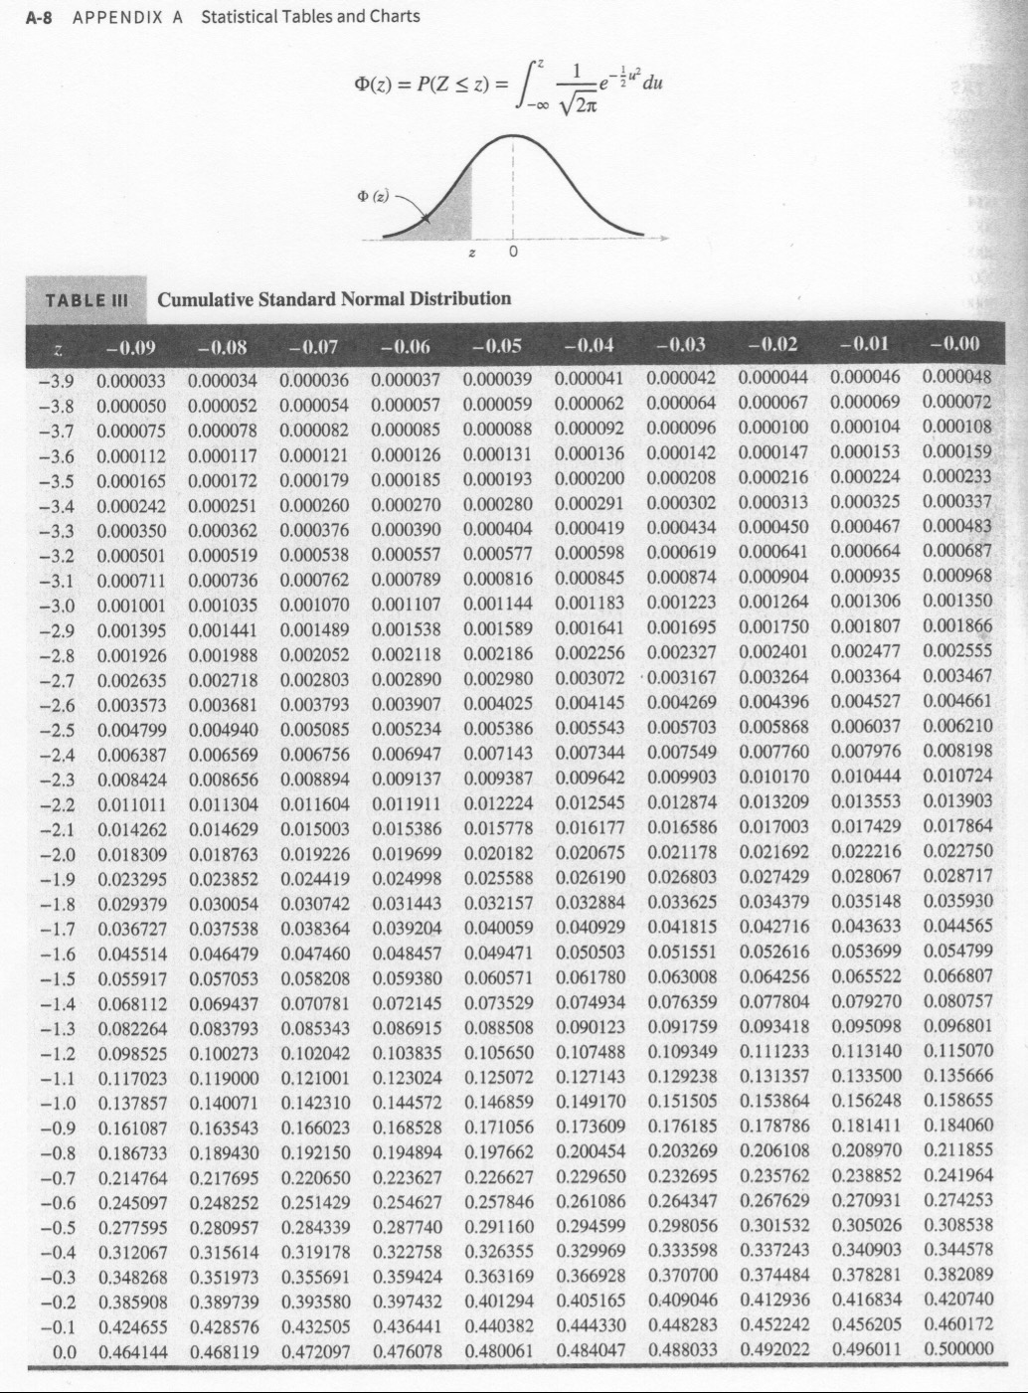

Slide 101
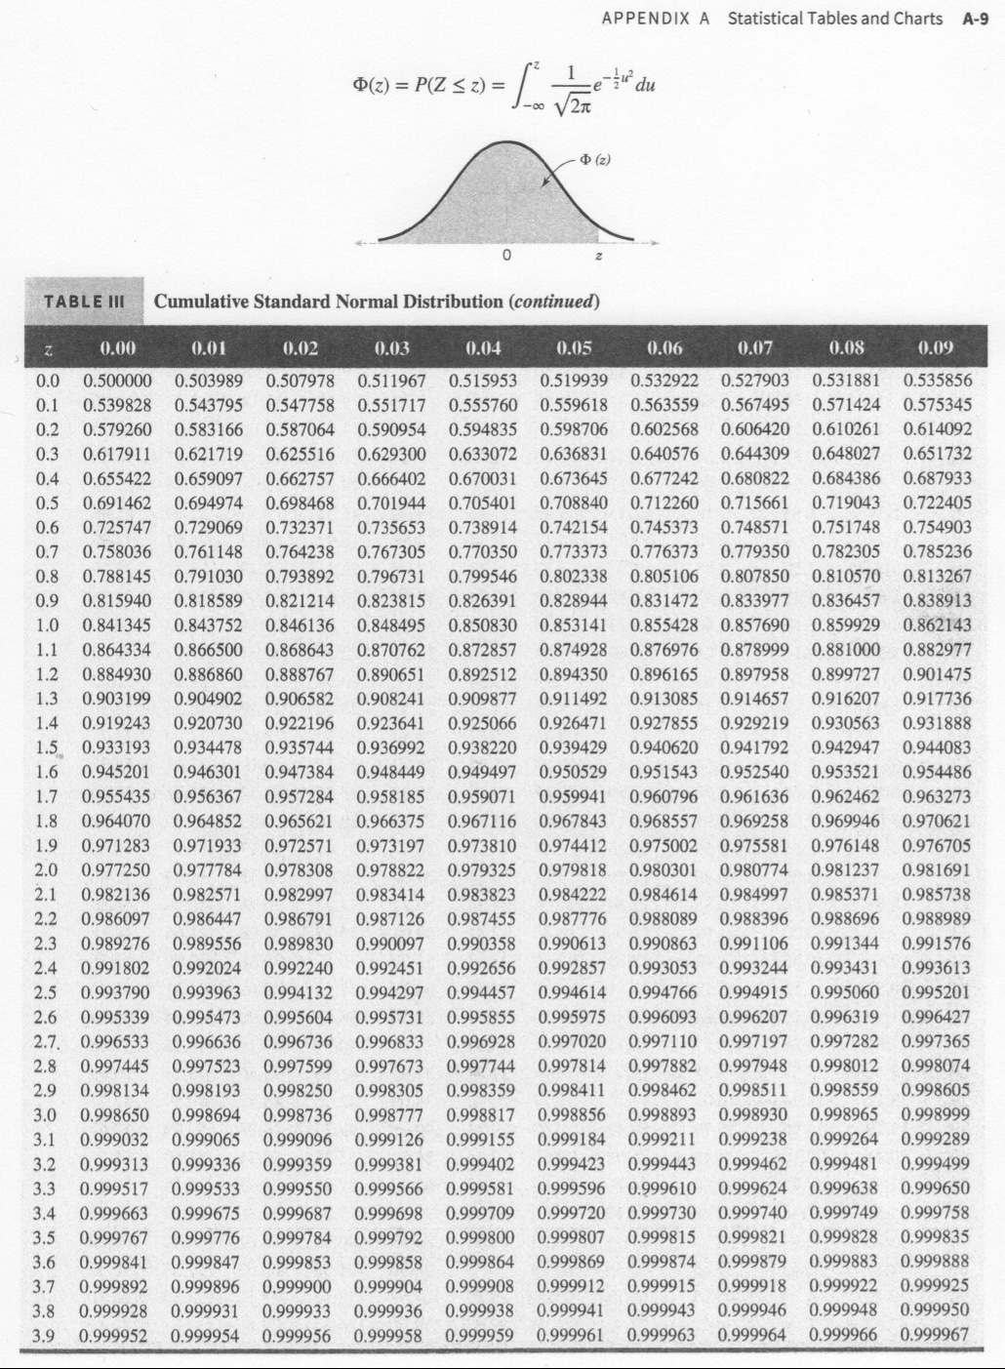

Slide 102
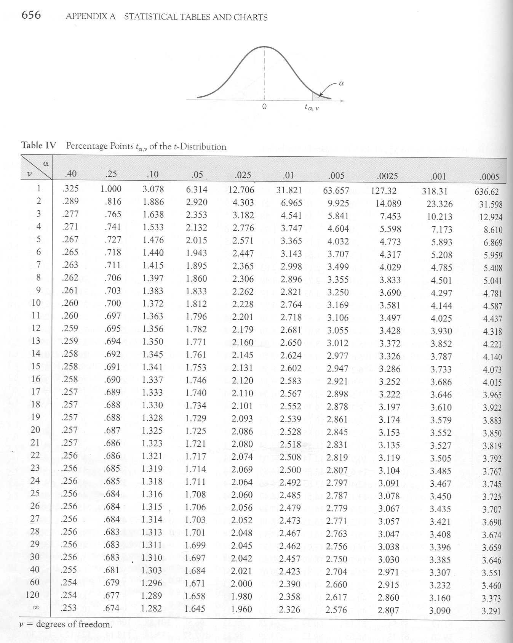

Slide 103
