Slide 1
MANE 3332.01

Slide 2
Lecture 25
Agenda
  Continue Chapter 9 lecture
    Chapter 9, Case 2
  Chapter 9, Case 1 2-sided Practice Problems (assigned 11/20/2025, due 11/25/2025)
  Chapter 9, Case 1 Lower Practice Problems (assigned 11/20/2025, due 11/25/2025)
  Chapter 9, Case 1 Upper Practice Problems (assigned 11/20/2025, due 11/25/2025)
  NEW: Chapter 9, Case 1 2-sided Quiz (assigned 11/25/2025, due 12/2/2025)
  NEW: Chapter 9, Case 1 Lower Quiz (assigned 11/25/2025, due 12/2/2025)
  NEW: Chapter 9, Case 1 Upper Quiz (assigned 11/25/2025, due 12/2/2025)
  NEW: Chapter 9, Case 2 2-sided Practice Problems (assigned 11/25/2025, due 12/2/2025)
  NEW: Chapter 9, Case 2 Lower Practice Problems (assigned 11/25/2025, due 12/2/2025)
  NEW: Chapter 9, Case 2 Upper Practice Problems (assigned 11/25/2025, due 12/2/2025)
  Attendance
  Questions?

Slide 3
Handouts
  Lecture 25 Slides
  Lecture 25 Slides - marked

Slide 4
Week | Tuesday Lecture | Thursday Lecture
13 | 11/25 - Chapter 9, Case 2 | 11/27 - Thanksgiving Holiday (no class)
14 | 12/2 - Chapter 9, Case 3 | 12/4 - Linear Regression
15 | 12/9 - Review Session | 12/11 - Study Day (no class)

Slide 5
The final exam for MANE 3332.01 is Thursday December 18, 2025 at 10:15 AM - 12:00 PM.

Slide 6
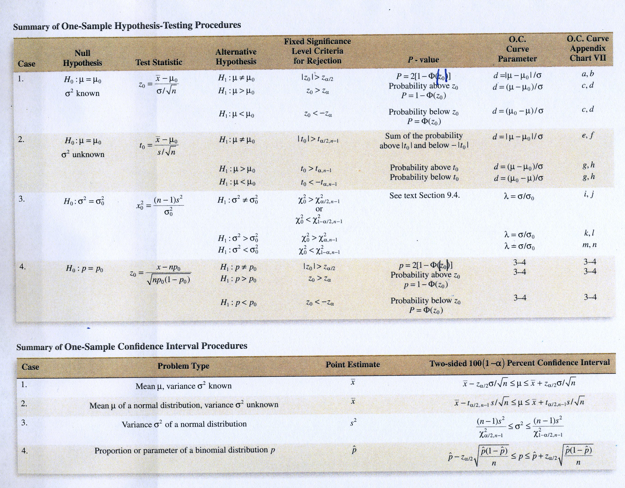

Slide 7
Chapter 9, Case 2
Hypothesis Test on the Mean, Variance Unknown
  Much more common case than variance known
  Substitute $S$ for $σ$
  The test statistics is now a $t$ random variable
$$T=\frac{\overline{X}−μ_{0}}{S/\sqrt{n}}$$

Slide 8
Summary of Case 2

Slide 9
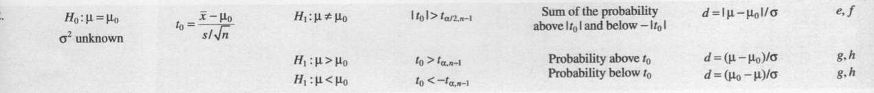

Slide 10
Problem 9.3.6

Slide 11
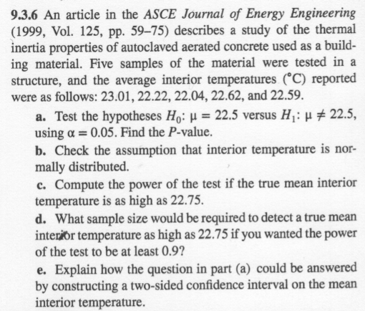

Slide 12
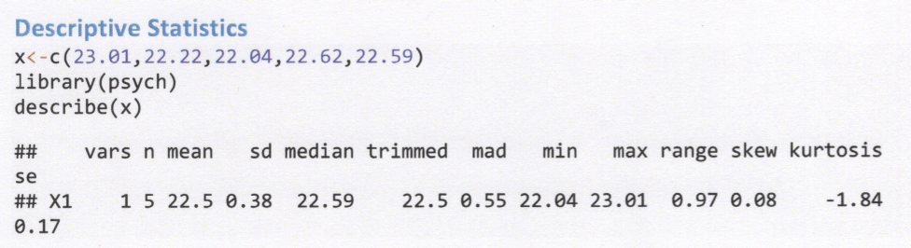

Slide 13
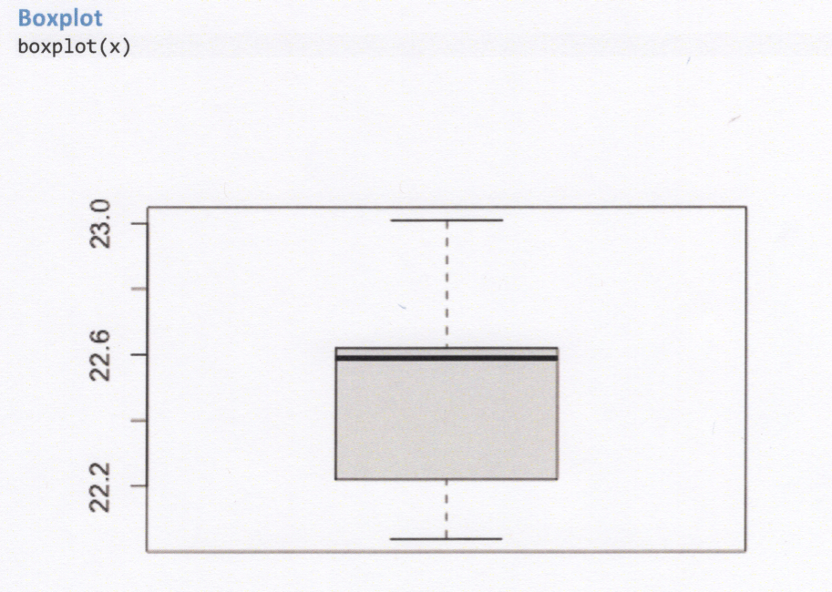

Slide 14
Classical Approach

Slide 15
Hypothesis Test Using R

Slide 16
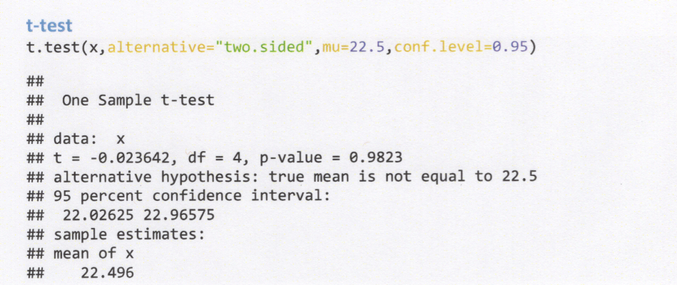

Slide 17
Normal Probability Plot

Slide 18
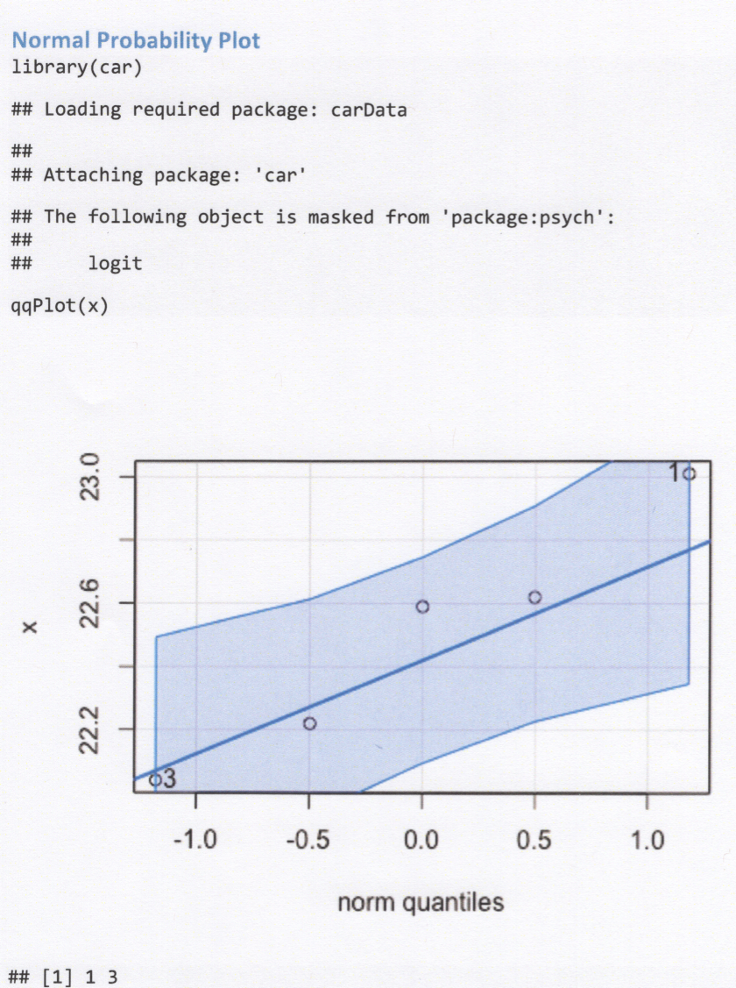

Slide 19
$P$-values
  More difficult to calculate since the $t$-tables only contain a few quantiles
  Can use tables to generate bounds on the $p$-value
  Software will provide $p$-values

Slide 20
P-values from R

Slide 22
Power Calculations
  Are much more complicated
  The true distribution is now a non-central $t$
  Use tables to solve (Chart VII in appendix) or software

Slide 23
Power Calculation using R

Slide 24
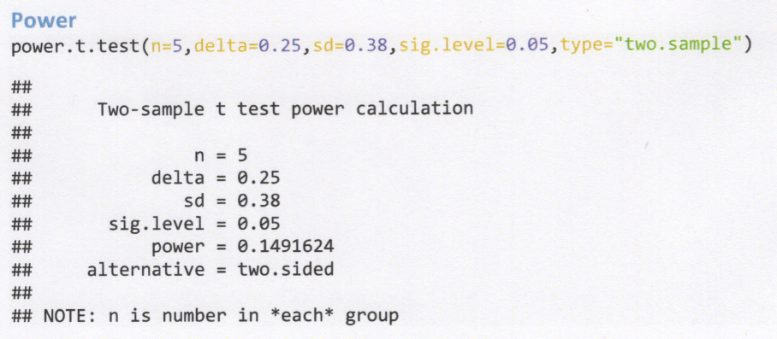

Slide 25
Sample Size using R

Slide 26
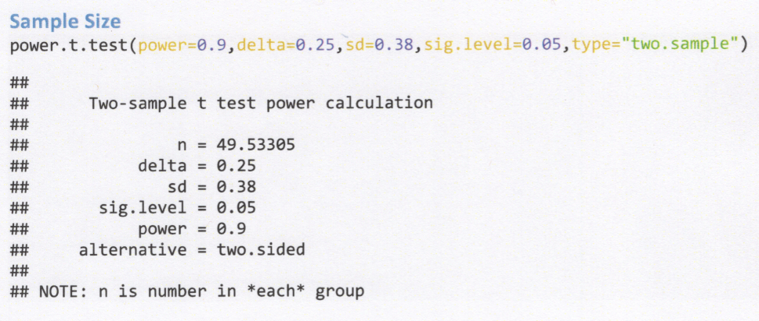

Slide 27
Chapter 9, Case 2 2-sided Practice Problems

Slide 28
Chapter 9, Case 2 Lower Practice Problems

Slide 29
Chapter 9, Case 2 Upper Practice Problems

Slide 30
Case 3. Hypothesis Test on Variance of Normal Population
  The test statistics is a $χ^{2}$ random variable
$$χ_{0}^{2}=\frac{(n−1)S^{2}}{σ_{0}^{2}}$$

Slide 31
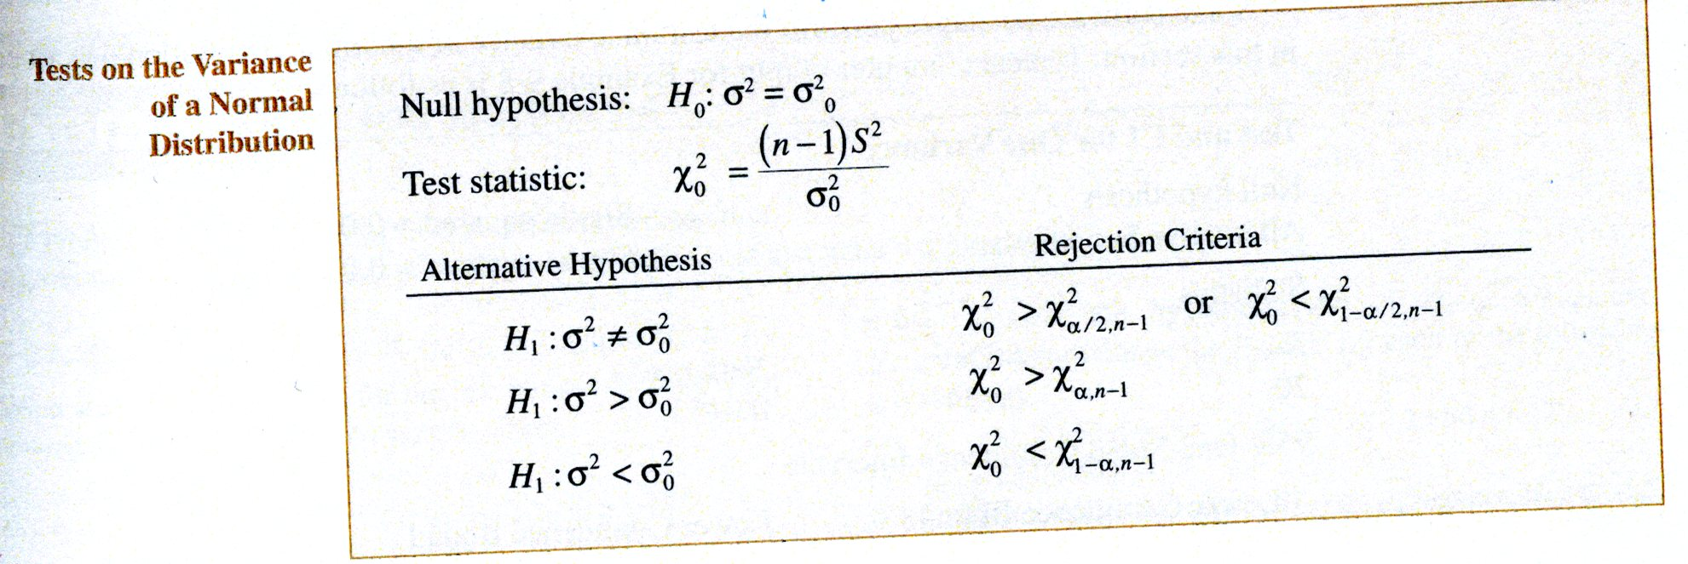

Slide 32
- The table below summarizes the three possible hypothesis tests. The rejection regions are clearly shown in Figure 9-17 on page 222

Slide 33
Figure 9-17

Slide 34
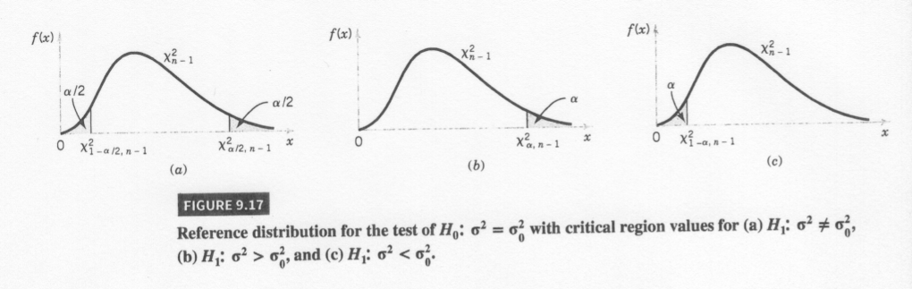

Slide 35
Test Summary
  See summary in your textbook

Slide 36
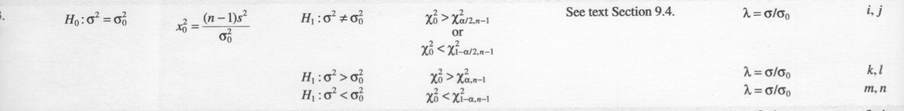

Slide 37
Problem 7.108
Problem taken from Ostle, Turner, Hicks and McElrath (1996). Engineering Statistics: The Industrial Experience. Duxbury Press.

Slide 38
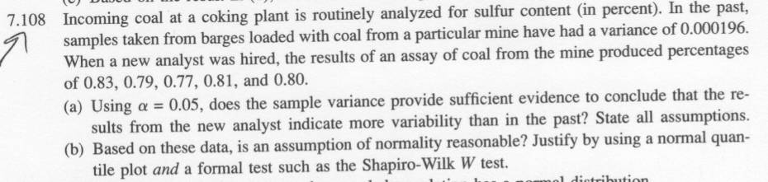

Slide 39
Statistics for Problem 7.108

Slide 40
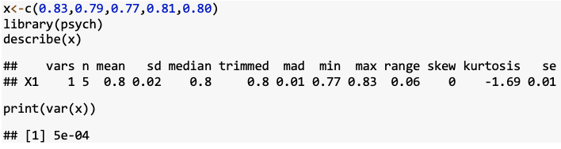

Slide 41
Classical Approach

Slide 42
Problem 7.108 Plots

Slide 43
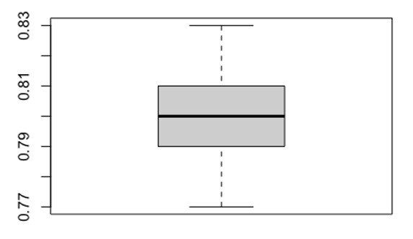

Slide 44
Problem 7.108 Plots

Slide 45
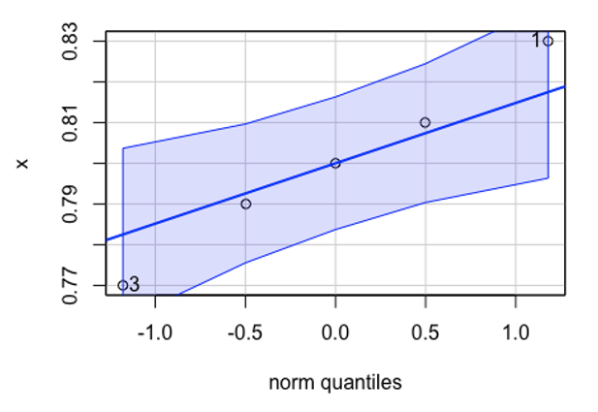

Slide 46
Problem 7.108 Shapiro-Wilks Test

Slide 47
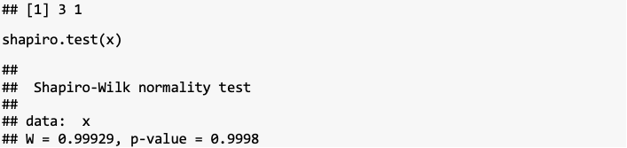

Slide 48
p-values
  Very similar to the case for the mean of a normal population with variance unknown
  Difficult to calculate since the $χ^{2}$-tables only contain a few quantiles
  Can use tables to generate bounds on the $p$-value
  Software will provide $p$-values

Slide 49
Test on Variance using R (EnvStats)

Slide 50
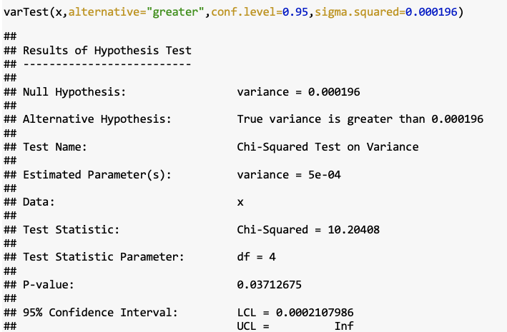

Slide 51
Power Calculations
  Can be done with OC curves found in Table VIIi–n
  Can be done in software such as R

Slide 52
Test on Standard Deviation
  What about test on standard deviation?

Slide 53
Chapter 9, Case 3 2-sided Practice Problems

Slide 54
Practice Problem Chapter 9, Case 3 Lower

Slide 55
Practice Problem Chapter 9, Case 3 Upper

Slide 56
Case 4. Hypothesis Test on a Population Proportion
  The test statistics for the hypothesis test is
$$Z_{0}=\frac{x−np_{0}}{\sqrt{np_{0}(1−p_{0})}}$$

Slide 57
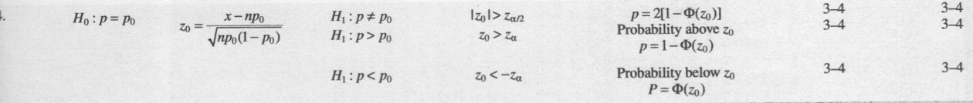

Slide 58
Problem 9.5.2

Slide 59
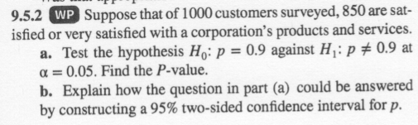

Slide 60
Problem 9.5.2 Classic Approach

Slide 61
Power Calculations
  For the two-sided alternative hypothesis
$$\begin{matrix}β & = & Φ\left(\frac{p_{0}−p+z_{α/2}\sqrt{p_{0}(1−p_{0})/n}}{\sqrt{p(1−p)/n}}\right) \\ & & −Φ\left(\frac{p_{0}−p−z_{α/2}\sqrt{p_{0}(1−p_{0})/n}}{\sqrt{p(1−p)/n}}\right)\end{matrix}$$
  If the alternative is $H_{1}:p<p_{0}$
$$β=1−Φ\left(\frac{p_{0}−p−z_{α}\sqrt{p_{0}(1−p_{0})/n}}{\sqrt{p(1−p)/n}}\right)$$
  and finally if the alternative hypothesis is $H_{1}:p>p_{0}$
$$β=Φ\left(\frac{p_{0}−p+z_{α}\sqrt{p_{0}(1−p_{0})/n}}{\sqrt{p(1−p)/n}}\right)$$

Slide 62
Sample Size
  Sample size requirements to satisfy type II($β$) error constraints for a two-tailed hypothesis test is given by
$$n={\left[\frac{z_{α/2}\sqrt{p_{0}(1−p_{0})}+z_{β}\sqrt{p(1−p)}}{p−p_{0}}\right]}^{2}.$$
  For a sample size for a one-sided test substitute $z_{α}$ for $z_{α/2}$.
  Problem 9.95

Slide 63
Testing for Goodness of Fit
  Material is presented in section 9-7 of your textbook
  Procedure determines if the sample data is from a specified underlying distribution
  Procedure uses a $χ^{2}$ distribution
  Example 9-12 presents a $χ^{2}$ goodness of fit test for a Poisson example
  Example 9-13 presents a $χ^{2}$ goodness of fit test for a normal example

Slide 64
Procedure
  Collect a random sample of size $n$ from a population with an unknown distribution,
  Arrange the $n$ observations in a frequency distribution containing $k$ classes
  Calculate the observed frequency in each class $O_{i}$,
  From the hypothesized distribution, calculate the expected frequency in class $i$, denoted $E_{i}$ (if $E_{i}$ is small combine classes)
  Calculate the test statistic
$$χ_{0}^{2}=\frac{\sum_{i=1}^{k}{{\left(O_{i}−E_{i}\right)}^{2}}}{E_{i}}$$
  Reject the null hypothesis if the calculated value of the test statistic $χ_{0}^{2}>χ_{α,k−p−1}^{2}$ where $p$ is the number of parameters in the hypothesized distribution

Slide 65
Example 9.12, part 1

Slide 66
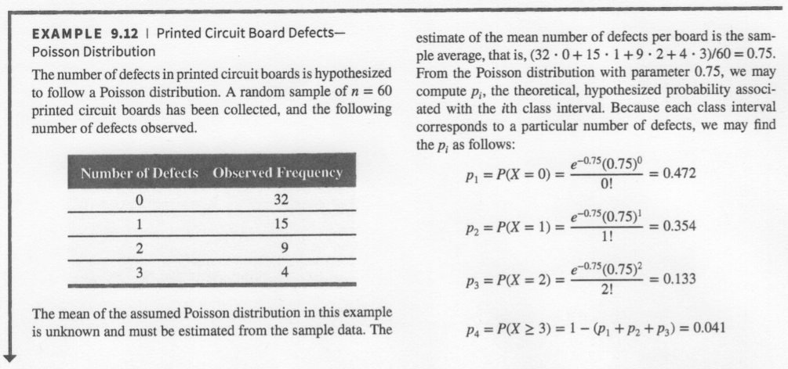

Slide 67
Example 9.12, part 2

Slide 68
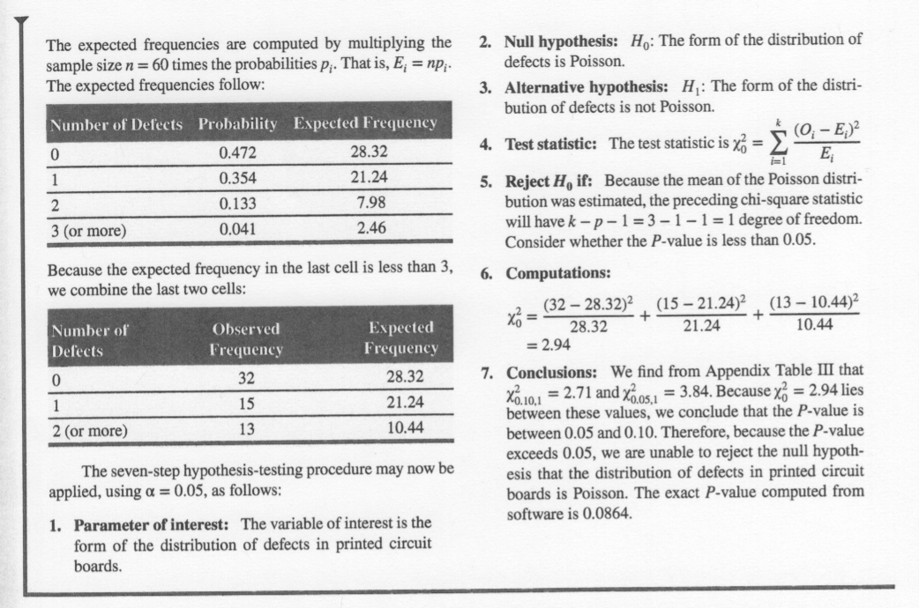

Slide 69
Chapter 9 Summary
  You should be prepared to work any practice problems assigned: Cases 1-3 with three different alternatives
  All other information is conceptual knowledge that can be questioned with multiple choice
    Name 3 ways to test if data is from a normal distribution

Slide 70
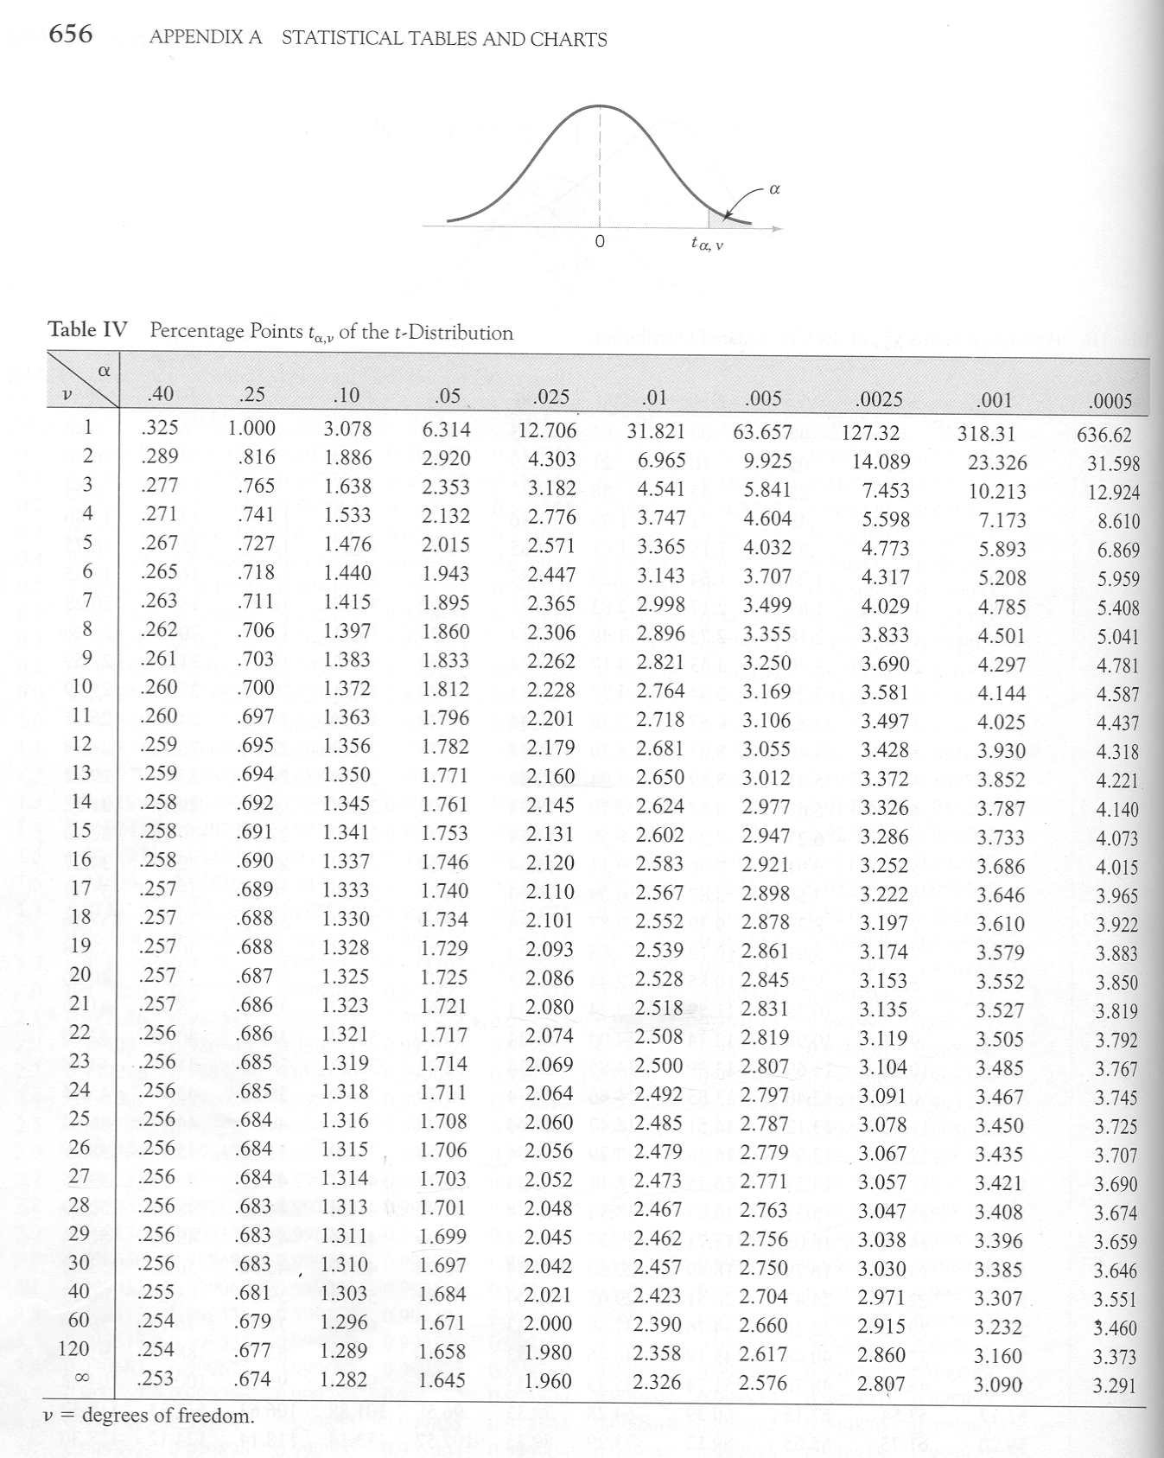

Slide 71
