Slide 1
MANE 3332.01

Slide 2
Lecture 1, September 2

Slide 3
Agenda
Discuss Syllabus
Me Talk
Grit Lesson
Lecture - Chapter 1
Call roll

Slide 4
Handouts
Lecture 1 Slides
Lecture 1 Marked Slides

Slide 5
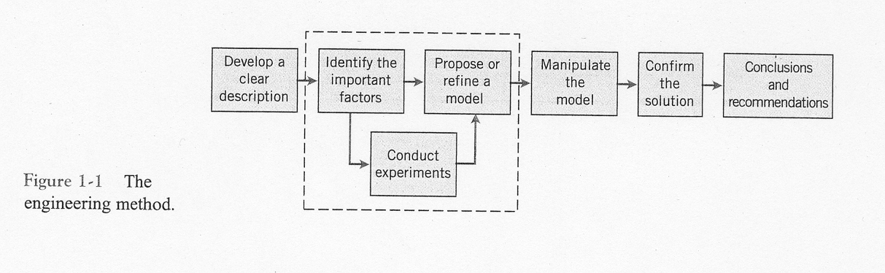
Statistics and Statistical Thinking
“The field of statistics deals with the collection, presentation, analysis and use of data to make decisions, solve problems, and design products and processes.”
image

Slide 6
Statistics
Moore (Ostle, Turner, Hicks and McElrath 1996) defines statistics as “the science of gaining information in the face of uncertainty.”
Generally the field of statistics is divided into two major branches: descriptive and inferential

Slide 7
Descriptive Statistics
Devore and Farnum (1999) define descriptive statistics in the following manner.
  an investigator who has collected data may wish simply to summarize and describe important features of the data. This entails using methods from descriptive statistics. Some of these methods are graphical in nature–the construction of histograms, boxplots, and scatter plots are primary examples. Other descriptive methods involve calculation of numerical summary measures, such as means, standard deviations and correlation coefficients.
Chapter 6 of the textbook emphasize descriptive statistics

Slide 8
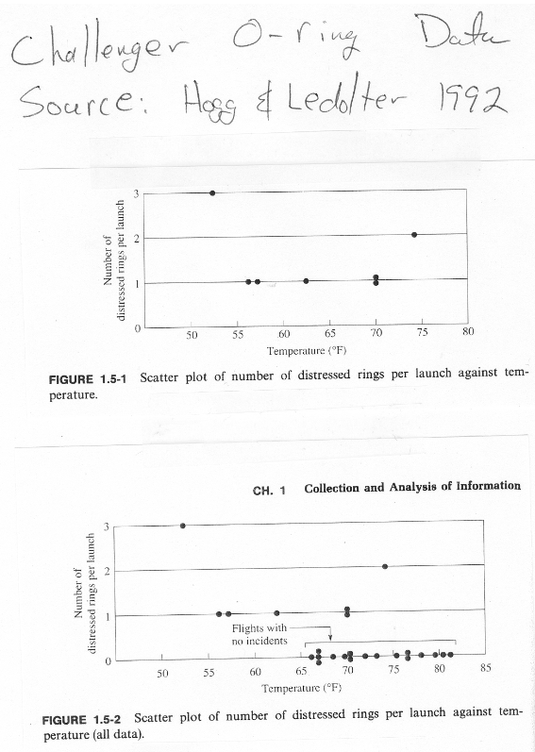
image

Slide 9
Inferential Statistics
Devore and Farnum (1999) gives the following description of inferential statistics
  Having obtained a sample from a population, an investigator would frequently like to use sample information to draw some type of conclusion (make an inference of some sort) about the population. That is, the sample is a means to an end rather than an end in itself. Techniques for generalizing from a sample to a population are gathered within the branch of our discipline called inferential statistics.
The field of inferential statistics can be further subdivided into two general areas: estimation and hypothesis testing
Chapters 4 - 14 of the textbook focus on inferential statistics

Slide 10
Statistical Thinking
The textbook points out that statistical methods are used to help us describe and understand variability
Variability is the differences in successive observations of a system or phenomenon
Vining (1998) gives the following definition of statistical thinking
  Only by “thinking statistically” can engineers truly address the problems inherent in the variability in real data. When we think statistically, we come to know that all decisions based on real data involve risk and uncertainty. Good decisions require us to quantify this risk. As we become more mature in our thinking, we understand that there are sources or causes of variability. Discovering these sources and removing them are often the keys to engineering success.

Slide 11
Population vs. Sample
The concept of populations, samples, parameters and statistics is very important. The following definitions are taken from Ostle, Turner, Hicks and McElrath (1996)
Population: the totality of all possible values (measurements, counts, and so on) of a particular characteristic for a specific group of objects
Population parameters: a numerical descriptive measure of a population characteristics
Sample: a portion of the population that is selected according to some rule or plan
Sample statistics: a numerical descriptive measure of a particular characteristic based upon the sample values

Slide 12
Enumerative vs. Analytical Studies
Deming introduced the concept of enumerative versus analytical studies
Enumerative study is one in which a sample is used to make inference on the current population. This is the safest use of statistical estimation.
Analytical study is one in which inference is applied to future populations. There is nothing wrong with this approach. However, you must be aware that there is an inherent assumption of stability

Slide 13
Data
Most statistical methods are data-driven
Data are almost always a sample from a population or populations
Engineering data are usually collected in 3 ways:
  A retrospective study based on historical data,
  An observational study,
  A designed experiment

Slide 14
“Happenstance” Data
Box, Hunter and Hunter (1978) group retrospective studies and observational studies as “happenstance” data
They point out the following dangers:
  Inconsistent data
  Range of variables limited by control
  Semiconfounding of effects
  Nonsense correlation – beware the lurking variable
  Serially correlated errors
  Dynamic relationships
  Feedback
So why use happenstance data?

Slide 15
Designed Experiments
“In a designed experiment, the engineer makes deliberate or purposeful changed in controllable variables (called factors) of the system, observes the resulting system output, and then makes a decision or an inference about which variables are responsible for the changed that he or she observes in the output performance.”
“An important distinction between a designed experiment and either an observational or retrospective study is that the different combinations of the factors of interest are applied randomly to a set of experimental units.”
Box, Hunter and Hunter (1978) present a table (shown below) that clarifies how designed experiments avoid the problems that occur in the analysis of happenstance data

Slide 16
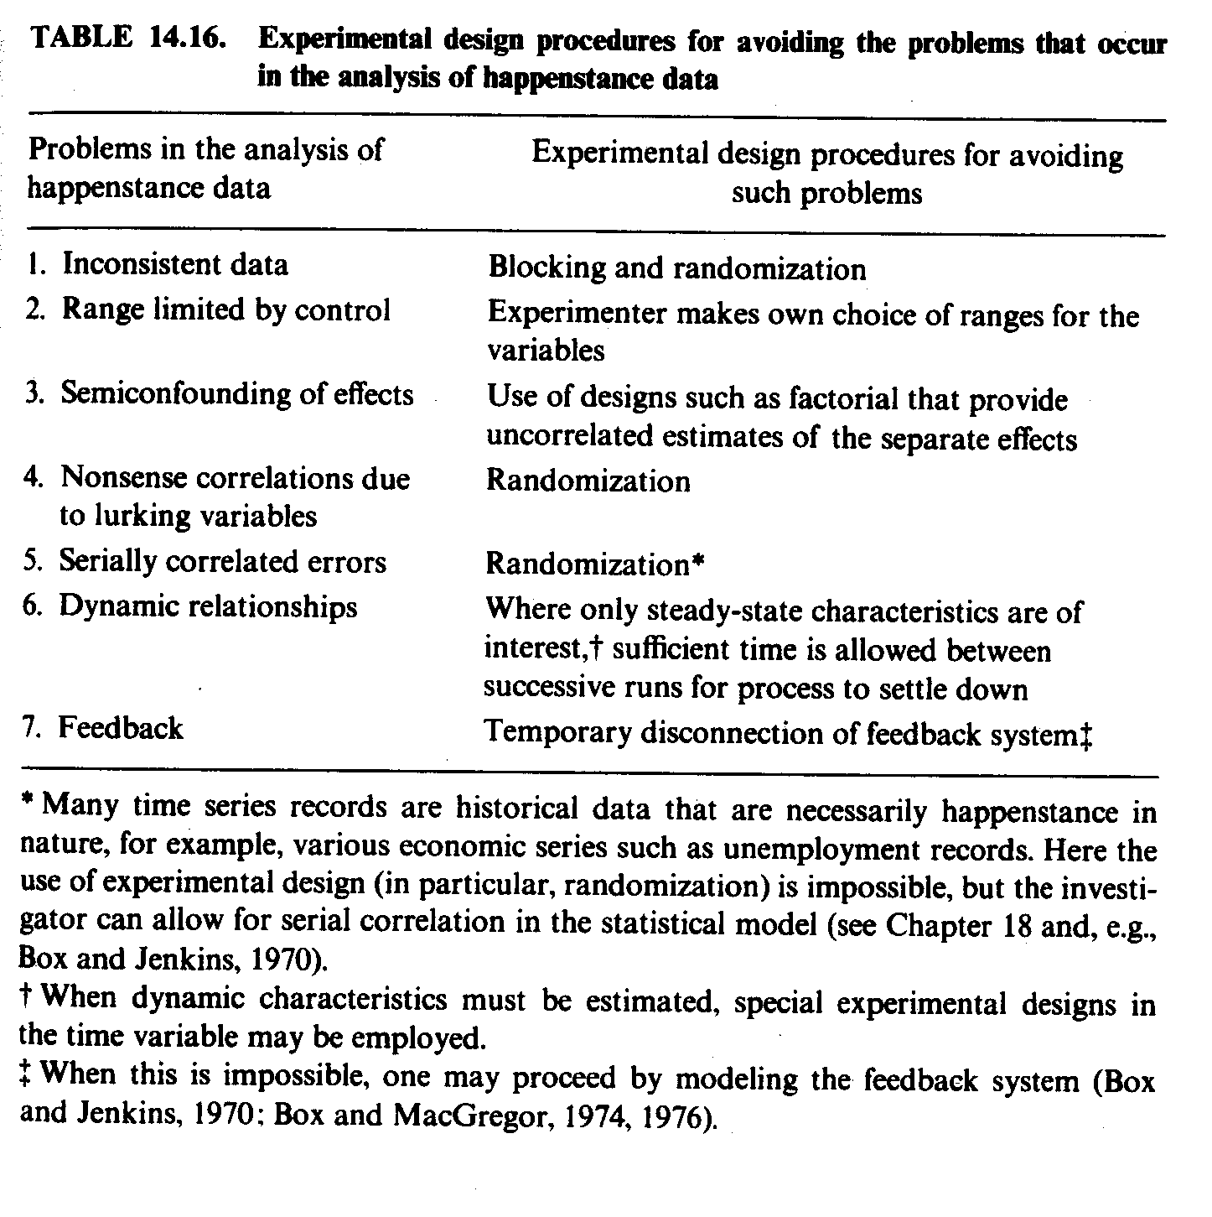
image

Slide 17
Data Collected Over Time
Often data is collected over time (either retrospective, observational or designed experiments)
Most elementary statistical techniques assume that the observations are independent (not always a good assumption)
The correct term for data collected over time is a time series
Time series analysis does not assume that the observations are independent over time

Slide 18
Models
“Models play an important part in engineering analysis”
From the statistical point of view, we will divide models into two categories: mechanistic and empirical
All models have these characteristics:
  One or more observed outcomes that we wish to understand or predict
  These outcomes are referred to as the response or dependent variable(s)
  The set of variables (factors) that influence response variables is called the independent or regressor variables
  A functional relationship between the dependent and independent variables

Slide 19
Mechanistic Models
Mechanistic models are based upon our understanding of the physical systems affecting the response variable
An engineer uses his knowledge, experience and training in mathematics, physics, chemistry and engineering to develop a mathematical expression that defines the response variable as a function of the regressor variable
Textbook uses Ohm’s law; consider a wind generator
Statistical techniques can augment mechanistic models

Slide 20
Empirical Models
There are many situations in which engineers and scientist do not have a clear understanding of the physical systems of a phenomenon. However, there is some knowledge that a set of regressor variables influences a response variable(s)
An empirical model is not build upon explicit knowledge of the physical phenomenon
Empirical variables do not prove or disprove that a variable has an affect on the response variable(s)

Slide 21
Regression Models
The most popular method of developing empirical models is the use of linear regression models
It is assumed that the response variable can be modelled by a low-order polynomial equation of the regressor variables
Very common approach
Consider the example from Lawson and Erjavec (2001)

Slide 22
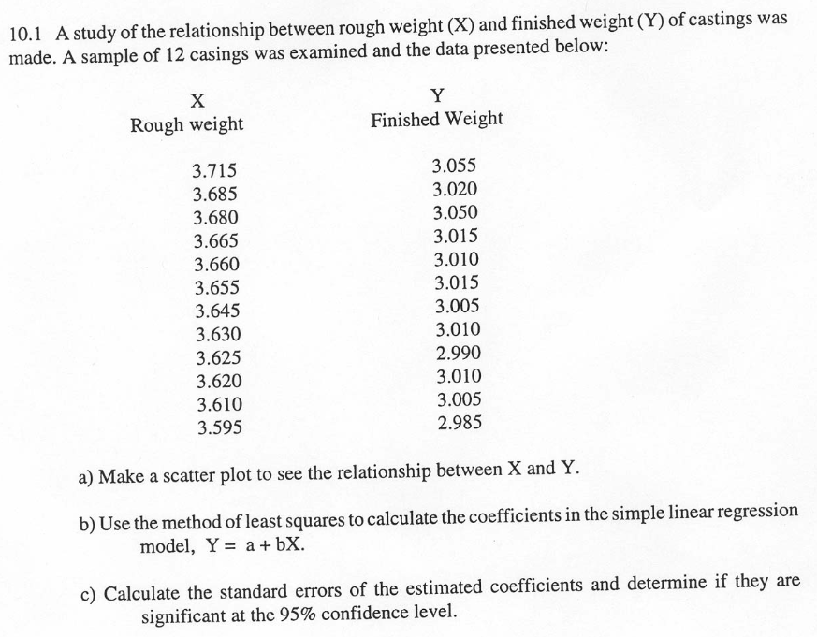
image

Slide 23
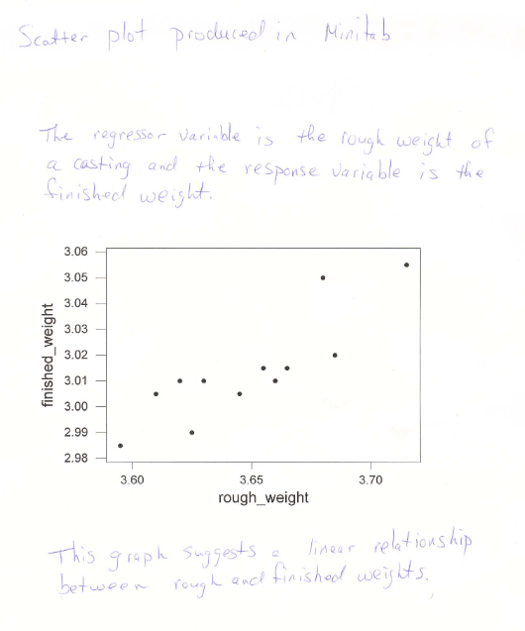
image

Slide 24
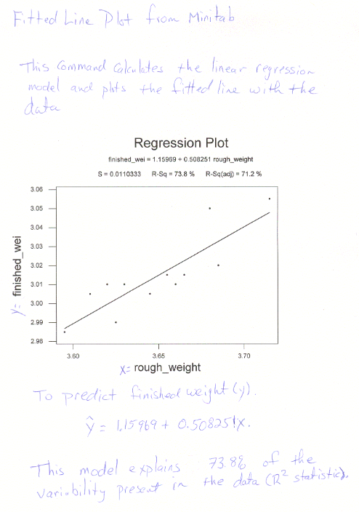
image

Slide 25
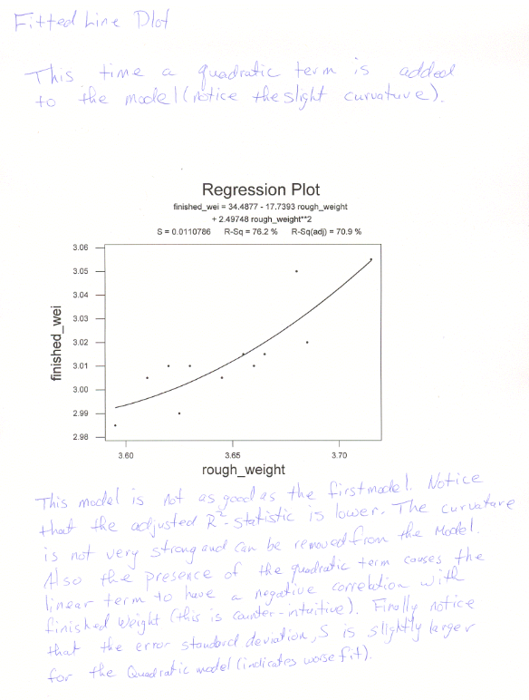
image

Slide 26
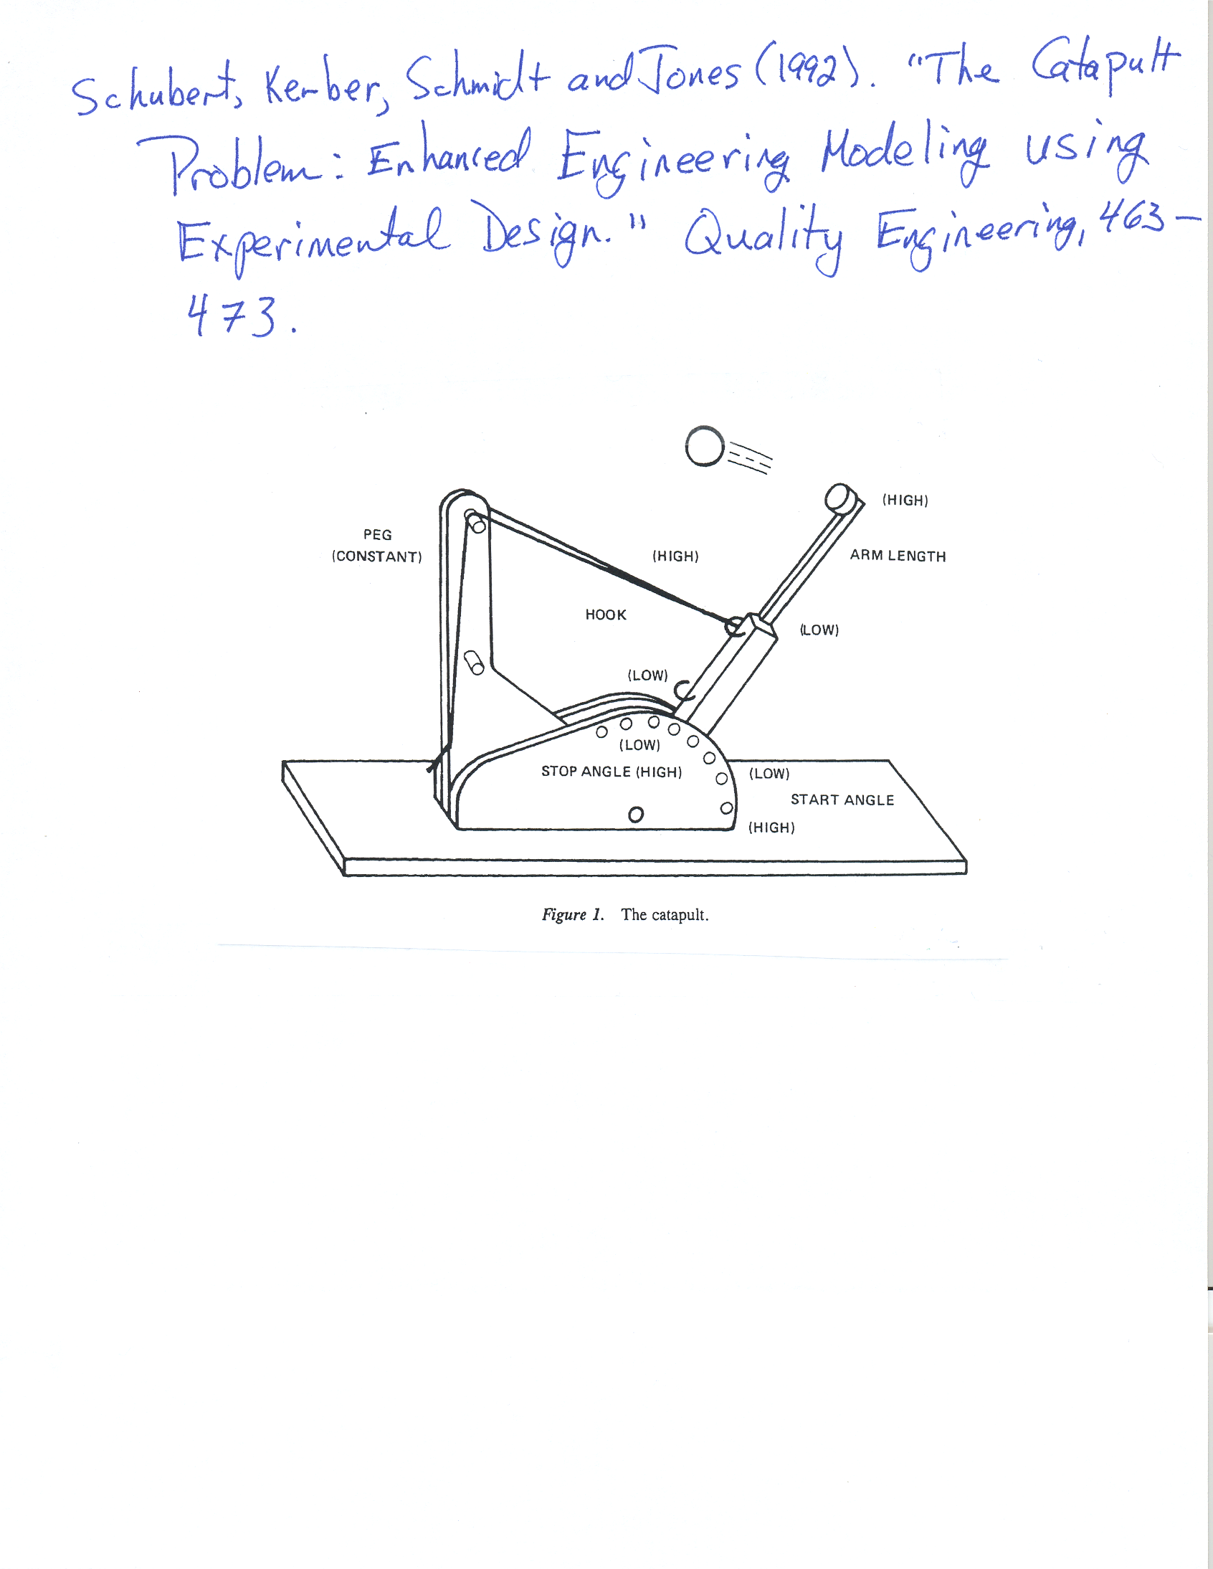
image

Slide 27
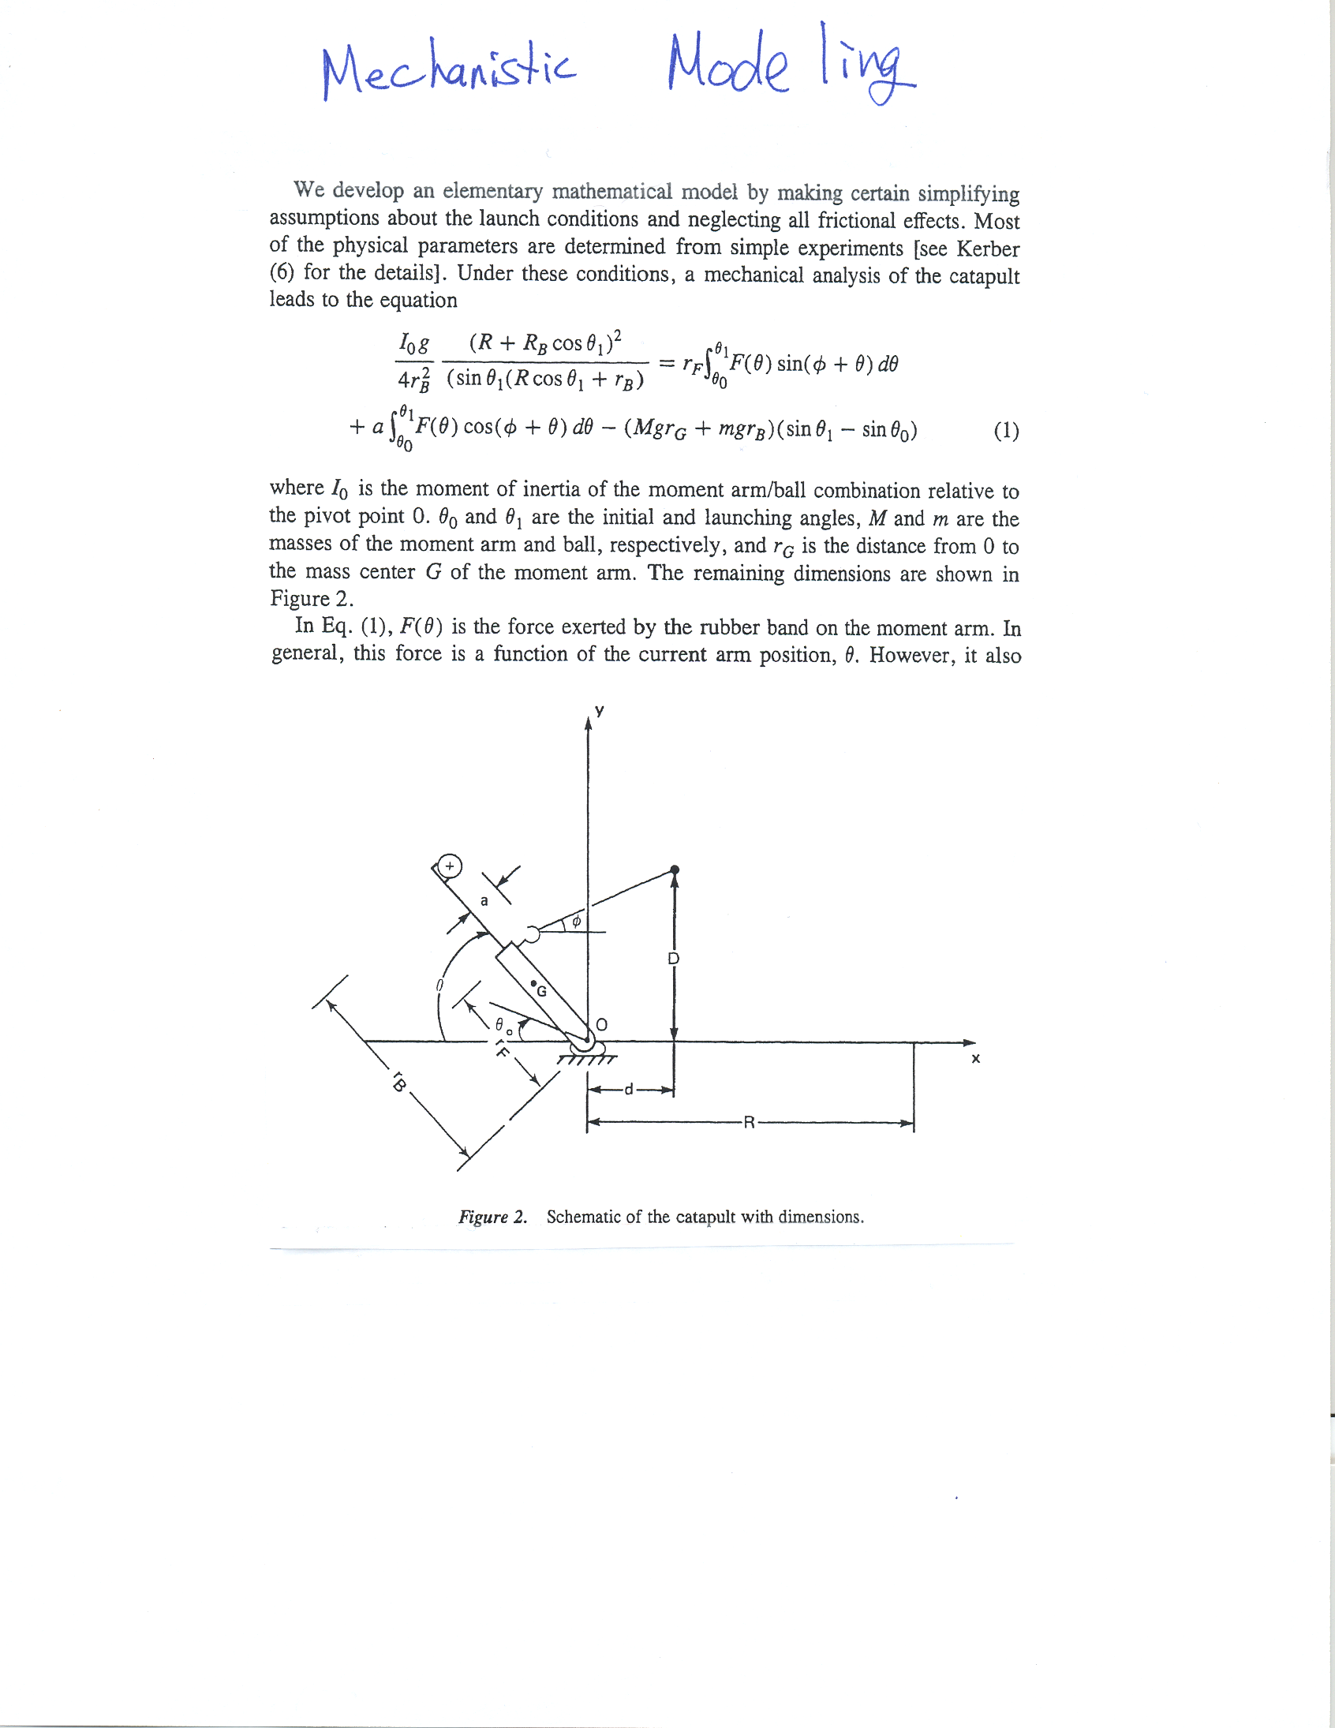
image

Slide 28
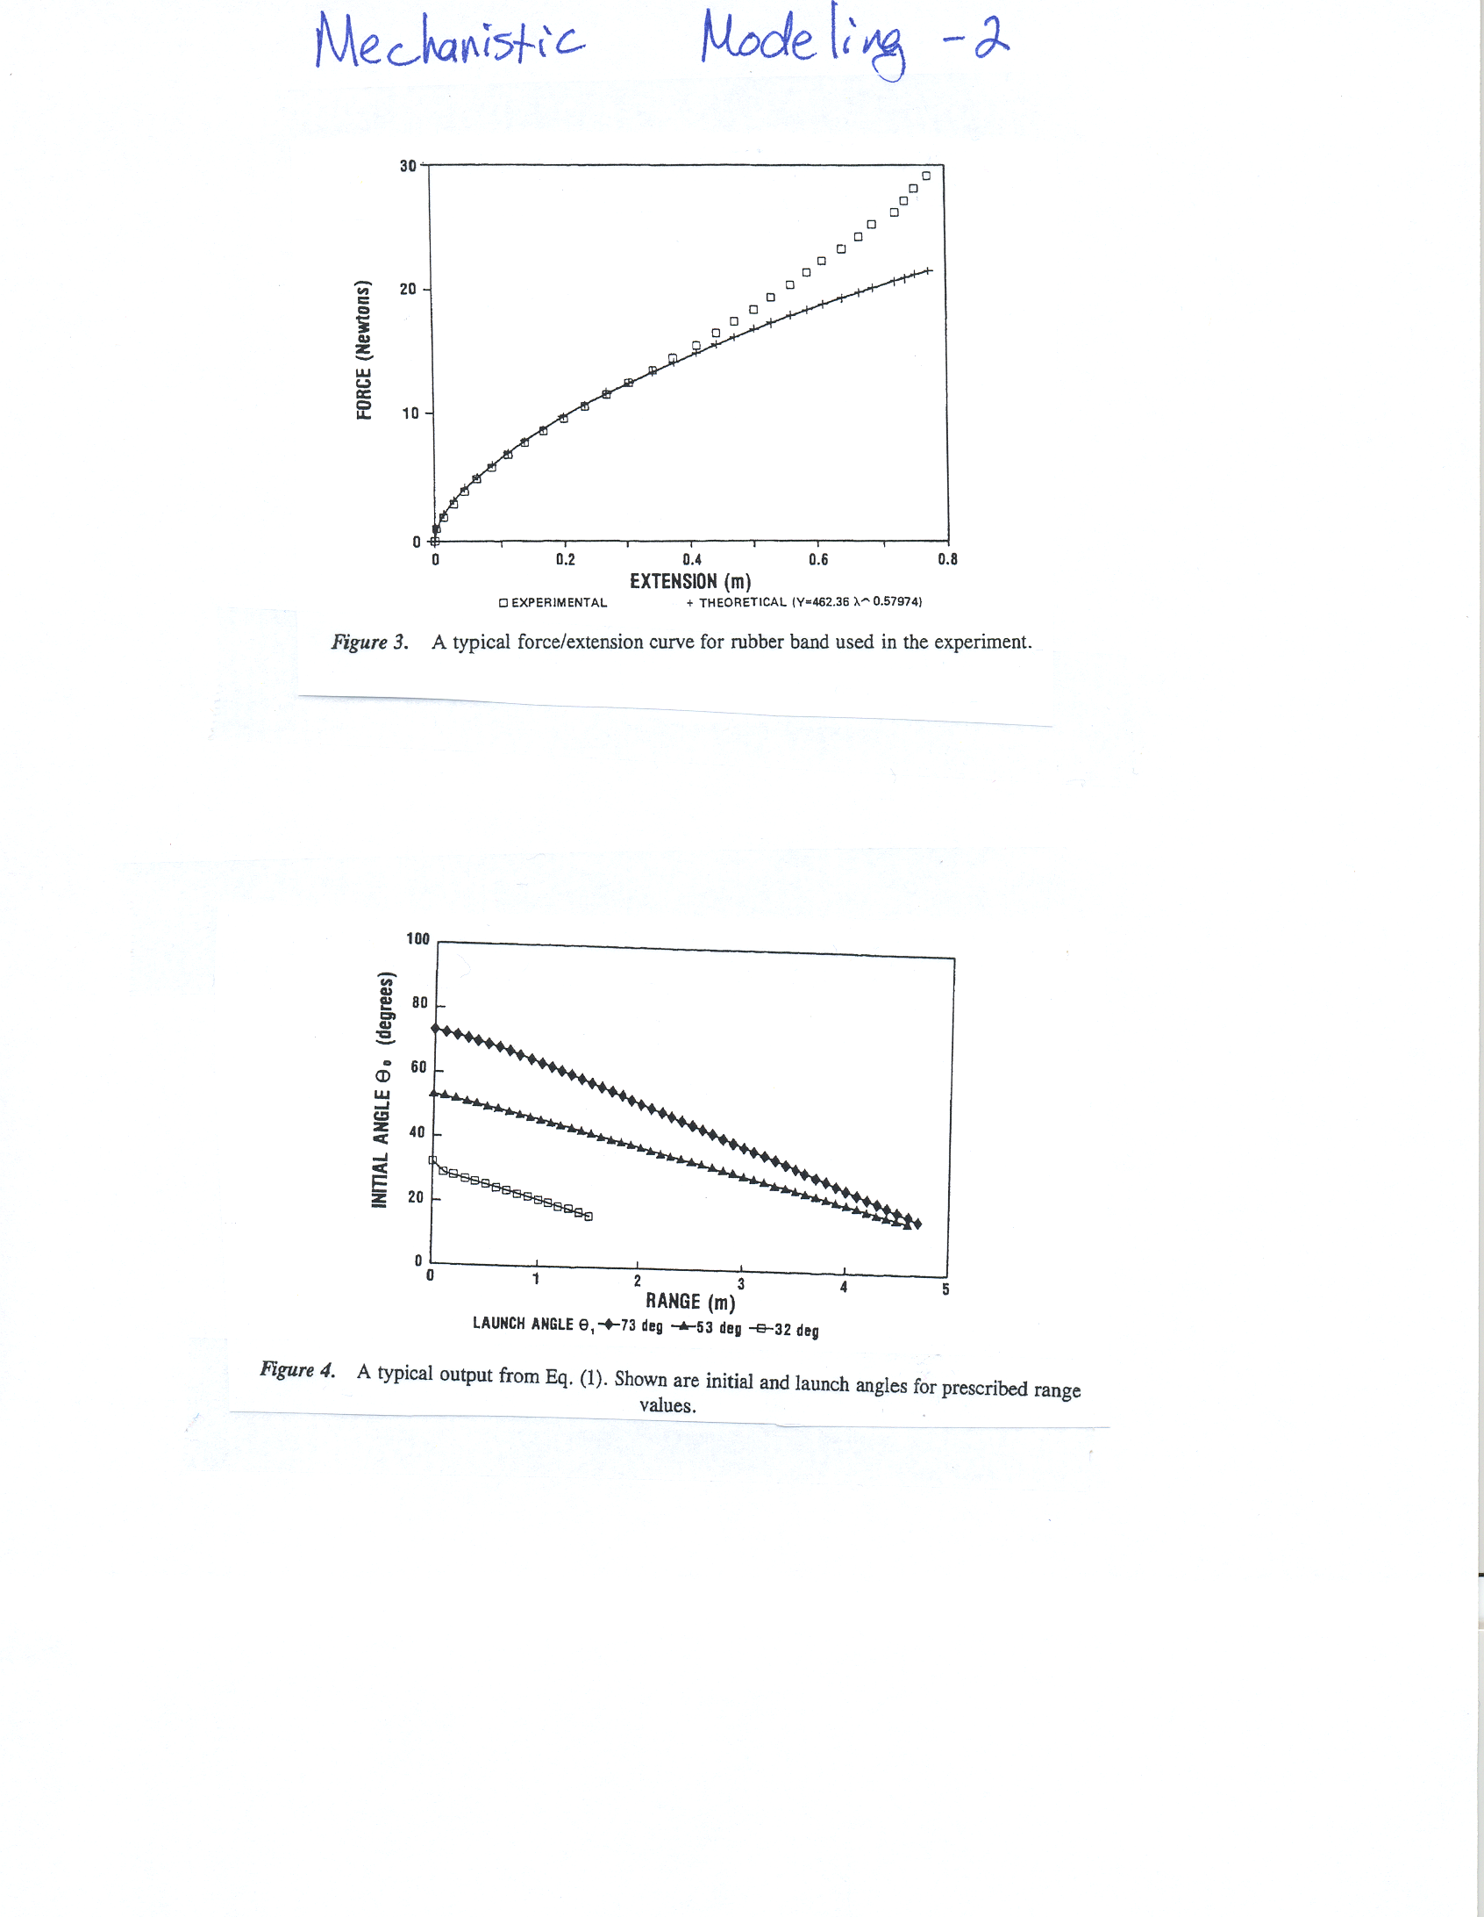
image

Slide 29
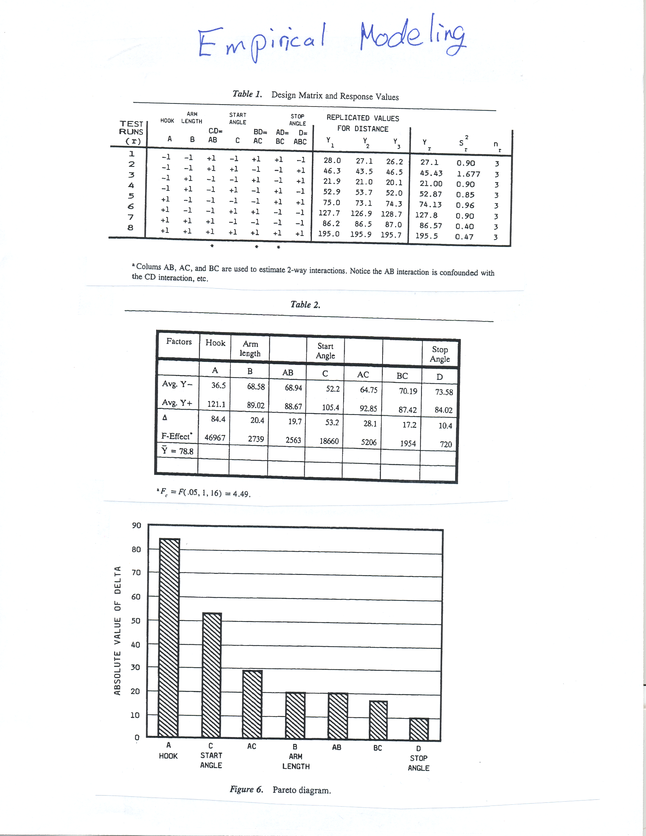
image

Slide 30
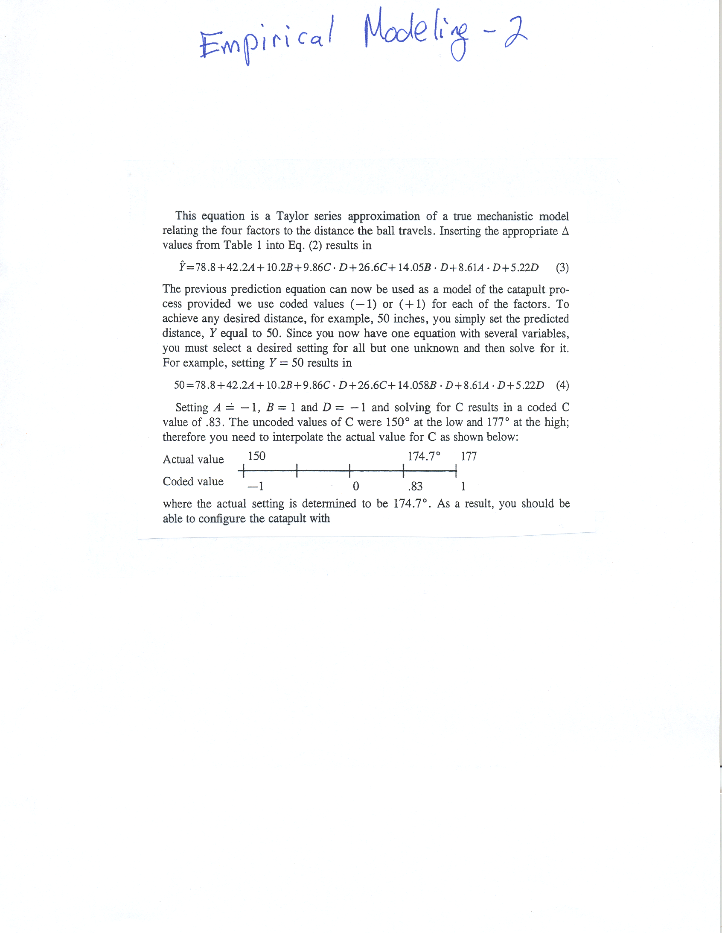
image

