Slide 1
MANE 3332.01

Slide 2
Lecture 10

Slide 3
Agenda
Continue Chapter 4 lectures
Poisson Practice Problems (assigned 9/30/2025, due 10/2/2025)
Poisson Quiz (assigned 10/2/2025, due 10/7/2025)
Standard Normal Practice Problems (assigned 10/2/2025, due 10/7/2025)
Schedule

Slide 4
Handouts
Lecture 10 Slides - Powerpoint
Lecture 10 Slides - marked (pdf)

Slide 5
Tuesday Date and Topic(s) | Thursday Date and Topic(s)
9/30: Poisson Distribution, Chapter 4 | 10/2: standard normal
10/7: normal distribution | 10/9: Exponential and Weibull distributions
10/14: Chapter 5 (not on midterm) | 10/16: Midterm Review
10/21: Midterm Exam | 10/23: Continue Part Two

Slide 6
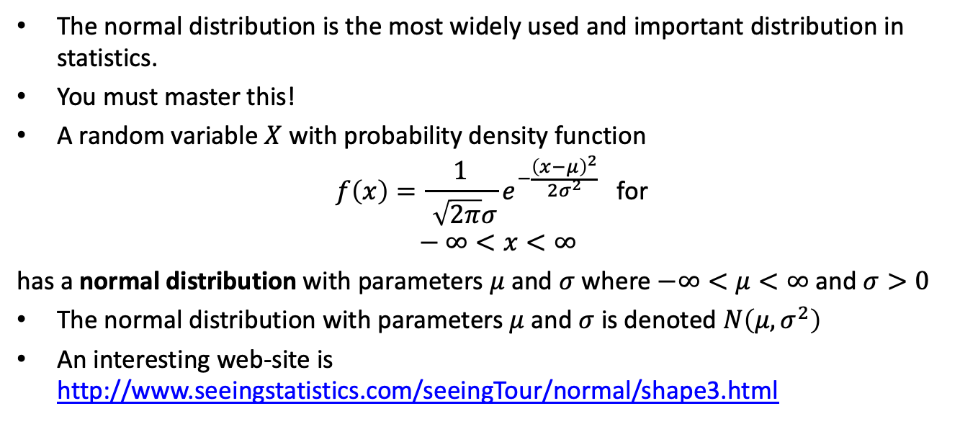
The Normal Distribution
The normal distribution is the most widely used and important distribution in statistics.
You must master this!
A random variable $X$ with probability density function
$$f\left(x\right)=\frac{1}{\sqrt{2π}σ}e^{−\frac{{\left(x−μ\right)}^{2}}{2σ^{2}}} \text{for} \\ −∞<x<∞$$
has a normal distribution with parameters $μ$ and $σ$ where $−∞<μ<∞$ and $σ>0$
The normal distribution with parameters $μ$ and $σ$ is denoted $N\left(μ,σ^{2}\right)$
An interesting web-site is http://www.seeingstatistics.com/seeingTour/normal/shape3.html

Slide 7
Mean and Variance of the Normal Distribution
The mean of the normal distribution with parameters $μ$ and $σ$ is
$$E\left(X\right)=μ$$
The variance of the normal distribution with parameters $μ$ and $σ$ is
$$V\left(X\right)=σ^{2}$$

Slide 8
Central Limit Theorem
Brief introduction
States that the distribution of the average of independent random variables will tend towards a normal distribution as $n$ gets large
More details later

Slide 9
Calculating Normal Probabilities
Is somewhat complicated
The difficulty is $\int_{a}^{b}{f}\left(x\right) dx$ does not have a closed form solution
Probabilities must be found by numerical techniques (tabled values)
It is very helpful to draw a sketch of the desired probabilities (I require this)

Slide 10
The Standard Normal Distribution
A normal random variable with $μ=0$ and $σ=1$ is called a standard normal random variable
A standard normal random variable is denoted as $z$
The cumulative distribution function for a standard normal is defined to be the function
$$Φ\left(z\right)=P\left(Z≤z\right)$$
These probabilities are contained in Appendix Table III on pages A-8 and A-9

Slide 11
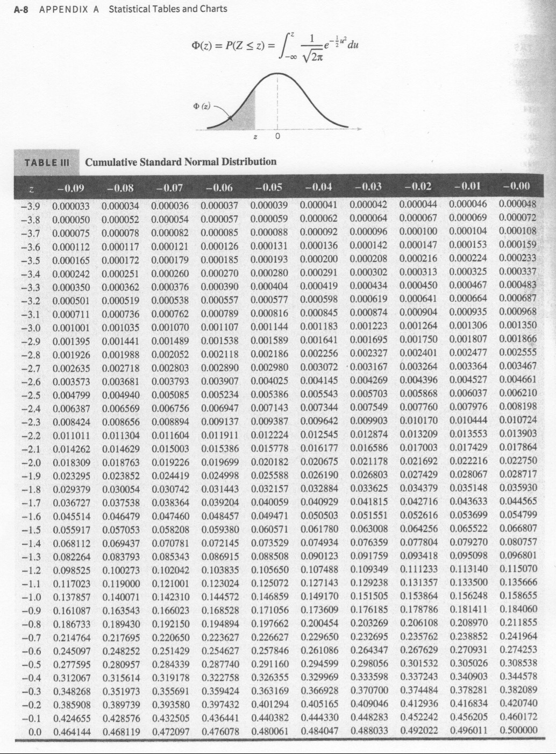
Cumulative Standard Normal Distribution
page A-8

Slide 12
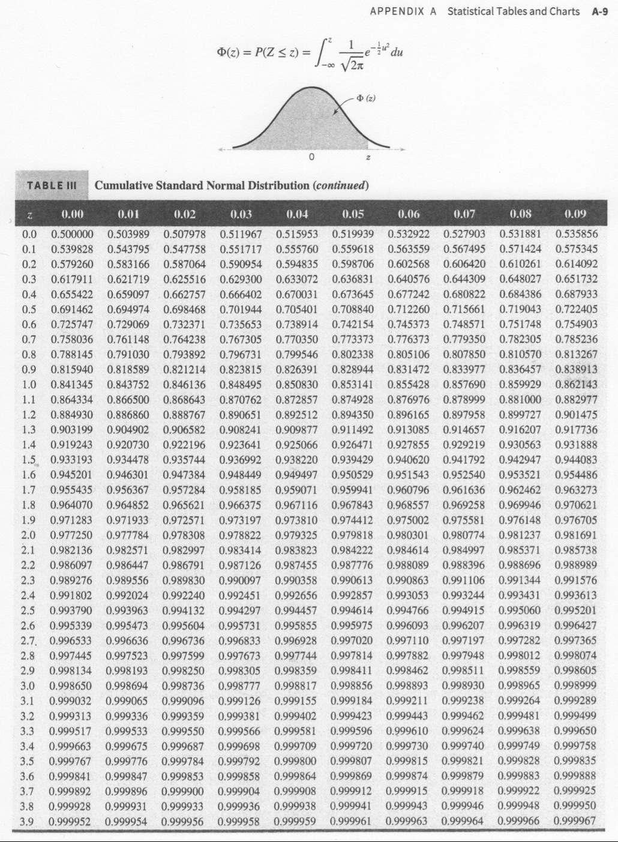
Cumulative Standard Normal Distribution
page A-9

Slide 13
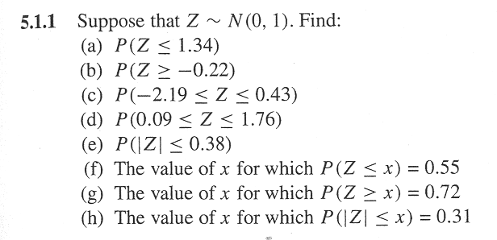
Standard Normal Problem
image

Slide 14
Standard Normal Practice Problems

Slide 16
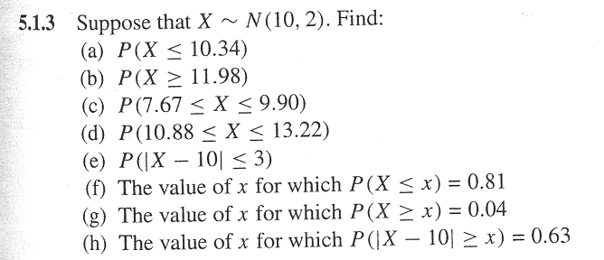
Normal Probability Problem
image

Slide 17
Normal Practice Problems

Slide 18
Normal Approximation to the Binomial Distribution
If $X$ is a binomial random variable,
$$Z=\frac{X−np}{\sqrt{np\left(1−p\right)}}$$
is approximately a standard normal random variable. Consequently, probabilities computed from $Z$ can be used to approximate probabilities for $X$
Usually holds when
$$np>5 \text{and} n\left(1−p\right)>5$$

Slide 19
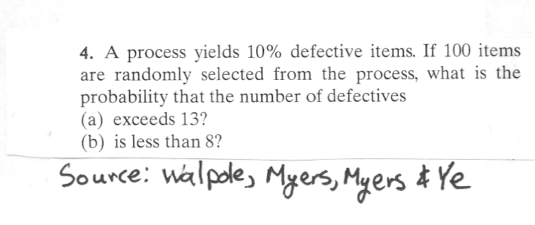
Problem
How good are the approximations?
image

Slide 21
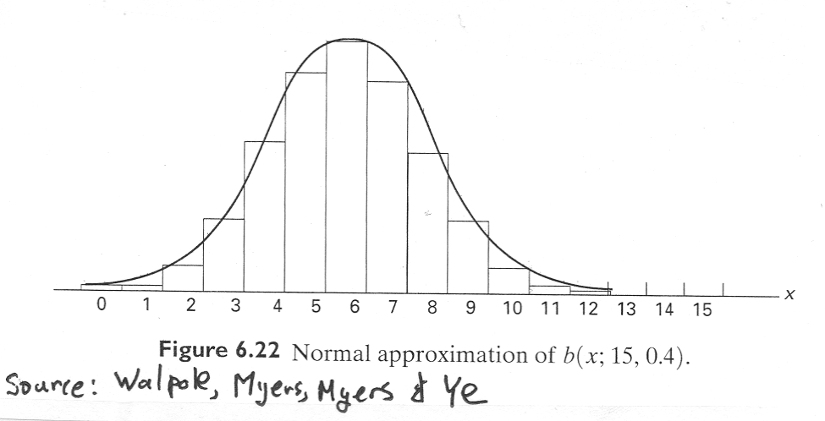
Normal Approximation - Figure
image

Slide 22
Rework Problem using Continuity Correction Factor
Are the approximations improved?

Slide 23
Normal Approximation to the Poisson Distribution
If $X$ is a Poisson random variable with $E\left(X\right)=λ$ and $V\left(X\right)=λ$,
$$Z=\frac{X−λ}{\sqrt{λ}}$$
is approximately a standard normal random variable.

Slide 24
Exponential Distribution
The exponential distribution is widely used in the area of reliability and life-test data.
Ostle, et. al. (1996) list the following applications of the exponential distribution
  the number of feet between two consecutive erroneous records on a computer tape,
  the lifetime of a component of a particular device,
  the length of a life of a radioactive material and
  the time to the next customer service call at a service desk

Slide 25
Exponential Distribution
The PDF for an exponential distribution with parameter $λ>0$ is
$$f\left(x\right)=λe^{−λx}, \text{for} 0≤x<∞$$
The mean of $X$ is
$$μ=E\left(X\right)=\frac{1}{λ}$$
The variance of $X$ is
$$σ^{2}=V\left(X\right)=\frac{1}{λ^{2}}$$
Note that other authors define $f\left(x\right)=\frac{1}{θ}e^{−x/θ}$. Either definition is acceptable. However one must be aware of which definition is being used.

Slide 26
The Exponential CDF
The CDF for the exponential distribution is easy to derive
$$\begin{matrix}F\left(x\right) & = & P\left(X≤x\right)=\int_{−∞}^{x}{λ}e^{−λy} dy \\ & = & \int_{0}^{x}{λ}e^{−λy} dy \\ & = & {\left.\left(−e^{−λy}\right)\right|}_{y=0}^{x} \\ & = & −e^{−λx}−\left(−e^{0}\right) \\ & = & −e^{−λx}+1 \\ & = & 1−e^{−λx}\end{matrix}$$

Slide 27
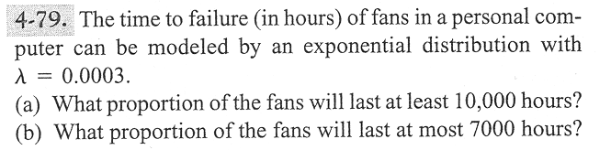
Problem 4-79
image

Slide 28
Lack of Memory Property
The mathematical definition is
$$P\left(X<t_{1}+t_{2}|X>t_{1}\right)=P\left(X<t_{2}\right)$$
That is “the probability of a failure time that is less than $t_{1}+t_{2}$ given the failure time is greater than $t_{1}$ is the probability that the item’s failure time is less than $t_{2}$
This property is unique to the exponential distribution
Often used to model the reliability of electronic components.

Slide 29
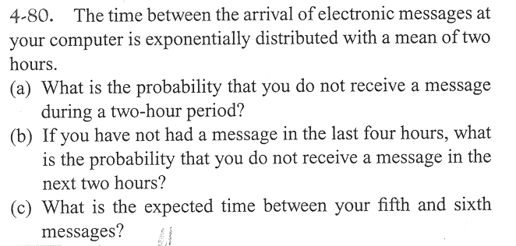
Problem 4–80
image

Slide 30
Relationship to the Poisson Distribution
Let $Y$ be a Poisson random variable with parameter $λ$. Note: $Y$ represents the number of occurrences per unit
Let $X$ be a random variable that records the time between occurrences for the same process as $Y$
$X$ has an exponential distribution with parameter $λ$

Slide 31
Lognormal Distribution
Let $W$ have a normal distribution with mean $θ$ and variance $ω^{2}$; then $X=exp\left(W\right)$ is a lognormal random variable with pdf
$$f\left(x\right)=\frac{1}{xω\sqrt{2π}}exp\left[−\frac{{\left(ln\left(x\right)−θ\right)}^{2}}{2ω^{2}}\right] 0<x<∞$$
The mean of $X$ is
$$E\left(X\right)=e^{θ+ω^{2}/2}$$
The variance of $X$ is
$$V\left(X\right)=e^{2θ+ω^{2}}\left(e^{ω^{2}}−1\right)$$

Slide 32
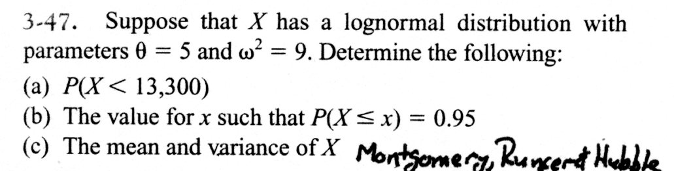
Example Problem
image

Slide 33
Gamma Distribution
The random variable $X$ with pdf
$$f\left(x\right)=\frac{λ^{r}x^{r−1}e^{−λx}}{Γ\left(r\right)}, \text{for} x>0$$
is a gamma random variable with parameters $λ>0$ and $r>0$.
The gamma function is
$$Γ\left(r\right)=\int_{0}^{∞}{x^{r−1}}e^{−x} dx \text{for} r>0$$
with special properties:
$Γ\left(r\right)$ is finite
$Γ\left(r\right)=\left(r−1\right)Γ\left(r−1\right)$
For any positive integer $r$, $Γ\left(r\right)=\left(r−1\right)!$
  $Γ\left(1/2\right)=π^{1/2}$

Slide 34
Gamma Distribution
The mean and variance are
$$μ=E\left(X\right)=r/λ \text{and} σ^{2}=V\left(X\right)=r/λ^{2}$$
We will not work any probability problems using the gamma distribution

Slide 35
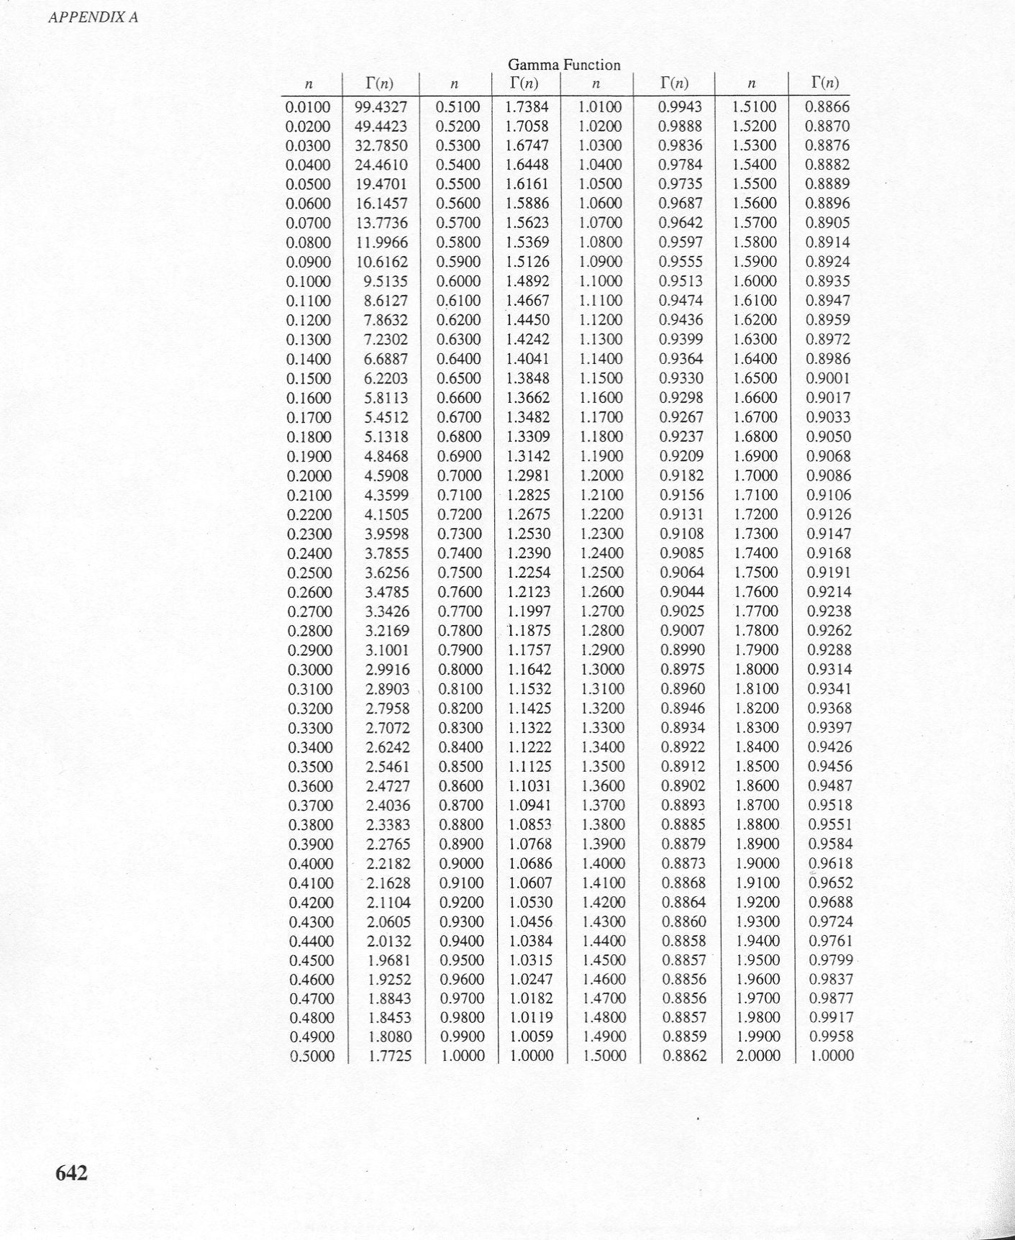
Gamma Tables
image

Slide 36
Weibull Distribution
The random variable $X$ with pdf
$$f\left(x\right)=\frac{β}{δ}{\left(\frac{x}{δ}\right)}^{β−1}exp\left[−{\left(\frac{x}{δ}\right)}^{β}\right], \text{for} x>0$$
is a Weibull random variable with scale parameter $δ>0$ and shape parameter $β>0$
The CDF for the Weibull distribution is
$$F\left(x\right)=1−exp\left[−{\left(\frac{x}{δ}\right)}^{β}\right]$$
The mean of the Weibull distribution is
$$μ=E\left(X\right)=δΓ\left(1+\frac{1}{β}\right)$$
The variance of the Weibull distribution is
$$σ^{2}=V\left(X\right)=δ^{2}Γ\left(1+\frac{2}{β}\right)−δ^{2}{\left[Γ\left(1+\frac{1}{β}\right)\right]}^{2}$$

Slide 37
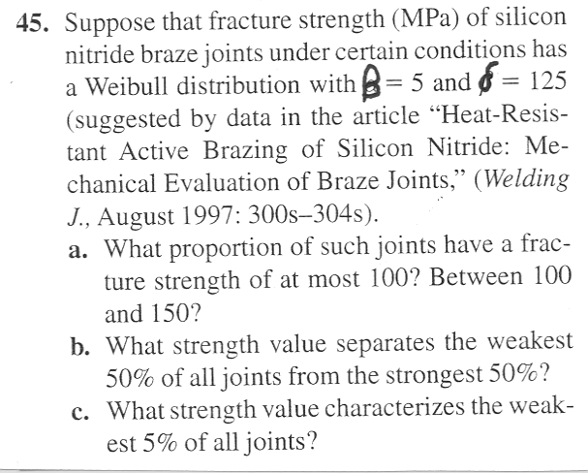
Weibull Problem
image

Slide 38
Weibull Practice Problems

