Slide 1
MANE 3332.01

Slide 2
Lecture 11

Slide 3
Agenda
Continue Chapter 4 lectures
Standard Normal Recap
Poisson Quiz (assigned 10/2/2025, due 10/7/2025)
Standard Normal Practice Problems (assigned 10/2/2025, due 10/7/2025)
Standard Normal Quiz (assigned 10/7/2025, due 10/9/2025)
Normal Practice Problems (assigned 10/7/2025, due 10/9/2025)
Schedule

Slide 4
Handouts
Lecture 11 Slides - Powerpoint
Lecture 11 Slides - marked (pdf)

Slide 5
Tuesday Date and Topic(s) | Thursday Date and Topic(s)
10/7: normal distribution | 10/9: Exponential and Weibull distributions
10/14: Chapter 5 (not on midterm) | 10/16: Midterm Review
10/21: Midterm Exam | 10/23: Continue Part Two

Slide 6
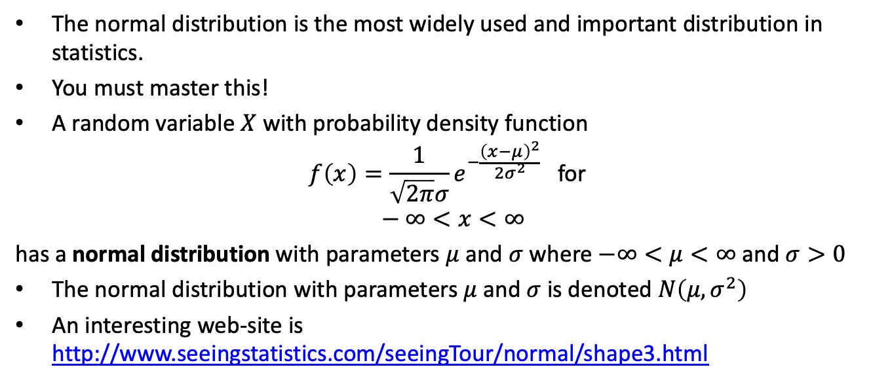
The Normal Distribution
The normal distribution is the most widely used and important distribution in statistics.
You must master this!
A random variable $X$ with probability density function
$$f\left(x\right)=\frac{1}{\sqrt{2π}σ}e^{−\frac{{\left(x−μ\right)}^{2}}{2σ^{2}}} \text{for} \\ −∞<x<∞$$
has a normal distribution with parameters $μ$ and $σ$ where $−∞<μ<∞$ and $σ>0$
The normal distribution with parameters $μ$ and $σ$ is denoted $N\left(μ,σ^{2}\right)$
An interesting web-site is http://www.seeingstatistics.com/seeingTour/normal/shape3.html

Slide 7
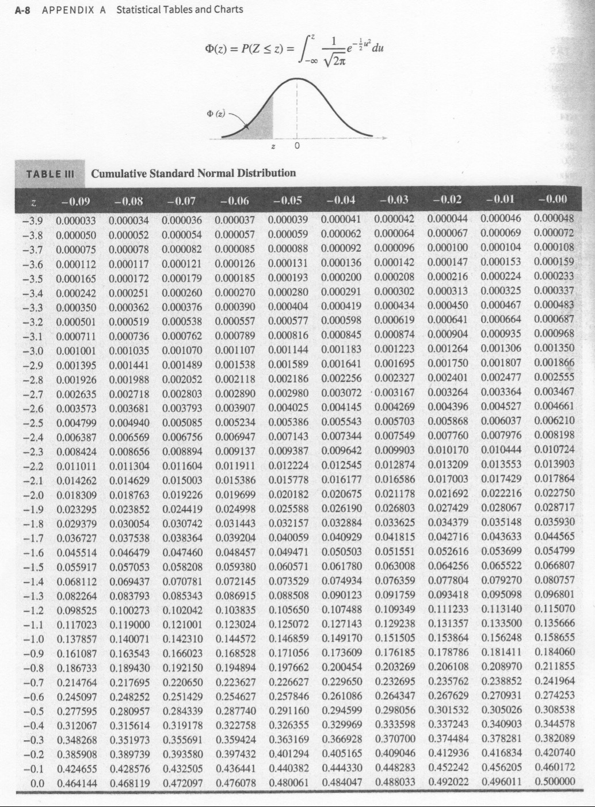
Cumulative Standard Normal Distribution
page A-8

Slide 8
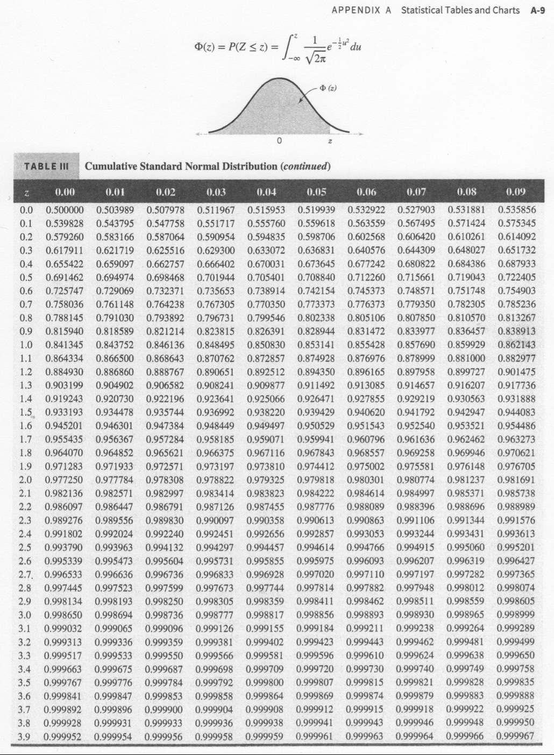
Cumulative Standard Normal Distribution
page A-9

Slide 9
Standardizing (the $z$-transform)
Suppose $X$ is a normal random variable with mean $μ$ and variance $σ^{2}$
$$P\left(X≤x\right)=P\left(\frac{X−μ}{σ}≤\frac{x−μ}{σ}\right)=P\left(Z≤z\right)$$
The $z$-value is $z=\left(x−μ\right)/σ$
Result allows the standard normal tables to be used to calculate probabilities for any normal distribution

Slide 10
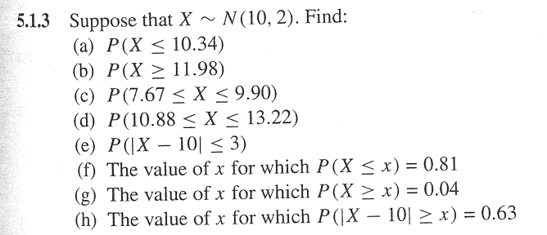
Normal Probability Problem
image

Slide 11
Normal Practice Problems

Slide 12
Normal Approximation to the Binomial Distribution
If $X$ is a binomial random variable,
$$Z=\frac{X−np}{\sqrt{np\left(1−p\right)}}$$
is approximately a standard normal random variable. Consequently, probabilities computed from $Z$ can be used to approximate probabilities for $X$
Usually holds when
$$np>5 \text{and} n\left(1−p\right)>5$$

Slide 13
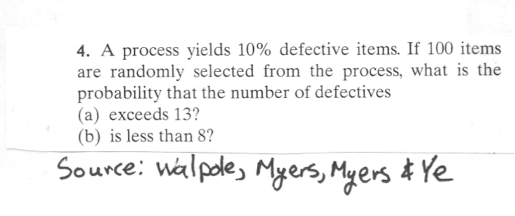
How good are the approximations?
Problem
image

Slide 15
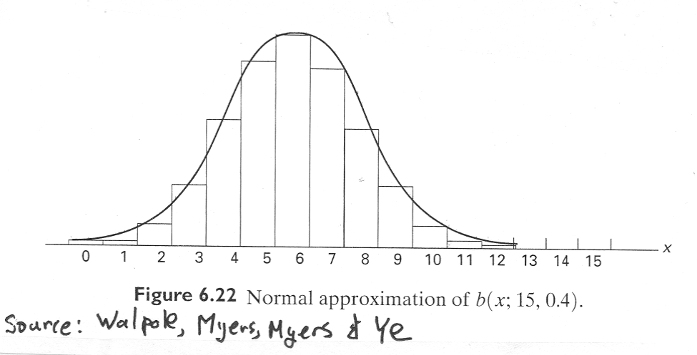
Normal Approximation - Figure
image

Slide 16
Rework Problem using Continuity Correction Factor
Are the approximations improved?

Slide 17
Normal Approximation to the Poisson Distribution
If $X$ is a Poisson random variable with $E\left(X\right)=λ$ and $V\left(X\right)=λ$,
$$Z=\frac{X−λ}{\sqrt{λ}}$$
is approximately a standard normal random variable.

Slide 18
Exponential Distribution
The exponential distribution is widely used in the area of reliability and life-test data.
Ostle, et. al. (1996) list the following applications of the exponential distribution
  the number of feet between two consecutive erroneous records on a computer tape,
  the lifetime of a component of a particular device,
  the length of a life of a radioactive material and
  the time to the next customer service call at a service desk

Slide 19
Exponential Distribution
The PDF for an exponential distribution with parameter $λ>0$ is
$$f\left(x\right)=λe^{−λx}, \text{for} 0≤x<∞$$
The mean of $X$ is
$$μ=E\left(X\right)=\frac{1}{λ}$$
The variance of $X$ is
$$σ^{2}=V\left(X\right)=\frac{1}{λ^{2}}$$
Note that other authors define $f\left(x\right)=\frac{1}{θ}e^{−x/θ}$. Either definition is acceptable. However one must be aware of which definition is being used.

Slide 20
The Exponential CDF
The CDF for the exponential distribution is easy to derive
$$\begin{matrix}F\left(x\right) & = & P\left(X≤x\right)=\int_{−∞}^{x}{λ}e^{−λy} dy \\ & = & \int_{0}^{x}{λ}e^{−λy} dy \\ & = & {\left.\left(−e^{−λy}\right)\right|}_{y=0}^{x} \\ & = & −e^{−λx}−\left(−e^{0}\right) \\ & = & −e^{−λx}+1 \\ & = & 1−e^{−λx}\end{matrix}$$

Slide 21
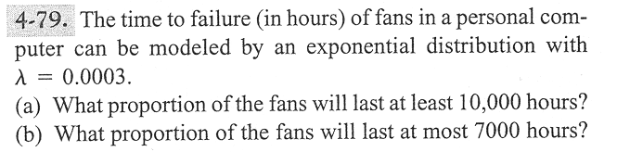
Problem 4-79
image

Slide 22
Lack of Memory Property
The mathematical definition is
$$P\left(X<t_{1}+t_{2}|X>t_{1}\right)=P\left(X<t_{2}\right)$$
That is “the probability of a failure time that is less than $t_{1}+t_{2}$ given the failure time is greater than $t_{1}$ is the probability that the item’s failure time is less than $t_{2}$
This property is unique to the exponential distribution
Often used to model the reliability of electronic components.

Slide 23
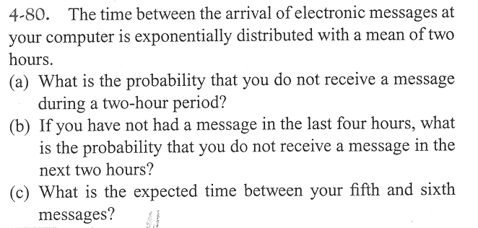
Problem 4–80
image

Slide 24
Relationship to the Poisson Distribution
Let $Y$ be a Poisson random variable with parameter $λ$. Note: $Y$ represents the number of occurrences per unit
Let $X$ be a random variable that records the time between occurrences for the same process as $Y$
$X$ has an exponential distribution with parameter $λ$

Slide 25
Lognormal Distribution
Let $W$ have a normal distribution with mean $θ$ and variance $ω^{2}$; then $X=exp\left(W\right)$ is a lognormal random variable with pdf
$$f\left(x\right)=\frac{1}{xω\sqrt{2π}}exp\left[−\frac{{\left(ln\left(x\right)−θ\right)}^{2}}{2ω^{2}}\right] 0<x<∞$$
The mean of $X$ is
$$E\left(X\right)=e^{θ+ω^{2}/2}$$
The variance of $X$ is
$$V\left(X\right)=e^{2θ+ω^{2}}\left(e^{ω^{2}}−1\right)$$

Slide 26
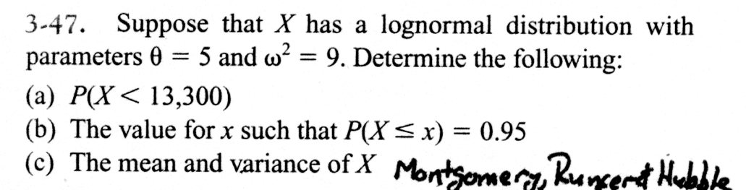
Example Problem
image

Slide 27
Gamma Distribution
The random variable $X$ with pdf
$$f\left(x\right)=\frac{λ^{r}x^{r−1}e^{−λx}}{Γ\left(r\right)}, \text{for} x>0$$
is a gamma random variable with parameters $λ>0$ and $r>0$.
The gamma function is
$$Γ\left(r\right)=\int_{0}^{∞}{x^{r−1}}e^{−x} dx \text{for} r>0$$
with special properties:
$Γ\left(r\right)$ is finite
$Γ\left(r\right)=\left(r−1\right)Γ\left(r−1\right)$
For any positive integer $r$, $Γ\left(r\right)=\left(r−1\right)!$
  $Γ\left(1/2\right)=π^{1/2}$

Slide 28
Gamma Distribution
The mean and variance are
$$μ=E\left(X\right)=r/λ \text{and} σ^{2}=V\left(X\right)=r/λ^{2}$$
We will not work any probability problems using the gamma distribution

Slide 29
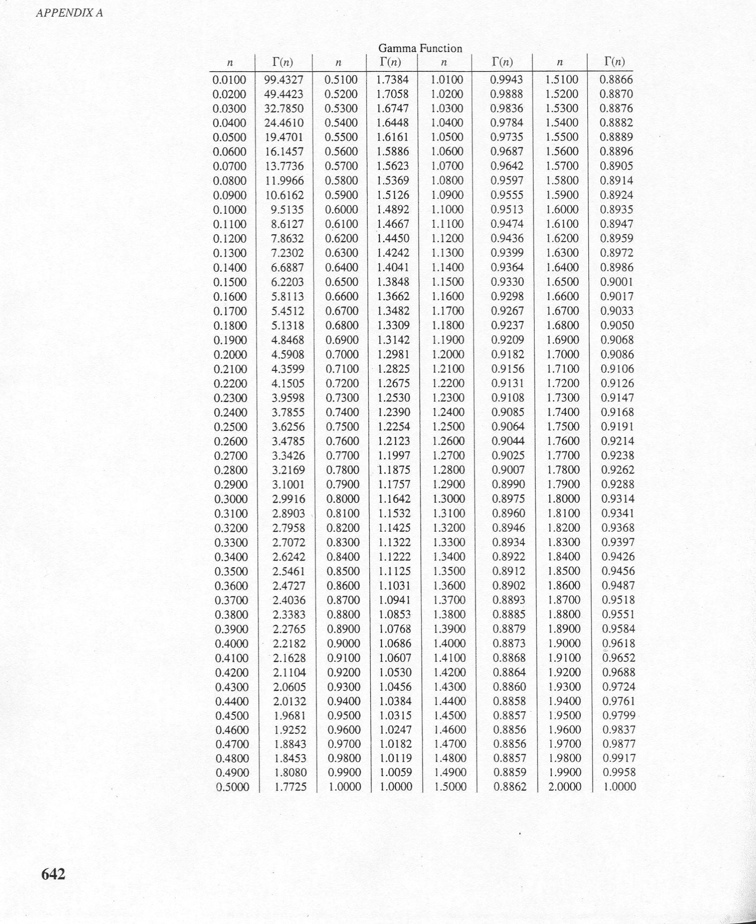
Gamma Tables
image

Slide 30
Weibull Distribution
The random variable $X$ with pdf
$$f\left(x\right)=\frac{β}{δ}{\left(\frac{x}{δ}\right)}^{β−1}exp\left[−{\left(\frac{x}{δ}\right)}^{β}\right], \text{for} x>0$$
is a Weibull random variable with scale parameter $δ>0$ and shape parameter $β>0$
The CDF for the Weibull distribution is
$$F\left(x\right)=1−exp\left[−{\left(\frac{x}{δ}\right)}^{β}\right]$$
The mean of the Weibull distribution is
$$μ=E\left(X\right)=δΓ\left(1+\frac{1}{β}\right)$$
The variance of the Weibull distribution is
$$σ^{2}=V\left(X\right)=δ^{2}Γ\left(1+\frac{2}{β}\right)−δ^{2}{\left[Γ\left(1+\frac{1}{β}\right)\right]}^{2}$$

Slide 31
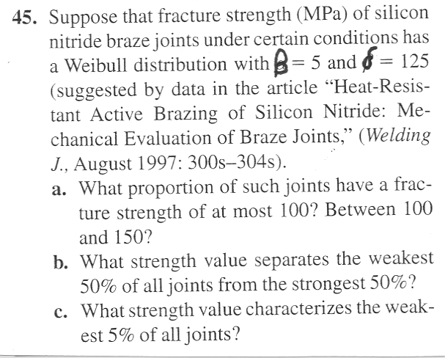
Weibull Problem
image

Slide 32
Weibull Practice Problems

