Slide 1
MANE 3332.01

Slide 2
Lecture 8

Slide 3
Agenda
Continue Chapter 3 lectures
CDF Quiz (assigned 9/23/2025, due 9/25/2025)
Binomial Practice Problems (assigned 9/23/2025, due 9/25/2025)
Binomial Quiz (assigned 9/25/2025, due 9/30/2025)
Schedule

Slide 4
Handouts
Lecture 8 Slides - Powerpoint
Lecture 8 Slides - marked (pdf)

Slide 5
Tuesday Date and Topic(s) | Thursday Date and Topic(s)
 | 9/26: Uniform, hypergeometric, geometric and negative binomial distribution
9/30: Poisson Distribution, Chapter 4 | 10/2: standard normal
10/7: normal distribution | 10/9: Exponential and Weibull distributions
10/14: Chapter 5 (not on midterm) | 10/16: Midterm Review
10/21: Midterm Exam | 10/23: Continue Part Two

Slide 6
Discrete Uniform Distribution
A random variable $X$ is a discrete uniform rv if each of the $n$ values in its range, $x_{1},x_{2},…,x_{n}$ has equal probability
The PMF of a discrete uniform is defined to be
$$f\left(x_{i}\right)=\frac{1}{n}$$
If the discrete uniform random variable is defined on the consecutive integers $a,a+1,…,b$ for $a≤b$. The mean is
$$μ=E\left(X\right)=\frac{b+a}{2}$$
and the standard deviation is
$$σ=\sqrt{\frac{{\left(b−a+1\right)}^{2}−1}{12}}$$
Work problem 3.80

Slide 7
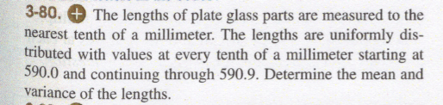
Problem 3.80
Problem 3.80

Slide 8
Hypergeometric Distribution
The hypergeometric distribution is one of the commonly occurring distributions in quality.
A random variable is hypergeometric when a set of $N$ objects contains
$K$ objects classified as successes and
$N−K$ objects classified as failures
a sample of size $n$ is selected without replacement from the $N$ objects, where $K≤N$ and $n≤N$

Slide 9
Hypergeometric Distribution
The hypergeometric PMF is
$$f\left(x\right)=\frac{\left(\begin{matrix}K \\ x\end{matrix}\right)\left(\begin{matrix}N−K \\ n−x\end{matrix}\right)}{\left(\begin{matrix}N \\ n\end{matrix}\right)}$$
The mean of $X$ is
$$E\left(X\right)=μ=np$$
The variance of $X$ is
$$σ^{2}=V\left(X\right)=np\left(1−p\right)\left[\frac{N−n}{N−1}\right]$$

Slide 10
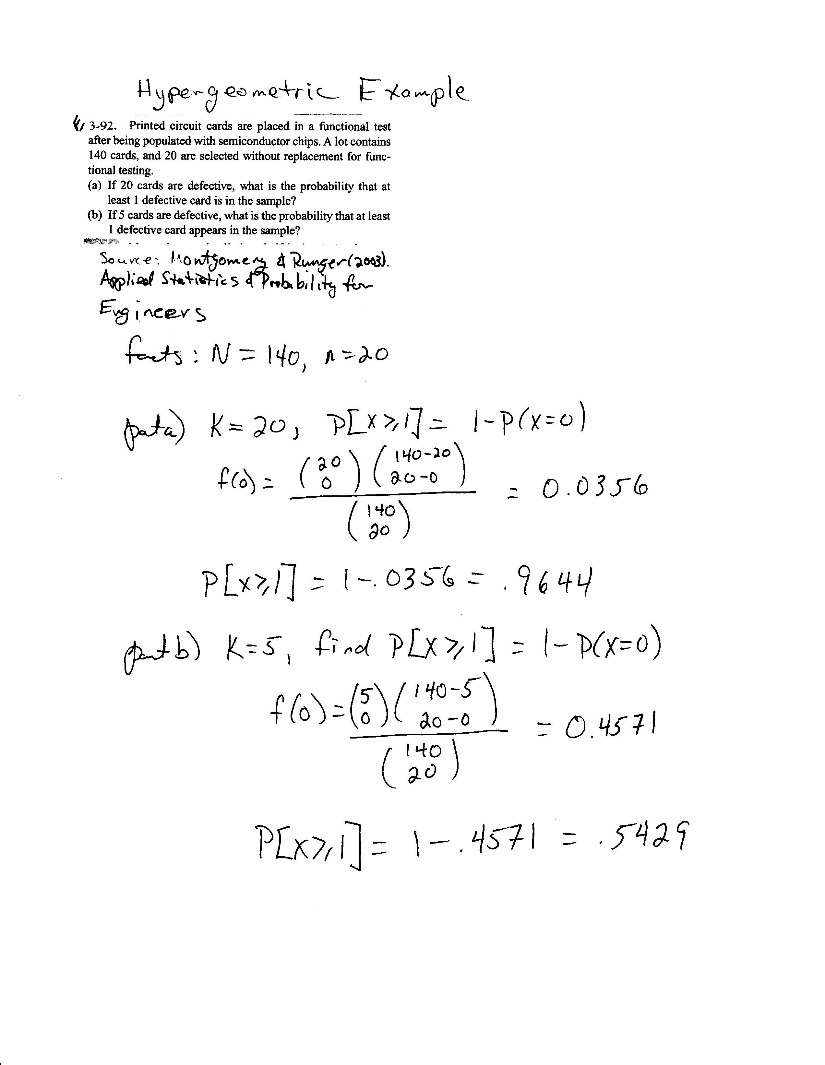
Hypergeometric Example Problem
image

Slide 11
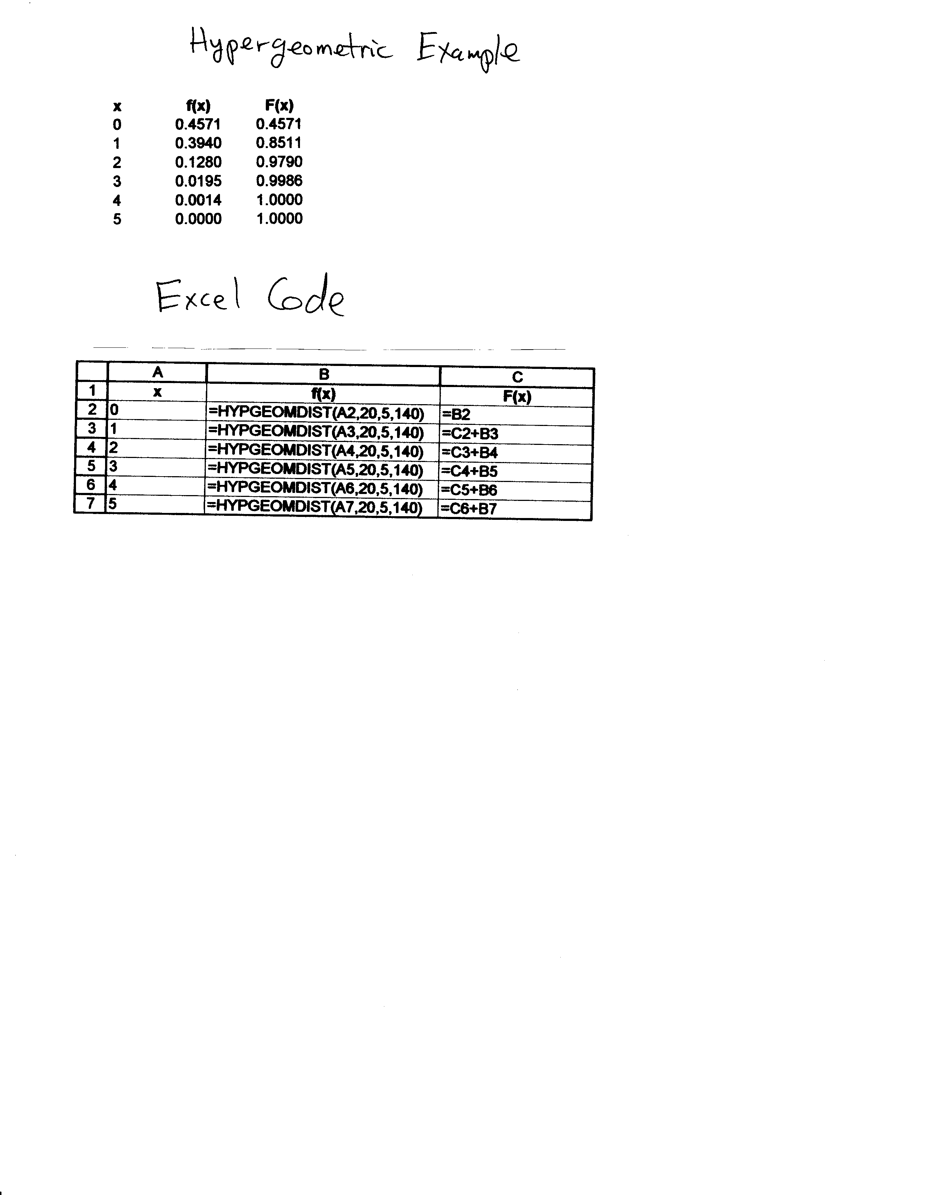
Excel for Hypergeometric Example
image

Slide 12
Binomial Approximation to the Hypergeometric Distribution
The mean and variance of the hypergeometric and binomial distribution are very similar. The variance only differs by the finite population correction factor,
$$\frac{N−n}{N−1}$$
Sampling with replacement is equivalent to sampling from an infinite set (without replacement) because the proportion remains constant
If $n$ is small relative to $N$, then the finite correction is negligible and the binomial distribution can be used as an approximation to the hypergeometric.
A rule of thumb is to use this approximation when $N/n>20$.

Slide 13
Geometric Distribution
Montgomery and Runger (2003) define a geometric random variable to be the number of trials until the first success of a series of independent Bernoulli trials, with constant probability $p$ of success
The PMF of a geometric distribution is
$$f\left(x\right)={\left(1−p\right)}^{x−1}p, x=1,2,…$$
The mean of a geometric random variable is
$$μ=E\left(X\right)=\frac{1}{p}$$
The variance of a geometric random variable is
$$σ^{2}=V\left(X\right)=\frac{1−p}{p^{2}}$$

Slide 14
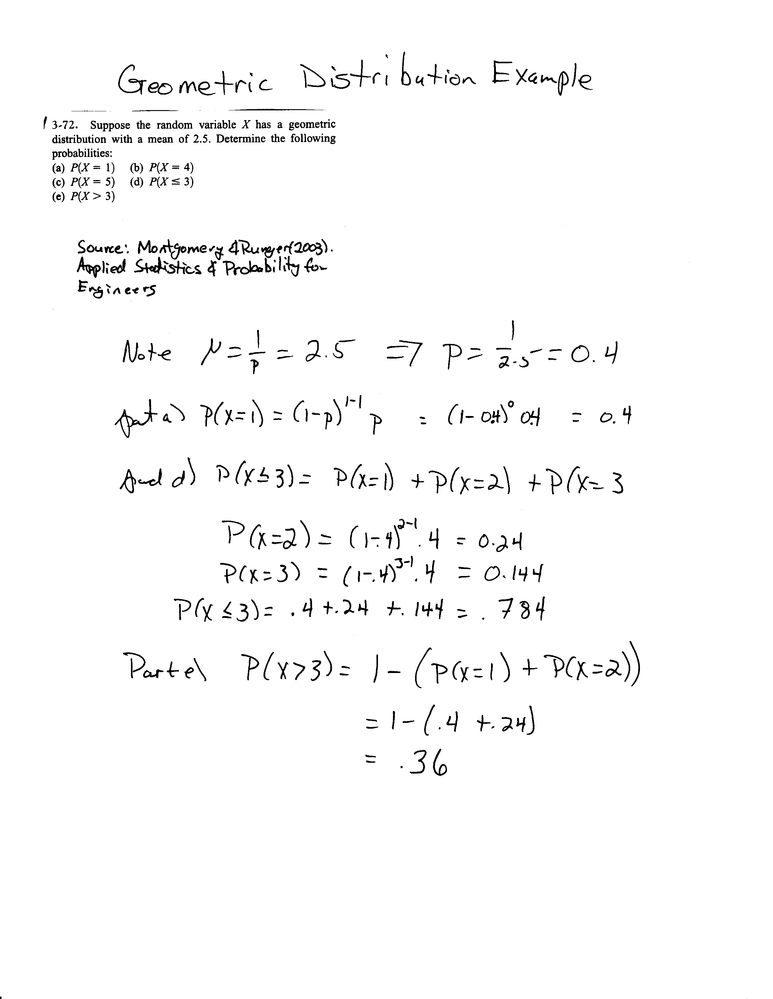
Geometric Distribution Example
image

Slide 15
Negative Binomial Distribution
Montgomery and Runger (2003) define a negative binomial random variable to be the number of trials until $r$ successes are observed of a series of independent Bernoulli trials, with constant probability $p$ of success
The geometric distribution is a special case of the negative binomial distribution with $r=1$
The PMF of a negative binomial distribution is
$$f\left(x\right)=\left(\begin{matrix}x−1 \\ r−1\end{matrix}\right){\left(1−p\right)}^{x−r}p^{r}, x=r,r+1,…$$
The mean of a negative binomial random variable is
$$μ=E\left(X\right)=\frac{r}{p}$$
The variance of a negative binomial random variable is
$$σ^{2}=V\left(X\right)=\frac{r\left(1−p\right)}{p^{2}}$$

Slide 16
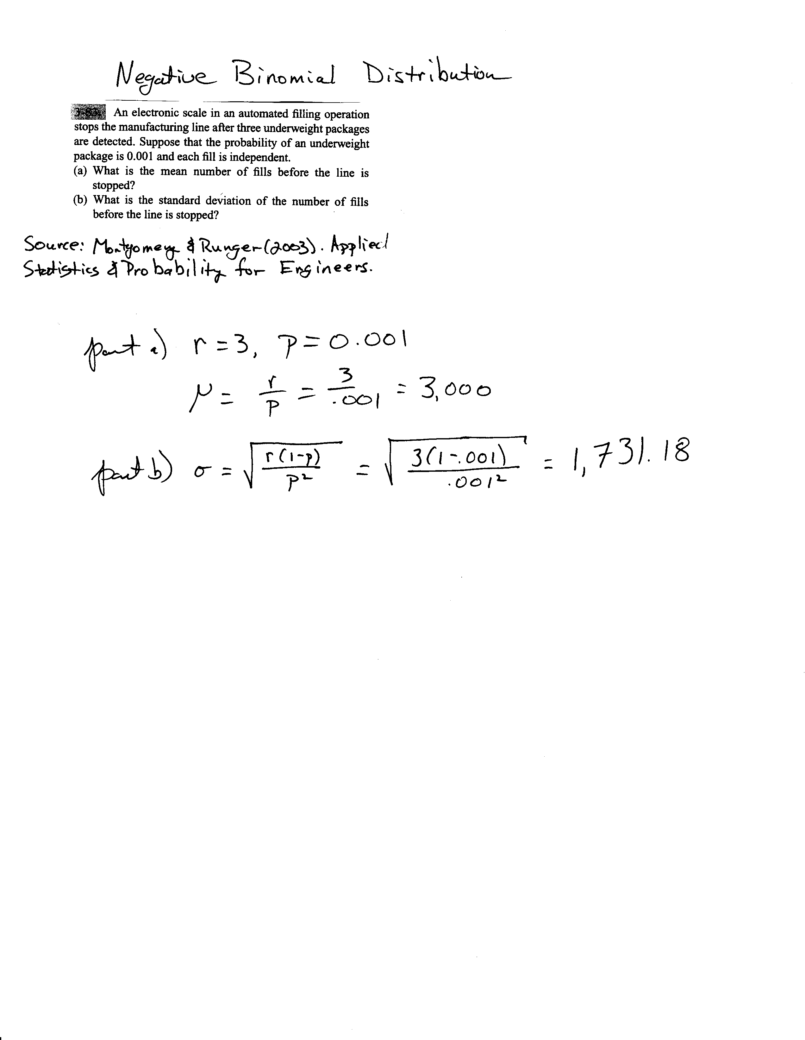
Negative Binomial Example
image

Slide 17
Poisson Process
The number of events over an interval (such as time) is a discrete random variable that is often modelled by the Poisson distribution
The length of the interval between events is often modeled by the (continuous) exponential distribution
These two distributions are related

Slide 18
Poisson Process
The number of events over an interval (such as time) is a discrete random variable that is often modelled by the Poisson distribution
The length of the interval between events is often modelled by the (continuous) exponential distribution
These two distributions are related

Slide 19
Poisson Process
Assume that the events occur at random throughout the interval. If the interval can be partitioned into subintervals of small enough length such that
The probability of more than one count in a subinterval is zero
The probability of one count in a subinterval is the same for all subintervals and proportional to the length of the subinterval, and
The count in each subinterval is independent of other subintervals, the random experiment is called a Poisson process

Slide 20
Poisson Distribution
If the mean number of counts in the interval is $λ>0$, the random variable $X$ that equals the number of counts in the interval has a Poisson distribution with parameter $λ$
The Poisson PMF is
$$f\left(x\right)=\frac{e^{−λ}λ^{x}}{x!}, x=0,1,2,…$$
The mean of a Poisson random variable is
$$E\left(X\right)=μ=λ$$
The variance of a Poisson random variable is
$$V\left(X\right)=σ^{2}=λ$$

Slide 21
Poisson Practice Problems

Slide 22
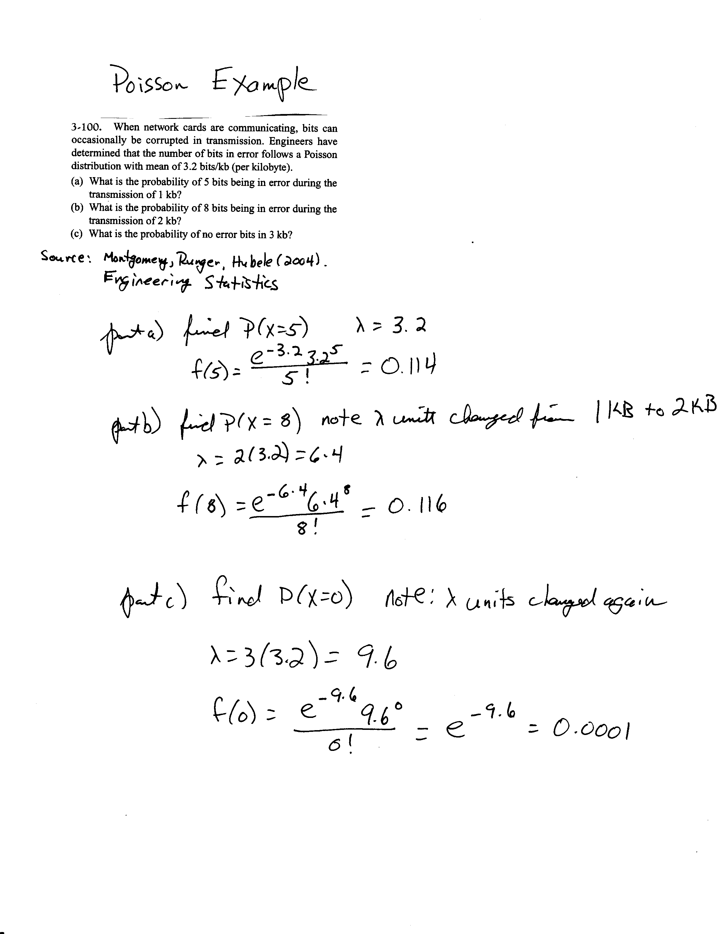
Poisson Example
image

