Slide 1
MANE 3332.01

Slide 2
Lecture 9

Slide 3
Agenda
Complete Chapter 3 lectures
Start Chapter 4 lectures
Binomial Quiz (assigned 9/25/2025, due 9/30/2025)
Poisson Practice Problems (assigned 9/30/2025, due 10/2/2025)
Schedule

Slide 4
Handouts
Lecture 9 Slides - Powerpoint
Lecture 9 Slides - marked (pdf)

Slide 5
Tuesday Date and Topic(s) | Thursday Date and Topic(s)
9/30: Poisson Distribution, Chapter 4 | 10/2: standard normal
10/7: normal distribution | 10/9: Exponential and Weibull distributions
10/14: Chapter 5 (not on midterm) | 10/16: Midterm Review
10/21: Midterm Exam | 10/23: Continue Part Two

Slide 6
Poisson Process
The number of events over an interval (such as time) is a discrete random variable that is often modelled by the Poisson distribution
The length of the interval between events is often modeled by the (continuous) exponential distribution
These two distributions are related

Slide 7
Poisson Process
The number of events over an interval (such as time) is a discrete random variable that is often modelled by the Poisson distribution
The length of the interval between events is often modelled by the (continuous) exponential distribution
These two distributions are related

Slide 8
Poisson Process
Assume that the events occur at random throughout the interval. If the interval can be partitioned into subintervals of small enough length such that
The probability of more than one count in a subinterval is zero
The probability of one count in a subinterval is the same for all subintervals and proportional to the length of the subinterval, and
The count in each subinterval is independent of other subintervals, the random experiment is called a Poisson process

Slide 9
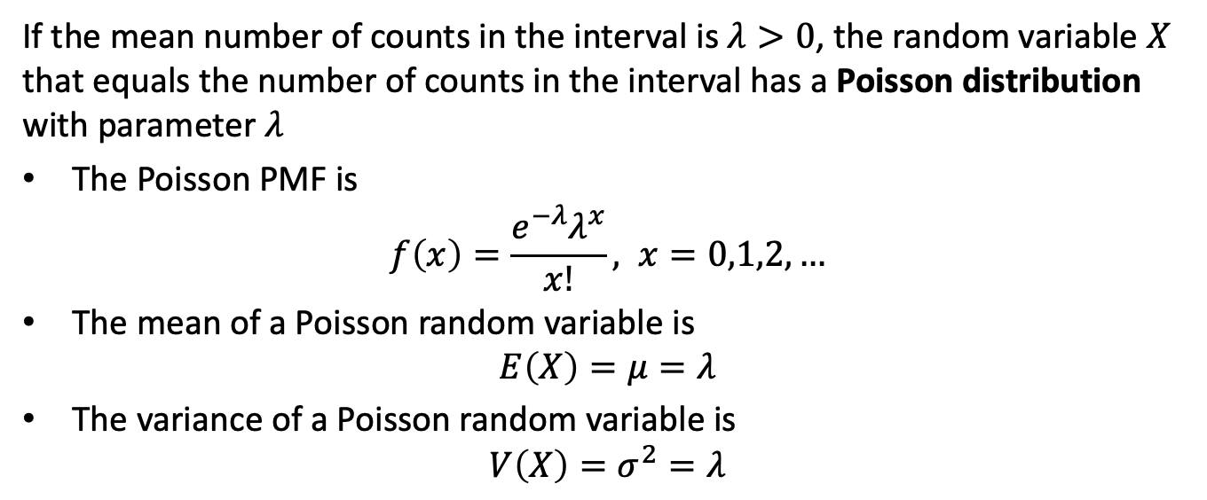
Poisson Distribution
If the mean number of counts in the interval is $λ>0$, the random variable $X$ that equals the number of counts in the interval has a Poisson distribution with parameter $λ$
The Poisson PMF is
$$f\left(x\right)=\frac{e^{−λ}λ^{x}}{x!}, x=0,1,2,…$$
The mean of a Poisson random variable is
$$E\left(X\right)=μ=λ$$
The variance of a Poisson random variable is
$$V\left(X\right)=σ^{2}=λ$$

Slide 10
Poisson Practice Problems

Slide 11
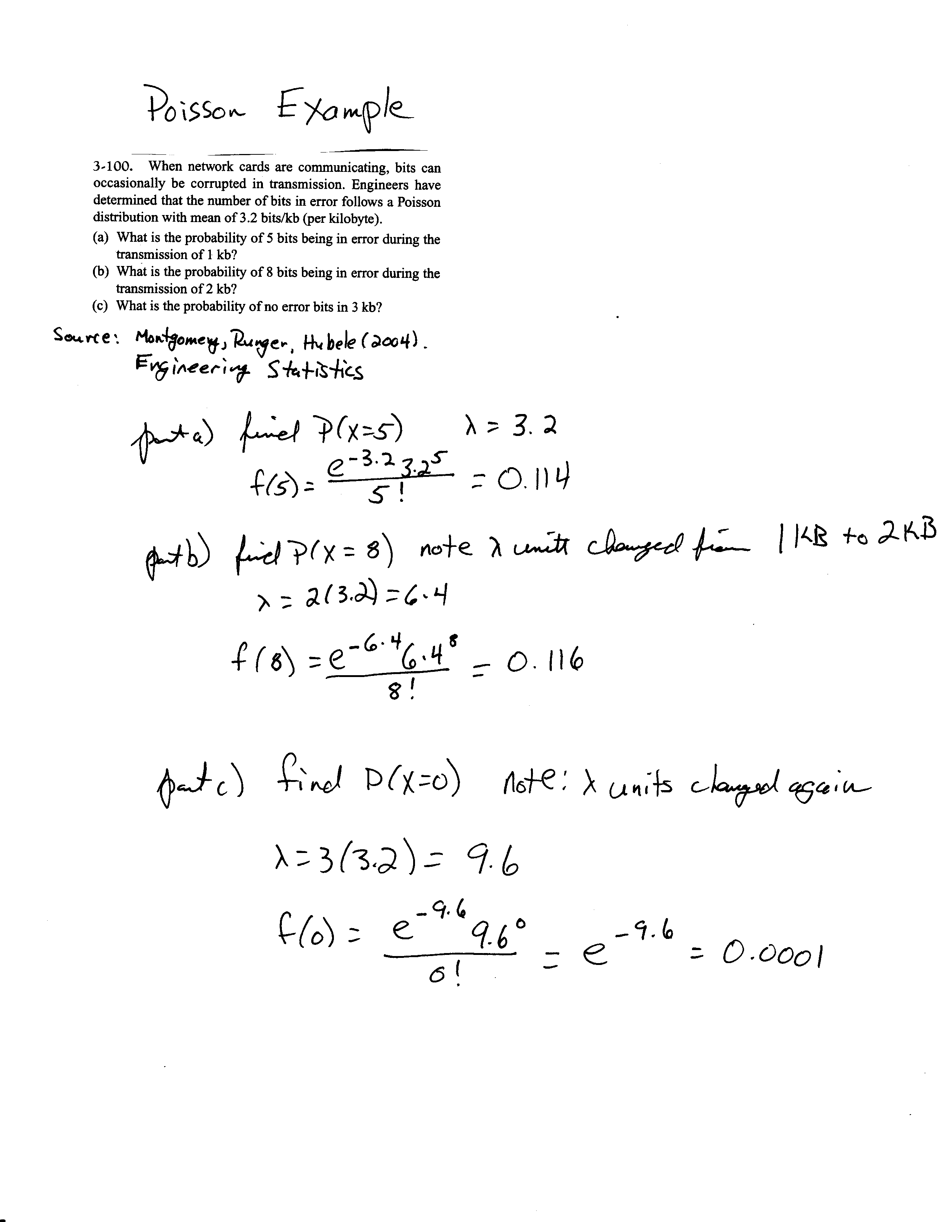
Poisson Example
image

Slide 12
Chapter 4 Content

Slide 13
Continuous Random Variable
The probability distribution of a random variable $X$ is a description of the set of probabilities associated with the possible values of $X$
Density functions are commonly used in engineering to describe physical systems.
A probability density function $f\left(x\right)$ can be used to describe the probability distribution of a continuous random variable

Slide 14
Probability Density Function
Notice the difference from a discrete random variable
The formal definition of a probability density function is a function such that
$f\left(x\right)≥0$
$\int_{−∞}^{∞}{f}\left(x\right) dx=1$
$P\left(a≤X≤b\right)=\int_{a}^{b}{f}\left(x\right) dx$

Slide 15
Probability Density Function
Any interesting property of continuous random variables is
$$\begin{matrix}P\left(x_{1}≤X≤x_{2}\right) & = & P\left(x_{1}<X≤x_{2}\right)=P\left(x_{1}≤X<x_{2}\right) \\ & = & P\left(x_{1}<X<x_{2}\right)\end{matrix}$$
Does not apply to discrete random variables
Explanation

Slide 16
Cumulative Distribution Function
The cumulative distribution function for a continuous random variable $X$ is
$$F\left(x\right)=P\left(X≤x\right)=\int_{−∞}^{x}{f}\left(y\right) dy$$

Slide 17
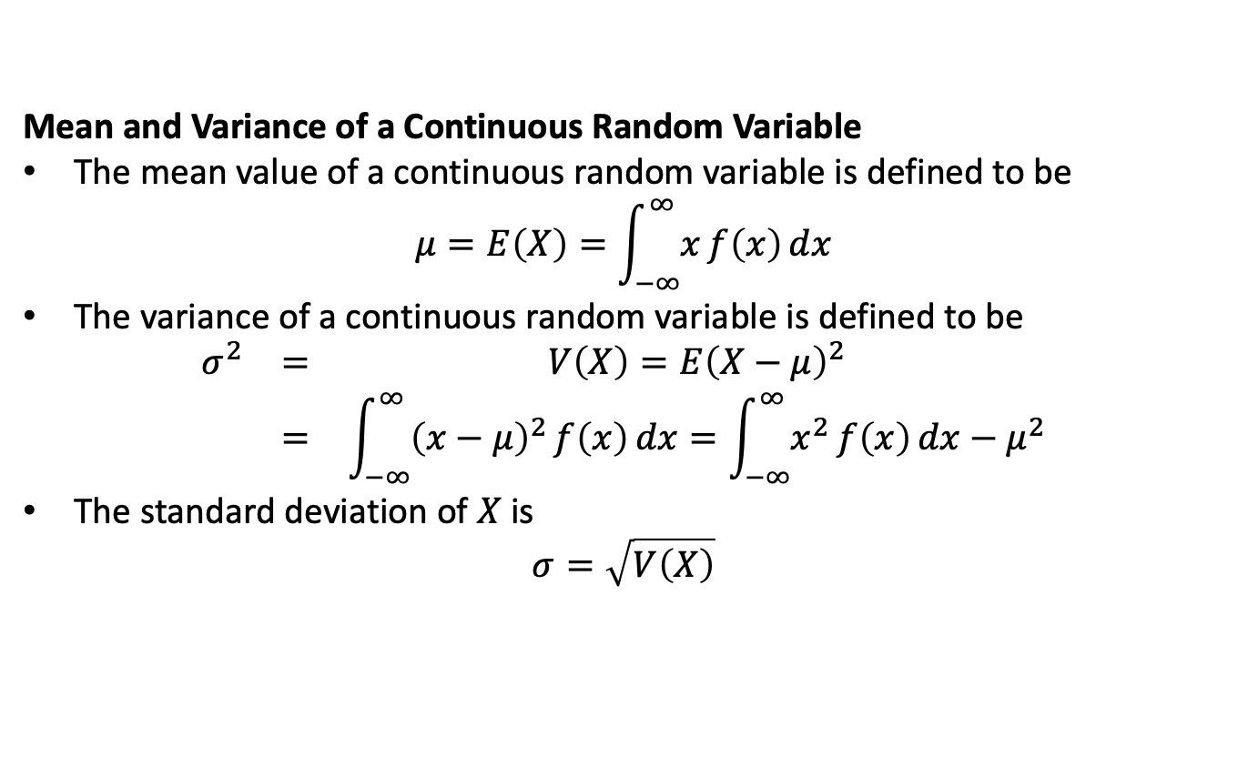
Mean and Variance of a Continuous Random Variable
The mean value of a continuous random variable is defined to be
$$μ=E\left(X\right)=\int_{−∞}^{∞}{x}f\left(x\right) dx$$
The variance of a continuous random variable is defined to be
$$\begin{matrix}σ^{2} & = & V\left(X\right)=E{\left(X−μ\right)}^{2} \\ & = & \int_{−∞}^{∞}{{\left(x−μ\right)}^{2}}f\left(x\right) dx=\int_{−∞}^{∞}{x^{2}}f\left(x\right) dx−μ^{2}\end{matrix}$$
The standard deviation of $X$ is
$$σ=\sqrt{V\left(X\right)}$$

Slide 18
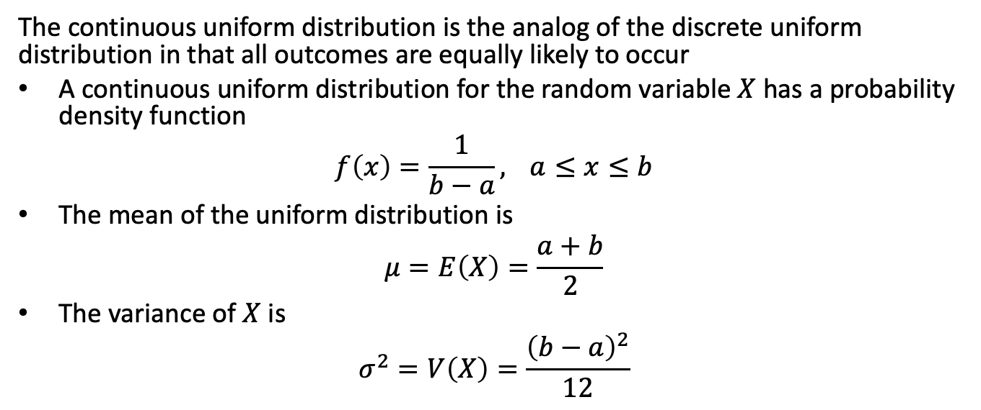
Continuous Uniform Distribution
The continuous uniform distribution is the analog of the discrete uniform distribution in that all outcomes are equally likely to occur
A continuous uniform distribution for the random variable $X$ has a probability density function
$$f\left(x\right)=\frac{1}{b−a}, a≤x≤b$$
The mean of the uniform distribution is
$$μ=E\left(X\right)=\frac{a+b}{2}$$
The variance of $X$ is
$$σ^{2}=V\left(X\right)=\frac{{\left(b−a\right)}^{2}}{12}$$

Slide 19
Uniform Problem 4.1.6
See page P-25

Slide 20
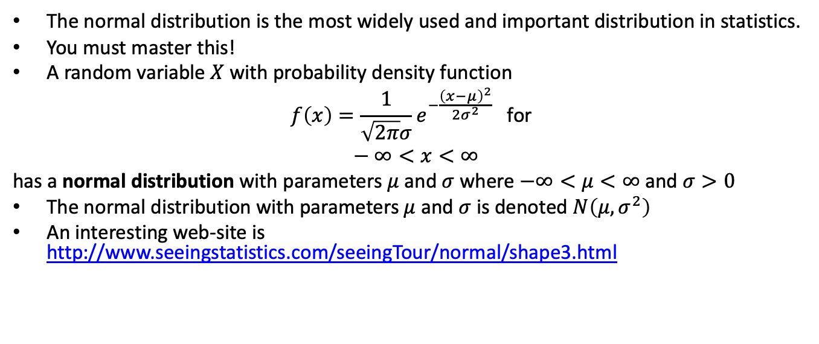
The Normal Distribution
The normal distribution is the most widely used and important distribution in statistics.
You must master this!
A random variable $X$ with probability density function
$$f\left(x\right)=\frac{1}{\sqrt{2π}σ}e^{−\frac{{\left(x−μ\right)}^{2}}{2σ^{2}}} \text{for} \\ −∞<x<∞$$
has a normal distribution with parameters $μ$ and $σ$ where $−∞<μ<∞$ and $σ>0$
The normal distribution with parameters $μ$ and $σ$ is denoted $N\left(μ,σ^{2}\right)$
An interesting web-site is http://www.seeingstatistics.com/seeingTour/normal/shape3.html

Slide 21
Mean and Variance of the Normal Distribution
The mean of the normal distribution with parameters $μ$ and $σ$ is
$$E\left(X\right)=μ$$
The variance of the normal distribution with parameters $μ$ and $σ$ is
$$V\left(X\right)=σ^{2}$$

Slide 22
Central Limit Theorem
Brief introduction
States that the distribution of the average of independent random variables will tend towards a normal distribution as $n$ gets large
More details later

Slide 23
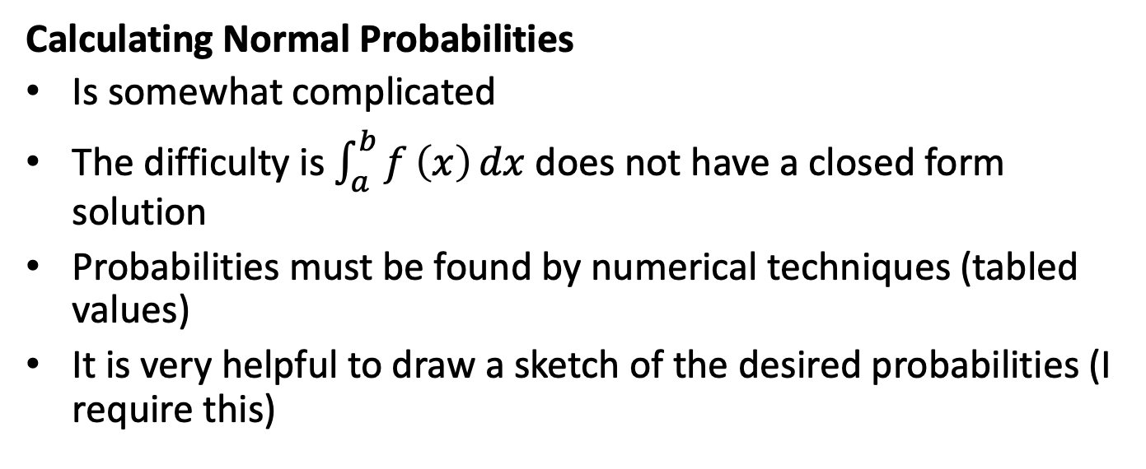
Calculating Normal Probabilities
Is somewhat complicated
The difficulty is $\int_{a}^{b}{f}\left(x\right) dx$ does not have a closed form solution
Probabilities must be found by numerical techniques (tabled values)
It is very helpful to draw a sketch of the desired probabilities (I require this)

Slide 24
The Standard Normal Distribution
A normal random variable with $μ=0$ and $σ=1$ is called a standard normal random variable
A standard normal random variable is denoted as $z$
The cumulative distribution function for a standard normal is defined to be the function
$$Φ\left(z\right)=P\left(Z≤z\right)$$
These probabilities are contained in Appendix Table III on pages A-8 and A-9

Slide 25
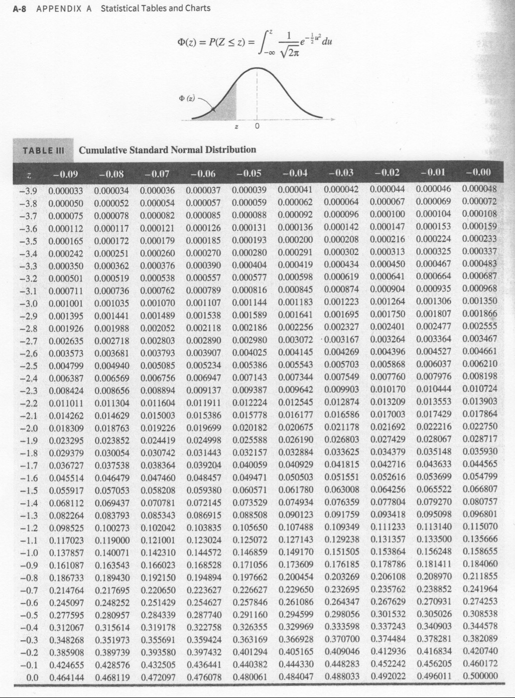
Cumulative Standard Normal Distribution
page A-8

Slide 26
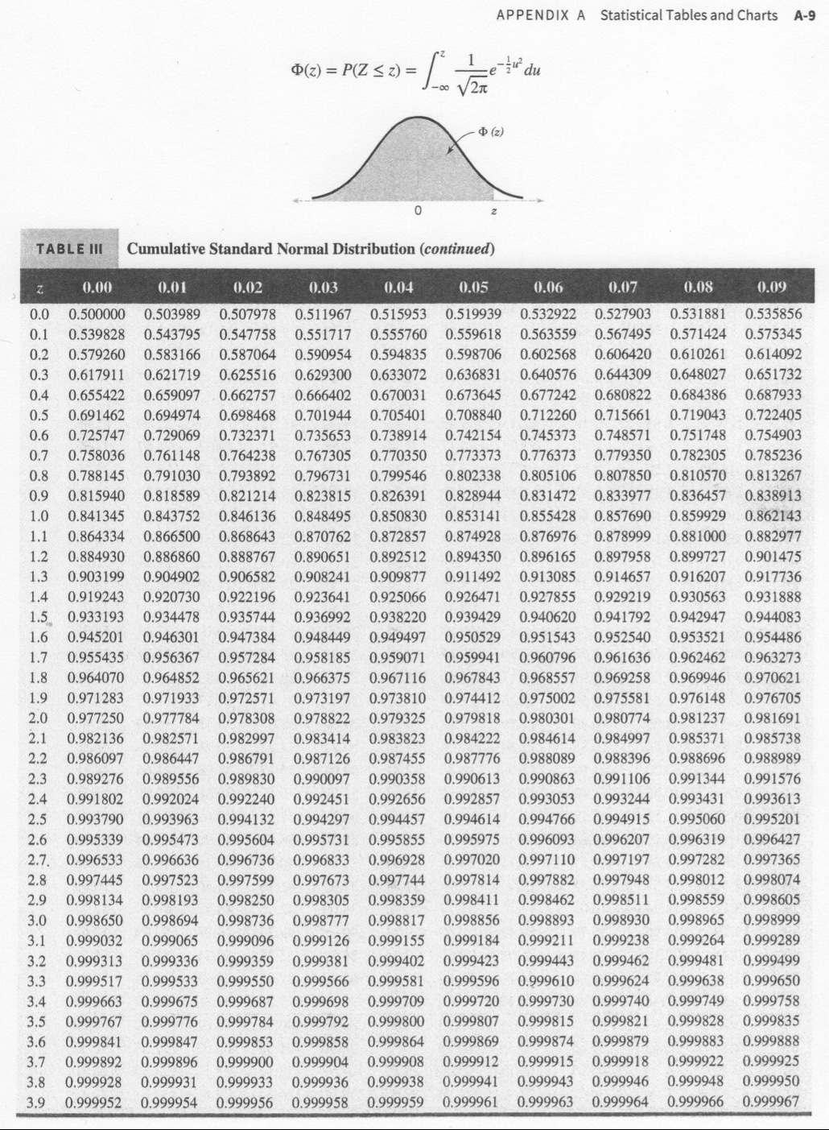
Cumulative Standard Normal Distribution
page A-9

Slide 27
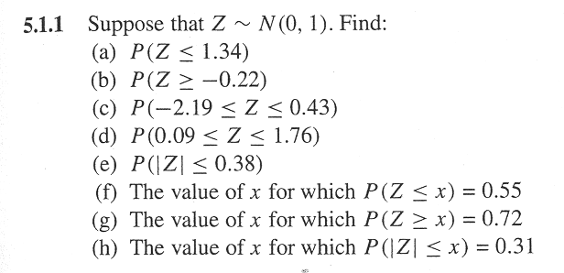
Standard Normal Problem
image

Slide 28
Standard Normal Practice Problems

Slide 29
Standardizing (the $z$-transform)
Suppose $X$ is a normal random variable with mean $μ$ and variance $σ^{2}$
$$P\left(X≤x\right)=P\left(\frac{X−μ}{σ}≤\frac{x−μ}{σ}\right)=P\left(Z≤z\right)$$
The $z$-value is $z=\left(x−μ\right)/σ$
Result allows the standard normal tables to be used to calculate probabilities for any normal distribution

Slide 30
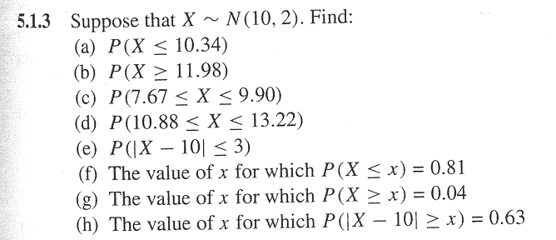
Normal Probability Problem
image

Slide 31
Normal Practice Problems

Slide 32
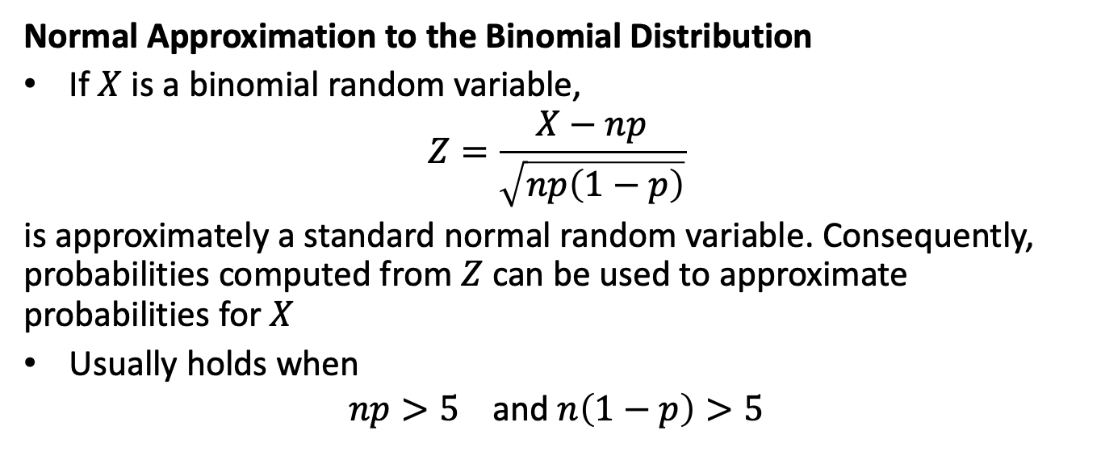
Normal Approximation to the Binomial Distribution
If $X$ is a binomial random variable,
$$Z=\frac{X−np}{\sqrt{np\left(1−p\right)}}$$
is approximately a standard normal random variable. Consequently, probabilities computed from $Z$ can be used to approximate probabilities for $X$
Usually holds when
$$np>5 \text{and} n\left(1−p\right)>5$$

Slide 33
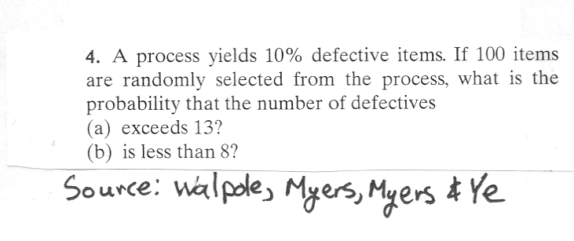
How good are the approximations?
Problem
image

Slide 34
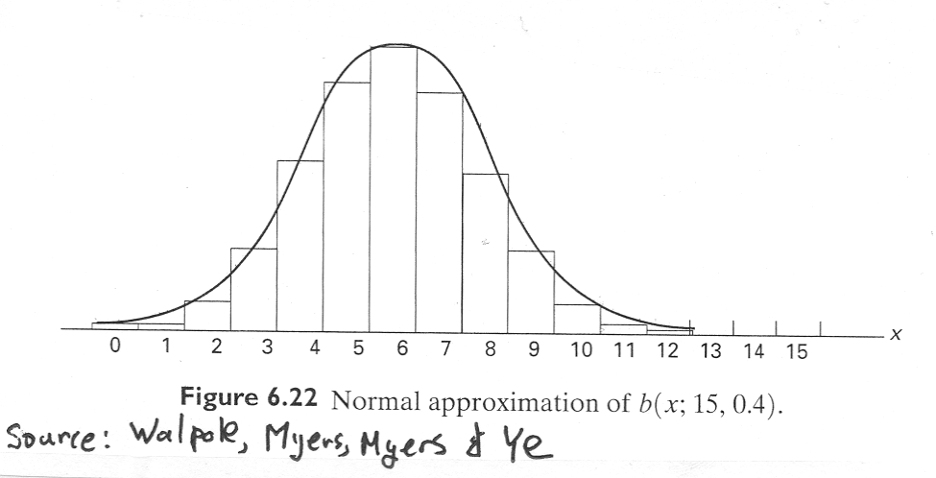
Normal Approximation - Figure
image

Slide 35
Rework Problem using Continuity Correction Factor
Are the approximations improved?

Slide 36
Normal Approximation to the Poisson Distribution
If $X$ is a Poisson random variable with $E\left(X\right)=λ$ and $V\left(X\right)=λ$,
$$Z=\frac{X−λ}{\sqrt{λ}}$$
is approximately a standard normal random variable.

Slide 37
Exponential Distribution
The exponential distribution is widely used in the area of reliability and life-test data.
Ostle, et. al. (1996) list the following applications of the exponential distribution
the number of feet between two consecutive erroneous records on a computer tape,
the lifetime of a component of a particular device,
the length of a life of a radioactive material and
the time to the next customer service call at a service desk

Slide 38
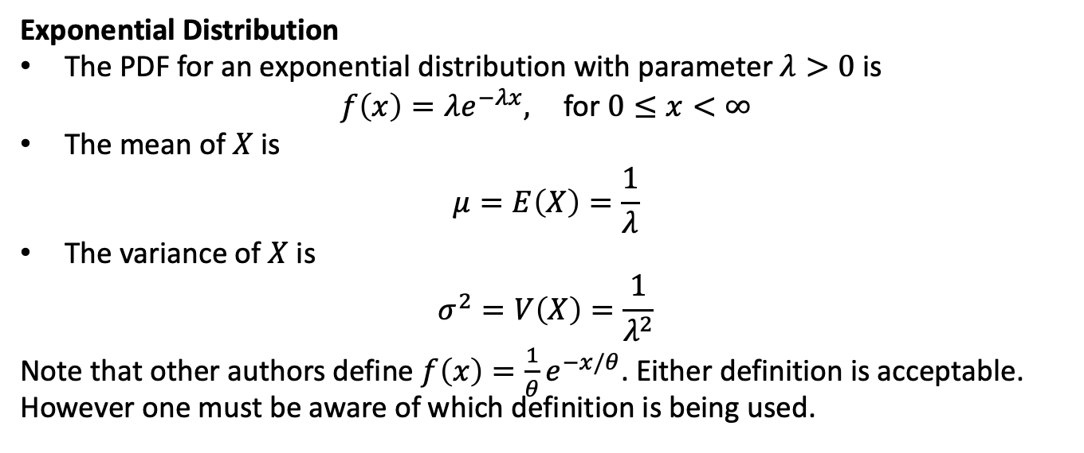
Exponential Distribution
The PDF for an exponential distribution with parameter $λ>0$ is
$$f\left(x\right)=λe^{−λx}, \text{for} 0≤x<∞$$
The mean of $X$ is
$$μ=E\left(X\right)=\frac{1}{λ}$$
The variance of $X$ is
$$σ^{2}=V\left(X\right)=\frac{1}{λ^{2}}$$
Note that other authors define $f\left(x\right)=\frac{1}{θ}e^{−x/θ}$. Either definition is acceptable. However one must be aware of which definition is being used.

Slide 39
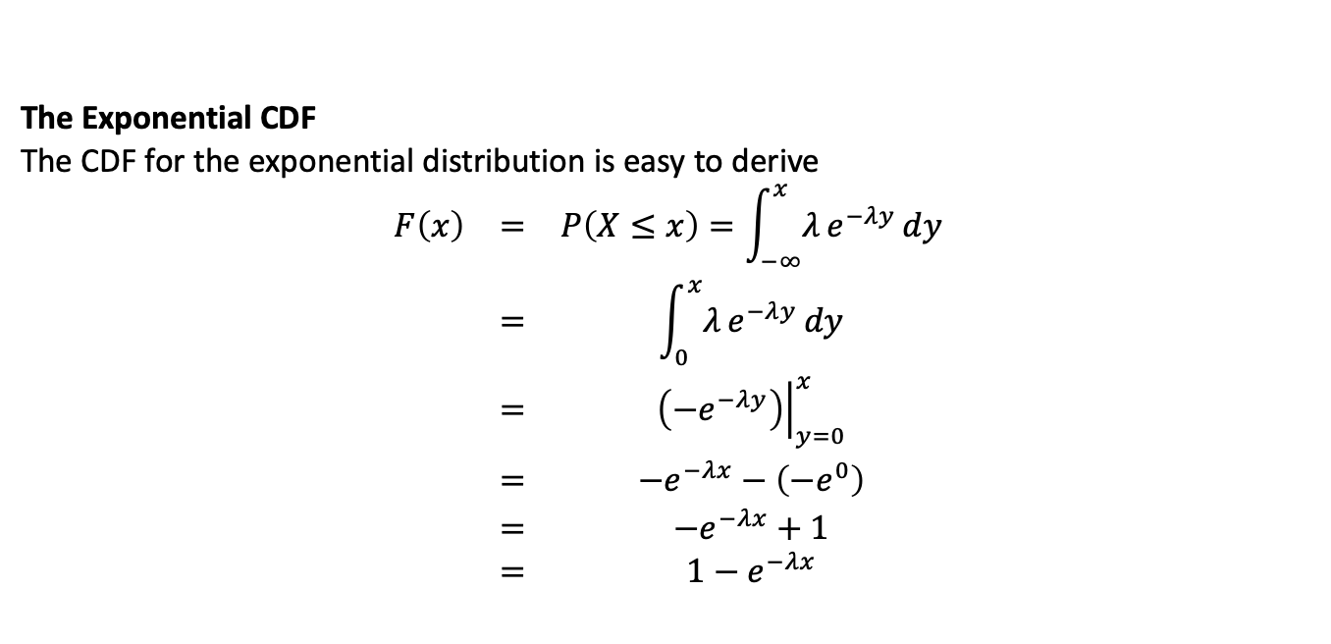
The Exponential CDF
The CDF for the exponential distribution is easy to derive
$$\begin{matrix}F\left(x\right) & = & P\left(X≤x\right)=\int_{−∞}^{x}{λ}e^{−λy} dy \\ & = & \int_{0}^{x}{λ}e^{−λy} dy \\ & = & {\left.\left(−e^{−λy}\right)\right|}_{y=0}^{x} \\ & = & −e^{−λx}−\left(−e^{0}\right) \\ & = & −e^{−λx}+1 \\ & = & 1−e^{−λx}\end{matrix}$$

Slide 40
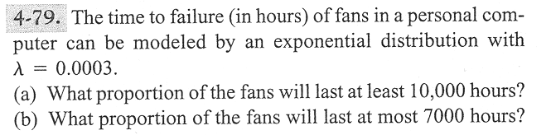
Problem 4-79
image

Slide 41
Lack of Memory Property
The mathematical definition is
$$P\left(X<t_{1}+t_{2}|X>t_{1}\right)=P\left(X<t_{2}\right)$$
That is “the probability of a failure time that is less than $t_{1}+t_{2}$ given the failure time is greater than $t_{1}$ is the probability that the item’s failure time is less than $t_{2}$
This property is unique to the exponential distribution
Often used to model the reliability of electronic components.

Slide 42
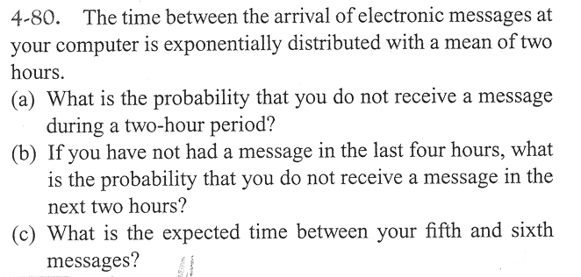
Problem 4–80
image

Slide 43
Relationship to the Poisson Distribution
Let $Y$ be a Poisson random variable with parameter $λ$. Note: $Y$ represents the number of occurrences per unit
Let $X$ be a random variable that records the time between occurrences for the same process as $Y$
$X$ has an exponential distribution with parameter $λ$

Slide 44
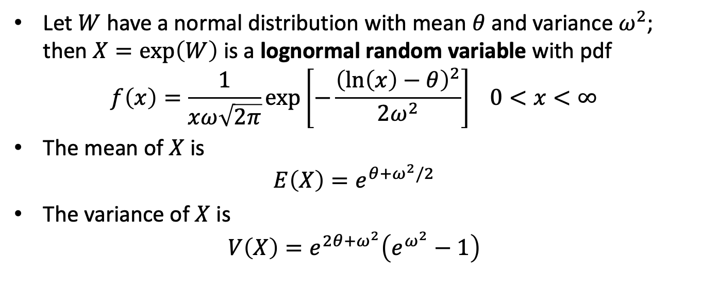
Lognormal Distribution
Let $W$ have a normal distribution with mean $θ$ and variance $ω^{2}$; then $X=exp\left(W\right)$ is a lognormal random variable with pdf
$$f\left(x\right)=\frac{1}{xω\sqrt{2π}}exp\left[−\frac{{\left(ln\left(x\right)−θ\right)}^{2}}{2ω^{2}}\right] 0<x<∞$$
The mean of $X$ is
$$E\left(X\right)=e^{θ+ω^{2}/2}$$
The variance of $X$ is
$$V\left(X\right)=e^{2θ+ω^{2}}\left(e^{ω^{2}}−1\right)$$

Slide 45
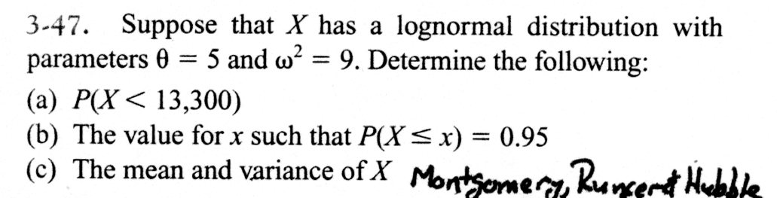
Example Problem
image

Slide 46
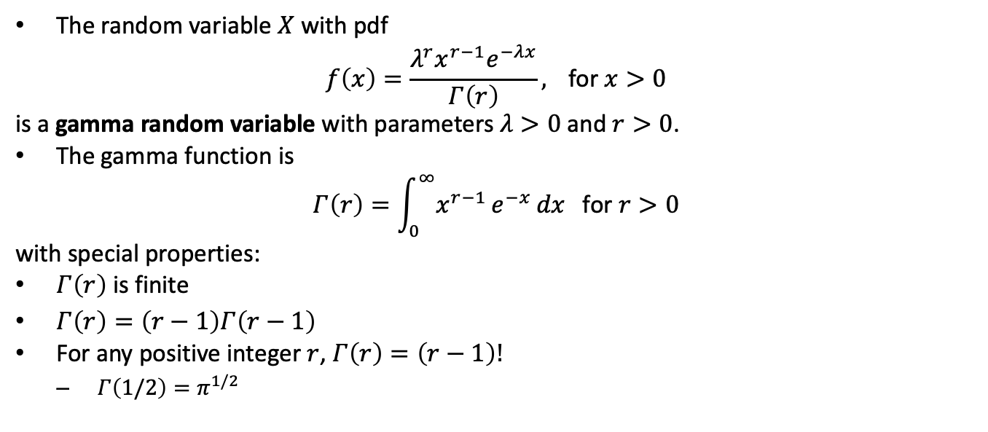
Gamma Distribution
The random variable $X$ with pdf
$$f\left(x\right)=\frac{λ^{r}x^{r−1}e^{−λx}}{Γ\left(r\right)}, \text{for} x>0$$
is a gamma random variable with parameters $λ>0$ and $r>0$.
The gamma function is
$$Γ\left(r\right)=\int_{0}^{∞}{x^{r−1}}e^{−x} dx \text{for} r>0$$
with special properties:
$Γ\left(r\right)$ is finite
$Γ\left(r\right)=\left(r−1\right)Γ\left(r−1\right)$
For any positive integer $r$, $Γ\left(r\right)=\left(r−1\right)!$
$Γ\left(1/2\right)=π^{1/2}$

Slide 47
Gamma Distribution
The mean and variance are
$$μ=E\left(X\right)=r/λ \text{and} σ^{2}=V\left(X\right)=r/λ^{2}$$
We will not work any probability problems using the gamma distribution

Slide 48
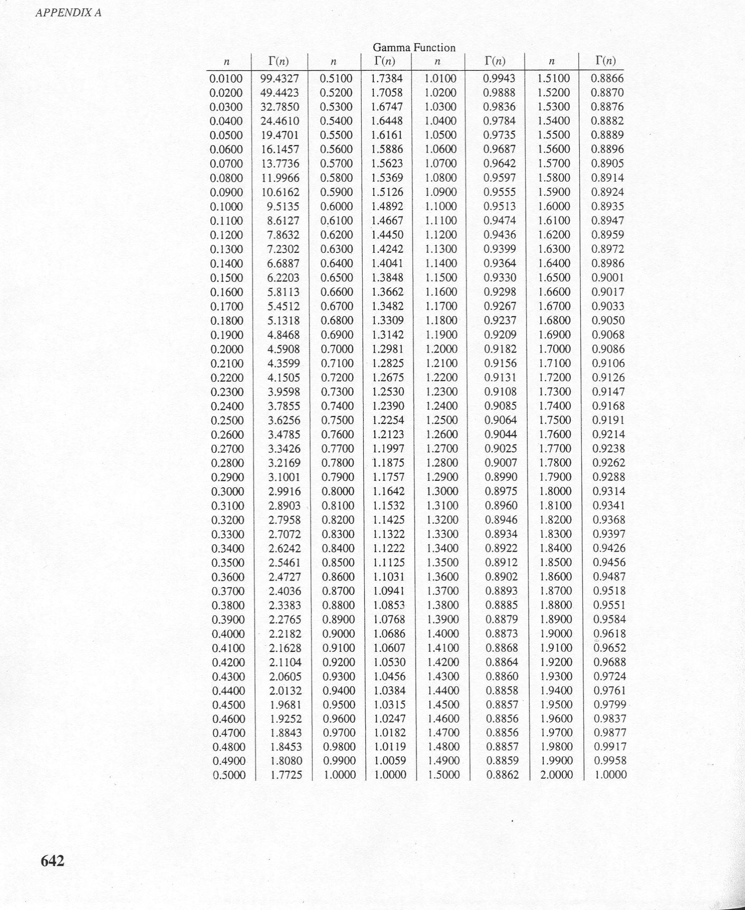
Gamma Tables
image

Slide 49
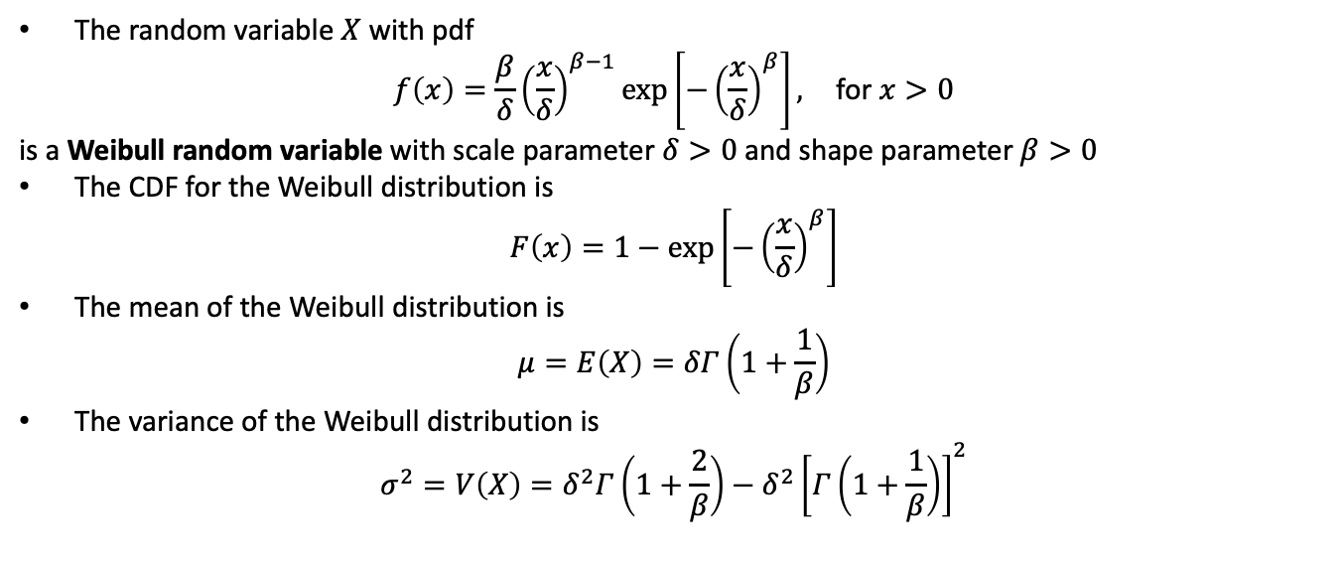
Weibull Distribution
The random variable $X$ with pdf
$$f\left(x\right)=\frac{β}{δ}{\left(\frac{x}{δ}\right)}^{β−1}exp\left[−{\left(\frac{x}{δ}\right)}^{β}\right], \text{for} x>0$$
is a Weibull random variable with scale parameter $δ>0$ and shape parameter $β>0$
The CDF for the Weibull distribution is
$$F\left(x\right)=1−exp\left[−{\left(\frac{x}{δ}\right)}^{β}\right]$$
The mean of the Weibull distribution is
$$μ=E\left(X\right)=δΓ\left(1+\frac{1}{β}\right)$$
The variance of the Weibull distribution is
$$σ^{2}=V\left(X\right)=δ^{2}Γ\left(1+\frac{2}{β}\right)−δ^{2}{\left[Γ\left(1+\frac{1}{β}\right)\right]}^{2}$$

Slide 50
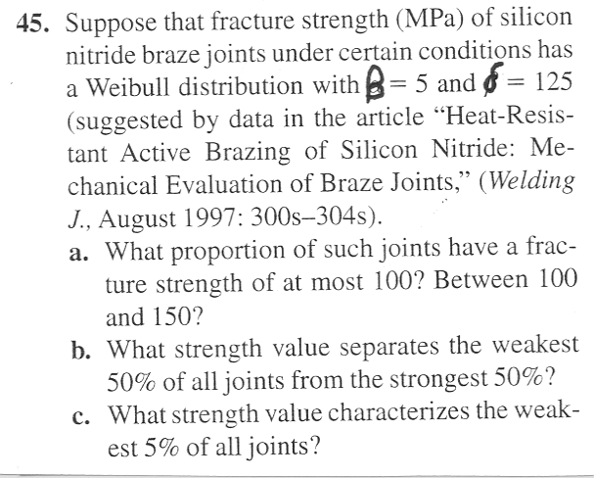
Weibull Problem
image

Slide 51
Weibull Practice Problems

