Slide 1
MANE 3332.05

Slide 2
Lecture 17
Agenda
Midterm exams are not graded; still contacting students who missed
Linear Combination Practice Problems (assigned 10/28, due 10/30)
Chapter Six
Attendance
Questions?

Slide 3
Handouts
Chapter 6 Slides
Chapter 6 Slides marked

Slide 4
Numerical Summaries
Called Descriptive Statistics in Chapter 6
Descriptive statistics help us understand the location or central tendency of data and the scatter or variability in data
Included in all statistical software packages, R does a good job calculating descriptive statistics

Slide 5
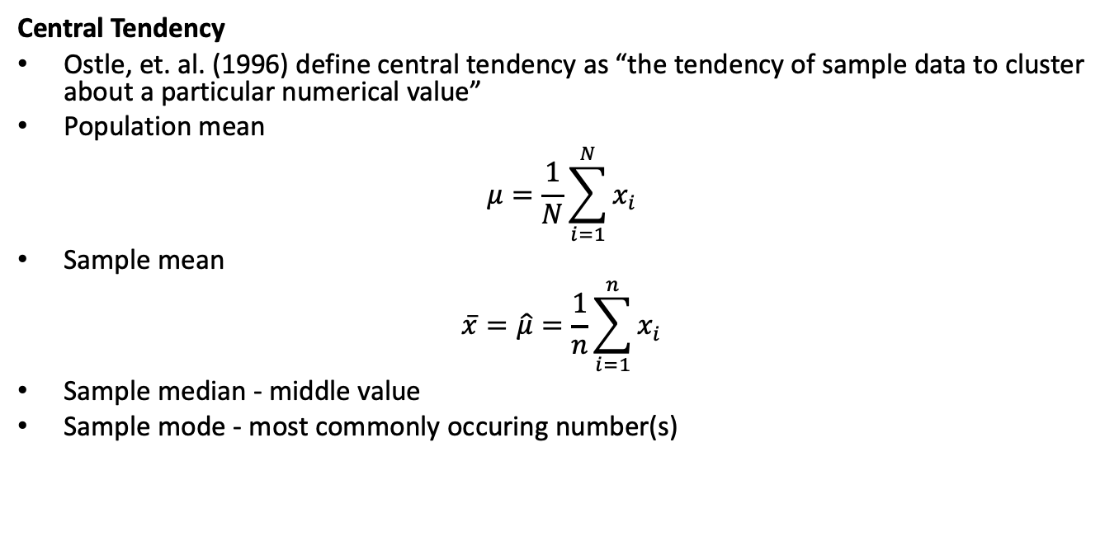
Central Tendency
Ostle, et. al. (1996) define central tendency as “the tendency of sample data to cluster about a particular numerical value”
Population mean
$$μ=\frac{1}{N}\sum_{i=1}^{N}{x_{i}}$$
Sample mean
$$\overset{‾}{x}=\hat{μ}=\frac{1}{n}\sum_{i=1}^{n}{x_{i}}$$
Sample median - middle value
Sample mode - most commonly occuring number(s)

Slide 6
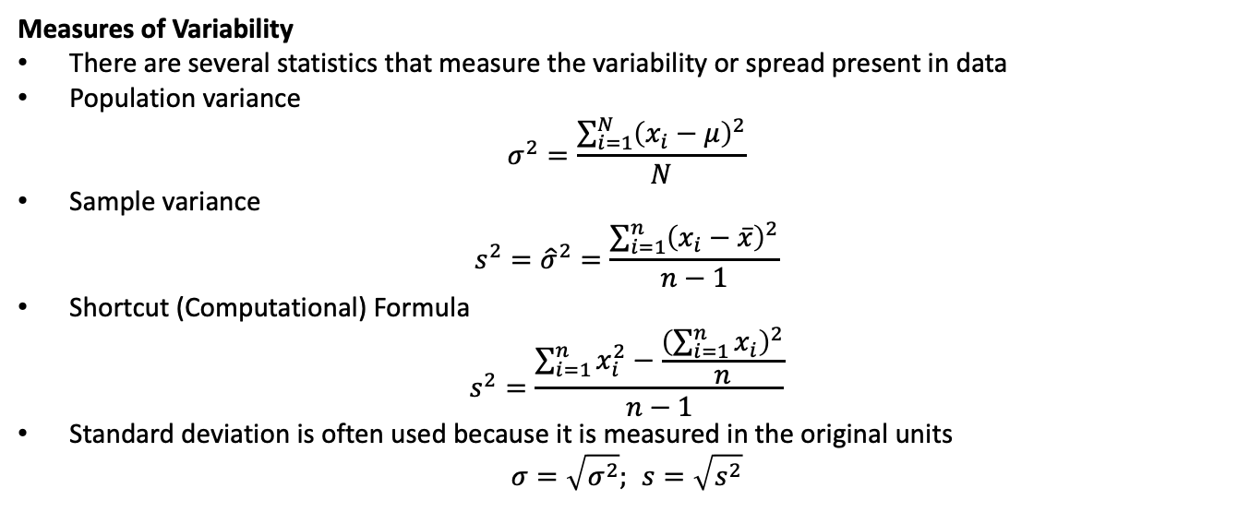
Measures of Variability
There are several statistics that measure the variability or spread present in data
Population variance
$$σ^{2}=\frac{\sum_{i=1}^{N}{{\left(x_{i}−μ\right)}^{2}}}{N}$$
Sample variance
$$s^{2}={\hat{σ}}^{2}=\frac{\sum_{i=1}^{n}{{\left(x_{i}−\overset{‾}{x}\right)}^{2}}}{n−1}$$
Shortcut (Computational) Formula
$$s^{2}=\frac{\sum_{i=1}^{n}{x_{i}^{2}}−\frac{{\left(\sum_{i=1}^{n}{x_{i}}\right)}^{2}}{n}}{n−1}$$
Standard deviation is often used because it is measured in the original units
$$σ=\sqrt{σ^{2}}; s=\sqrt{s^{2}}$$

Slide 7
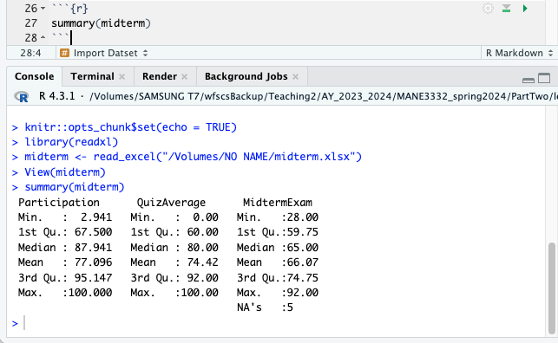
R Function Summary - Data Frame
R code
summary(midterm)
Output is from Spring 2024 results
Descriptive Statistics

Slide 8
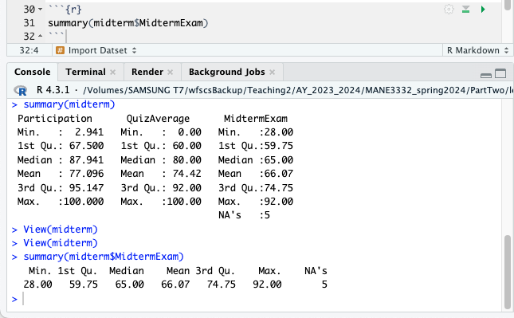
R Function Summary - Variable
R code
summary(midterm$MidtermExam)
Output is from Spring 2024 results
Descriptive Statistics

Slide 9
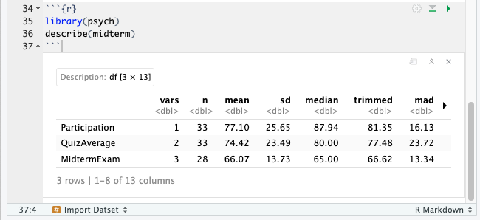
R Function Describe
Summary() does not report variability
Describe() has to be imported
Describe() is part of the package psych
R Code for descriptive statistics using psych package
library(psych) describe(midterm)
Psych package output from Spring 2024
Describe() Output

Slide 10
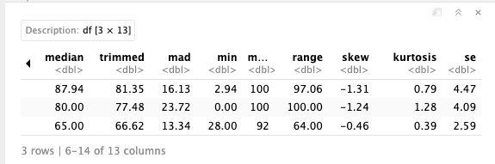
Describe Output, part 2
Describe Output

Slide 11
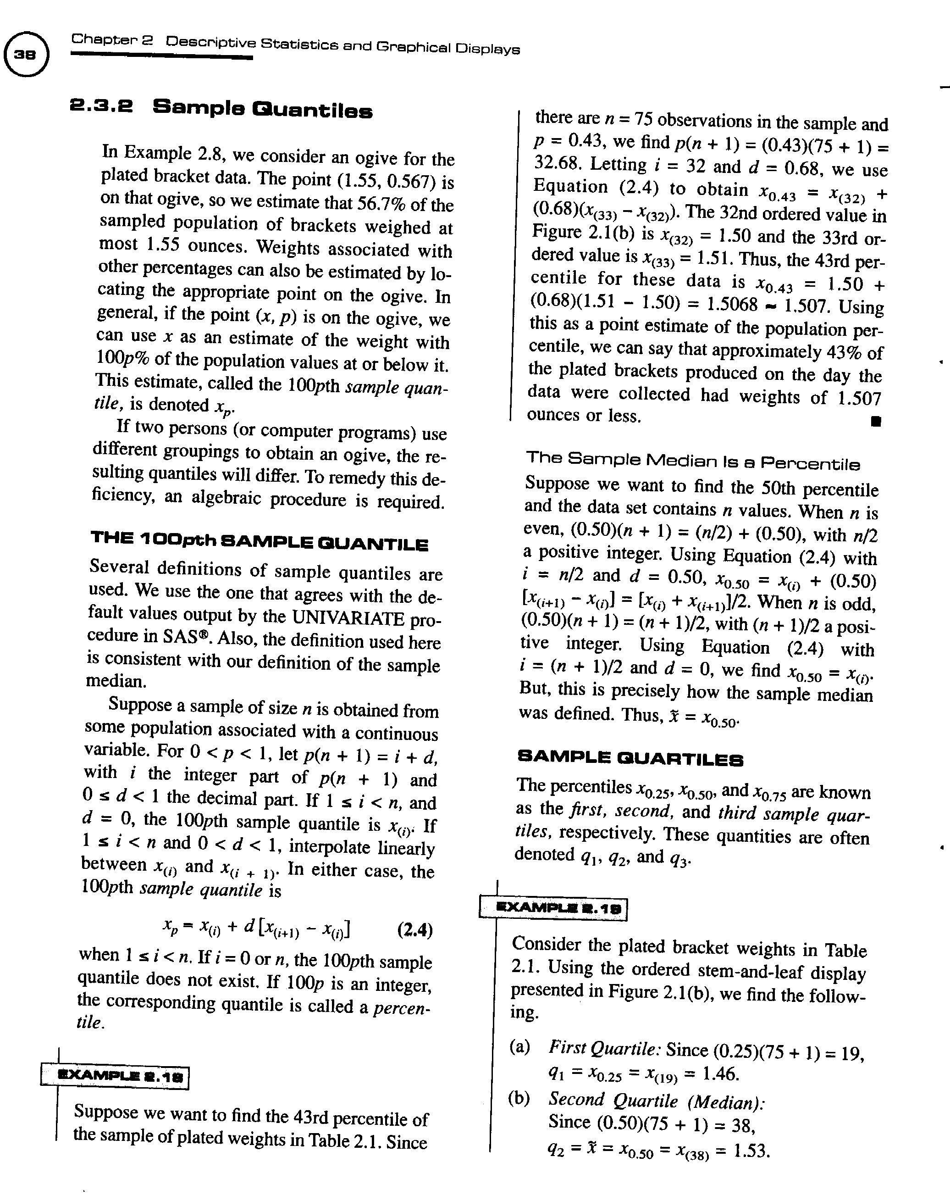
Calculating Quantiles
reference for calculating quantiles

Slide 12
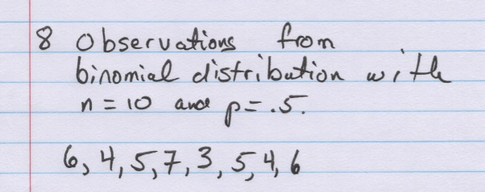
Quantile Example
Quantile Example

Slide 13
Exploratory Data (Graphical) Analysis
Exploratory data analysis (EDA) is the use of graphical procedures to analyze data.
John Tukey was a pioneer in this field and invented several of the procedures
Tools include stem-and-leaf diagrams, box plots, time series plots and digidot plots

Slide 14
Stem and Leaf Diagram
Excellent tool that maintains data integrity
The stem is the leading digit or digits
The leaf is the remaining digit
Make sure to include units
R Code
stem(midterm$MidtermExam)

Slide 15
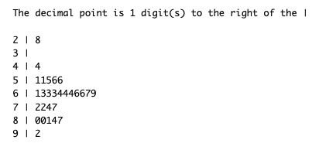
Stem and Leaf Example
R output of a Stem and Leaf diagram
Stem and Leaf Plot of Midterm Exam Scores

Slide 16
Histogram
A histogram is a barchart displaying the frequency distribution information
There are three types of histograms: frequency, relative frequency and cumulative relative frequency
R code
hist(midterm$MidtermExam)

Slide 17
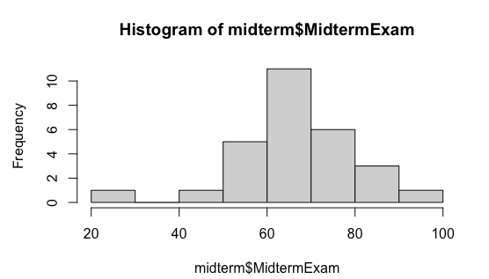
Histogram Example
R output of histogram
Histogram of Midterm Exam Scores

Slide 18
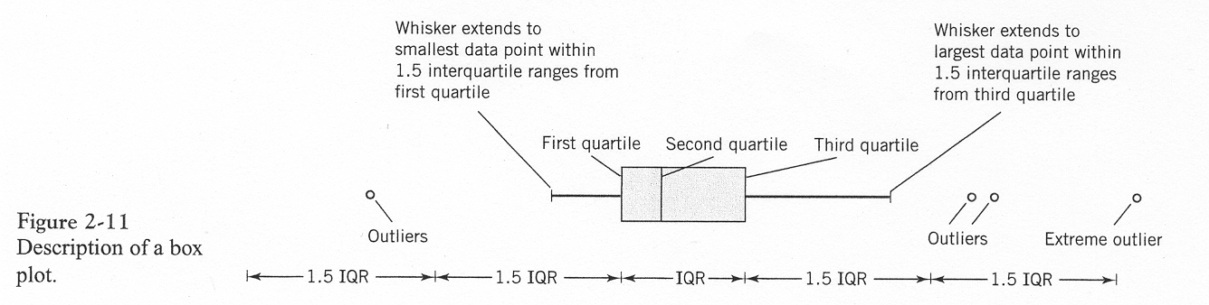
Boxplot
Graphical display that simultaneously describes several important features of a data set such as center, spread, departure from symmetry and outliers
Requires the calculation of quantiles (quartiles)
Box Plot 1
Box plot with explanation

Slide 19
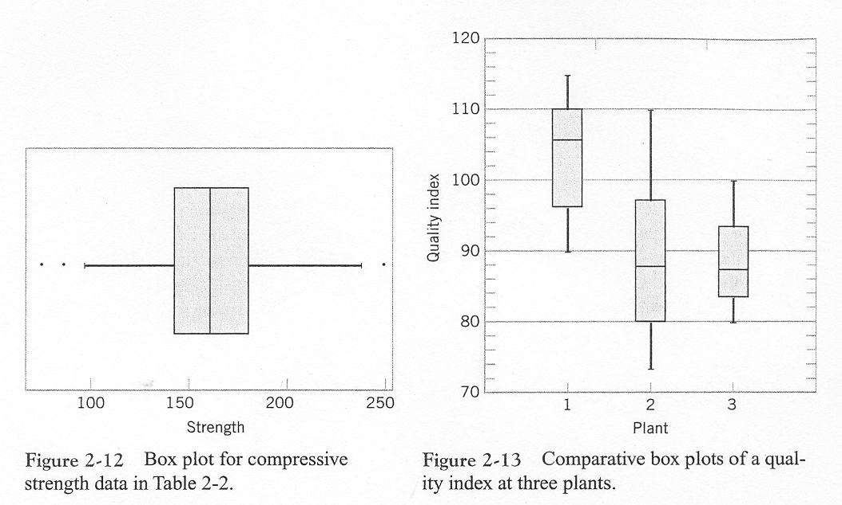
Box Plot 2
examples of boxplots

Slide 20
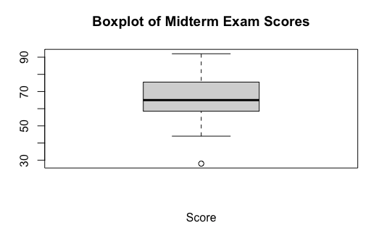
Box Plot 3
R code for Box Plot
boxplot(midterm$MidtermExam,xlab='Score',main='Boxplot of Midterm Exam Scores')
R Box Plot output
Boxplot of Midterm Exam Scores

Slide 21
Time Series Plot
A time series plot is a graph in which the vertical axis denotes the observed value of the variable (say $x$) and the horizontal axis denotes time
Excellent tool for detecting:
trends,
cycles,
other non-random patterns

Slide 22
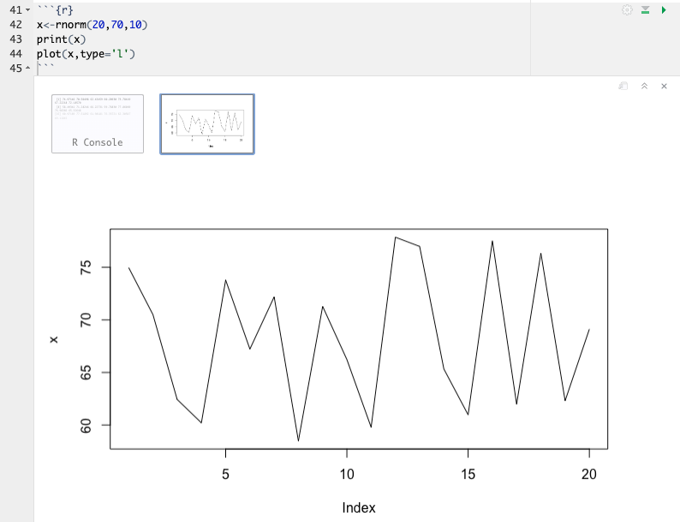
Time Series Plot in R
Time Series Plot

Slide 23
Probability Plotting
Probability plotting is a graphical method of determining whether sample data conform to a hypothesized distribution
Used for validating assumptions
Alternative to hypothesis testing

Slide 24
Construction
Sort the data from smallest to largest, .
$x_{\left(1\right)},x_{\left(2\right)},…,x_{\left(n\right)}$
Calculate the observed cumulative frequency $\left(j−0.5\right)/n$
For the normal distribution find $z_{j}$ that satisfies
$$\frac{j−0.5}{n}=P\left(Z≤z_{j}\right)=Φ\left(z_{j}\right)$$
Plot $z_{j}$ versus $x_{\left(j\right)}$ on special graph paper

Slide 25
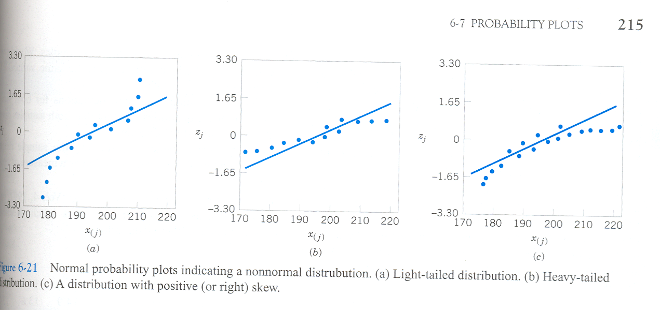
Usage
If the data plots as a straight line, the assumed distribution is correct
normal probability plots from textbook, figure 6.21 on page 215

Slide 26
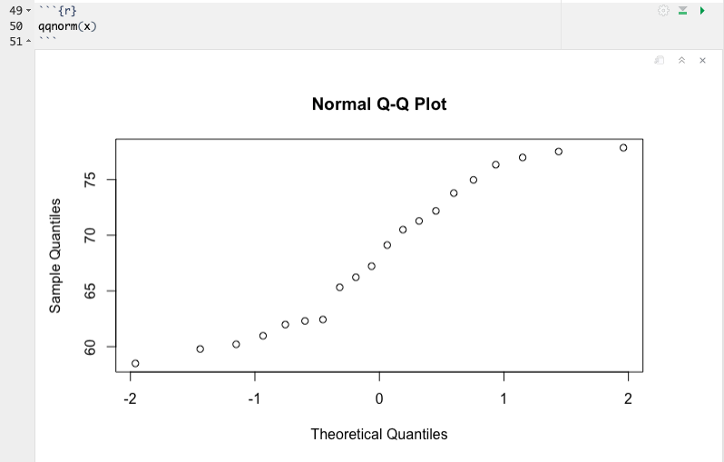
Probability Plot Example 1 in R
Normal Probability Plot

Slide 27
Probability Plot Example 2
Difficulty from example one is how close to straight is “good enough”
Add confidence bands to normal probability plot
Requires package car to be added to R
If all points are within the band, we are 95% confident that the sample is from a normal distribution. However if one or more points are not within band, the data is not from a normal distribution

Slide 28
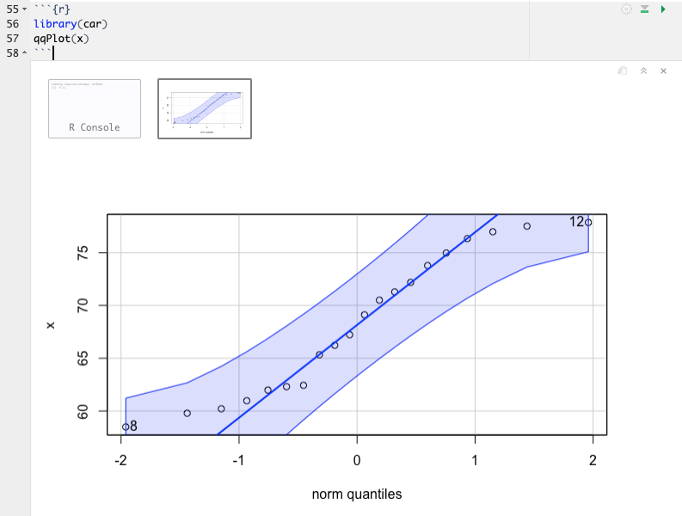
QQ Plot with band

Slide 29
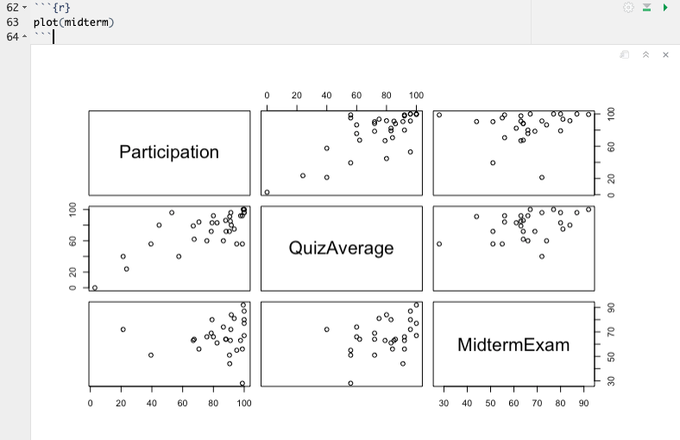
Multivariate Data
Matrix of Scatter Plot in R
Scatter Plots

Slide 30
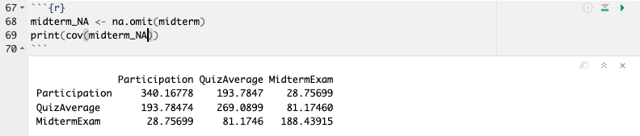
Covariance in R
Covariance Matrix

Slide 31
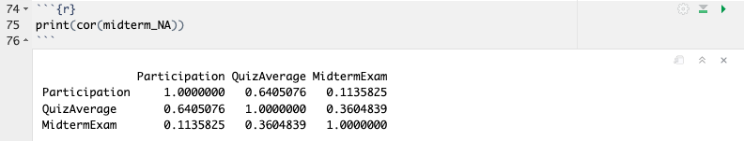
Correlation
Correlation Matrix

