Slide 1
MANE 3332.05

Slide 2
Lecture 18

Slide 3
Agenda
Midterm exams are not graded; still contacting students who missed
Linear Combination Practice Problems (assigned 10/28, due 10/30)
Linea Combination Quiz (assigned 10/30, due 11/4)
Complete Chapter Six and Start Chapter 7
Attendance
Questions?

Slide 4
Handouts
Lecture 18 Slides
Lecture 18 Slides - marked

Slide 5
Chapter 6, continued

Slide 6
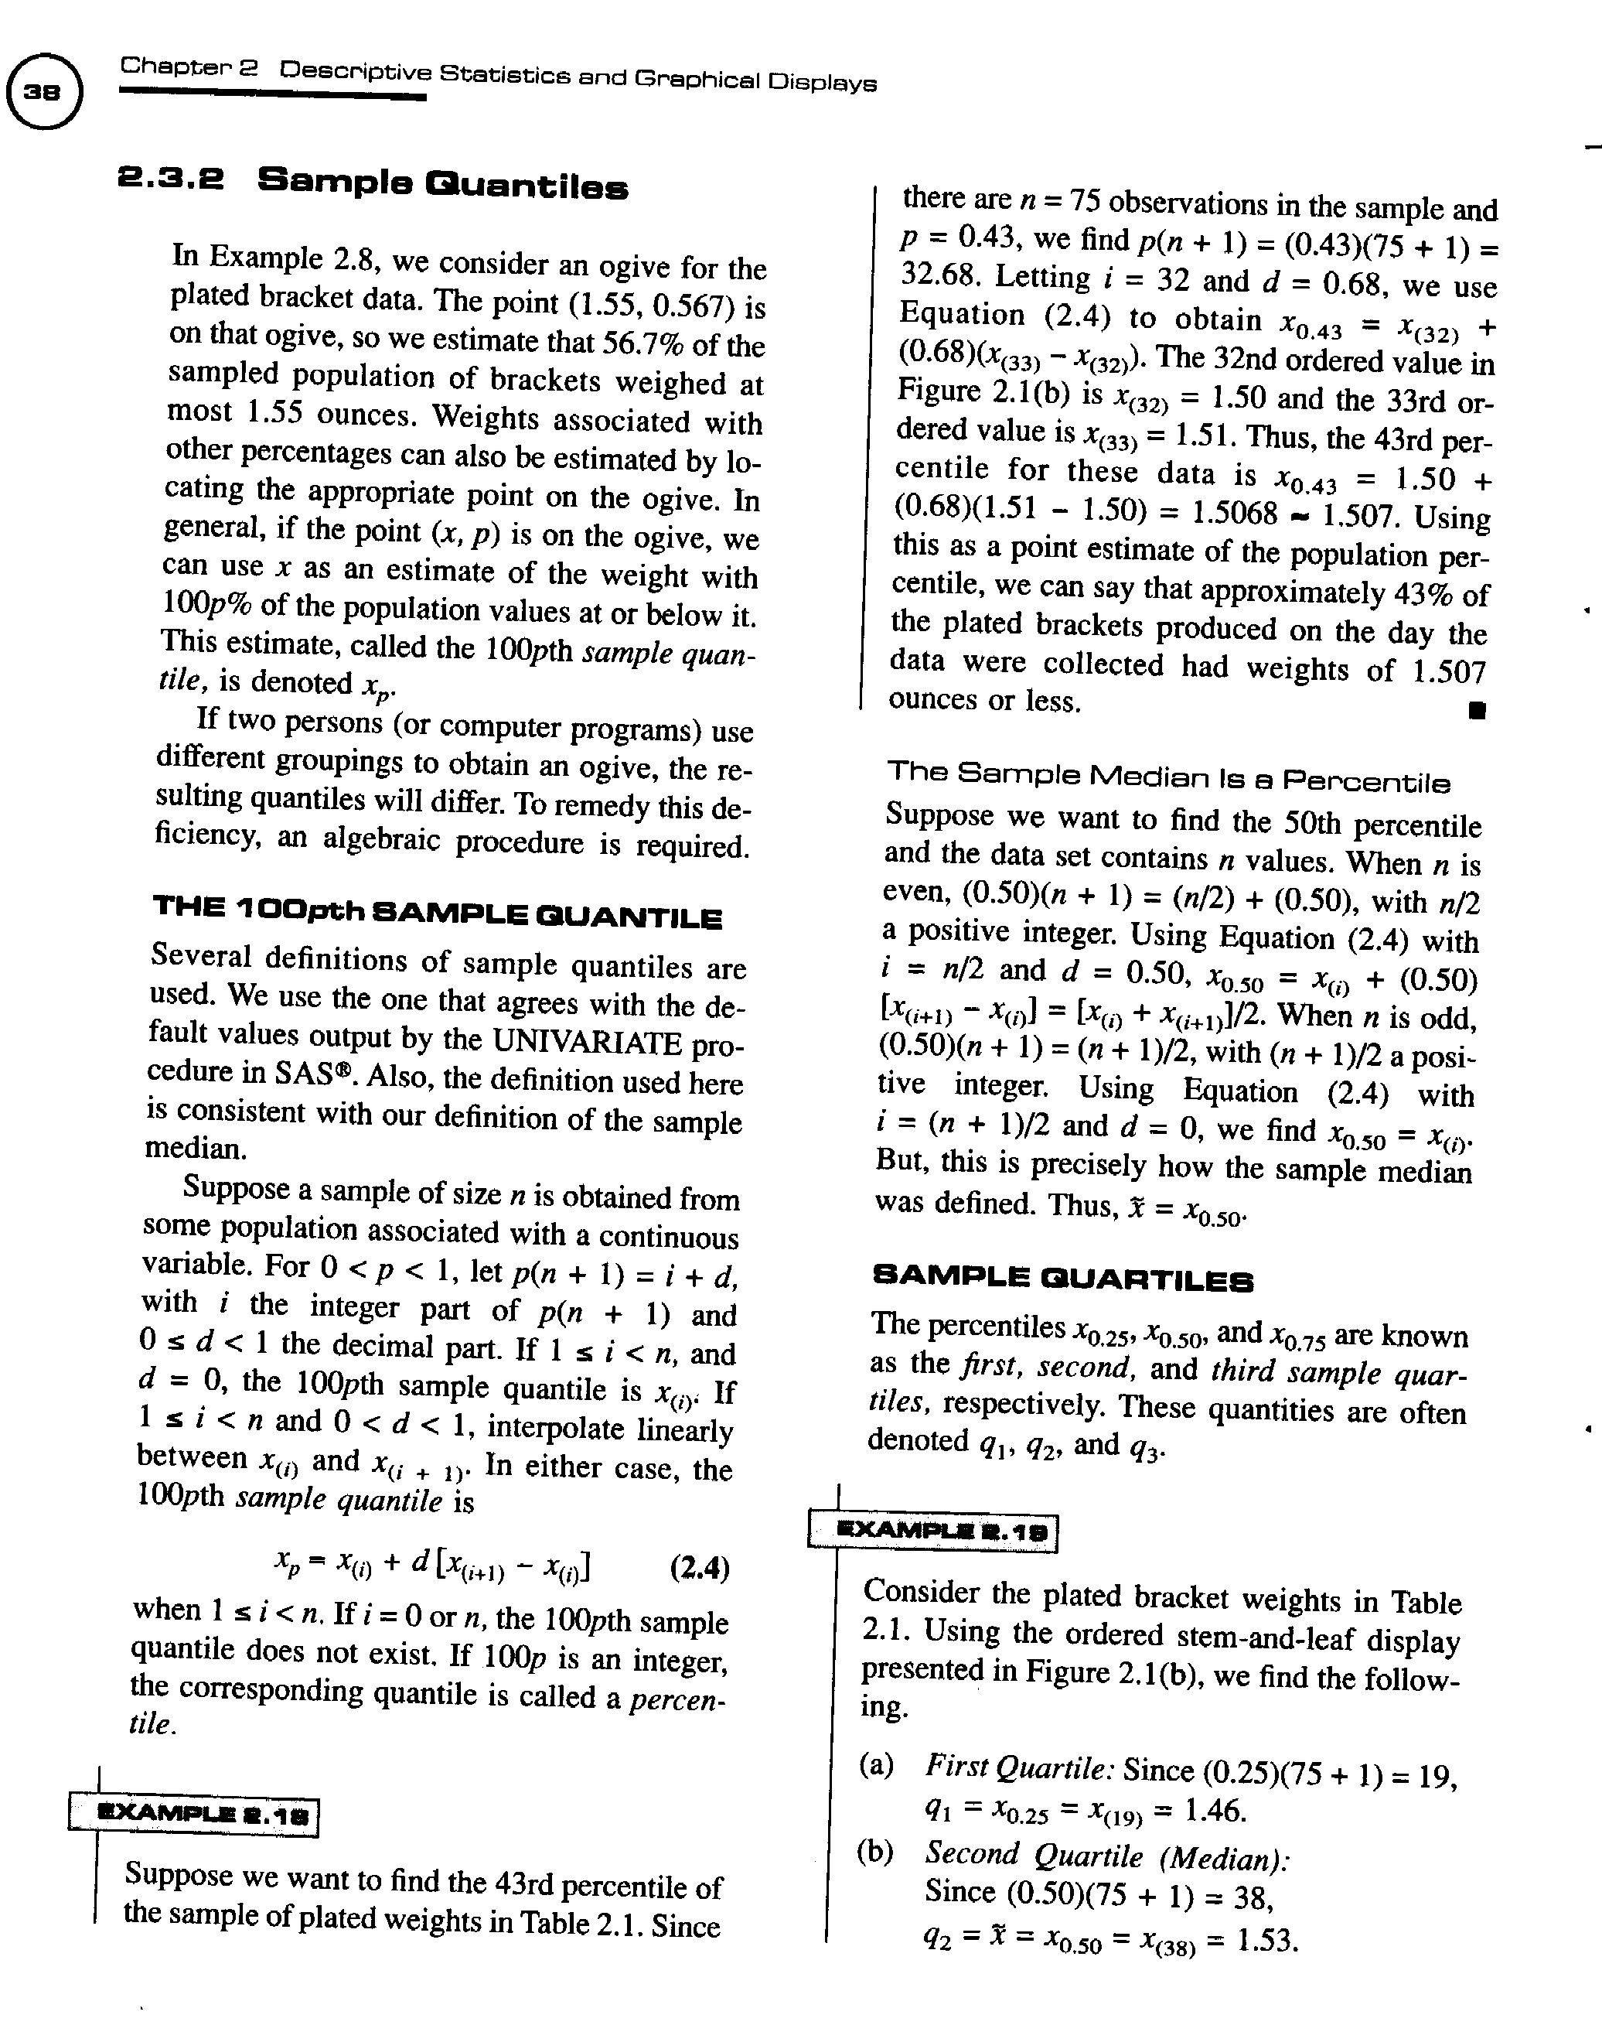
Calculating Quantiles
reference for calculating quantiles

Slide 7
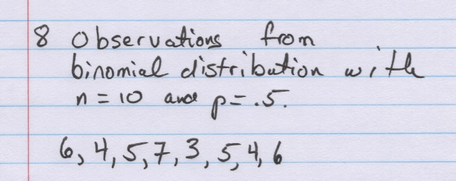
Quantile Example
Quantile Example

Slide 8
Exploratory Data (Graphical) Analysis
Exploratory data analysis (EDA) is the use of graphical procedures to analyze data.
John Tukey was a pioneer in this field and invented several of the procedures
Tools include stem-and-leaf diagrams, box plots, time series plots and digidot plots

Slide 9
Stem and Leaf Diagram
Excellent tool that maintains data integrity
The stem is the leading digit or digits
The leaf is the remaining digit
Make sure to include units
R Code
stem(midterm$MidtermExam)

Slide 10
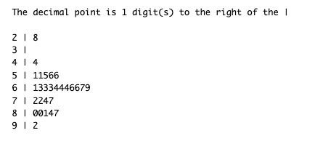
Stem and Leaf Example
R output of a Stem and Leaf diagram
Stem and Leaf Plot of Midterm Exam Scores

Slide 11
Histogram
A histogram is a barchart displaying the frequency distribution information
There are three types of histograms: frequency, relative frequency and cumulative relative frequency
R code
hist(midterm$MidtermExam)

Slide 12
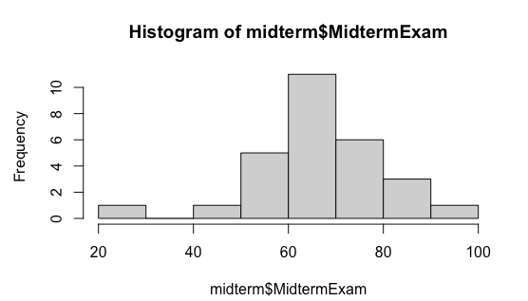
Histogram Example
R output of histogram
Histogram of Midterm Exam Scores

Slide 13
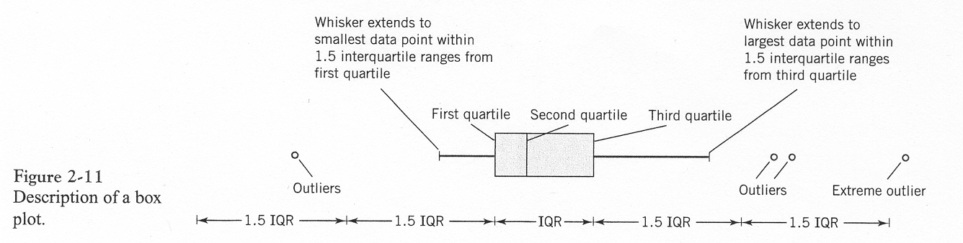
Boxplot
Graphical display that simultaneously describes several important features of a data set such as center, spread, departure from symmetry and outliers
Requires the calculation of quantiles (quartiles)
Box Plot 1
Box plot with explanation

Slide 14
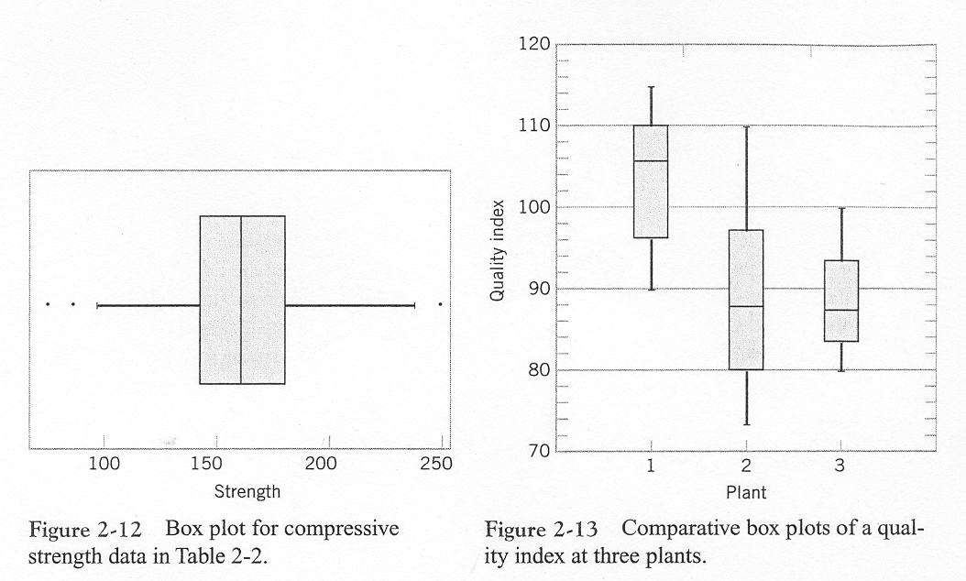
Box Plot 2
examples of boxplots

Slide 15
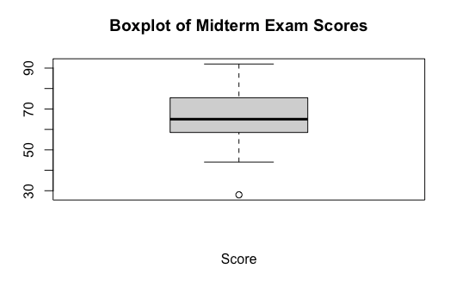
Box Plot 3
R code for Box Plot
boxplot(midterm$MidtermExam,xlab='Score',main='Boxplot of Midterm Exam Scores')
R Box Plot output
Boxplot of Midterm Exam Scores

Slide 16
Time Series Plot
A time series plot is a graph in which the vertical axis denotes the observed value of the variable (say $x$) and the horizontal axis denotes time
Excellent tool for detecting:
trends,
cycles,
other non-random patterns

Slide 17
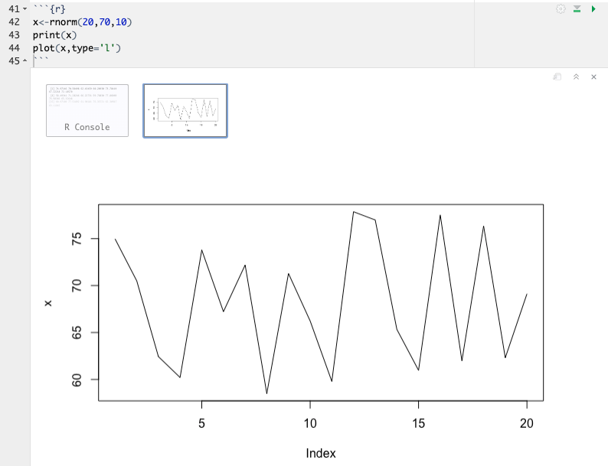
Time Series Plot in R
Time Series Plot

Slide 18
Probability Plotting
Probability plotting is a graphical method of determining whether sample data conform to a hypothesized distribution
Used for validating assumptions
Alternative to hypothesis testing

Slide 19
Construction
Sort the data from smallest to largest, .
$x_{\left(1\right)},x_{\left(2\right)},…,x_{\left(n\right)}$
Calculate the observed cumulative frequency $\left(j−0.5\right)/n$
For the normal distribution find $z_{j}$ that satisfies
$$\frac{j−0.5}{n}=P\left(Z≤z_{j}\right)=Φ\left(z_{j}\right)$$
Plot $z_{j}$ versus $x_{\left(j\right)}$ on special graph paper

Slide 20
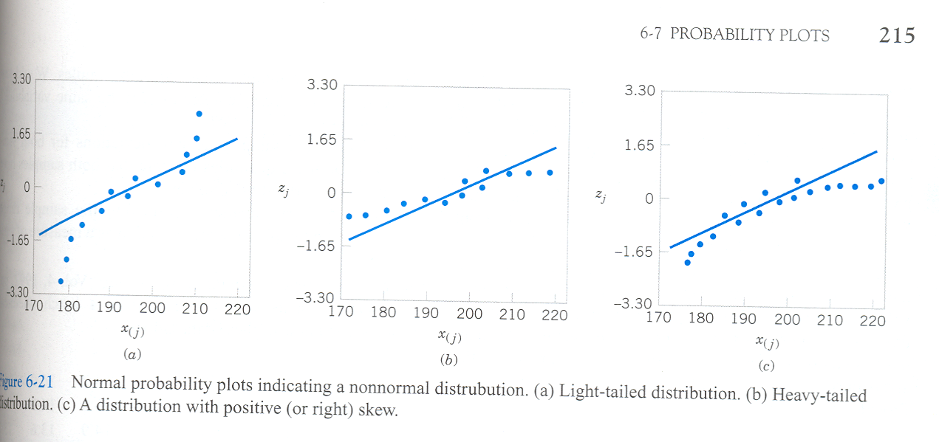
Usage
If the data plots as a straight line, the assumed distribution is correct
normal probability plots from textbook, figure 6.21 on page 215

Slide 21
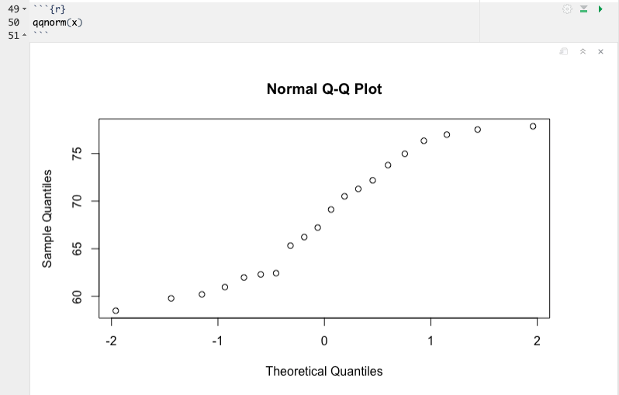
Probability Plot Example 1 in R
Normal Probability Plot

Slide 22
Probability Plot Example 2
Difficulty from example one is how close to straight is “good enough”
Add confidence bands to normal probability plot
Requires package car to be added to R
If all points are within the band, we are 95% confident that the sample is from a normal distribution. However if one or more points are not within band, the data is not from a normal distribution

Slide 23
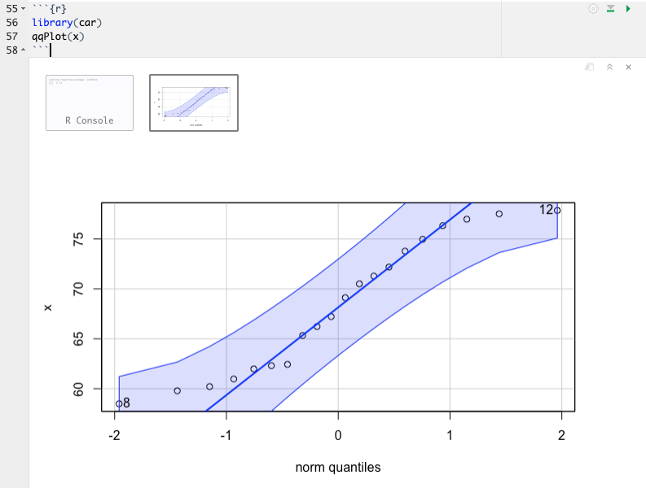
QQ Plot with band

Slide 24
Multivariate Data

Slide 25
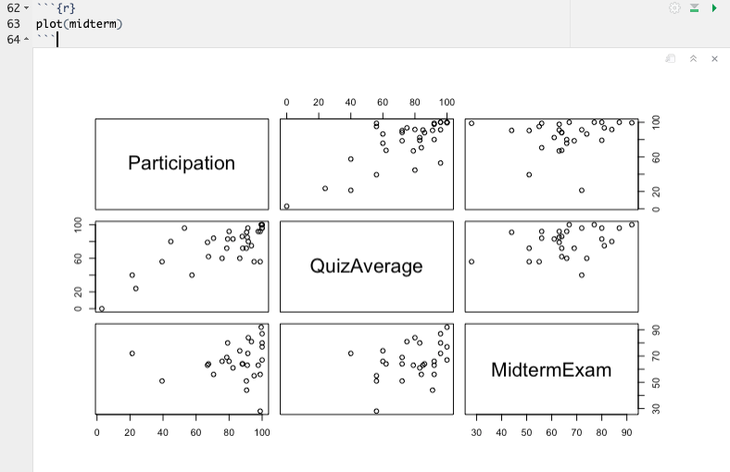
Matrix of Scatter Plot in R
Scatter Plots

Slide 26
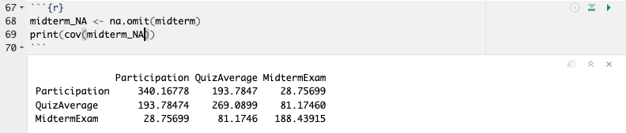
Covariance in R
Covariance Matrix

Slide 27
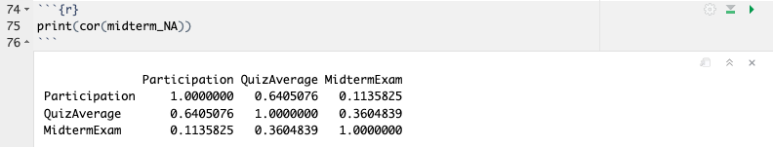
Correlation
Correlation Matrix

Slide 28
Chapter 7 Overview
Chapter 7 contains a detailed explanation of point estimates for parameters
Much of this chapter is of a highly statistical nature and will not be covered in this course
Key concepts we will discuss are:
Statistical inference
Statistic
Sampling distribution
Point estimator
Unbiased estimate
MVUE estimator
Central limit theorem
Sampling distributions

Slide 29
Statistical Inference
Montgomery gives the following description of statistical inference.
The field of statistical inference consists of those methods used to make decisions or to draw conclusions about a population. There methods utilize the information contained in a sample from the population in drawing conclusions. This chapter begins our study of the statistical methods used for inference and decision making.
Statistical inference may be divided into two major areas: parameter estimation and hypothesis testing

Slide 30
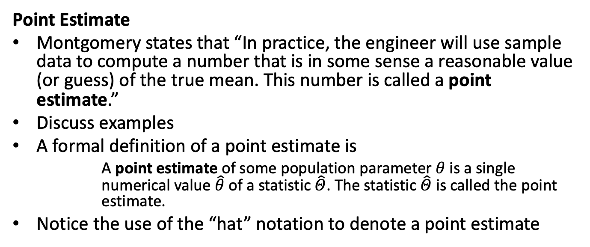
Point Estimate
Montgomery states that “In practice, the engineer will use sample data to compute a number that is in some sense a reasonable value (or guess) of the true mean. This number is called a point estimate.”
Discuss examples
A formal definition of a point estimate is
A point estimate of some population parameter $θ$ is a single numerical value $\hat{θ}$ of a statistic $\hat{Θ}$. The statistic $\hat{Θ}$ is called the point estimate.
Notice the use of the “hat” notation to denote a point estimate

Slide 31
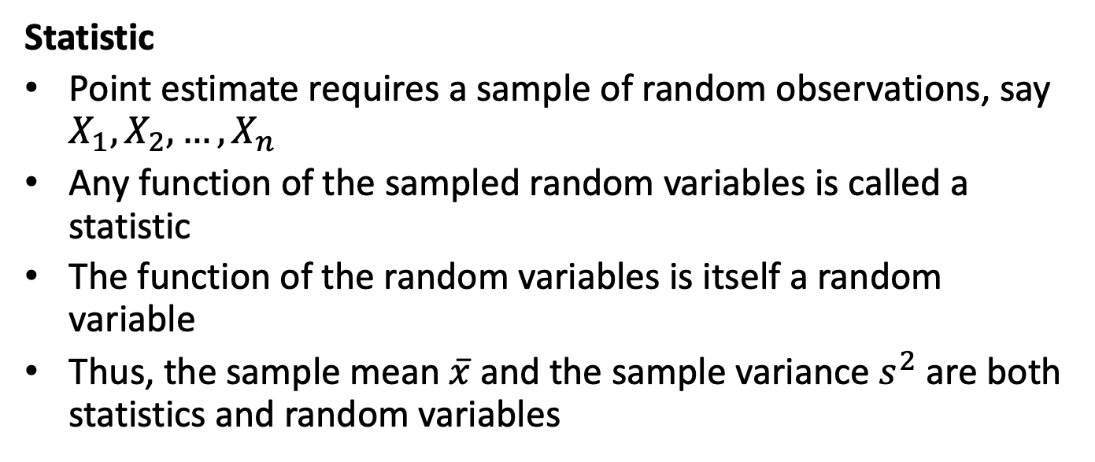
Statistic
Point estimate requires a sample of random observations, say $X_{1},X_{2},…,X_{n}$
Any function of the sampled random variables is called a statistic
The function of the random variables is itself a random variable
Thus, the sample mean $\overset{‾}{x}$ and the sample variance $s^{2}$ are both statistics and random variables

Slide 32
Properties of point estimators
We would like point estimates to be both accurate and precise
An unbiased estimator addresses the accuracy criteria
A minimum variance unbiased estimator addresses the precision criteria

Slide 33
Unbiased Estimator
The point estimator $\hat{Θ}$ is an unbiased estimator for the parameter $θ$ if
$$E\left(\hat{Θ}\right)=θ$$
If the point estimator is not unbiased, then the difference
$$E\left(\hat{Θ}\right)−θ$$
is called the bias of the estimator $\hat{Θ}$

Slide 34
MVUE
Montgomery gives the following definition of a minimum variance unbiased estimator (MVUE)
If we consider all unbiased estimators of $θ$, the one with the smallest variance is called the minimum variance unbiased estimator
An import fact is that the sample mean $\overset{‾}{x}$ is the MVUE for $μ$ when the data comes from a normal distribution

Slide 35
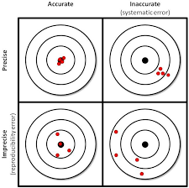
Accuracy vs. Precision
graph of accuracy vs. precision

Slide 36
Sampling Distribution
The probability distribution of a statistic is called a sampling distribution

Slide 37
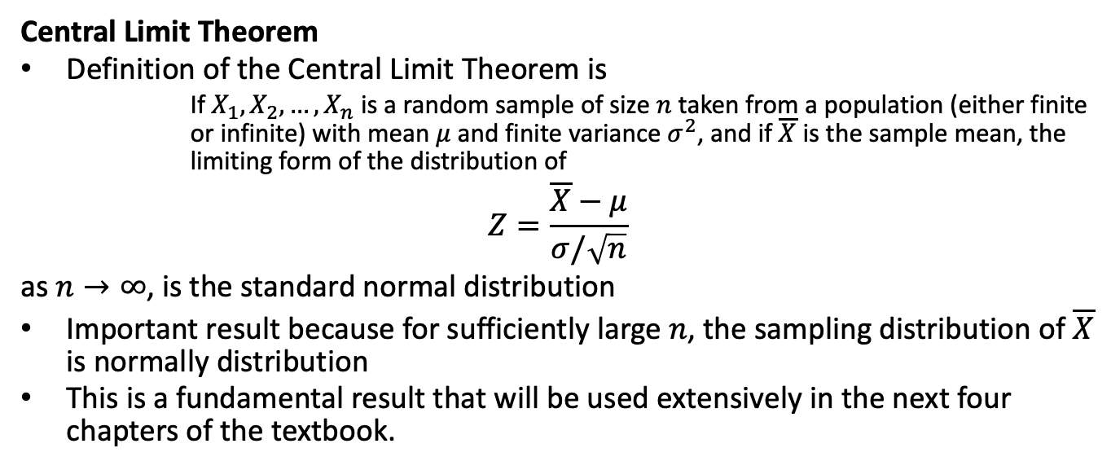
Central Limit Theorem
Definition of the Central Limit Theorem is
If $X_{1},X_{2},…,X_{n}$ is a random sample of size $n$ taken from a population (either finite or infinite) with mean $μ$ and finite variance $σ^{2}$, and if $\overline{X}$ is the sample mean, the limiting form of the distribution of
$$Z=\frac{\overline{X}−μ}{σ/\sqrt{n}}$$
as $n→∞$, is the standard normal distribution
Important result because for sufficiently large $n$, the sampling distribution of $\overline{X}$ is normally distribution
This is a fundamental result that will be used extensively in the next four chapters of the textbook.

