Slide 1
MANE 3332.05

Slide 2
Lecture 20
Agenda
Haven’t started partial credit requests yet
Start Chapter 8
Chapter 8, Case 1 Practice Problems (assigned 11/6/2025, due 11/11/2025)
Attendance
Questions?

Slide 3
Handouts
Lecture 20 Slides
Lecture 20 Slides - marked

Slide 4
Week | Tuesday Lecture | Thursday Lecture
10 | 11/4 - Return Midterm | 11/6 - Chapter 8 (part 1)
11 | 11/11 - Chapter 8 (part 2) | 11/13 - Chapter 8 (part 3)
12 | 11/18 - Chapter 8 (part 4) | 11/25 - Chapter 9 (part 1)
13 | 11/25 - Chapter 9 (part 2) | 11/27 - Thanksgiving Holiday (no class)
14 | 12/2 - Chapter 9 (part 3) | 12/4 - Linear Regression
15 | 12/9 - Review Session | 12/11 - Study Day (no class)

Slide 5
The final exam for MANE 3332.01 is Thursday December 18, 2025 at 1:15 PM - 3:00 PM.

Slide 6
Chapter 8 Introduction
Intervals are another method of performing estimation
A confidence interval is an interval estimate on a population parameter (primary focus of this chapter)
Three types of interval estimates
A confidence intervals bounds population or distribution parameters
A tolerance interval bounds a selected proportion of a distribution
A prediction interval bounds future observations from the population or distribution
Interval estimates, especially confidence intervals are commonly used in science and engineering

Slide 7
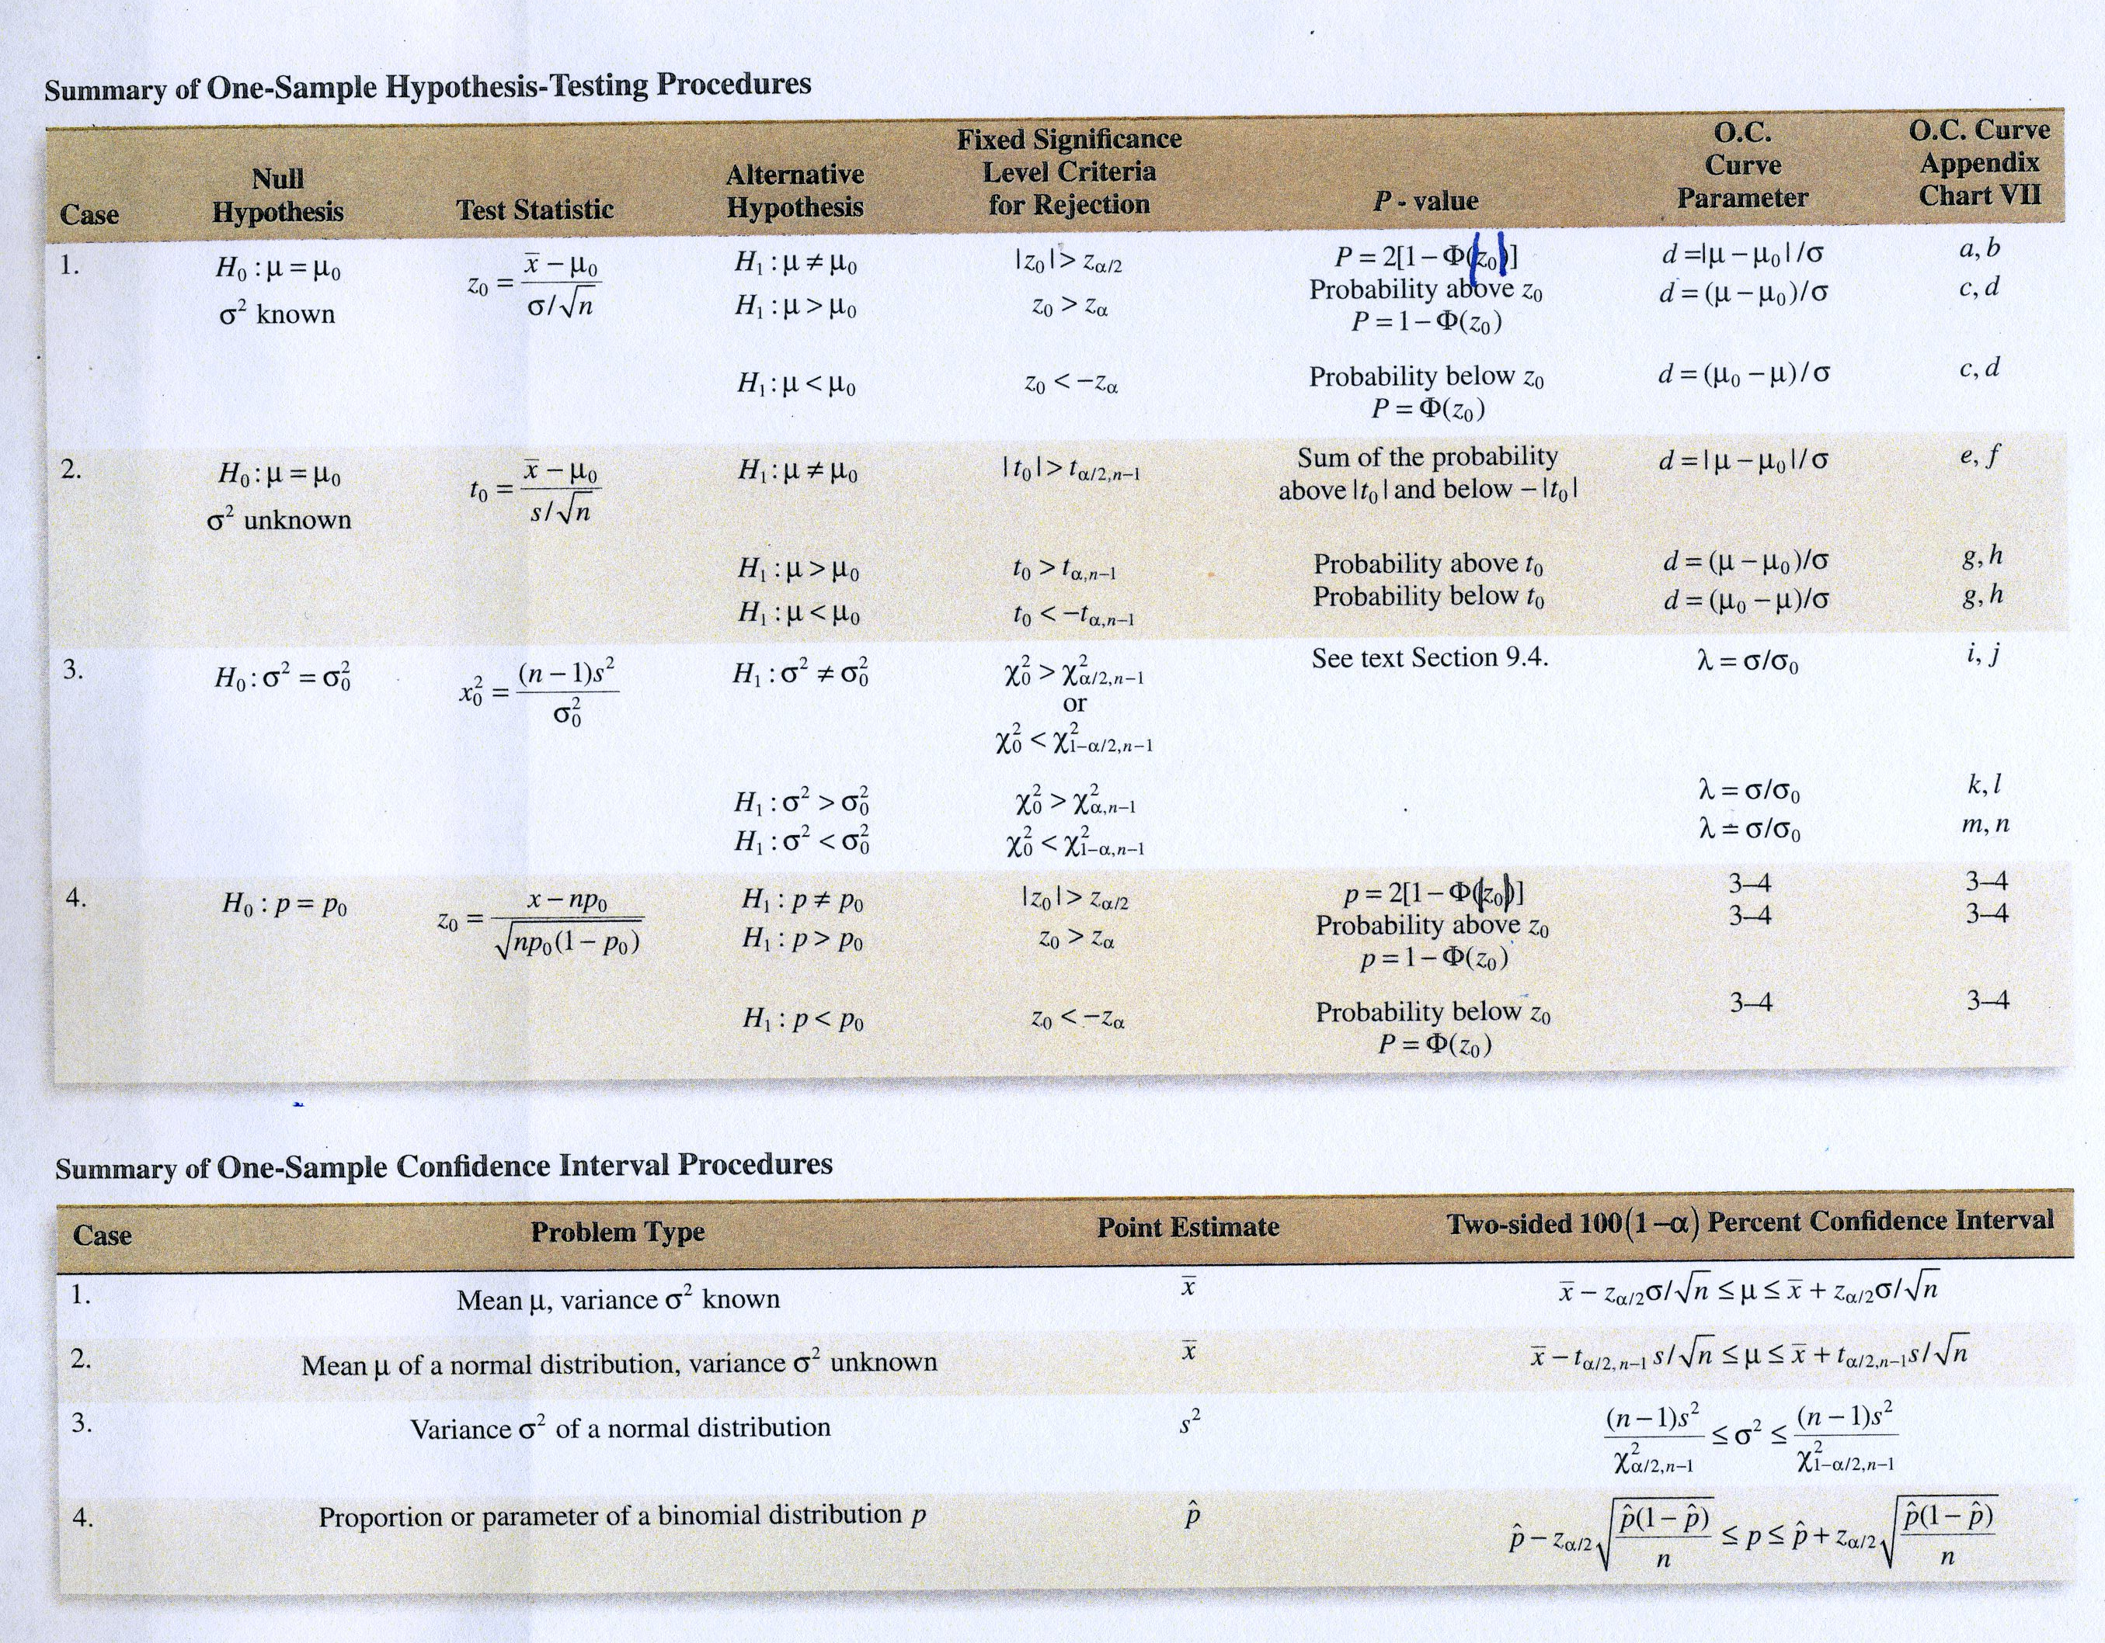
image

Slide 8
Confidence Interval on the Mean of a normal distribution, variance known (Case 1)
Suppose that $X_{1},X_{2},…,X_{n}$ is a random sample from a normal population with unknown mean $μ$ and known variance $σ^{2}$
A general expression for a confidence interval is
$$P\left[L≤μ≤U\right]=1−α$$
Using the sample results we calculate a $100(1−α)\%$ confidence of the form
$$l≤μ≤u$$
A $100(1−α)\%$ confidence interval for the mean of a normal distribution with variance known is
$$\overset{‾}{x}−z_{α/2}\frac{σ}{\sqrt{n}}≤μ≤\overset{‾}{x}+z_{α/2}\frac{σ}{\sqrt{n}}$$
where $z_{α/2}$ is the upper $100α/2$ percentage point of the standard normal distribution.

Slide 9
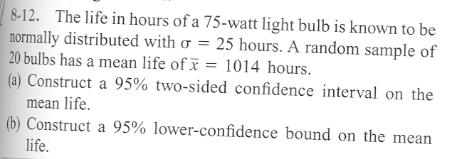
Problem 8-12,part a (6th edition)
image

Slide 10
Interpreting Confidence Intervals
Montgomery gives the following statement regarding the correct interpretation of confidence intervals.
The correct interpretation lies in the realization that a CI is a random interval because in the probability statement defining the end-points of the interval, $L$ and $U$ are random variables. Consequently, the correct interpretation of a $100(1−α)$% CI depends on the relative frequency view of probability. Specifically, if an infinite number of random samples are collected and a $100(1−α)$% confidence interval for $μ$ is computed from each sample, $100(1−α)$% of these intervals will contain the true value of $μ$.

Slide 11
One-sided Confidence Bounds
It is possible to construct on-sided confidence bounds
A $100(1−α)\%$ upper-confidence bound for $μ$ is
$$μ≤u=\overset{‾}{x}+z_{α}\frac{σ}{\sqrt{n}}$$
A $100(1−α)\%$ lower-confidence bound for $μ$ is
$$\overset{‾}{x}−z_{α}\frac{σ}{\sqrt{n}}=l≤μ$$

Slide 12
Sample Size Considerations
If $\overset{‾}{x}$ is used as an estimate of $μ$, we can be $100(1−α)\%$ confident that the error $|\overset{‾}{x}−μ|$ will not exceed a specified amount $E$ when the sample size is
$$n={\left(\frac{z_{α/2}σ}{E}\right)}^{2}$$

Slide 13
Problem 8–12,part b (6th edition)
image

Slide 14
A Large Sample CI for $μ$
When $n$ is large (say greater than or equal to 40), the central limit theorem can be used
It states that $\frac{\overset{‾}{x}−μ}{σ/\sqrt{n}}$ is approximately a standard normal random variable.
Thus, we can replace the quantity $σ/\sqrt{n}$ with $S/\sqrt{n}$ and still use the quantiles of the normal distribution to construct a confidence interval.
$$\overset{‾}{x}−z_{α/2}\frac{s}{\sqrt{n}}≤μ≤\overset{‾}{x}+z_{α/2}\frac{s}{\sqrt{n}}$$
What assumption did we relax and why?

Slide 15
Chapter 8, Case 1 Practice Problems

Slide 16
Confidence Interval for the mean of Normal distribution with variance unknown (Case 2)
The $t$ distribution
Definition.
Let $X_{1},X_{2},…,X_{n}$ be a random sample from a normal distribution with unknown mean $μ$ and unknown variance $σ^{2}$. The random variable
$$T=\frac{\overline{X}−μ}{S/\sqrt{n}}$$
has a $t$ distribution with $n−1$ degrees of freedom.
A table of percentage points (quantiles) is given in Appendix A Table 5
Figure 8-4 on page 180 shows the relationship between the $t$ and normal distributions.
Figure 8-5 explains the percentage points of the $t$ distribution

Slide 17
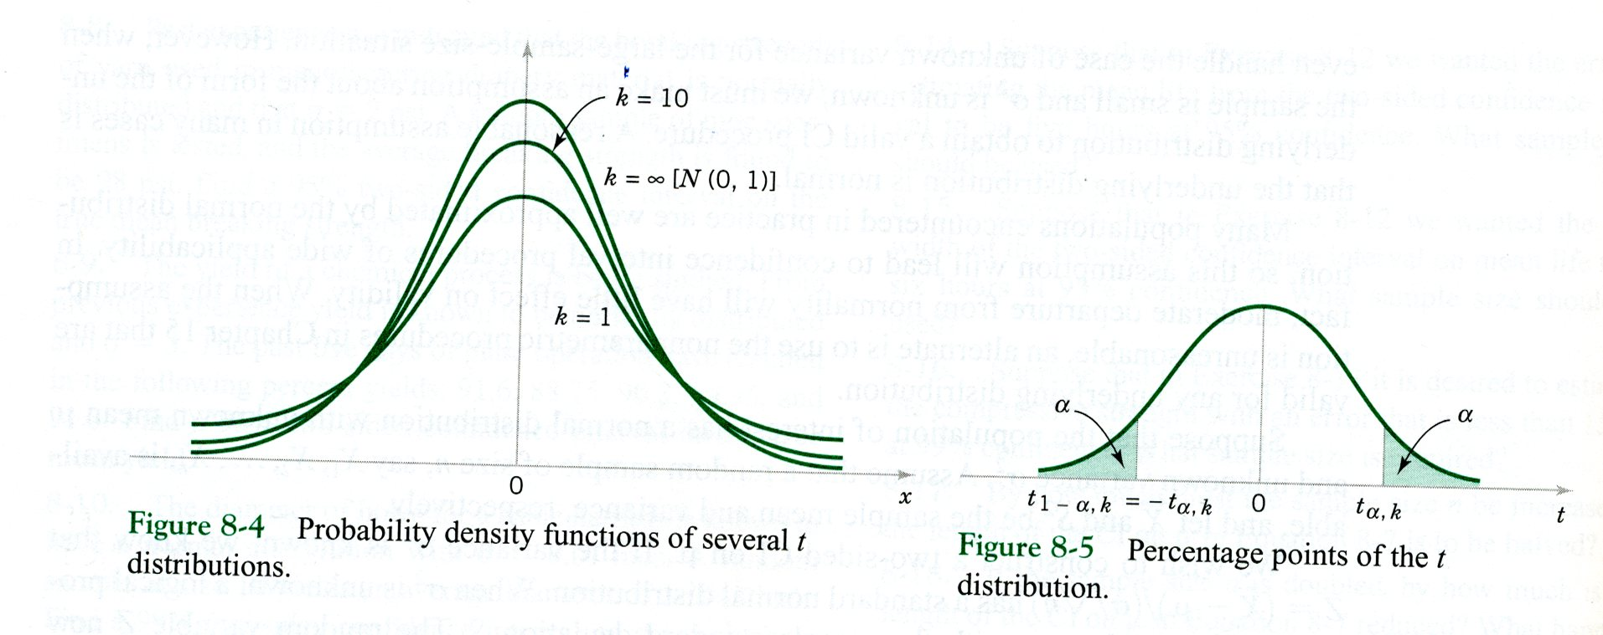
image

Slide 18
Confidence interval definition
Using the $t$ distribution it is possible to construct CIs
If $\overset{‾}{x}$ and $s$ are the mean and standard deviation of a random sample from a normal distribution with unknown variance $σ^{2}$, a $100(1−α)\%$ confidence interval on $μ$ is given by
$$\overset{‾}{x}−t_{α/2,n−1}\frac{s}{\sqrt{n}}≤μ≤\overset{‾}{x}+t_{α/2,n−1}\frac{s}{\sqrt{n}}$$
where $t_{α/2,n−1}$ is the upper $100(α/2)$ percentage point of the $t$ distribution with $n−1$ degrees of freedom.

Slide 19
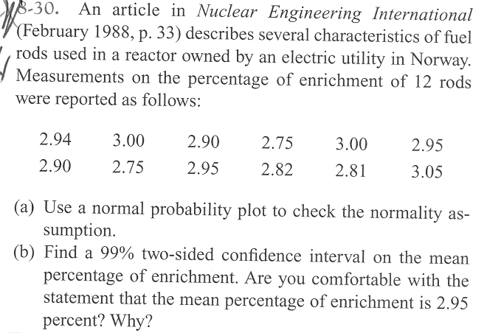
Problem 8-30 (6th edition)
image

Slide 20
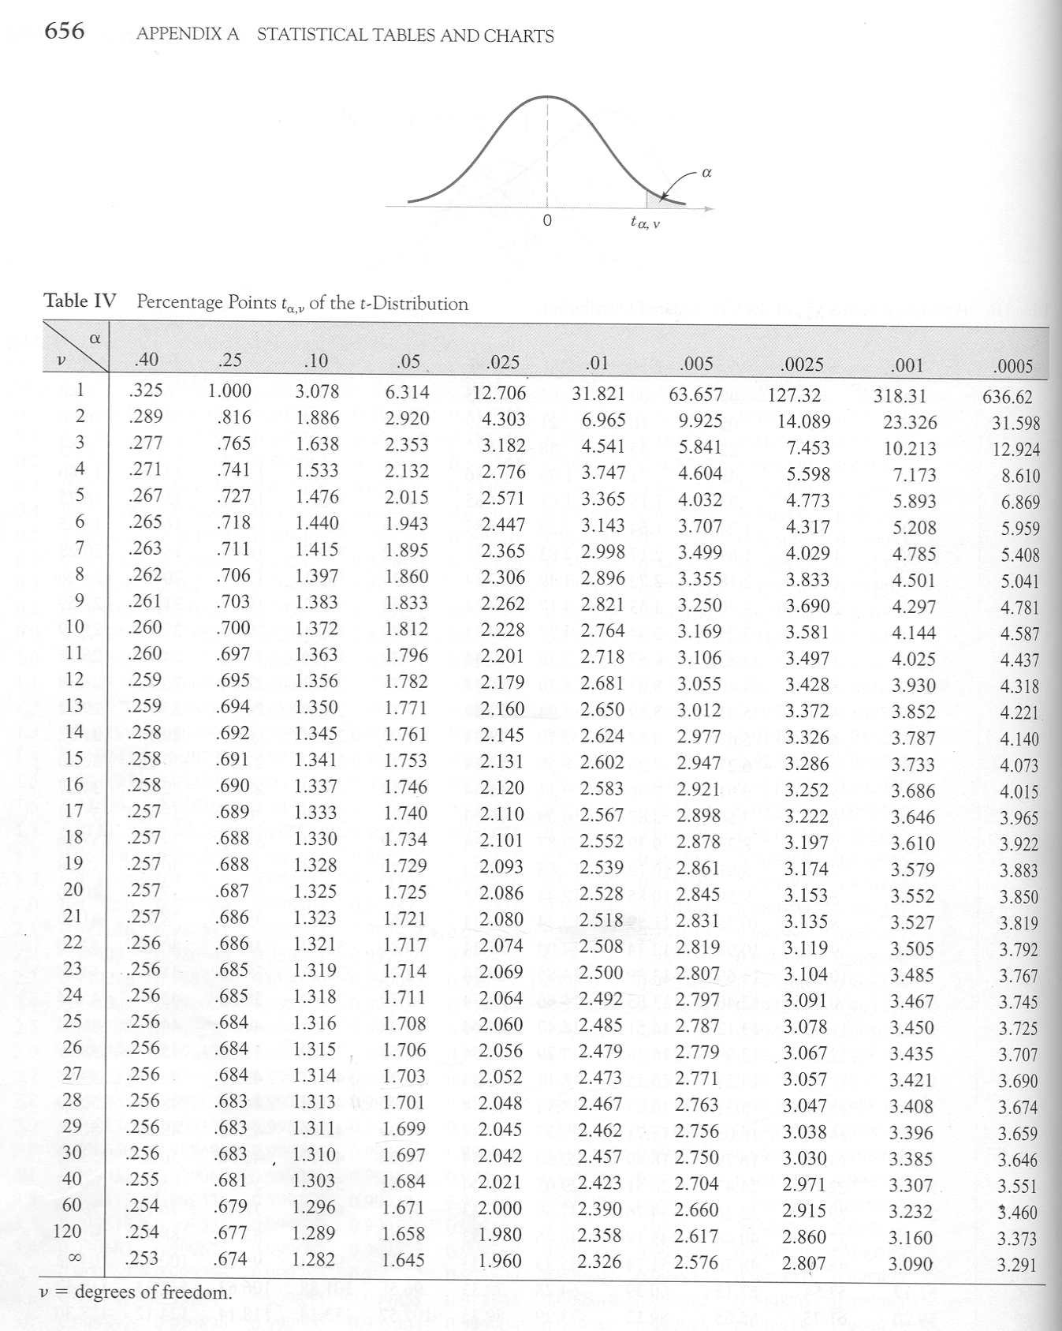
image

Slide 21
One-sided confidence bounds
Are easy to construct
Use only the appropriate upper or lower bound
Change $t_{α/2,n−1}$ to $t_{α,n−1}$

Slide 22
Chapter 8, Case 2 Practice Problems

Slide 23
Confidence Interval for $σ^{2}$ and $σ$ (Case 3)
Section 8-3 presents a CI for $σ^{2}$ or $σ$
Requires the $χ^{2}$ (chi-squared) distribution
Let $X_{1},X_{2},…,X_{n}$ be a random sample from a normal distribution with mean $μ$ and variance $σ^{2}$ and let $S^{2}$ be the sample variance. Then the random variable
$$χ^{2}=\frac{(n−1)S^{2}}{σ^{2}}$$
has a chi-square ($χ^{2}$) distribution with $n−1$ degrees of freedom
A table of the upper percentage points of the $χ^{2}$ distribution are given in Table 4 in the appendix
Figure 8-9 on page 183 explains the percentage points of the $χ^{2}$ distribution

Slide 24
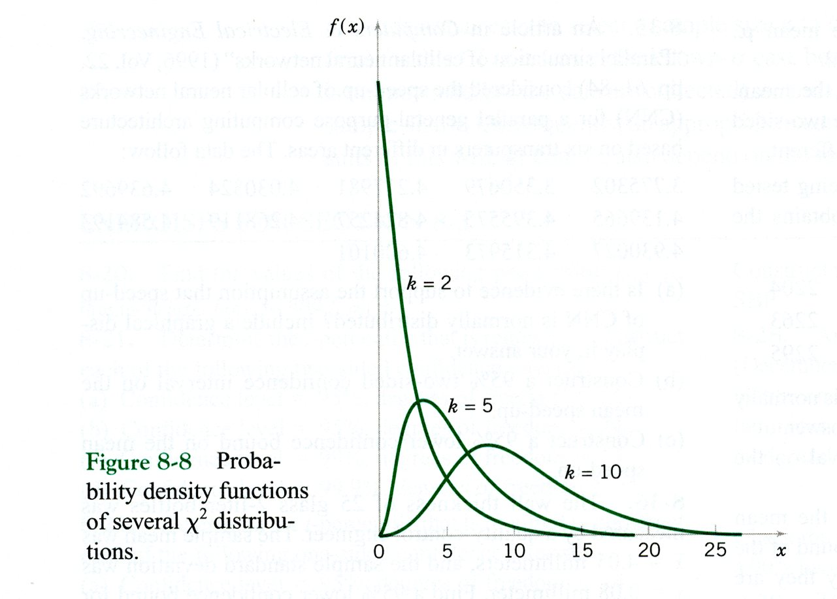
image

Slide 25
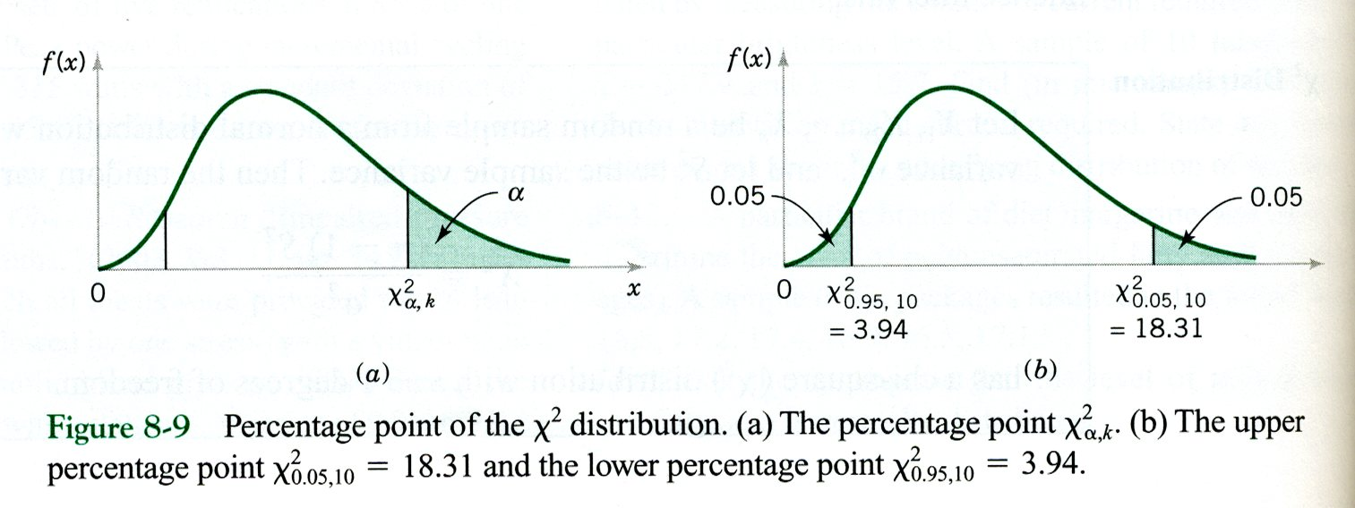
image

Slide 26
Confidence Intervals for $σ^{2}$ and $σ$
If $s^{2}$ is the sample variance from a random sample of $n$ observations from a normal distribution with unknown variance $σ^{2}$, then a $100(1−α)\%$ confidence interval on $σ^{2}$ is
$$\frac{(n−1)s^{2}}{χ_{α/2,n−1}^{2}}≤σ^{2}≤\frac{(n−1)s^{2}}{χ_{1−α/2,n−1}^{2}}$$
where $χ_{α/2,n−1}^{2}$ and $χ_{1−α/2,n−1}^{2}$ are the upper and lower $100α/2$ percentage points of the $χ^{2}$-distribution with $n−1$ degrees of freedom

Slide 27
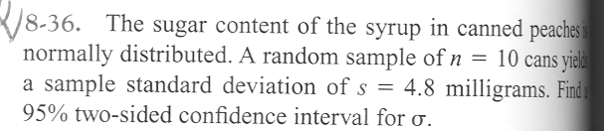
Problem 8-36 (6th edition)
image

Slide 28
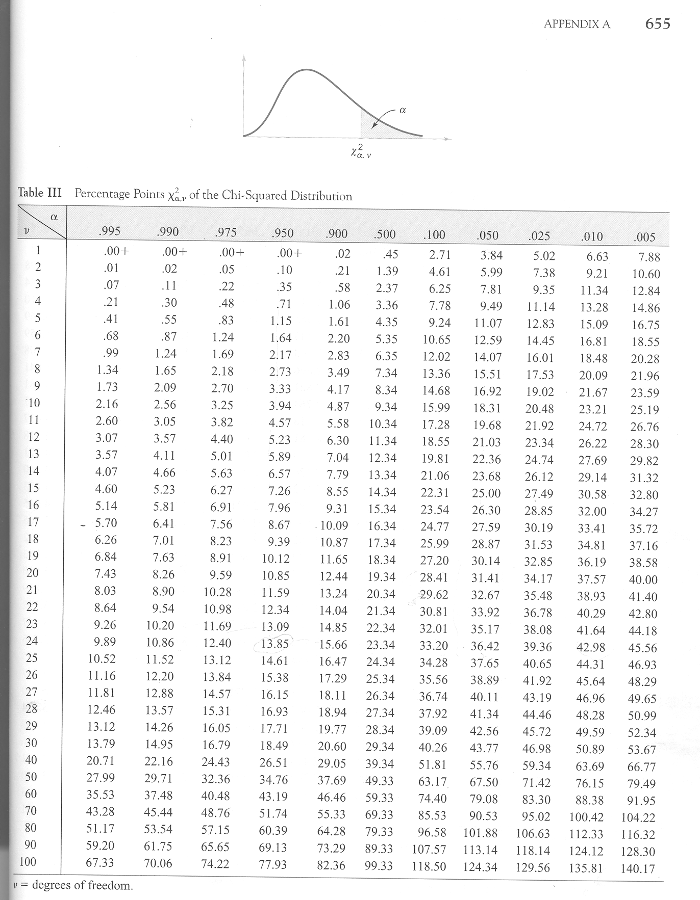
image

Slide 29
One-sided confidence bounds
Are easy to construct
Use only the appropriate upper or lower bound
Change $χ_{α/2,n−1}^{2}$ to $χ_{α,n−1}^{2}$ or $χ_{1−α/2,n−1}^{2}$ to $χ_{1−α,n−1}^{2}$
See eqn (8-20) on page 184

Slide 30
Chapter 8, Case 3 Practice Problems

Slide 31
Large-Sample CI for a Population Proportion (Case 4)
Recall from chapter 4, that the sampling distribution of $\hat{P}$ is approximately normal with mean $p$ and variance $p(1−p)/p$, if $n$ is not too close to either 0 or 1 and if $n$ is relatively large.
Typically, we require both $np≥5$ and $n(1−p)≥5$
f $n$ is large, the distribution of
$$Z=\frac{X−np}{\sqrt{np(1−p)}}=\frac{\hat{P}−p}{\sqrt{\frac{p(1−p)}{n}}}$$
is approximately standard normal.

Slide 32
If $\hat{p}$ is the proportion of observations in a random sample of size $n$ that belongs to a class of interest, an approximate $100(1−α)\%$ confidence interval on the proportion $p$ of the population that belongs to this class is
$$\hat{p}−z_{α/2}\sqrt{\frac{\hat{p}(1−\hat{p})}{n}}≤p≤\hat{p}+z_{α/2}\sqrt{\frac{\hat{p}(1−\hat{p})}{n}}$$
where $z_{α/2}$ is the upper $α/2$ percentage point of the standard normal distribution

Slide 33
Other Considerations
We can select a sample so that we are $100(1−α)\%$ confident that error $E=|p−\hat{P}|$ using
$$n={\left(\frac{z_{α/2}}{E}\right)}^{2}p(1−p)$$
An upper bound on is given by
$$n={\left(\frac{z_{α/2}}{E}\right)}^{2}(0.25)$$
One-sided confidence bounds are given in eqn (8-26) on page 187

Slide 34
Guidelines for Constructing Confidence Intervals
Review excellent guide given in Table 8-1
Other Interval Estimates
When we want to predict the value of a single value in the future, a prediction interval is used
A tolerance interval captures $100(1−α)\%$ of observations from a distribution

Slide 35
Prediction Interval for a Normal Distribution
Excellent discussion on pages 189 - 190
A $100(1−α)\%$ PI on a single future observation from a normal distribution is given by
$$\overset{‾}{x}−t_{α/2,n−1}s\sqrt{1+\frac{1}{n}}≤X_{n+1}≤\overset{‾}{x}+t_{α/2,n−1}s\sqrt{1+\frac{1}{n}}$$

Slide 36
Tolerance Intervals for a Normal Distribution
A tolerance interval to contain at least $γ\%$ of the values in a normal population with confidence level $100(1−α)\%$ is
$$\overset{‾}{x}−ks,\overset{‾}{x}+ks$$
where $k$ is a tolerance interval factor for the normal distribution found in appendix A Table XII. Values are given for $1−α$=0.9, 0.95 and 0.99 confidence levels and for $γ=.90, .95, \text{and }.99\%$ probability of coverage
One-sided tolerance bounds can also be computed. The factors are also in Table XII

