Slide 1
MANE 3332.05

Slide 2
Lecture 26
Agenda
Complete Chapter 9 lectures
  Chapter 9, Case 3
Chapter 9, Case 1 2-sided Quiz (assigned 11/25/2025, due 12/2/2025)
Chapter 9, Case 1 Lower Quiz (assigned 11/25/2025, due 12/2/2025)
Chapter 9, Case 1 Upper Quiz (assigned 11/25/2025, due 12/2/2025)
Chapter 9, Case 2 2-sided Practice Problems (assigned 11/25/2025, due 12/2/2025)
Chapter 9, Case 2 Lower Practice Problems (assigned 11/25/2025, due 12/2/2025)
Chapter 9, Case 2 Upper Practice Problems (assigned 11/25/2025, due 12/2/2025)
NEW: Chapter 9, Case 2 2-sided Quiz (assigned 12/2/2025, due 12/4/2025)
NEW: Chapter 9, Case 2 Lower Quiz (assigned 12/2/2025, due 12/4/2025)
NEW: Chapter 9, Case 2 Upper Quiz (assigned 12/2/2025, due 12/4/2025)
NEW: Chapter 9, Case 3 2-sided Practice Problems (assigned 12/2/2025, due 12/4/2025)
NEW: Chapter 9, Case 3 Lower Practice Problems (assigned 12/2/2025, due 12/4/2025)
NEW: Chapter 9, Case 3 Upper Practice Problems (assigned 12/2/2025, due 12/4/2025)
Attendance
Questions?

Slide 3
Handouts
Lecture 26 Slides
Lecture 26 Slides - marked

Slide 4
Week | Tuesday Lecture | Thursday Lecture
14 | 12/2 - Chapter 9, Case 3 | 12/4 - Linear Regression
15 | 12/9 - Review Session | 12/11 - Study Day (no class)

Slide 5
The final exam for MANE 3332.01 is Thursday December 18, 2025 at 1:15 PM - 3:00 PM.

Slide 6
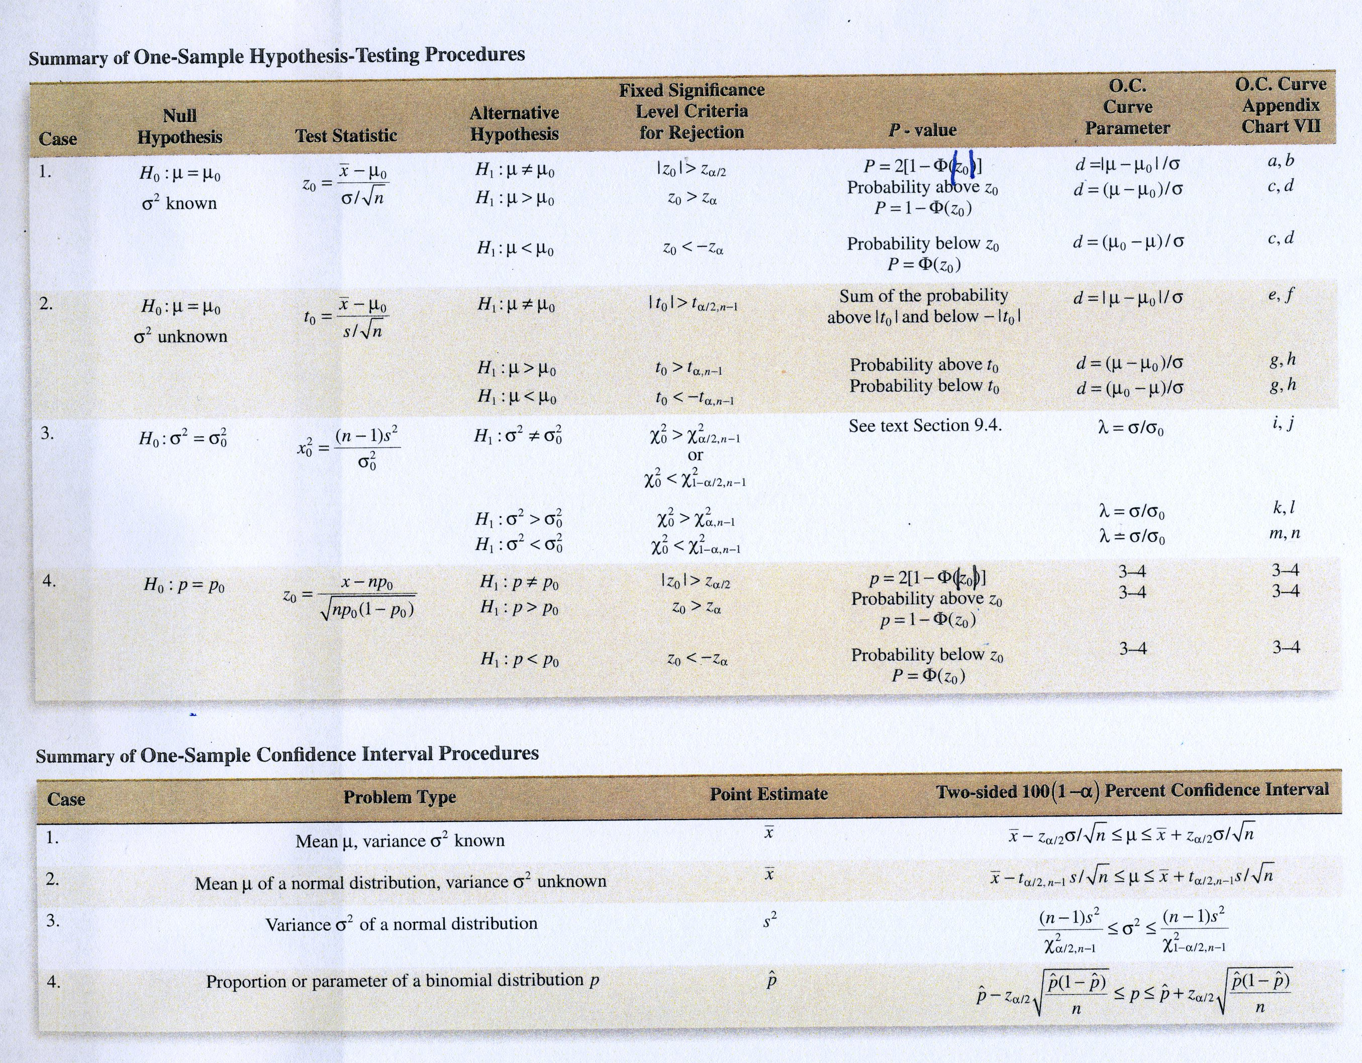

Slide 7
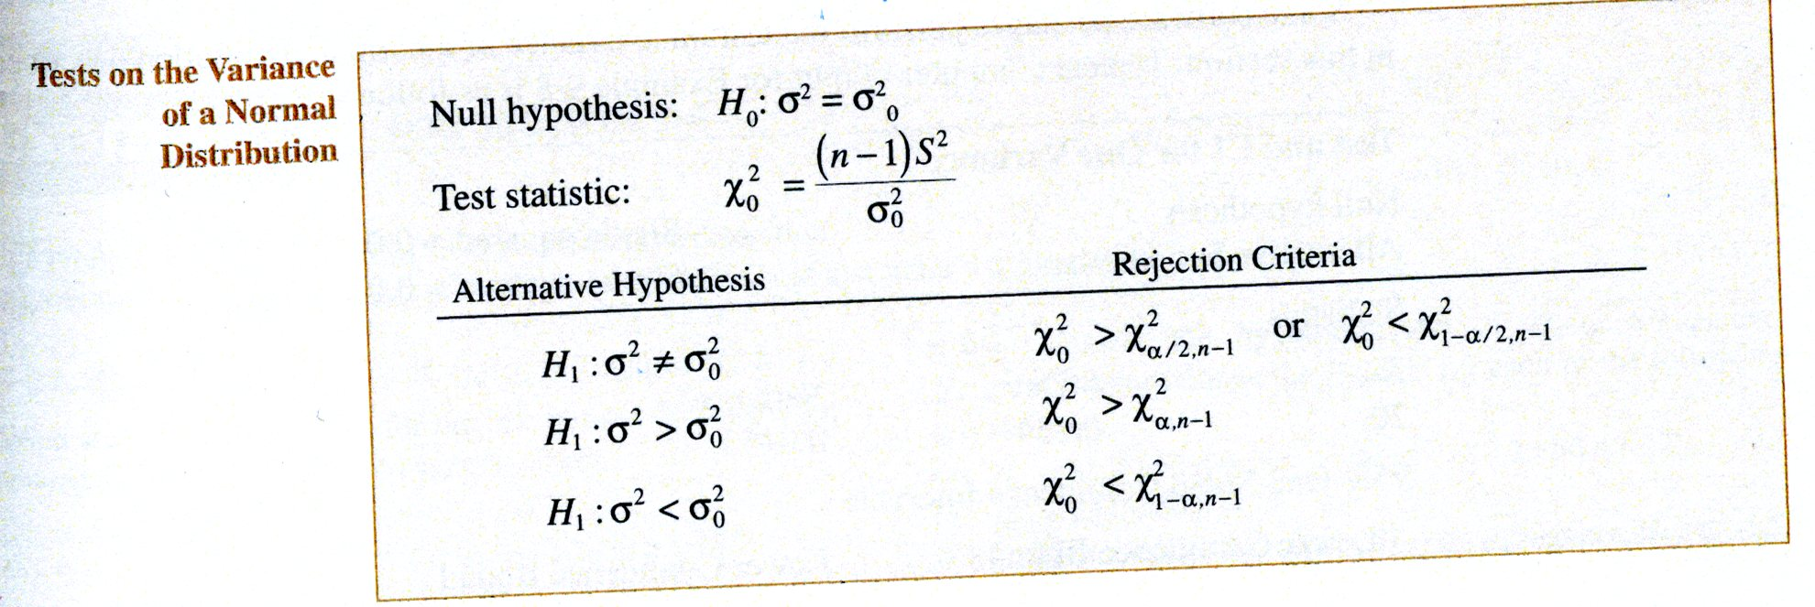
Case 3. Hypothesis Test on Variance of Normal Population
The test statistics is a $χ^{2}$ random variable
$$χ_{0}^{2}=\frac{(n−1)S^{2}}{σ_{0}^{2}}$$

Slide 8
- The table below summarizes the three possible hypothesis tests. The rejection regions are clearly shown in Figure 9-17 on page 222

Slide 9
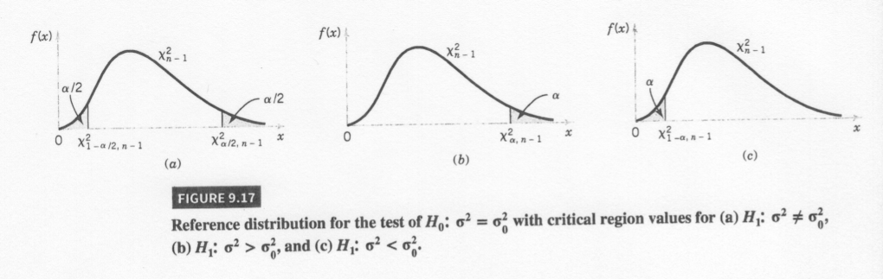
Figure 9-17

Slide 10
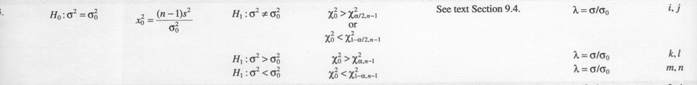
Test Summary
See summary in your textbook

Slide 11
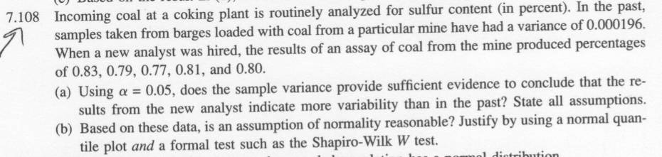
Problem 7.108
Problem taken from Ostle, Turner, Hicks and McElrath (1996). Engineering Statistics: The Industrial Experience. Duxbury Press.

Slide 12
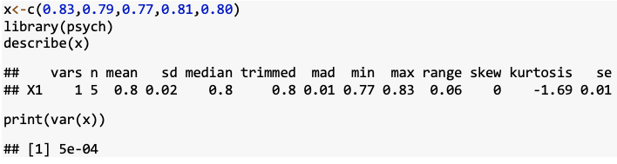
Statistics for Problem 7.108

Slide 13
Classical Approach

Slide 14
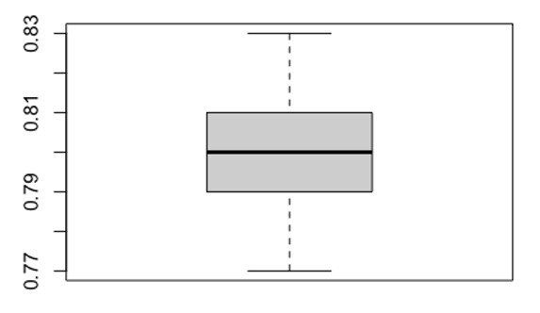
Problem 7.108 Plots

Slide 15
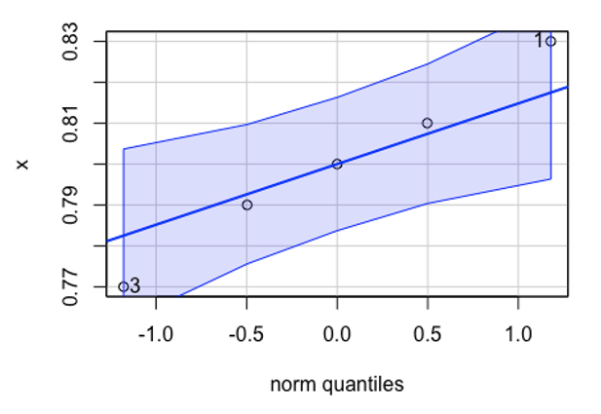
Problem 7.108 Plots

Slide 16
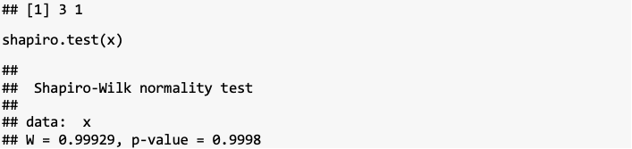
Problem 7.108 Shapiro-Wilks Test

Slide 17
p-values
Very similar to the case for the mean of a normal population with variance unknown
Difficult to calculate since the $χ^{2}$-tables only contain a few quantiles
Can use tables to generate bounds on the $p$-value
Software will provide $p$-values

Slide 18
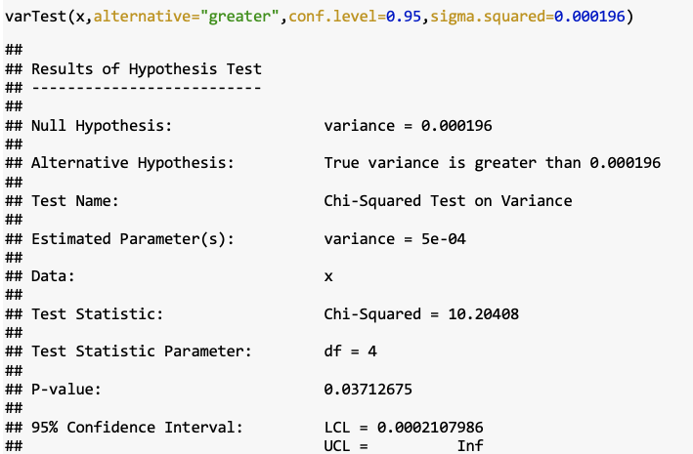
Test on Variance using R (EnvStats)

Slide 19
Power Calculations
Can be done with OC curves found in Table VIIi–n
Can be done in software such as R

Slide 20
Test on Standard Deviation
What about test on standard deviation?

Slide 21
Chapter 9, Case 3 2-sided Practice Problems

Slide 22
Practice Problem Chapter 9, Case 3 Lower

Slide 23
Practice Problem Chapter 9, Case 3 Upper

Slide 24
Case 4. Hypothesis Test on a Population Proportion
The test statistics for the hypothesis test is
$$Z_{0}=\frac{x−np_{0}}{\sqrt{np_{0}(1−p_{0})}}$$

Slide 25
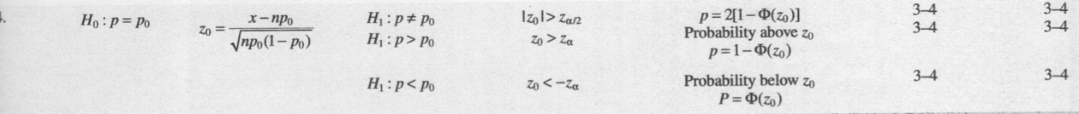

Slide 26
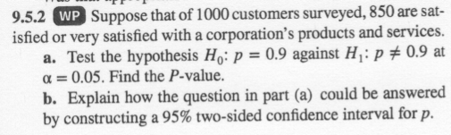
Problem 9.5.2

Slide 27
Problem 9.5.2 Classic Approach

Slide 28
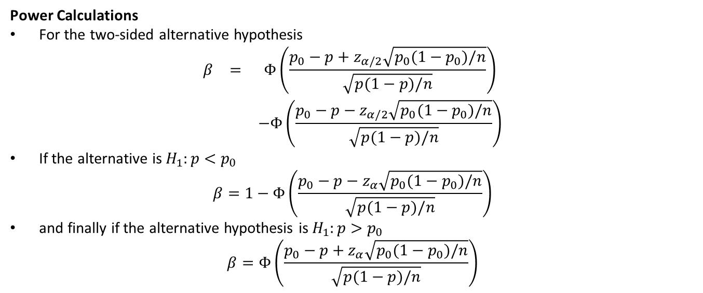
Power Calculations
For the two-sided alternative hypothesis
$$\begin{matrix}β & = & Φ\left(\frac{p_{0}−p+z_{α/2}\sqrt{p_{0}(1−p_{0})/n}}{\sqrt{p(1−p)/n}}\right) \\ & & −Φ\left(\frac{p_{0}−p−z_{α/2}\sqrt{p_{0}(1−p_{0})/n}}{\sqrt{p(1−p)/n}}\right)\end{matrix}$$
If the alternative is $H_{1}:p<p_{0}$
$$β=1−Φ\left(\frac{p_{0}−p−z_{α}\sqrt{p_{0}(1−p_{0})/n}}{\sqrt{p(1−p)/n}}\right)$$
and finally if the alternative hypothesis is $H_{1}:p>p_{0}$
$$β=Φ\left(\frac{p_{0}−p+z_{α}\sqrt{p_{0}(1−p_{0})/n}}{\sqrt{p(1−p)/n}}\right)$$

Slide 29
Sample Size
Sample size requirements to satisfy type II($β$) error constraints for a two-tailed hypothesis test is given by
$$n={\left[\frac{z_{α/2}\sqrt{p_{0}(1−p_{0})}+z_{β}\sqrt{p(1−p)}}{p−p_{0}}\right]}^{2}.$$
For a sample size for a one-sided test substitute $z_{α}$ for $z_{α/2}$.
Problem 9.95

Slide 30
Testing for Goodness of Fit
Material is presented in section 9-7 of your textbook
Procedure determines if the sample data is from a specified underlying distribution
Procedure uses a $χ^{2}$ distribution
Example 9-12 presents a $χ^{2}$ goodness of fit test for a Poisson example
Example 9-13 presents a $χ^{2}$ goodness of fit test for a normal example

Slide 31
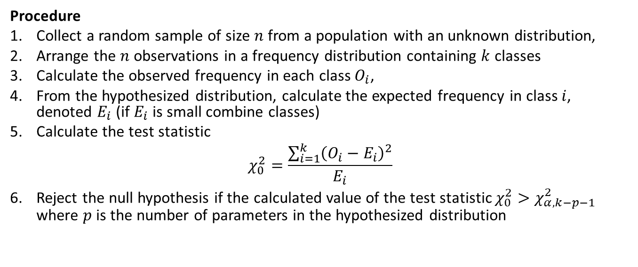
Procedure
Collect a random sample of size $n$ from a population with an unknown distribution,
Arrange the $n$ observations in a frequency distribution containing $k$ classes
Calculate the observed frequency in each class $O_{i}$,
From the hypothesized distribution, calculate the expected frequency in class $i$, denoted $E_{i}$ (if $E_{i}$ is small combine classes)
Calculate the test statistic
$$χ_{0}^{2}=\frac{\sum_{i=1}^{k}{{\left(O_{i}−E_{i}\right)}^{2}}}{E_{i}}$$
Reject the null hypothesis if the calculated value of the test statistic $χ_{0}^{2}>χ_{α,k−p−1}^{2}$ where $p$ is the number of parameters in the hypothesized distribution

Slide 32
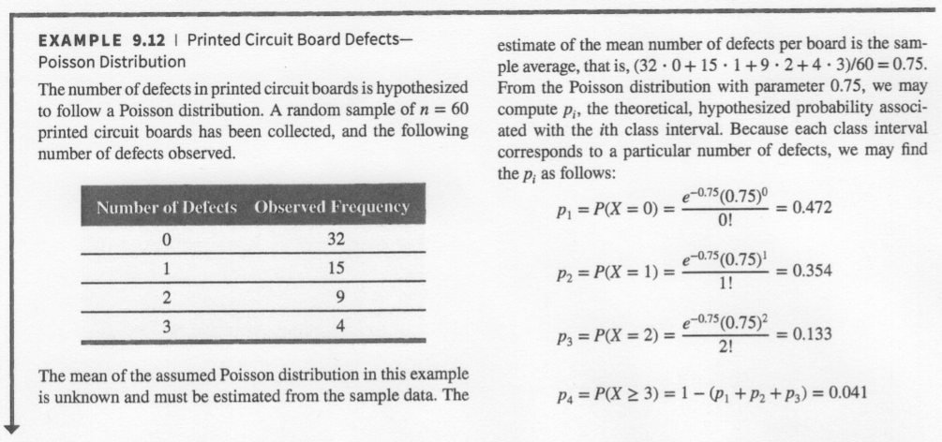
Example 9.12, part 1

Slide 33
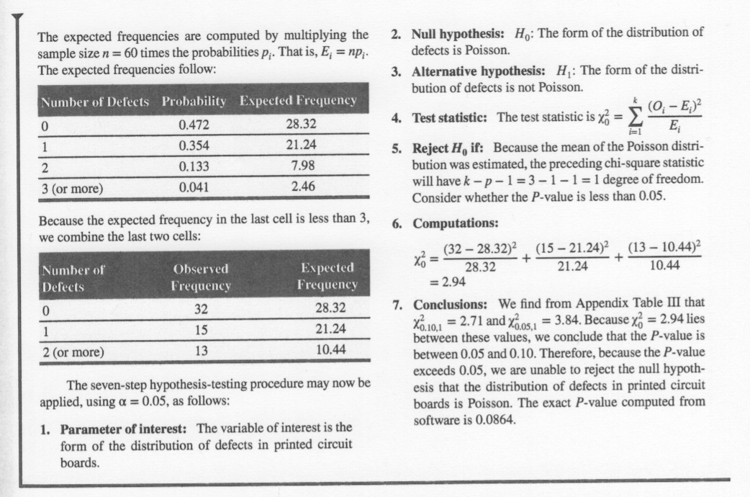
Example 9.12, part 2

Slide 34
Chapter 9 Summary
You should be prepared to work any practice problems assigned: Cases 1-3 with three different alternatives
All other information is conceptual knowledge that can be questioned with multiple choice
  Name 3 ways to test if data is from a normal distribution

Slide 35
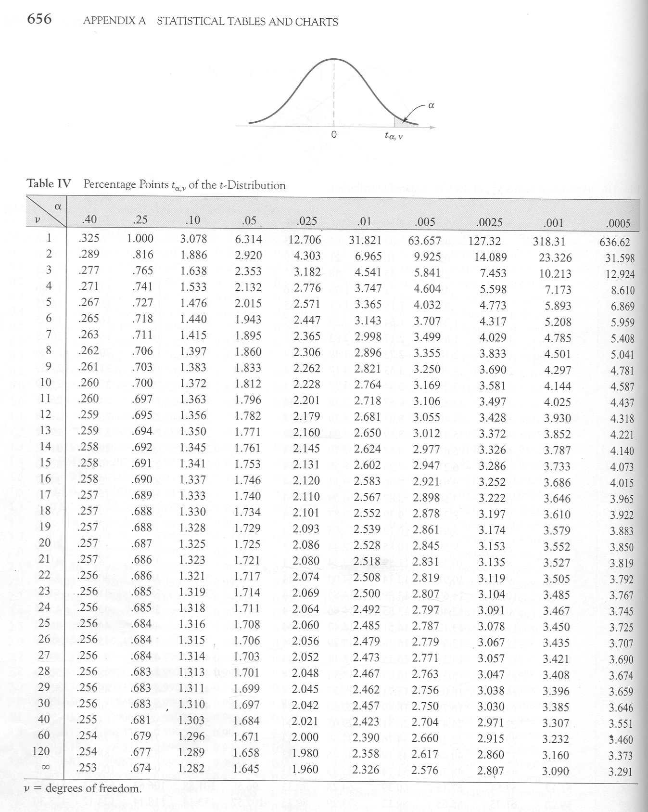

Slide 36
