Slide 1
MANE 3332.05

Slide 2
Lecture 27
Agenda
Linear Regression Lecture (Chapters 11 and 12)
Chapter 9, Case 2 2-sided Quiz (assigned 12/2/2025, due 12/4/2025)
Chapter 9, Case 2 Lower Quiz (assigned 12/2/2025, due 12/4/2025)
Chapter 9, Case 2 Upper Quiz (assigned 12/2/2025, due 12/4/2025)
Chapter 9, Case 3 2-sided Practice Problems (assigned 12/2/2025, due 12/4/2025)
Chapter 9, Case 3 Lower Practice Problems (assigned 12/2/2025, due 12/4/2025)
Chapter 9, Case 3 Upper Practice Problems (assigned 12/2/2025, due 12/4/2025)
NEW: Chapter 9, Case 3 2-sided Quiz (assigned 12/4/2025, due 12/9/2025)
NEW: Chapter 9, Case 3 Lower Quiz (assigned 12/4/2025, due 12/9/2025)
New: Chapter 9, Case 3 Upper Quiz (assigned 12/4/2025, due 12/9/2025)
Attendance
Questions?

Slide 3
Handouts
Regression slides
Regression Review - Tuesday 12/9/25)
Regression slides marked

Slide 4
Week | Tuesday Lecture | Thursday Lecture
14 | 12/2 - Chapter 9, Case 3 | 12/4 - Linear Regression
15 | 12/9 - Review Session | 12/11 - Study Day (no class)
Class Schedule

Slide 5
The final exam for MANE 3332.01 is Thursday December 18, 2025 at 1:15 PM - 3:00 PM.

Slide 6
Simple Linear Regression
Regression analysis is a statistical technique for modeling and investigating the relationship between two or more variables.
Simple linear regression considers the relationship between a single independent variable and a dependent variable
A good tool to examine the relationship is a scatter diagram

Slide 7
Empirical Models
An empirical model is a model that captures the relationship between regressor inputs and a response variable that is not based upon theoretical knowledge
There are many types of empirical models
Discuss wind-powered generator

Slide 8
Simple Linear Regression Model
A simple linear regression model is shown below
$$Y=β_{0}+β_{1}x+ε$$
where $Y$ is the dependent (or response) variable, $x$ is the independent (or regressor) variable and $ε$ is the random error term
We can use this model to predict $Y$ for a given value of $x$
$$E(Y|x)=μ_{Y|x}=β_{0}+β_{1}x$$

Slide 9
Assuming $ε$ has zero mean and variance $σ^{2}$
$$\begin{matrix}E(Y|x) & = & E(β_{0}+β_{1}x+ε)=β_{0}+β_{1}x+E(ε) \\ & = & β_{0}+β_{1}x \\ V(Y|x) & = & V(β_{0}+β_{1}x+ε)=V(β_{0}+β_{1}x)+V(ε) \\ & = & 0+σ^{2}\end{matrix}$$
Examine the graphic shown below

Slide 10
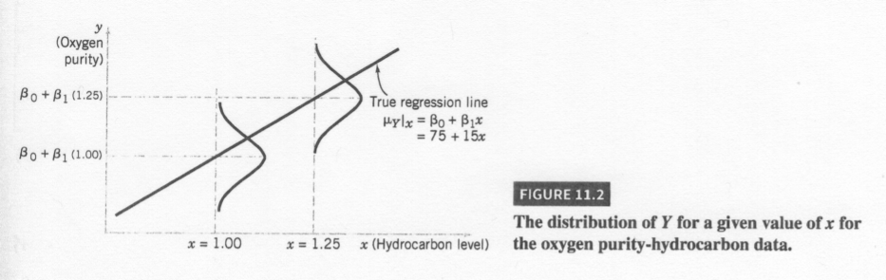
Figure 11-2
Figure 11-2 on page 283
Figure 11-2

Slide 11
Method of Least Squares
The method use to estimate values for $β_{0}$ and $β_{1}$ is called least squares and was developed by Gauss
Examine figure shown below
Minimize
$$L=\sum_{i=1}^{n}{ε_{i}^{2}}=\sum_{i=1}^{n}{{\left(y_{i}−β_{0}−β_{1}x_{i}\right)}^{2}}$$
The solution to this problem is called the least squares normal equations
Examine the graphics shown below

Slide 12
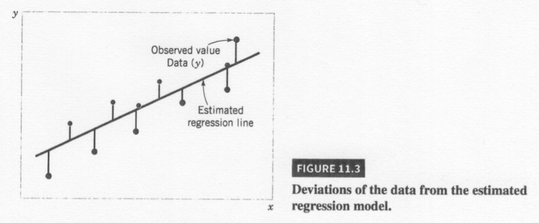
Figure 11-3, page 285
Figure 11-3

Slide 13
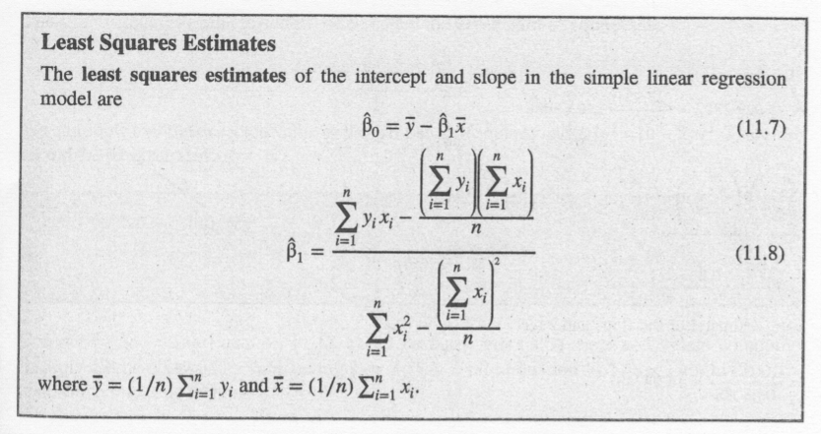
Equations 11-7 and 11-8 on page 285
Equations

Slide 14
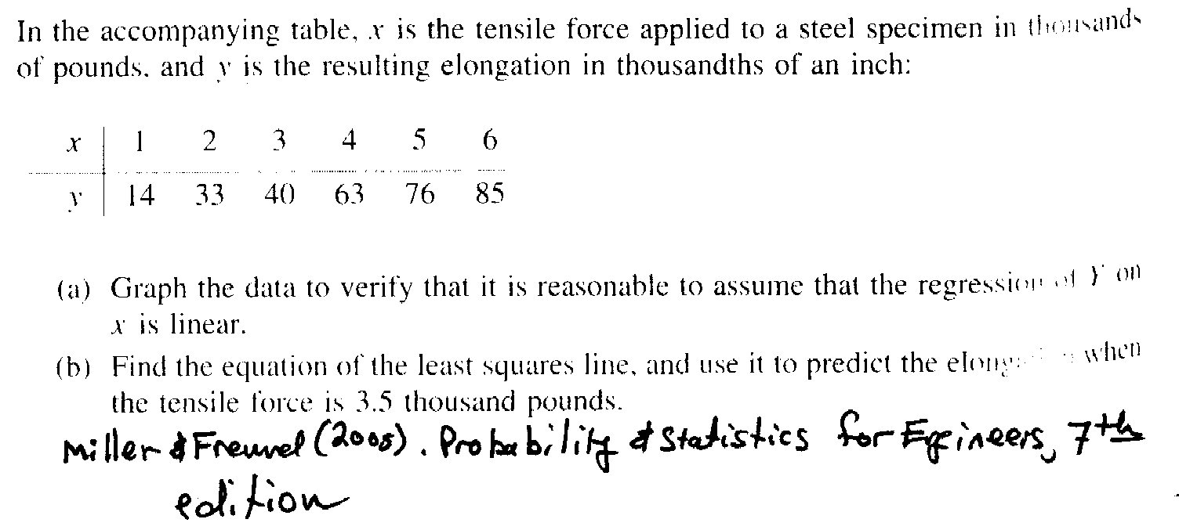
R
In this course, we will use R to estimate the parameters and calculate sums of squares quantities
Example Problem
Example Problem

Slide 15
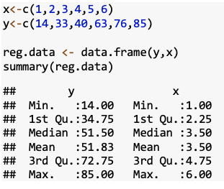
Creating Regression Data in R

Slide 16
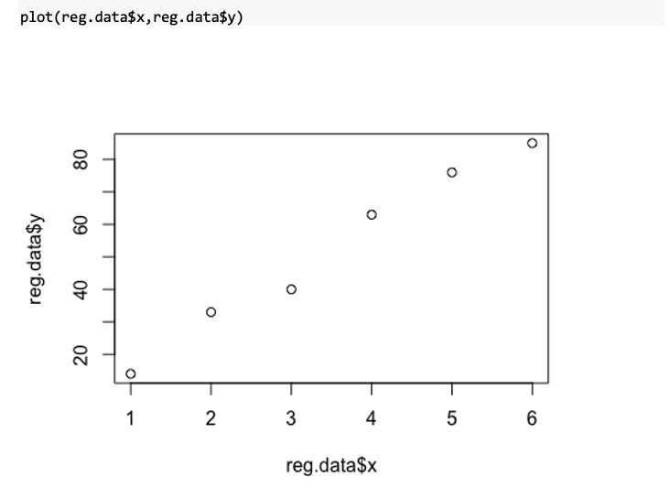

Slide 17
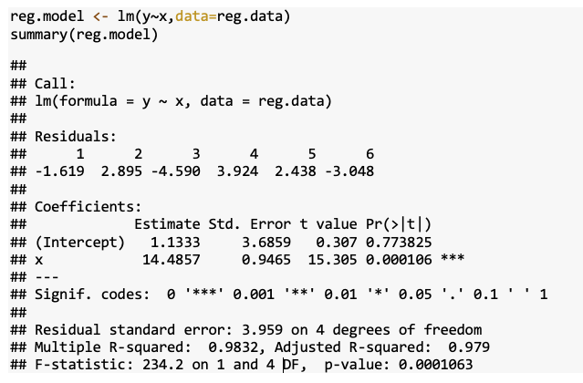

Slide 18
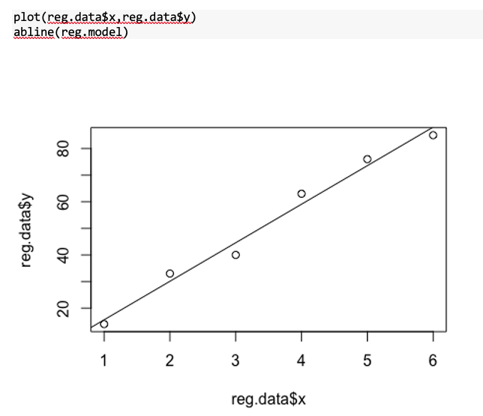

Slide 19
Hypothesis Test
It is possible to perform a hypothesis involving the slope parameter, $β_{1}$
$$\begin{matrix}H_{0}:β_{1} & = & β_{1,0} \\ H_{1}:β_{1} & ≠ & β_{1,0} \\ & & \end{matrix}$$
where $β_{1,0}$ is a constant (often 0).
Requires the assumption that $ε∼\text{NID}(0,σ^{2})$
The test statistic is a $t$-random variable
$$t_{0}=\frac{{\hat{β}}_{1}−β_{1,0}}{se({\hat{β}}_{1})}$$
A similar test can be formed for $β_{0}$

Slide 21
Examining Model Adequacy
Two major concerns
  Does the model provide an adequate explanation of the data?
  Are the model assumptions satisfied?

Slide 22
Residual Analysis
The residuals are defined to be
$$e_{i}=y_{i}−{\hat{y}}_{i}=y_{i}−{\hat{β}}_{0}−{\hat{β}}_{1}x$$
Examine normality assumption by generating a normal probability plot of residuals

Slide 23
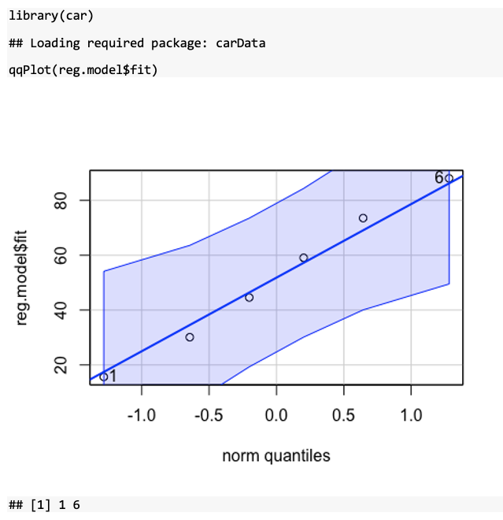

Slide 24
Residual Analysis - Constant Variance
Examine the assumption of constant variance by plotting residuals versus fitted values and residuals vs $x$
Examine if additional terms are required (such as quadratic) by examining residuals vs $x$
Residuals are often standardized

Slide 25
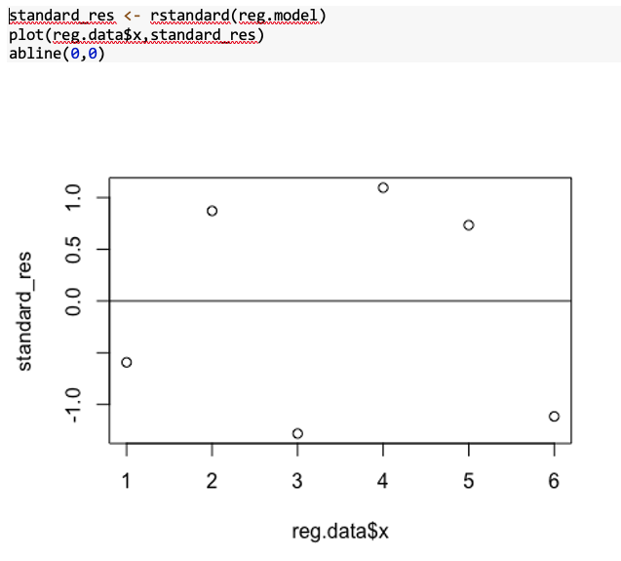

Slide 26
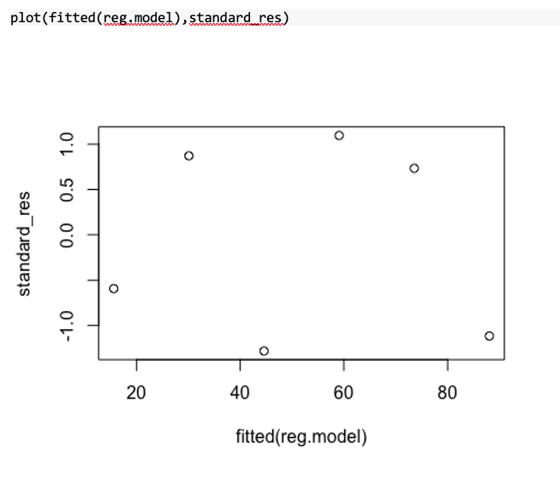

Slide 27
Lack of Fit Test
If there are repeated observations (identical values of $x$) a lack of fit test can be performed
$$\begin{matrix}H_{0} & : & \text{The} \text{model} \text{is} \text{correct} \\ H_{1} & : & \text{The} \text{model} \text{is} \text{NOT} \text{correct}\end{matrix}$$

Slide 28
The repeated observations allows the $SS_{E}$ error term to be partitioned
$$SS_{E}=SS_{PE}+SS_{LOF}$$
The test statistic is
$$F_{0}=\frac{MS_{LOF}}{MS_{PE}}$$

Slide 29
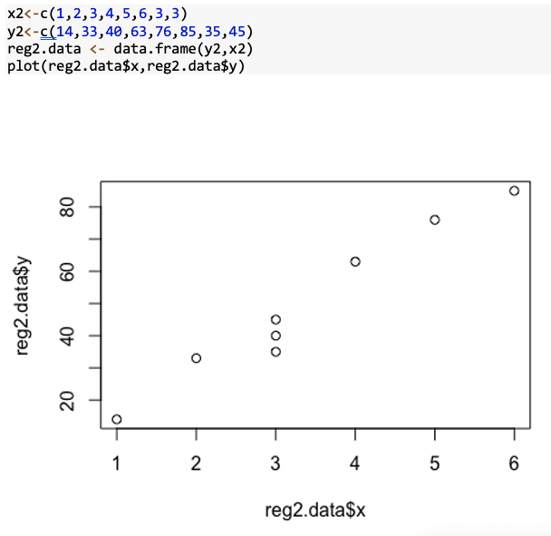

Slide 30
