Slide 1
MANE 3332.05

Slide 2
Lecture 5

Slide 3
Agenda
Continue Chapter 2 Lecture
Start with Two Events Practice Problems
Single Event Quiz (assigned 9/11/2025, due 9/15/2025)
Two Events Practice Problems (assigned 9/16/2025, due 9/18/2025)

Slide 4
Handouts
Lecture 5 Slides - Powerpoint
Lecture 5 Slides - Marked (pdf)

Slide 5
Two Events Practice Problems

Slide 6
Multiplication Rules
This rule provides another method for calculating $P\left(A∩B\right)$
$\begin{matrix}P\left(A∩B\right) & = & P\left(A|B\right)P\left(B\right)=P\left(B|A\right)P\left(A\right)\end{matrix}$
This leads to the total probability rule
$\begin{matrix}P\left(B\right) & = & P\left(B∩A\right)+P\left(B∩A^{′}\right) \\ & = & P\left(B|A\right)P\left(A\right)+P\left(B|A^{′}\right)P\left(A^{′}\right) \\ & & \end{matrix}$
Consider problems from 3rd edition (next slide) and 2-129

Slide 7
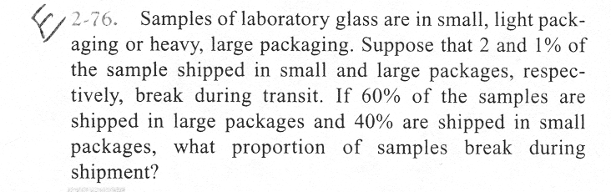
Example Problem 2-76
problem 2-76

Slide 8
Independent Events
Two events are independent if any one of the following is true:
$P\left(A|B\right)=P\left(A\right)$
$P\left(B|A\right)=P\left(B\right)$
$P\left(A∩B\right)=P\left(A\right)P\left(B\right)$
Consider problem 2-146

Slide 9
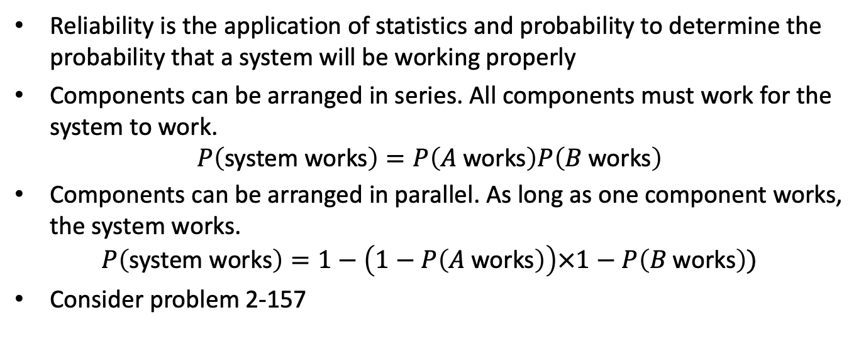
Reliability Analysis
Reliability is the application of statistics and probability to determine the probability that a system will be working properly
Components can be arranged in series. All components must work for the system to work.
$$P\left(\text{system} \text{works}\right)=P\left(A \text{works}\right)P\left(B \text{works}\right)$$
Components can be arranged in parallel. As long as one component works, the system works.
$$P\left(\text{system} \text{works}\right)=1−\left(1−P\left(A \text{works}\right)\right)×1−P\left(B \text{works}\right))$$
Consider problem 2-157

