Slide 1
MANE 3332.05

Slide 2
Lecture 3

Slide 3
Agenda
Continue Chapter 2 Lecture
Search function in course website
Single Event Practice Problems

Slide 4
Handouts
Lecture 3 Slides - Powerpoint
Lecture 3 Slides - Marked (pdf)

Slide 5
Examples of Random Experiments, Sample Space, Events
Consider the bead bowl
Consider the Texas Lottery’s Pick Three game (I am not encouraging gambling)

Slide 6
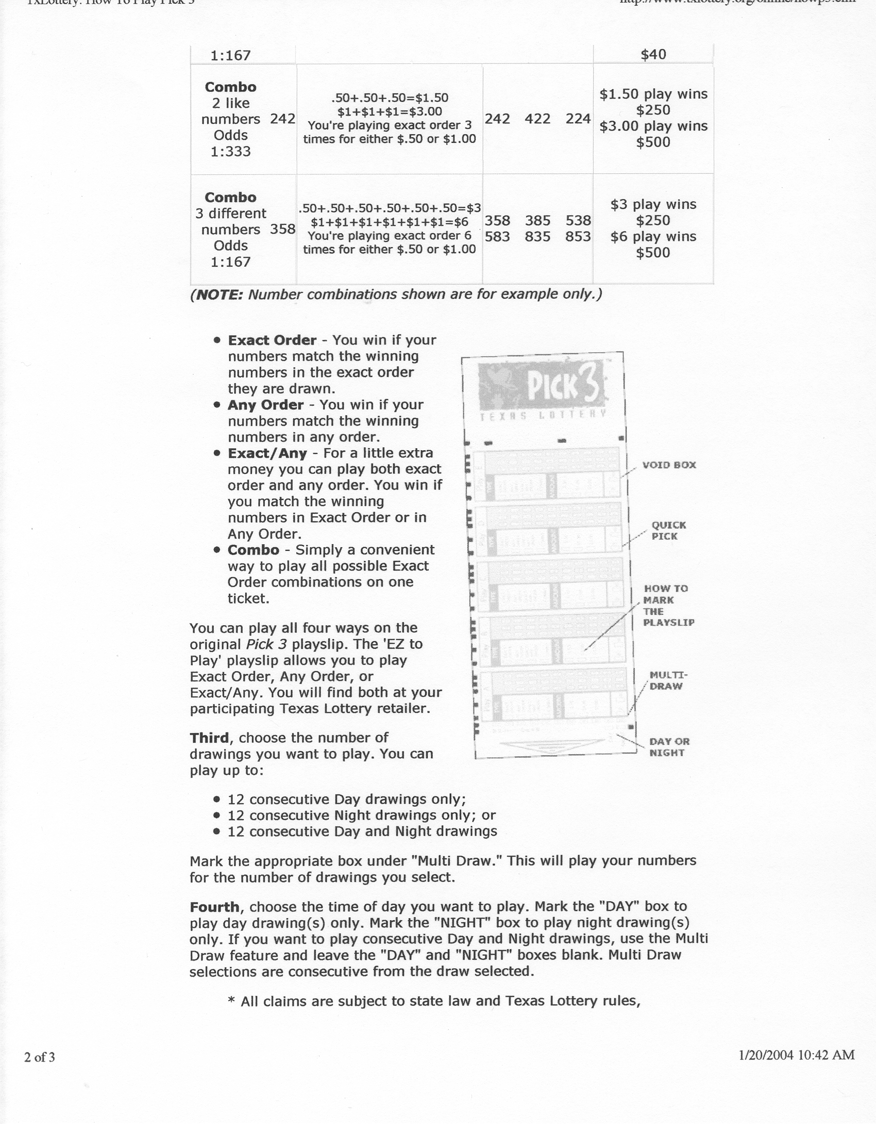
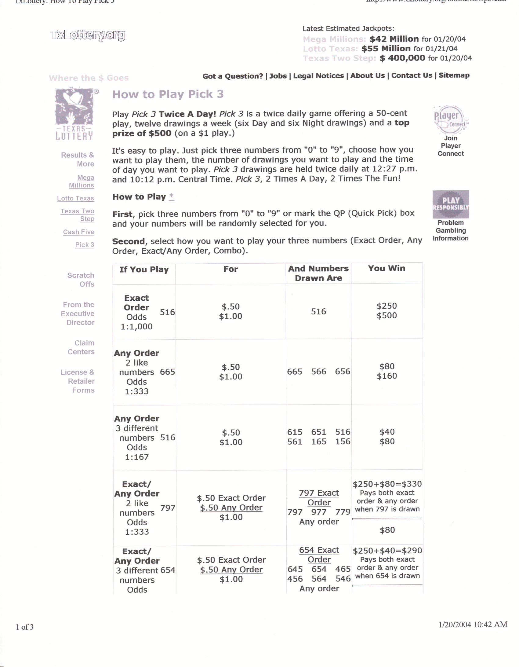
–
Pick 3 Front Page
Pick 3 Back Page

Slide 7
Tree Diagrams
Tree diagrams are a useful tool for understanding sample spaces and events. Apply to Pick Three game.

Slide 8
Probability
The probability of an event is the likelihood that it occurs
Probability is expressed as a number between 0 and 1
Probability of an event can be found by dividing the number of outcomes of the desired events divided by the total number of outcomes in the sample space (if all events are equally likely)

Slide 9
Counting Techniques
Consider ordered versus unordered subsets
Ordered subsets (Permutations)
$$P_{r}^{n}=\frac{n!}{\left(n−r\right)!}$$
Unordered subsets (Combinations)
$$C_{r}^{n}=\frac{n!}{r!\left(n−r\right)!}$$
Good idea to do a calculator check

Slide 10
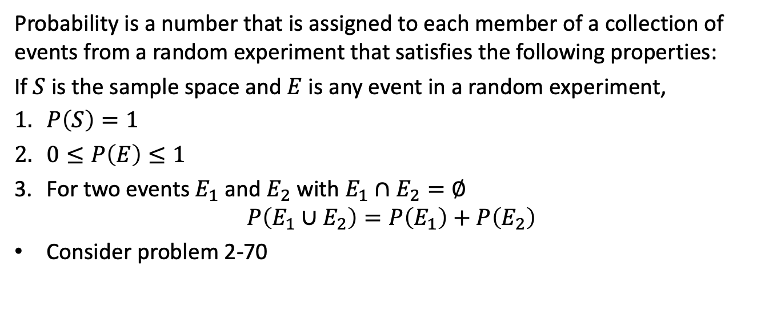
Axioms (Rules) of Probability
Probability is a number that is assigned to each member of a collection of events from a random experiment that satisfies the following properties:
If $S$ is the sample space and $E$ is any event in a random experiment,
$P\left(S\right)=1$
$0≤P\left(E\right)≤1$
For two events $E_{1}$ and $E_{2}$ with $E_{1}∩E_{2}=∅$
$$P\left(E_{1}∪E_{2}\right)=P\left(E_{1}\right)+P\left(E_{2}\right)$$
Consider problem 2-70

Slide 11
Practice Problems - Single Event

Slide 12
A Word of Warning
It usually looks very easy when I work a problem
I have been using statistics for almost 40 years
This is something you MUST practice
Rework class room examples and textbook examples

Slide 13
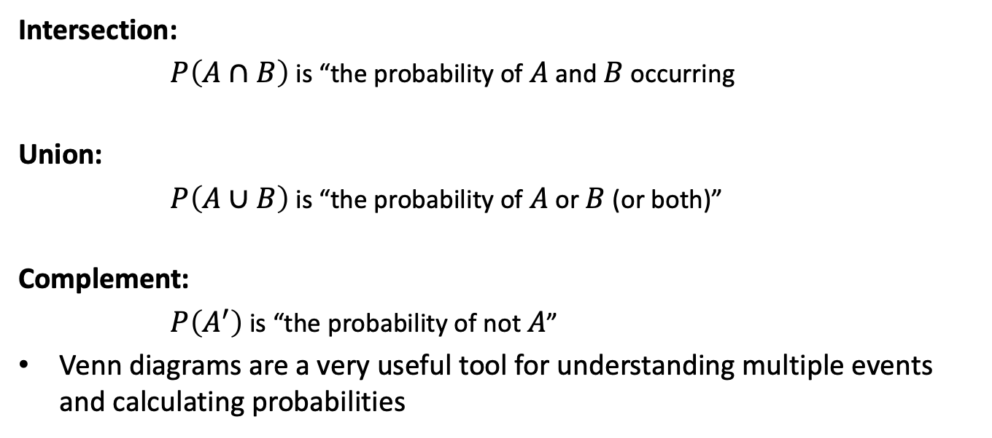
Probability of Multiple Events
Intersection:
$P\left(A∩B\right)$ is “the probability of $A$ and $B$ occurring
Union:
$P\left(A∪B\right)$ is “the probability of $A$ or $B$ (or both)”
Complement:
$P\left(A^{′}\right)$ is “the probability of not $A$”
Venn diagrams are a very useful tool for understanding multiple events and calculating probabilities

Slide 14
Addition Rules
Used to calculate the union of two events
$$P\left(A∪B\right)=P\left(A\right)+P\left(B\right)−P\left(A∩B\right)$$
If two events are mutually exclusive ($A∩B=∅$)
$$P\left(A∪B\right)=P\left(A\right)+P\left(B\right)$$
Consider problems 2-82 and 2-85

Slide 15
Addition Rule for 3 or More Events
For three events
$$\begin{matrix}P\left(A∪B∪C\right) & = & P\left(A\right)+P\left(B\right)+P\left(C\right) \\ & & −P\left(A∩B\right)−P\left(A∩C\right)−P\left(B∩C\right) \\ & & +P\left(A∩B∩C\right) \\ & & \end{matrix}$$
For a set of events to mutually exclusive all pairs of variables must satisfy $E_{1}∩E_{2}=∅$
For a collection of mutually exclusive events,
$$P\left(E_{1}∪E_{2}∪…∪E_{k}\right)=P\left(E_{1}\right)+P\left(E_{2}\right)+⋯+P\left(E_{k}\right)$$

Slide 16
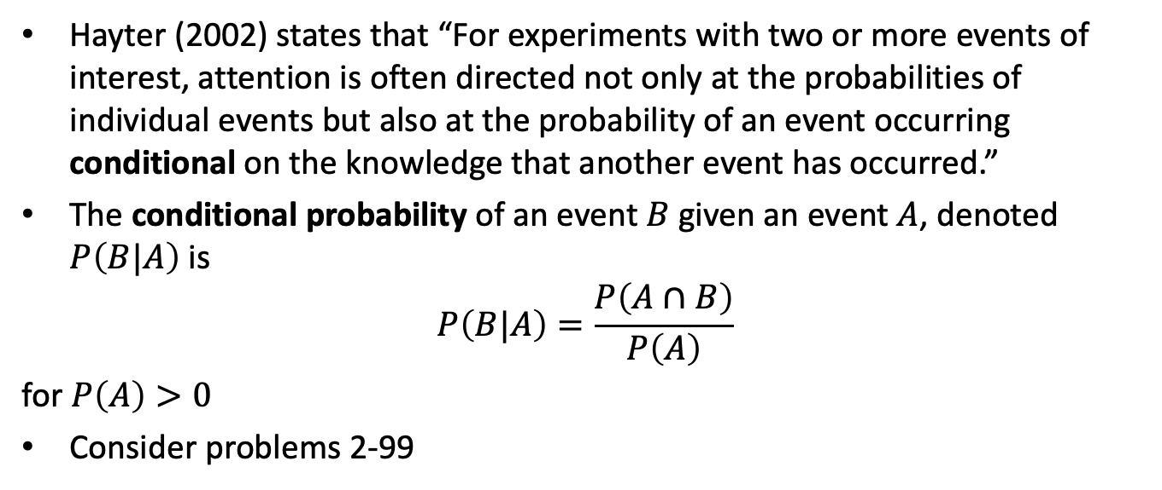
Conditional Probability
Hayter (2002) states that “For experiments with two or more events of interest, attention is often directed not only at the probabilities of individual events but also at the probability of an event occurring conditional on the knowledge that another event has occurred.”
The conditional probability of an event $B$ given an event $A$, denoted $P\left(B|A\right)$ is
$$P\left(B|A\right)=\frac{P\left(A∩B\right)}{P\left(A\right)}$$
for $P\left(A\right)>0$
Consider problems 2-99

Slide 17
Multiplication Rules
This rule provides another method for calculating $P\left(A∩B\right)$
$\begin{matrix}P\left(A∩B\right) & = & P\left(A|B\right)P\left(B\right)=P\left(B|A\right)P\left(A\right)\end{matrix}$
This leads to the total probability rule
$\begin{matrix}P\left(B\right) & = & P\left(B∩A\right)+P\left(B∩A^{′}\right) \\ & = & P\left(B|A\right)P\left(A\right)+P\left(B|A^{′}\right)P\left(A^{′}\right) \\ & & \end{matrix}$
Consider problems from 3rd edition (next slide) and 2-129

Slide 18
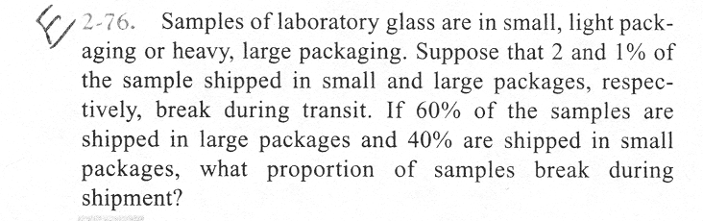
Example Problem 2-76
problem 2-76

Slide 19
Independent Events
Two events are independent if any one of the following is true:
$P\left(A|B\right)=P\left(A\right)$
$P\left(B|A\right)=P\left(B\right)$
$P\left(A∩B\right)=P\left(A\right)P\left(B\right)$
Consider problem 2-146

Slide 20
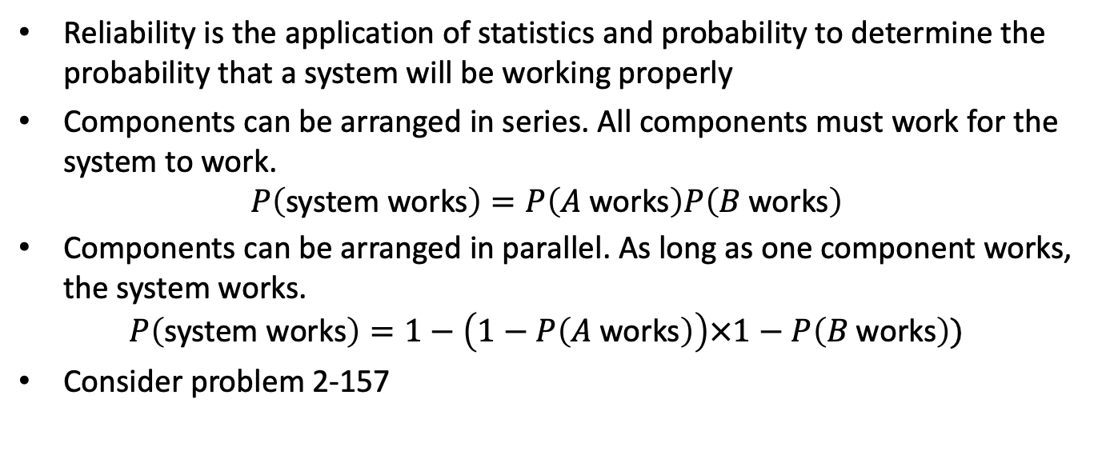
Reliability Analysis
Reliability is the application of statistics and probability to determine the probability that a system will be working properly
Components can be arranged in series. All components must work for the system to work.
$$P\left(\text{system} \text{works}\right)=P\left(A \text{works}\right)P\left(B \text{works}\right)$$
Components can be arranged in parallel. As long as one component works, the system works.
$$P\left(\text{system} \text{works}\right)=1−\left(1−P\left(A \text{works}\right)\right)×1−P\left(B \text{works}\right))$$
Consider problem 2-157

