Slide 1
MANE 3332.05

Slide 2
Lecture 12

Slide 3
Agenda
Continue Chapter 4 lectures - Normal Practice Problems
Old Midterm posted
Standard Normal Quiz (assigned 10/7/2025, due 10/9/2025)
Normal Practice Problems (assigned 10/9/2025, due 10/14/2025)
Schedule

Slide 4
Handouts
Lecture 12 Slides - Powerpoint
Lecture 12 Slides - marked (pdf)

Slide 5
Tuesday Date and Topic(s) | Thursday Date and Topic(s)
10/7: normal distribution | 10/9: normal practice problems
10/14: Exponential and Weibull distributions | 10/16: Chapter 5 (not on midterm)
10/21: Midterm Review | 10/23: Midterm Exam

Slide 6
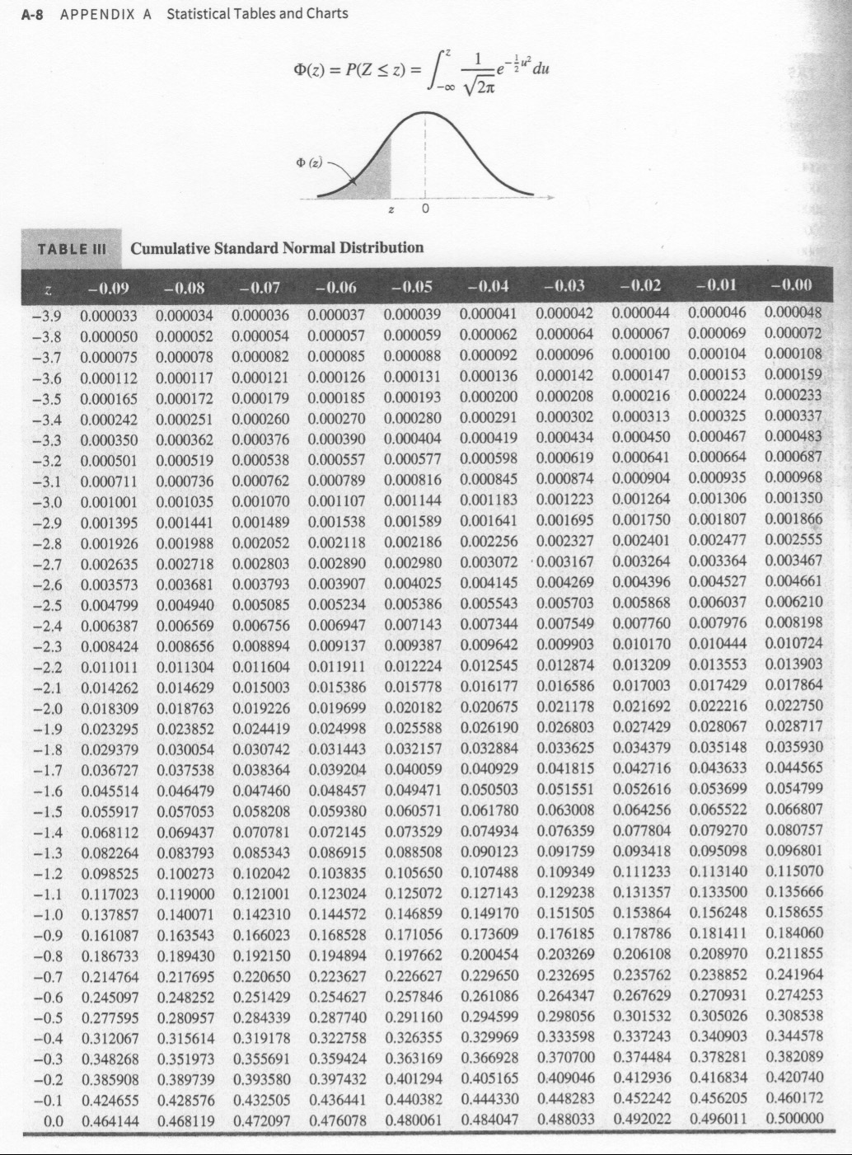
Cumulative Standard Normal Distribution
page A-8

Slide 7
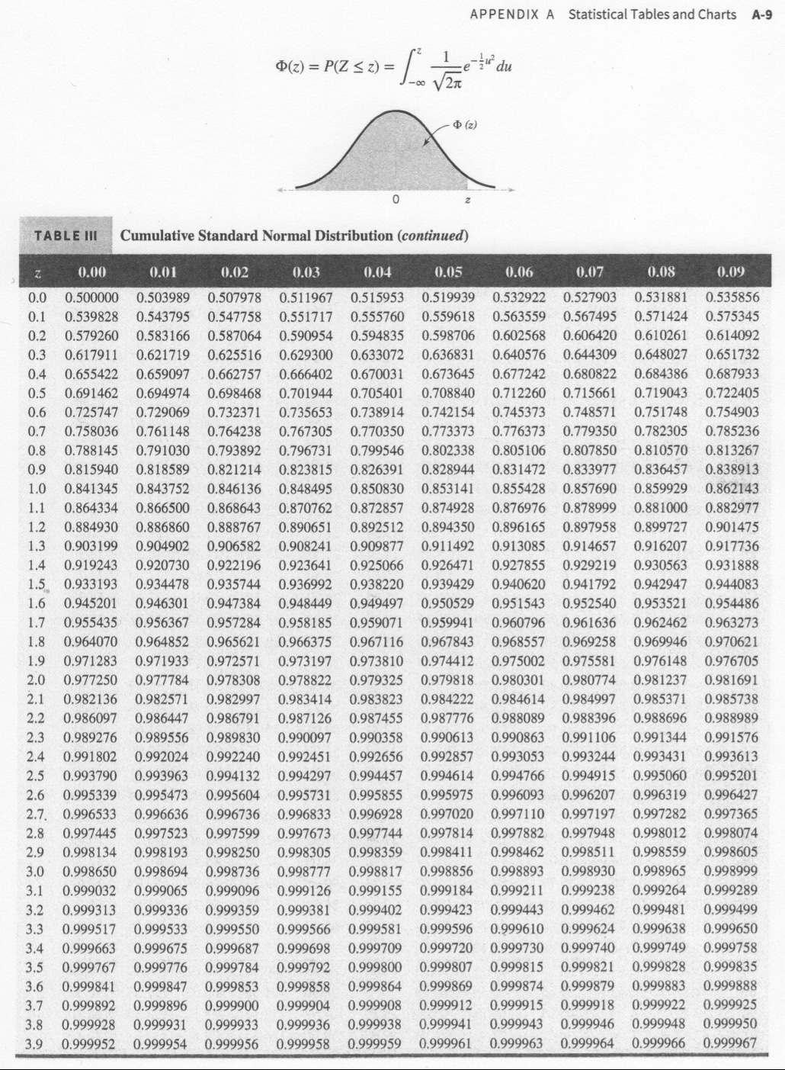
Cumulative Standard Normal Distribution
page A-9

Slide 8
Standardizing (the $z$-transform)
Suppose $X$ is a normal random variable with mean $μ$ and variance $σ^{2}$
$$P\left(X≤x\right)=P\left(\frac{X−μ}{σ}≤\frac{x−μ}{σ}\right)=P\left(Z≤z\right)$$
The $z$-value is $z=\left(x−μ\right)/σ$
Result allows the standard normal tables to be used to calculate probabilities for any normal distribution

Slide 9
Normal Practice Problems

Slide 10
Normal Approximation to the Binomial Distribution
If $X$ is a binomial random variable,
$$Z=\frac{X−np}{\sqrt{np\left(1−p\right)}}$$
is approximately a standard normal random variable. Consequently, probabilities computed from $Z$ can be used to approximate probabilities for $X$
Usually holds when
$$np>5 \text{and} n\left(1−p\right)>5$$

Slide 11
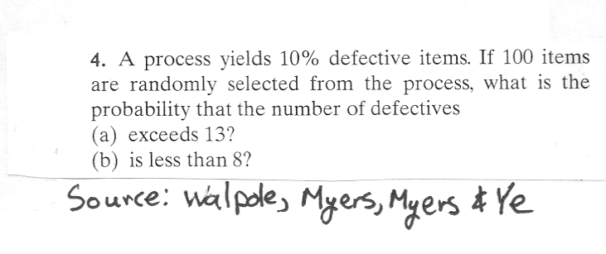
How good are the approximations?
Problem
image

Slide 12
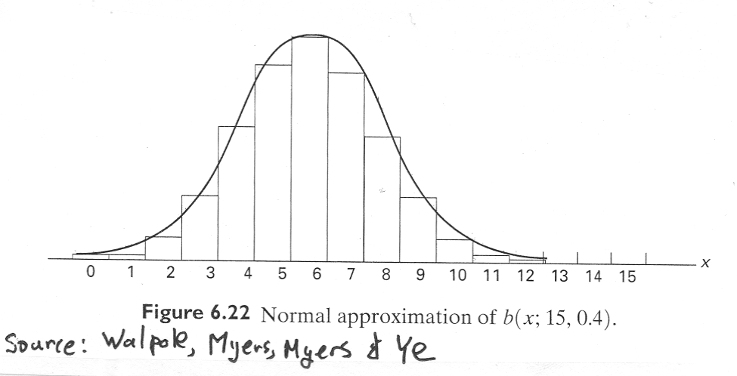
Normal Approximation - Figure
image

Slide 14
Rework Problem using Continuity Correction Factor
Are the approximations improved?

Slide 15
Normal Approximation to the Poisson Distribution
If $X$ is a Poisson random variable with $E\left(X\right)=λ$ and $V\left(X\right)=λ$,
$$Z=\frac{X−λ}{\sqrt{λ}}$$
is approximately a standard normal random variable.

Slide 16
Exponential Distribution
The exponential distribution is widely used in the area of reliability and life-test data.
Ostle, et. al. (1996) list the following applications of the exponential distribution
  the number of feet between two consecutive erroneous records on a computer tape,
  the lifetime of a component of a particular device,
  the length of a life of a radioactive material and
  the time to the next customer service call at a service desk

Slide 17
Exponential Distribution
The PDF for an exponential distribution with parameter $λ>0$ is
$$f\left(x\right)=λe^{−λx}, \text{for} 0≤x<∞$$
The mean of $X$ is
$$μ=E\left(X\right)=\frac{1}{λ}$$
The variance of $X$ is
$$σ^{2}=V\left(X\right)=\frac{1}{λ^{2}}$$
Note that other authors define $f\left(x\right)=\frac{1}{θ}e^{−x/θ}$. Either definition is acceptable. However one must be aware of which definition is being used.

Slide 18
The Exponential CDF
The CDF for the exponential distribution is easy to derive
$$\begin{matrix}F\left(x\right) & = & P\left(X≤x\right)=\int_{−∞}^{x}{λ}e^{−λy} dy \\ & = & \int_{0}^{x}{λ}e^{−λy} dy \\ & = & {\left.\left(−e^{−λy}\right)\right|}_{y=0}^{x} \\ & = & −e^{−λx}−\left(−e^{0}\right) \\ & = & −e^{−λx}+1 \\ & = & 1−e^{−λx}\end{matrix}$$

Slide 19
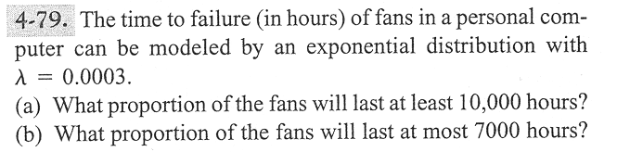
Problem 4-79
image

Slide 20
Lack of Memory Property
The mathematical definition is
$$P\left(X<t_{1}+t_{2}|X>t_{1}\right)=P\left(X<t_{2}\right)$$
That is “the probability of a failure time that is less than $t_{1}+t_{2}$ given the failure time is greater than $t_{1}$ is the probability that the item’s failure time is less than $t_{2}$
This property is unique to the exponential distribution
Often used to model the reliability of electronic components.

Slide 21
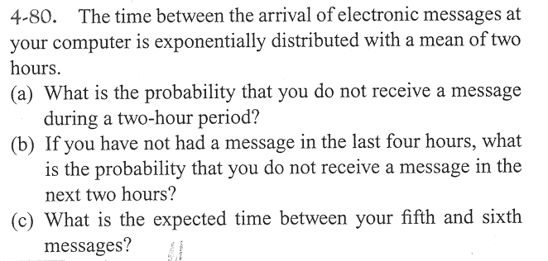
Problem 4–80
image

Slide 22
Relationship to the Poisson Distribution
Let $Y$ be a Poisson random variable with parameter $λ$. Note: $Y$ represents the number of occurrences per unit
Let $X$ be a random variable that records the time between occurrences for the same process as $Y$
$X$ has an exponential distribution with parameter $λ$

Slide 23
Lognormal Distribution
Let $W$ have a normal distribution with mean $θ$ and variance $ω^{2}$; then $X=exp\left(W\right)$ is a lognormal random variable with pdf
$$f\left(x\right)=\frac{1}{xω\sqrt{2π}}exp\left[−\frac{{\left(ln\left(x\right)−θ\right)}^{2}}{2ω^{2}}\right] 0<x<∞$$
The mean of $X$ is
$$E\left(X\right)=e^{θ+ω^{2}/2}$$
The variance of $X$ is
$$V\left(X\right)=e^{2θ+ω^{2}}\left(e^{ω^{2}}−1\right)$$

Slide 24
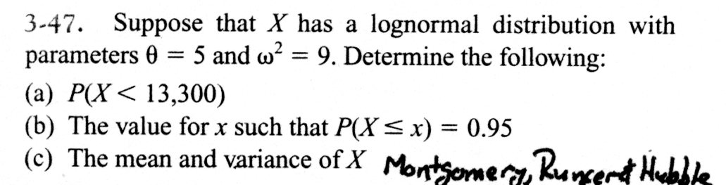
Example Problem
image

Slide 25
Gamma Distribution
The random variable $X$ with pdf
$$f\left(x\right)=\frac{λ^{r}x^{r−1}e^{−λx}}{Γ\left(r\right)}, \text{for} x>0$$
is a gamma random variable with parameters $λ>0$ and $r>0$.
The gamma function is
$$Γ\left(r\right)=\int_{0}^{∞}{x^{r−1}}e^{−x} dx \text{for} r>0$$
with special properties:
$Γ\left(r\right)$ is finite
$Γ\left(r\right)=\left(r−1\right)Γ\left(r−1\right)$
For any positive integer $r$, $Γ\left(r\right)=\left(r−1\right)!$
  $Γ\left(1/2\right)=π^{1/2}$

Slide 26
Gamma Distribution
The mean and variance are
$$μ=E\left(X\right)=r/λ \text{and} σ^{2}=V\left(X\right)=r/λ^{2}$$
We will not work any probability problems using the gamma distribution

Slide 27
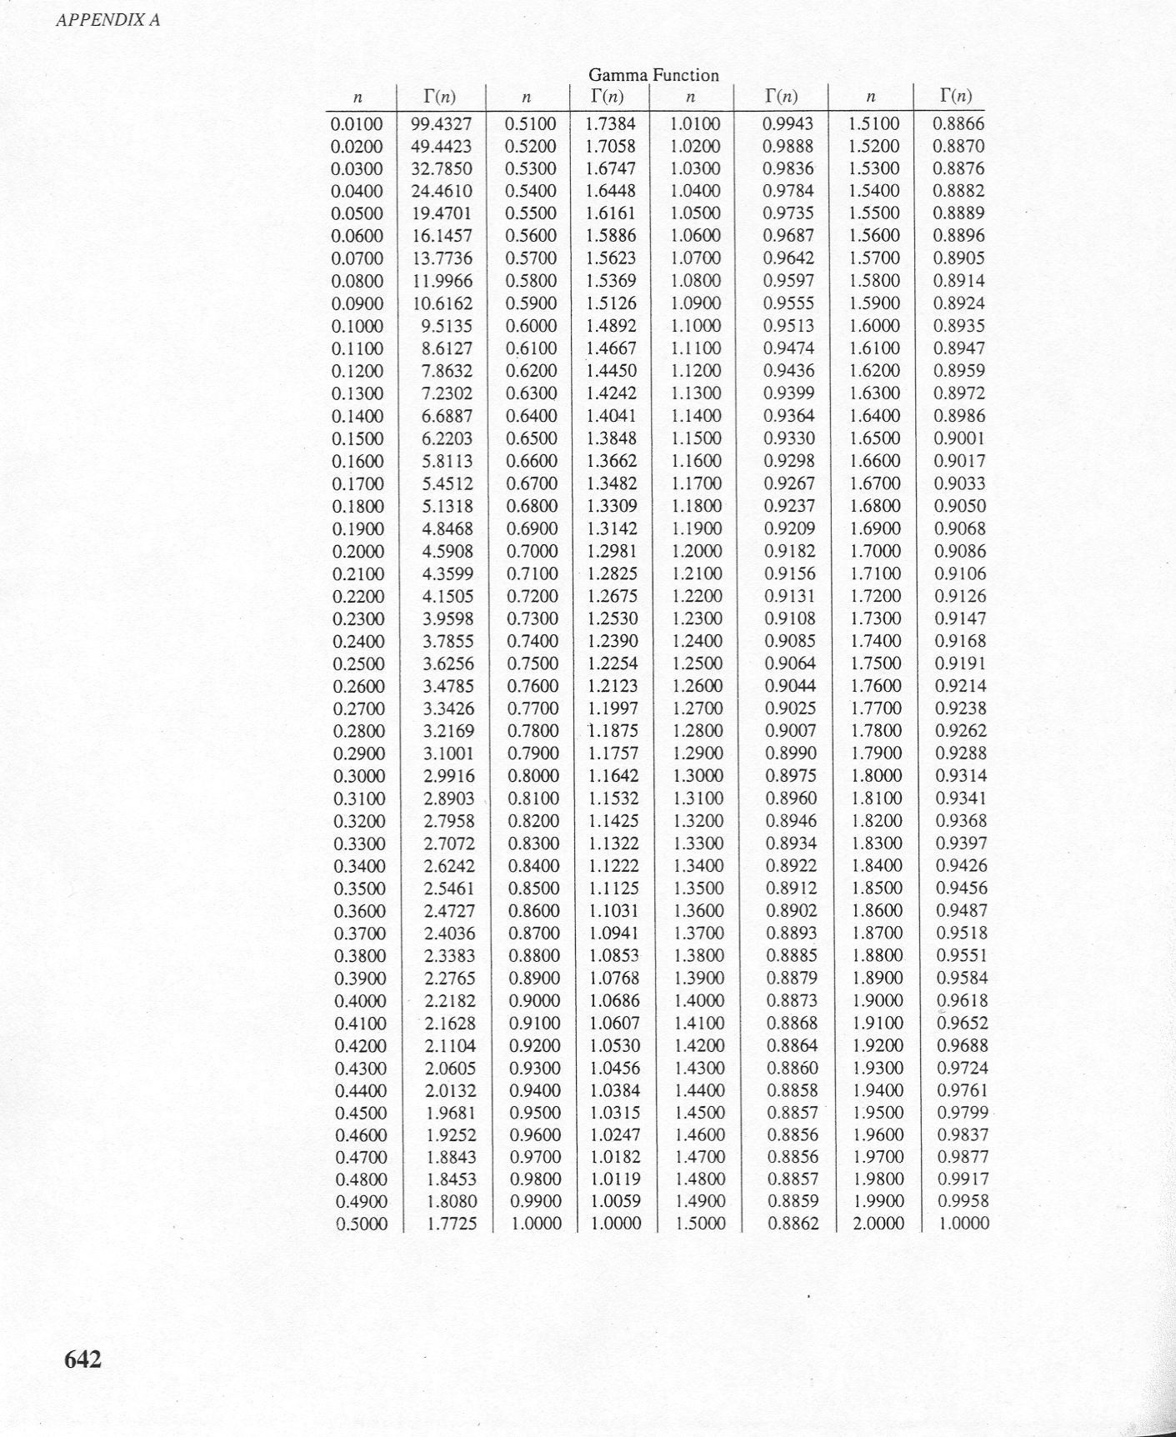
Gamma Tables
image

Slide 28
Weibull Distribution
The random variable $X$ with pdf
$$f\left(x\right)=\frac{β}{δ}{\left(\frac{x}{δ}\right)}^{β−1}exp\left[−{\left(\frac{x}{δ}\right)}^{β}\right], \text{for} x>0$$
is a Weibull random variable with scale parameter $δ>0$ and shape parameter $β>0$
The CDF for the Weibull distribution is
$$F\left(x\right)=1−exp\left[−{\left(\frac{x}{δ}\right)}^{β}\right]$$
The mean of the Weibull distribution is
$$μ=E\left(X\right)=δΓ\left(1+\frac{1}{β}\right)$$
The variance of the Weibull distribution is
$$σ^{2}=V\left(X\right)=δ^{2}Γ\left(1+\frac{2}{β}\right)−δ^{2}{\left[Γ\left(1+\frac{1}{β}\right)\right]}^{2}$$

Slide 29
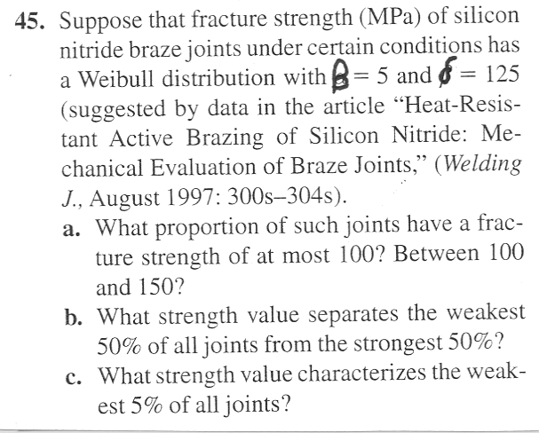
Weibull Problem
image

Slide 30
Weibull Practice Problems

