Slide 1
MANE 3332.05

Slide 2
Lecture 13

Slide 3
Agenda
Continue Chapter 4 lectures - Exponential and Weibull Distributions
Normal Practice Problems (assigned 10/9/2025, due 10/14/2025)
Normal Quiz (assigned 10/14/2025, due 10/16/2026)
Exponential Practice Problems (assigned 10/14/2025, due 10/16/2025)
Schedule

Slide 4
Handouts
Lecture 13 Slides - Powerpoint
Lecture 13 Slides - marked (pdf)

Slide 5
Tuesday Date and Topic(s) | Thursday Date and Topic(s)
10/14: Exponential and Weibull distributions | 10/16: Chapter 5 (not on midterm)
10/21: Midterm Review | 10/23: Midterm Exam

Slide 6
Exponential Distribution
The exponential distribution is widely used in the area of reliability and life-test data.
Ostle, et. al. (1996) list the following applications of the exponential distribution
the number of feet between two consecutive erroneous records on a computer tape,
the lifetime of a component of a particular device,
the length of a life of a radioactive material and
the time to the next customer service call at a service desk

Slide 7
Exponential Distribution
The PDF for an exponential distribution with parameter $λ>0$ is
$$f(x)=λe^{−λx}, \text{ for }0≤x<∞$$
The mean of $X$ is
$$μ=E(X)=\frac{1}{λ}$$
The variance of $X$ is
$$σ^{2}=V(X)=\frac{1}{λ^{2}}$$
Note that other authors define $f(x)=\frac{1}{θ}e^{−x/θ}$. Either definition is acceptable. However one must be aware of which definition is being used.

Slide 8
The Exponential CDF
The CDF for the exponential distribution is easy to derive
$$\begin{matrix}F(x) & = & P(X≤x)=\int_{−∞}^{x}{λ}e^{−λy} dy \\ & = & \int_{0}^{x}{λ}e^{−λy} dy \\ & = & {\left.\left(−e^{−λy}\right)\right|}_{y=0}^{x} \\ & = & −e^{−λx}−(−e^{0}) \\ & = & −e^{−λx}+1 \\ & = & 1−e^{−λx}\end{matrix}$$

Slide 9
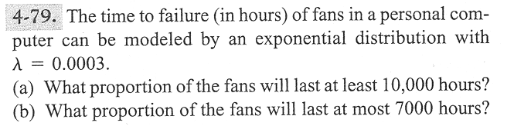
Problem 4-79
image

Slide 10
Lack of Memory Property
The mathematical definition is
$$P(X<t_{1}+t_{2}|X>t_{1})=P(X<t_{2})$$
That is “the probability of a failure time that is less than $t_{1}+t_{2}$ given the failure time is greater than $t_{1}$ is the probability that the item’s failure time is less than $t_{2}$
This property is unique to the exponential distribution
Often used to model the reliability of electronic components.

Slide 11
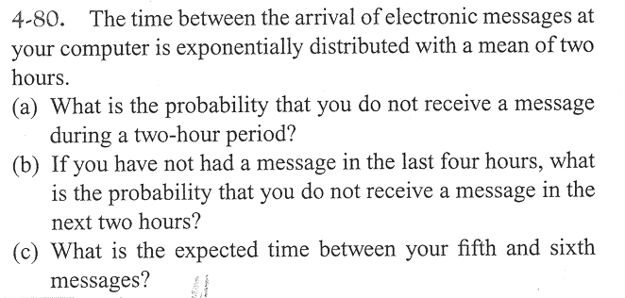
Problem 4–80
image

Slide 12
Relationship to the Poisson Distribution
Let $Y$ be a Poisson random variable with parameter $λ$. Note: $Y$ represents the number of occurrences per unit
Let $X$ be a random variable that records the time between occurrences for the same process as $Y$
$X$ has an exponential distribution with parameter $λ$

Slide 13
Lognormal Distribution
Let $W$ have a normal distribution with mean $θ$ and variance $ω^{2}$; then $X=exp(W)$ is a lognormal random variable with pdf
$$f(x)=\frac{1}{xω\sqrt{2π}}exp\left[−\frac{{\left(ln(x)−θ\right)}^{2}}{2ω^{2}}\right] 0<x<∞$$
The mean of $X$ is
$$E(X)=e^{θ+ω^{2}/2}$$
The variance of $X$ is
$$V(X)=e^{2θ+ω^{2}}\left(e^{ω^{2}}−1\right)$$

Slide 14
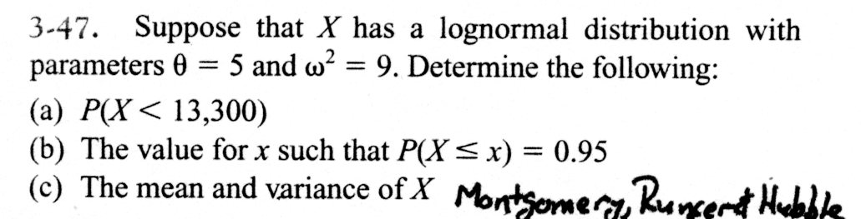
Example Problem
image

Slide 15
Gamma Distribution
The random variable $X$ with pdf
$$f(x)=\frac{λ^{r}x^{r−1}e^{−λx}}{Γ(r)}, \text{for }x>0$$
is a gamma random variable with parameters $λ>0$ and $r>0$.
The gamma function is
$$Γ(r)=\int_{0}^{∞}{x^{r−1}}e^{−x} dx \text{for }r>0$$
with special properties:
$Γ(r)$ is finite
$Γ(r)=(r−1)Γ(r−1)$
For any positive integer $r$, $Γ(r)=(r−1)!$
$Γ(1/2)=π^{1/2}$

Slide 16
Gamma Distribution
The mean and variance are
$$μ=E(X)=r/λ\text{ and }σ^{2}=V(X)=r/λ^{2}$$
We will not work any probability problems using the gamma distribution

Slide 17
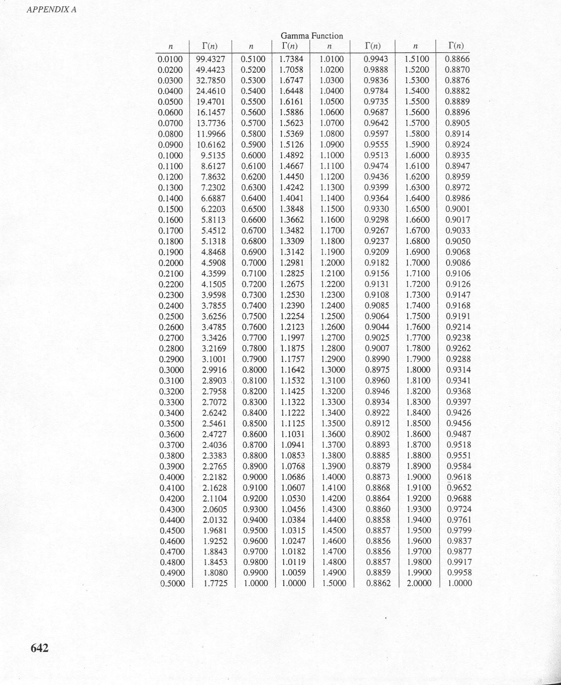
Gamma Tables
image

Slide 18
Weibull Distribution
The random variable $X$ with pdf
$$f(x)=\frac{β}{δ}{\left(\frac{x}{δ}\right)}^{β−1}exp\left[−{\left(\frac{x}{δ}\right)}^{β}\right], \text{ for }x>0$$
is a Weibull random variable with scale parameter $δ>0$ and shape parameter $β>0$
The CDF for the Weibull distribution is
$$F(x)=1−exp\left[−{\left(\frac{x}{δ}\right)}^{β}\right]$$
The mean of the Weibull distribution is
$$μ=E(X)=δΓ\left(1+\frac{1}{β}\right)$$
The variance of the Weibull distribution is
$$σ^{2}=V(X)=δ^{2}Γ\left(1+\frac{2}{β}\right)−δ^{2}{\left[Γ\left(1+\frac{1}{β}\right)\right]}^{2}$$

Slide 19
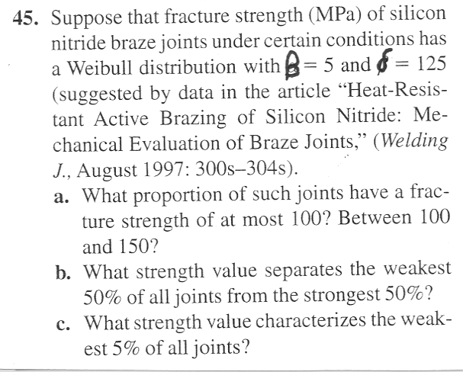
Weibull Problem
image

