Slide 1
MANE 3332.05

Slide 2
Lecture 14
Agenda
Start Part Two of Course
Major Quiz Announcement
  All Part One Quizzes will be modified to two attempts and highest grade counted
  Deadline for completing Part One Quizzes is 10/23/2025 12:30 PM
Normal Quiz (assigned 10/14/2025, due 10/16/2026)
Exponential Practice Problems (assigned 10/14/2025, due 10/16/2025)
Exponential Quiz (assigned 10/16/2025, due 10/23/2025)
Schedule
Attendance
Questions?

Slide 3
Handouts
Lecture 14 slides (Powerpoint)
Lecture 14 slides - marked (pdf)

Slide 4
Tuesday Date and Topic(s) | Thursday Date and Topic(s)
10/14: Exponential and Weibull distributions | 10/16: Chapter 5 (not on midterm)
10/21: Midterm Review | 10/23: Midterm Exam
Class Schedule

Slide 5
Chapter Five
Joint Probability Distributions
Contains eight sections
We will only examine 5.4 (Covariance and Correlation) and 5.6 (linear functions of random variables)

Slide 6
Covariance and Correlation
Covariance
When two or more variables are defined on a probability space, it is useful to describe how they vary together
A common measure of the relationship between two random variables is the covariance
$$\begin{matrix}σ_{XY} & = & E\left(XY\right)−μ_{X}μ_{Y}\end{matrix}$$

Slide 7
Covariance, continued
Theoretically for two continuous random variables with joint probability distribution function $f_{XY}\left(x,y\right)$, the covariance is found by
$$\begin{matrix}σ_{XY} & = & \int_{−∞}^{∞}{\int_{−∞}^{∞}{x}}yf_{XY}\left(x,y\right)dxdy−μ_{X}μ_{Y}\end{matrix}$$

Slide 8
Covariance and Independence
If $X$ and $Y$ are independent random variables,
$$σ_{XY}=0$$
However, $σ_{XY}=0$ does not imply that $X$ and $Y$ are independent. Textbook mentions Figure 5-13(d)
SPECIAL CASE. IF $X$ and $Y$ are normal random variables and have $σ_{XY}=0$, then $X$ and $Y$ are independent

Slide 9
Sample Covariance
To calculate the sample covariance use
$$s_{XY}=\frac{1}{n}\sum_{i=1}^{n}{\left(x_{i}−\overset{‾}{x}\right)}\left(y_{i}−\overset{‾}{y}\right)$$
Easily done in software

Slide 10
Correlation
The correlation between two random variables $X$ and $Y$ is
$$ρ_{XY}=\frac{\text{cov}\left(X,Y\right)}{\sqrt{V\left(X\right)V\left(Y\right)}}=\frac{σ_{XY}}{σ_{X}σ_{Y}}$$
For any two random variables $X$ and $Y$
$$−1≤ρ_{XY}≤1$$
If $X$ and $Y$ are independent $ρ_{XY}=0$. The converse is not true.

Slide 11
Sample Correlation Coefficient
To calculate the sample correlation coefficient,
$$r_{XY}=\frac{s_{XY}}{\sqrt{S_{X}^{2}S_{Y}^{2}}}$$

Slide 12
Summary
Correlation is a linear measure and will not work for non-linear relationships
Correlation is a measure of association; it does not prove cause and effect relationships
  -Examine examples at Spurious Correlations website

Slide 13
Linear Functions of Random Variables
Functions of Random Variables
Additive System. Let $X$ be a random variable with mean $μ$ and variance $σ^{2}$. Define a new random variable $Y$
$$Y=X+c$$
It follows that
$$\begin{matrix}E\left(Y\right) & = & E\left(X\right)+c=μ+c \\ V\left(Y\right) & = & V\left(X\right)+0=σ^{2}\end{matrix}$$

Slide 14
Linear Functions of Random Variables
Functions of Random Variables
Multiplicative System. Consider the new random variable $Y$
$$Y=cX$$
It follows that
$$\begin{matrix}E\left(Y\right) & = & E\left(cX\right)=cE\left(X\right)=cμ \\ V\left(Y\right) & = & V\left(cX\right)=c^{2}V\left(x\right)=c^{2}σ^{2}\end{matrix}$$

Slide 15
Linear Combination
A linear combination of the random variables $X_{1},X_{2},…,X_{n}$ is
$$Y=c_{1}X_{1}+c_{2}X_{2}+⋯+c_{n}X_{n}$$
The mean of a linear combination of random variables is
$$E\left(Y\right)=c_{1}μ_{1}+c_{2}μ_{2}+⋯+c_{n}μ_{n}$$
The variance of a linear combination of random variables is
$$V\left(Y\right)=c_{1}^{2}σ_{1}^{2}+c_{s}^{2}σ_{s}^{2}+⋯+c_{n}^{2}σ_{n}^{2}$$

Slide 16
Linear Combination of Non-independent R.V.
Let $X_{1},X_{2},…,X_{n}$ be random variables with means $E\left(X_{i}\right)=μ_{i}$, variances $V\left(X_{i}\right)=σ_{i}^{2}$ and covariances $\text{Cov}\left(X_{i},X_{j}\right)$ for $i,j=1,2,…,n$ with $i<j$
The linear combination is defined to be
$$Y=c_{1}X_{1}+c_{2}X_{2}+⋯+c_{n}X_{n}$$
The mean of $Y$ is
$$E\left(Y\right)=c_{1}μ_{1}+c_{2}μ_{2}+⋯+c_{n}μ_{n}$$

Slide 17
Linear Combination of Non-independent R.V.
and the variance is
$$\begin{matrix}V\left(Y\right) & = & c_{1}^{2}σ^{2}+c_{2}^{2}σ^{2}+⋯+c_{n}^{2}σ_{n}^{2} \\ & & +2{∑∑}_{i<j}c_{i}c_{j}\text{Cov}\left(X_{i},X_{j}\right)\end{matrix}$$

Slide 18
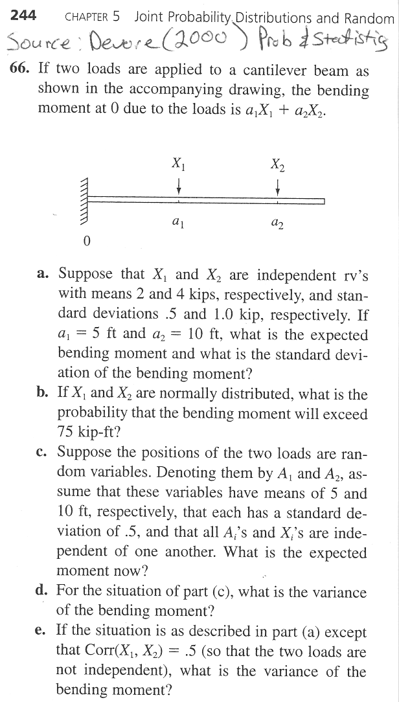
Linear Combination Problem
linear combination problem

Slide 19
Linear Combination Practice Problems

Slide 20
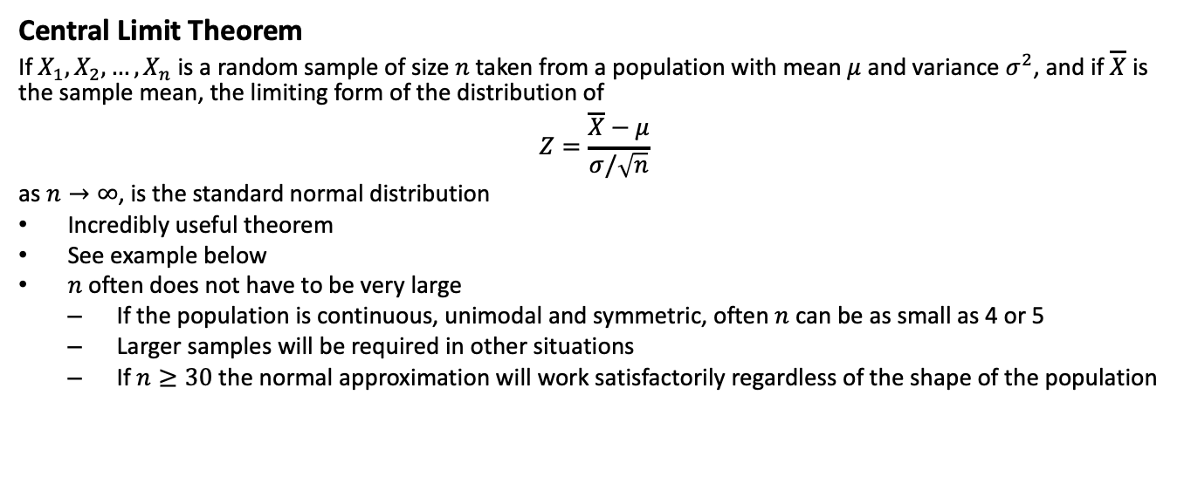
Central Limit Theorem
If $X_{1},X_{2},…,X_{n}$ is a random sample of size $n$ taken from a population with mean $μ$ and variance $σ^{2}$, and if $\overline{X}$ is the sample mean, the limiting form of the distribution of
$$Z=\frac{\overline{X}−μ}{σ/\sqrt{n}}$$
as $n→∞$, is the standard normal distribution
Incredibly useful theorem
See example below
$n$ often does not have to be very large
  If the population is continuous, unimodal and symmetric, often $n$ can be as small as 4 or 5
  Larger samples will be required in other situations
  If $n≥30$ the normal approximation will work satisfactorily regardless of the shape of the population

Slide 21
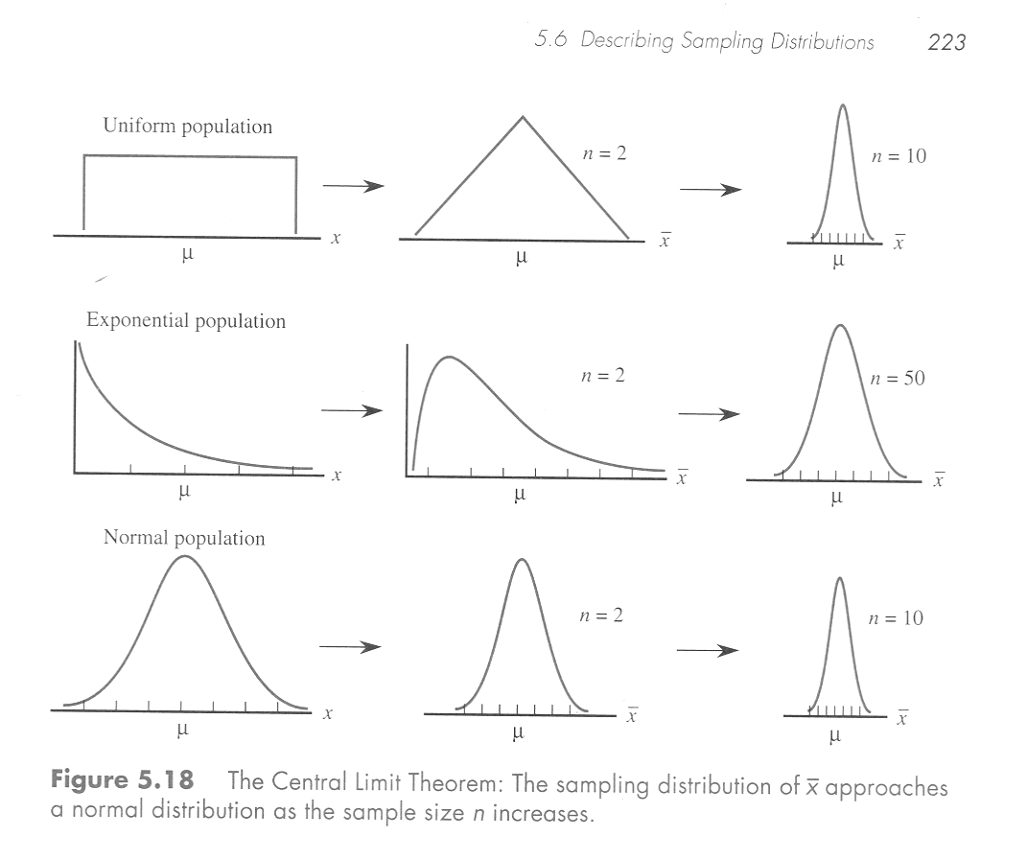
CLT Illustration
central limit theorem illustration

