Slide 1
MANE 3351

Slide 2
Lecture 11

Slide 3
Classroom Management
Agenda
Test 1 not graded
Lab 4 extended until end of day on Thursday October 9, 2025
Newton’s Method

Slide 4
Resources

Slide 5
Handouts
Lecture 11 Slides
Lecture 11 Marked Slides

Slide 6
Newton’s Method
Both the bisection and False Position methods were bracketing approaches to find roots that required two starting points that “bracketed” the root. Today’s topic, Newton’s method or Newton-Raphson method, require only one starting point. Newton’s method also requires the knowledge of the derivative.

Slide 7
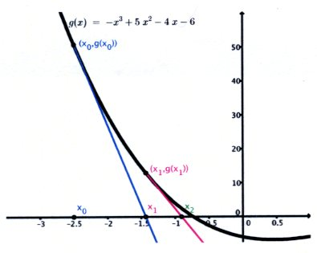
Geometric Inspiration
Brin (2020)¹ demonstrate the geometric inspiration for Newton’s method
Newton’s Method

Slide 8
Newton’s Method
The formula is simply
$$x_{i+1}=x_{i}−\frac{f\left(x_{i}\right)}{f^{′}\left(x_{i}\right)}$$

Slide 9
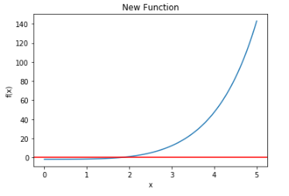
New Example Problem
Consider a new function, $f\left(x\right)=e^{x}+2^{−x}+2cos\left(x\right)−6=0$
Example Function for Newton’s Method

Slide 10
First Derivative
Newton’s Method requires the first derivative:
$$\frac{d}{dx}\left[e^{x}+2^{−x}+2cos\left(x\right)\right]=e^{x}−2^{−x}ln\left(x\right)−2sin\left(x\right)$$

Slide 11
Review of Derivatives
An excellent table derivatives is found at Table of Derivatives
A helpful site is Derivative Calculator

Slide 12
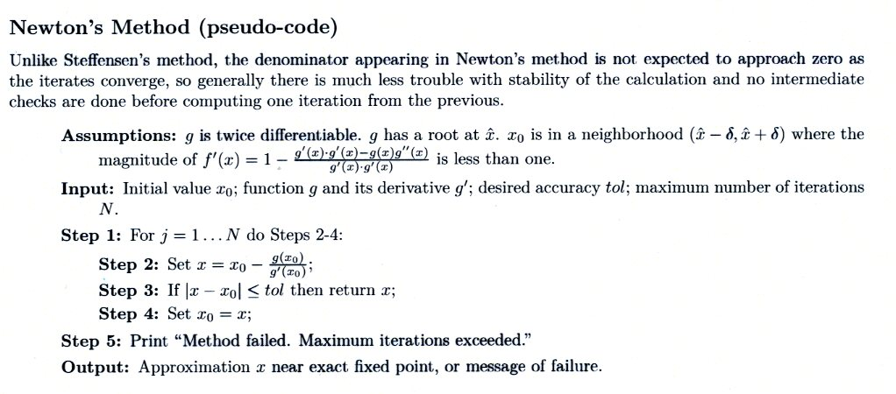
Pseudo-code
Brin (2020)²provides the following pseudo-code
Newton’s Method pseducode

Slide 13
Vectorizing a Function
All Python functions considered so far have operated on scalars
Functions can be created to process a vector of values with a single call. This is called a vectorized function
Consider plotting the new function defined earlier using a vectorized function

Slide 14
Vectorized Function Code
import math import numpy as np import matplotlib.pyplot as plt # def f(x): return (math.exp(x)+2**-x+2*math.cos(x)-6) # convert f(x) in a vectorized function that can be applied to array vec_f=np.vectorize(f) x=np.linspace(0,5,101) #print(x) # y=f(x) f_x=vec_f(x) #print(f_x) fig, ax = plt.subplots() ax.plot(x,f_x) ax.axhline(y=0.0, color='r', linestyle='-') ax.set(xlabel='x', ylabel='f(x)', title='New Function') plt.show()

Slide 15
Newton Raphson Python Code
import math def f(x): return (math.exp(x)+2**(-x)+2*math.cos(x)-6) def f_prime(x): return(math.exp(x)-2.0**(-x)*math.log(2.0)-2*math.sin(x)) N=100 tol=0.0005 x_0=3.5 counter=0 for j in range(N+1): counter=counter+1 x=x_0-f(x_0)/f_prime(x_0) print("x={}".format(x)) if math.fabs(x-x_0)<tol: print("the root is {} with value {}, required {} steps".format(x,f(x),counter)) break x_0=x print("completed")

Slide 16
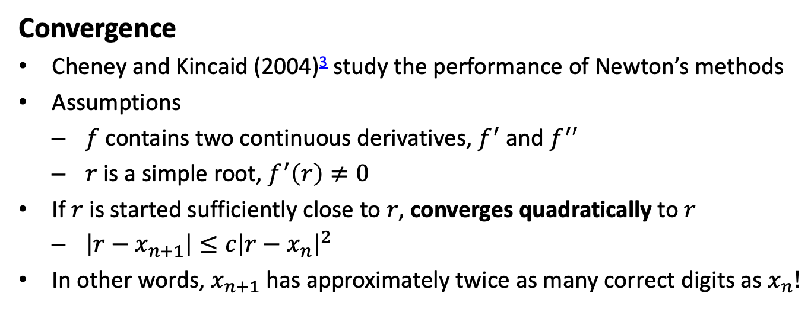
Convergence
Cheney and Kincaid (2004)³ study the performance of Newton’s methods
Assumptions
$f$ contains two continuous derivatives, $f^{′}$ and $f^{′′}$
$r$ is a simple root, $f^{′}\left(r\right)≠0$
If $r$ is started sufficiently close to $r$, converges quadratically to $r$
$\left|r−x_{n+1}\right|≤c{\left|r−x_{n}\right|}^{2}$
In other words, $x_{n+1}$ has approximately twice as many correct digits as $x_{n}!$

Slide 17
Other Comments
Kiusalaas (2013)⁴ provides the following introduction to the Newton-Raphson Method
The Newton-Raphson algorithm is the best known method of finding roots for a good reason: It is simple and fast. The only drawback of the methods is that it uses the derivative $f^{′}\left(x\right)$ of the function as well as the function $f\left(x\right)$ itself. Therefore, the Newton-Raphson method is usable only in problems where $f^{′}\left(x\right)$ can be readily computed.

Slide 18
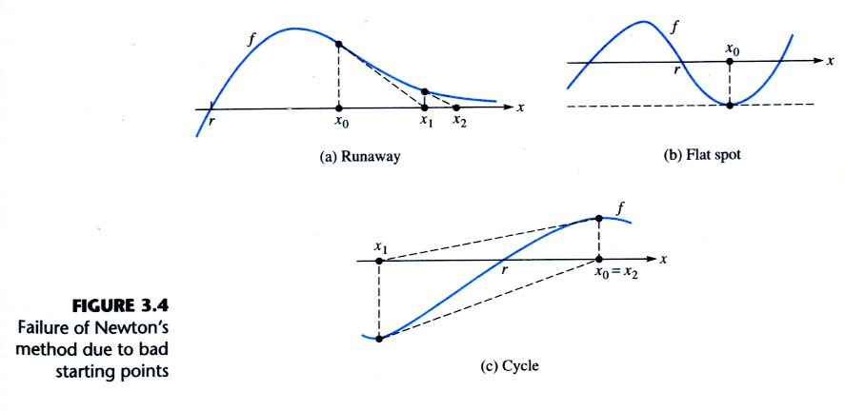
Importance of Good Starting Point
Cheney and Kincaid (2004)⁵, provide several illustrations of bad starting points and the problems that can occur.
Bad Starting Points

Slide 19
Notes
1. Brin, L, (2020), Tea Time Numerical Analysis: Experiences in Mathematics, 3rd edition
2. Brin, L, (2020), Tea Time Numerical Analysis: Experiences in Mathematics, 3rd edition
3. Cheny, W., and Kincaid, D., (2004), Numerical Mathematics and Computer, 5th edition
4. Kiusalaas, J., (2013), Numerical Methods in Engineering with Python 3
5. Cheny, W., and Kincaid, D., (2004), Numerical Mathematics and Computer, 5th edition

