Slide 1
MANE 3351

Slide 2
Lecture 12
Classroom Management
Agenda
Test 1 graded. Will return after lecture and before lab
Discuss Schedule
Lecture: Secant Method; last root finding method
Lab Session: Lab Five - GitHub/GitHub Desktop

Slide 3
Calendar
Week | Monday Lecture | Wednesday Lecture
7 | 10/13: Secant Method | 10/15: Trapezoid Rule
8 | 10/20: Simpson’s Rule | 10/22: Romberg Integration
9 | 10/27: Gaussian Quadrature | 10/29: Numerical Differentiation (not on Test 2)
10 | 11/3: Linear Algebra | 11/5: Test 2 (Root Finding and Numerical Integration)

Slide 4
Resources
Handouts
Lecture 12 Slides
Lecture 12 Marked Slides

Slide 5
Lecture 12 Content
Today’s topic is the secant method.
The secant method does not utilize derivative information as Newton’s method does.
The secant method is also similar to the false position method.
The secant method is the last root finding method covered

Slide 6
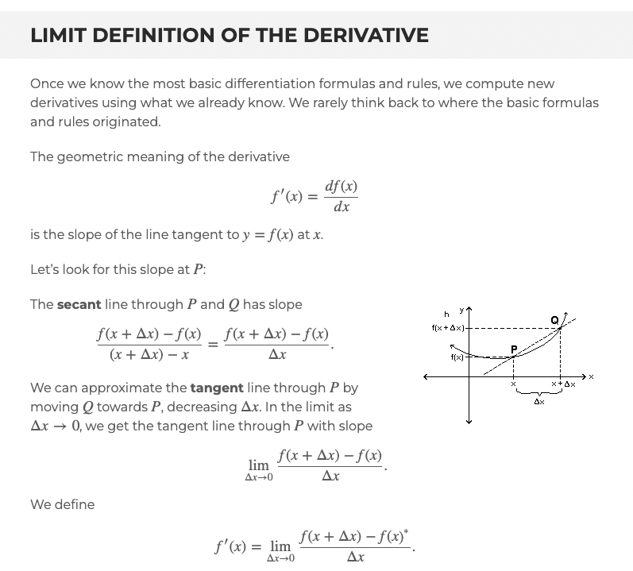
Limit Definition of the Derivative
Recall the limit definition of the derivative¹
Definition of Derivative

Slide 7
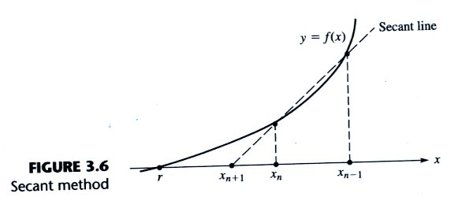
Geometric Inspiration
Cheney and Kincaid (2004)² demonstrate the geometric inspiration for secant method
Secant method

Slide 8
Secant Method
The formula is simply
$$x_{n+1}=x_{n}−g\left(x_{n}\right)\frac{x_{n}−x_{n−1}}{g\left(x_{n}\right)−g\left(x_{n−1}\right)}$$

Slide 9
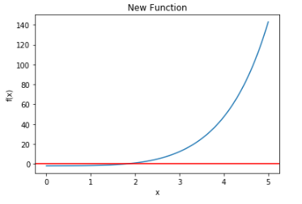
Example Problem Used for Newton’s Method
Consider a new function, $f\left(x\right)=e^{x}+2^{−x}+2cos\left(x\right)−6=0$
Example Function for Newton’s method

Slide 10
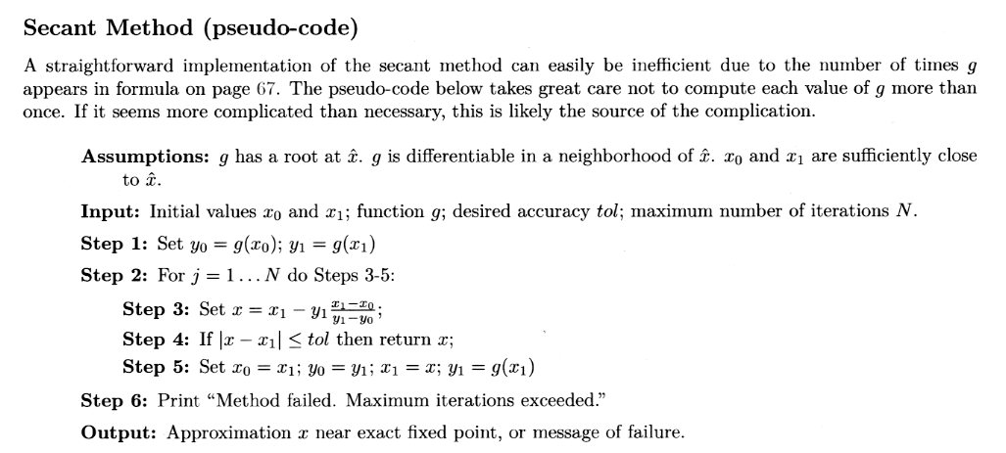
Pseudo-code
Brin (2020)³provides the following pseudo-code
Secant Method pseud-ocode

Slide 11
Convergence
Brin (2020)⁴ study the performance of Secant Method
The secant method converges with order $\frac{1+\sqrt{5}}{2}=1.62$
Not quite as fast as Newton’s Method (quadratic)

Slide 12
Similarity to False Position
Secant method: $x_{n+1}=x_{n}−g\left(x_{n}\right)\frac{x_{n}−x_{n−1}}{g\left(x_{n}\right)−g\left(x_{n−1}\right)}$
False Position method: $x_{r}=x_{u}−\frac{f\left(x_{u}\right)\left(x_{l}−x_{u}\right)}{f\left(x_{l}\right)−f\left(x_{u}\right)}$
Secant method is not guaranteed to bracket result when starting

Slide 13
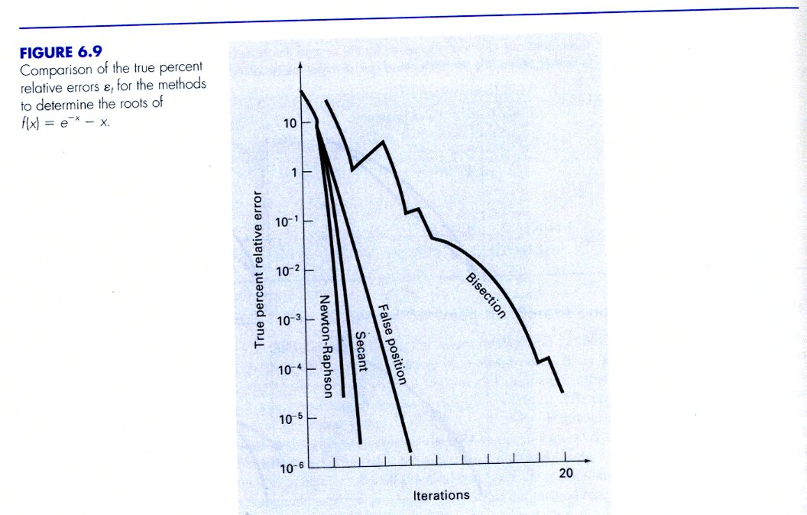
Speed of Convergence
Chapra and Canale (2015)⁵ compared the performance of various root finding methods
Comparison

Slide 14
Secant Code
import math def f(x): return (math.exp(x)+2**(-x)+2*math.cos(x)-6) N=100 tol=0.0005 x0=6.0 x1=5.0 # step 1 y0=f(x0) y1=f(x1) # counter is additional counter=0 for j in range(N+1): counter=counter+1 # step 3 x=x1-y1*((x1-x0)/(y1-y0)) if math.fabs(x-x1)<tol: print("the root is {} with value {}, required {} steps".format(x,f(x),counter)) break # step 5 x0=x1 y0=y1 x1=x y1=f(x1) print("completed")

Slide 15
Notes
1. https://math.hmc.edu/calculus/hmc-mathematics-calculus-online-tutorials/single-variable-calculus/limit-definition-of-the-derivative/
2. Cheny, W., and Kincaid, D., (2004), Numerical Mathematics and Computer, 5th edition
3. Brin, L, (2020), Tea Time Numerical Analysis: Experiences in Mathematics, 3rd edition
4. Brin, L, (2020), Tea Time Numerical Analysis: Experiences in Mathematics, 3rd edition
5. Chapra, S., and Canale, R., (2015), Numerical Methods for Engineers, 7th edition

