Slide 1
MANE 3351

Slide 2
Lecture 13
Classroom Management
Agenda
Homework 3 Assignment
Numerical Integration
Lab 5 if not completed on Monday

Slide 3
Calendar
Week | Monday Lecture | Wednesday Lecture
7 | 10/13: Secant Method | 10/15: Trapezoid Rule
8 | 10/20: Simpson’s Rule | 10/22: Romberg Integration
9 | 10/27: Gaussian Quadrature | 10/29: Numerical Differentiation (not on Test 2)
10 | 11/3: Linear Algebra | 11/5: Test 2 (Root Finding and Numerical Integration)

Slide 4
Resources
Handouts
Lecture 13 Slides
Lecture 13 Marked Slides

Slide 5
Lecture 13 Content
Today’s topic is numerical integration.
This is a major new topic after root finding.
Trapezoid Rule

Slide 6
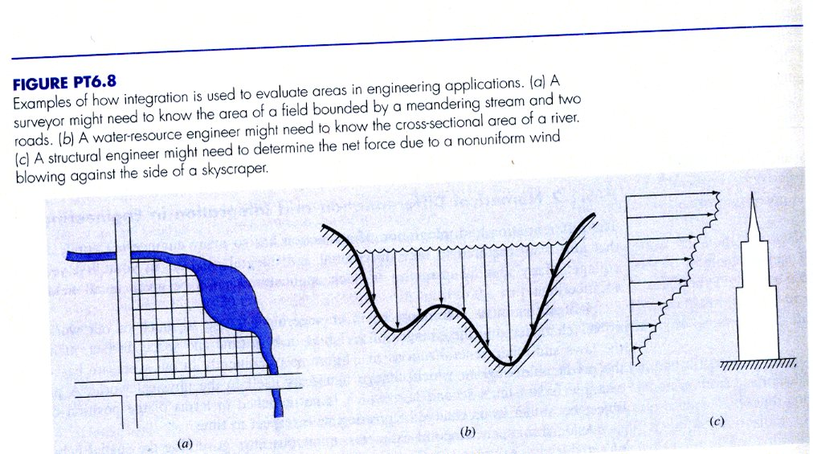
Introduction to Numerical Integration
In layman’s terms, an integral calculates the area under a curve
Frequently used in engineering analysis
Examples of integration

Slide 7
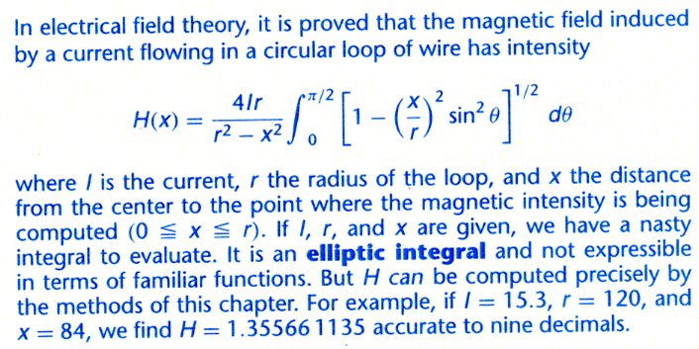
Another Integration Example

Slide 8
Definitions
Cheney and Kincaid (2004)¹ provide the following definitions
Indefinite integral : $∫x^{2} dx=\frac{1}{3}x^{3}+C$
Definite integral: $∫x^{2} dx=\frac{8}{3}$

Slide 9
Numerical Integration
Kiusalaas (2013)² suggest three major approaches to numerical integration that we will investigate:
Newton-Cotes
  Trapezoid rule (n=1)
  Simpson’s rule (n=2)
  3/8 Simpson’s rule (n=3)
Romberg Integration
Gaussian Quadrature
Note: there are many different techniques for numerical integration than the ones listed above

Slide 10
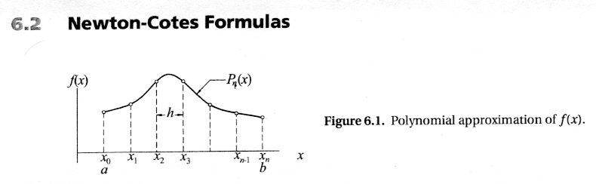
Newton-Cotes Formulas
Kiusalass (2013)³ provide the following illustration to explain Newton-Cotes techniques
Newton Cotes Approach

Slide 11
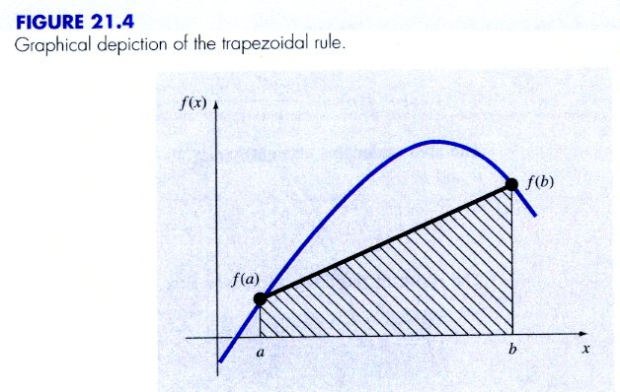
Trapezoid Rule
Chapra and Canale (2015)⁴ provide the figure shown below illustrating the trapezoid rule
Trapezoid Rule

Slide 12
Trapezoid Rule, continued
Chapra and Canale (2015)⁵ provided the following formulae
$I=\left(b−a\right)\frac{f\left(a\right)+f\left(b\right)}{2}$
$E=−\frac{1}{12}f^{′′}\left(ξ\right){\left(b−a\right)}^{3}$

Slide 13
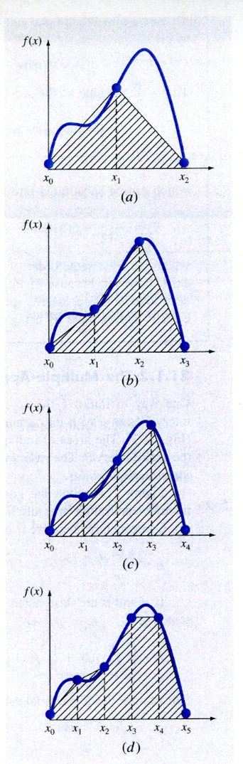
Multiple Applications of the Trapezoid Rule
Typically, the region form $a$ to $b$ is sub-divided into multiple regions and then the Trapezoid Rule for each region is applied. Chapra and Canale (2015)⁶ illustrate this concept.
Multiple Trapezoid Rules

Slide 14
Uniform Spacing
Cheney and Kincaid (2004)⁷ the following formula for composite (multiple) applications of the Trapezoid Rule
$$\int_{a}^{b}{=}f\left(x\right)dx≈T\left(f;P\right)=h\left\{\sum_{i=1}^{n−1}{f}\left(x_{i}\right)+\frac{1}{2}\left[f\left(x_{0}\right)+f\left(x_{n}\right)\right]\right\}$$

Slide 15
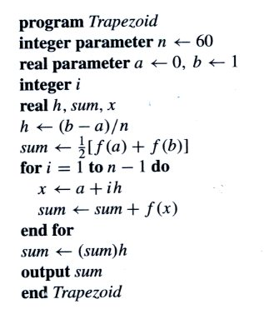
Pseudo-code
Cheney and Kincaid (2004)⁸ provided the following pseudo-code for the composite trapezoid rule
Trapezoid Rule Pseudo-code

Slide 16
Python Code for Multiple Trapezoid Rule Applications
import math
def f(z):
return (math.exp(-0.5*z**2)/((2.0*math.pi)**0.5))
n=4
a=-5.0
b=0.0
h=(b-a)/n
sum=0.5*(f(a)+f(b))
for i in range(1,n):
x=a+i*h
sum=sum+f(x)
sum=sum*h
print("The area is {} for {} sub-intervals".format(sum,n))

Slide 17
Notes
1. Cheny, W., and Kincaid, D., (2004), Numerical Mathematics and Computer, 5th edition
2. Kiusalaas, J. (2013), Numerical Methods in Engineering with Python 3
3. Kiusalaas, J. (2013), Numerical Methods in Engineering with Python 3
4. Chapra, S., and Canale, R., (2015), Numerical Methods for Engineers, 7th edition
5. Chapra, S., and Canale, R., (2015), Numerical Methods for Engineers, 7th edition
6. Chapra, S., and Canale, R., (2015), Numerical Methods for Engineers, 7th edition
7. Cheny, W., and Kincaid, D., (2004), Numerical Mathematics and Computer, 5th edition
8. Cheny, W., and Kincaid, D., (2004), Numerical Mathematics and Computer, 5th edition

