Slide 1
MANE 3351

Slide 2
Lecture 14
Classroom Management
Agenda
Simpson’s Rule
Lab 5 due before 9:30 AM
Lab 6 Assigned today
Homework 3 due 10/22/2025 before 11:59 PM

Slide 3
Calendar
Week | Monday Lecture | Wednesday Lecture
8 | 10/20: Simpson’s Rule | 10/22: Romberg Integration
9 | 10/27: Gaussian Quadrature | 10/29: Numerical Differentiation (not on Test 2)
10 | 11/3: Linear Algebra | 11/5: Test 2 (Root Finding and Numerical Integration)

Slide 4
Resources
Handouts
Lecture 14 Slides
Lecture 14 Marked Slides

Slide 5
Lecture 14
Today’s topic is Simpson’s Rule.
Simpson’s (1/3) rule is Newton-Cotes with $n=2$
Chapra and Canale (2015)¹ illustrate Simpson’s rule in the figure shown below Simpson’s Rule

Slide 6
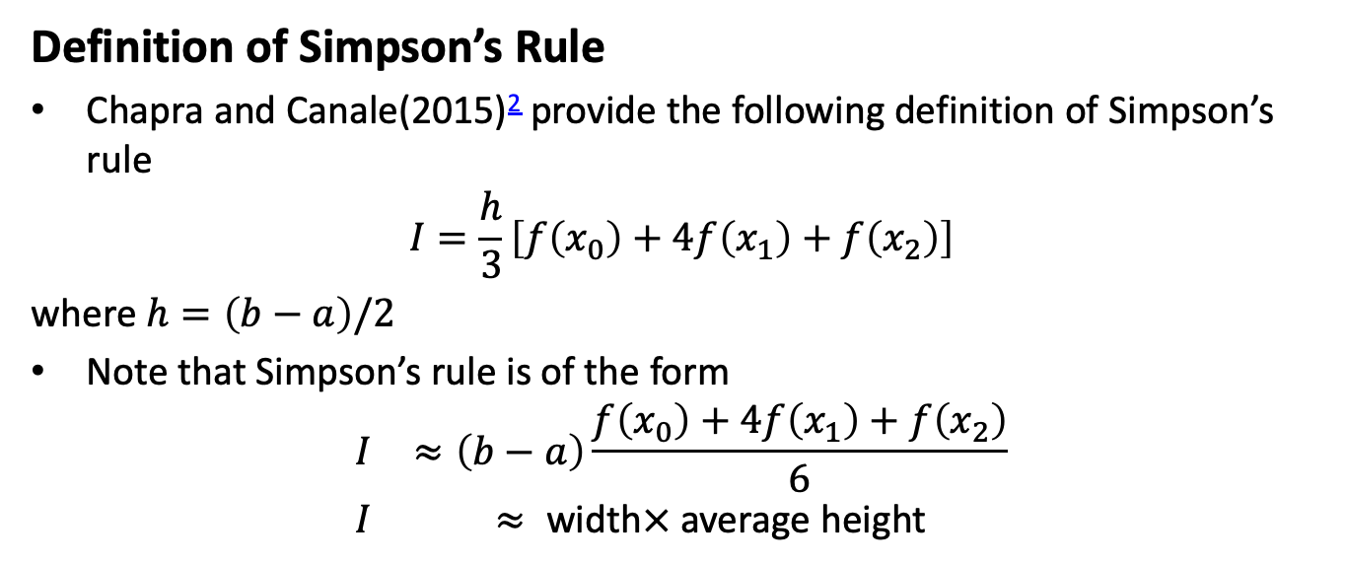
Definition of Simpson’s Rule
Chapra and Canale(2015)² provide the following definition of Simpson’s rule
$$I=\frac{h}{3}\left[f\left(x_{0}\right)+4f\left(x_{1}\right)+f\left(x_{2}\right)\right]$$
where $h=\left(b−a\right)/2$
Note that Simpson’s rule is of the form
$$\begin{matrix}I & ≈\left(b−a\right)\frac{f\left(x_{0}\right)+4f\left(x_{1}\right)+f\left(x_{2}\right)}{6} \\ I & ≈ \text{width}× \text{average} \text{height}\end{matrix}$$

Slide 7
Simpson’s Rule Error Analysis
Chapra and Canale (2015)³ provides the following definition:
$$\begin{matrix}I & =\frac{h}{3}\left[f\left(x_{0}\right)+4f\left(x_{1}\right)+f\left(x_{2}\right)\right]−\frac{1}{90}f^{\left(4\right)}\left(ξ\right)h^{5} \\ I & =\text{Simpson}\text{’}\text{s}\text{ 1/3 }\text{approximation}− \text{Truncation} \text{error}\end{matrix}$$

Slide 8
Multiple Applications of Simpson’s Rule
The number of segments must be even
The formula is
$$I≈\left(b−a\right)\frac{f\left(x_{0}\right)+4\sum_{i=1,3,5}^{n−1}{f}\left(x_{i}\right)+2\sum_{j=2,4,6}^{n−2}{f}\left(x_{j}\right)+f\left(x_{n}\right)}{3n}$$
where $h=\frac{b−a}{n}$

Slide 9
Pseudo-code: Simpson’s 1/3 Rule
CodeSansar⁴ provides the following pseudo-code Simpson’s 1/3 pseudo-code

Slide 10
Python Code for Multiple Simpson’s 1/3 Rule
import math def f(z): return (math.exp(-0.5*z**2)/((2.0*math.pi)**0.5)) n=10 a=-5.0 b=0.0 h=(b-a)/n sum=f(a)+f(b) for i in range(1,n): # print(i) k=a+i*h if i%2==0: #print("even number") sum=sum+2.0*f(k) else: #print("odd number") sum=sum+4.0*f(k) sum=sum*h/3.0 print("The area is {} after {} iterations".format(sum,n))

Slide 11
Simpson’s 3/8 Rule
Simpson’s 3/8 rule is Newton-Cotes with $n=3$
Chapra and Canale (2015)⁵ illustrate Simpson’s rule in the figure shown below Simpson’s3/8 Rule

Slide 12

Definition of Simpson’s 3/8 Rule
Chapra and Canale(2015)⁶ provide the following definition of Simpson’s rule
$$I=\frac{3h}{8}\left[f\left(x_{0}\right)+3f\left(x_{1}\right)+3f\left(x_{2}\right)+f\left(x_{3}\right)\right]$$
where $h=\left(b−a\right)/3$
Note that Simpson’s 3/8 rule is of the form
$$\begin{matrix}I & ≈\left(b−a\right)\frac{f\left(x_{0}\right)+3f\left(x_{1}\right)+3f\left(x_{2}\right)+f\left(x_{3}\right)}{8} \\ I & ≈ \text{width}× \text{average} \text{height}\end{matrix}$$

Slide 13
Truncation Error of Simpson’s 3/8 Rule
$$\begin{matrix}E_{t} & =−\frac{3}{80}h^{5}f^{\left(4\right)}\left(ξ\right) \\ & =−\frac{{\left(b−a\right)}^{5}}{6480}f^{\left(4\right)}\left(ξ\right)\end{matrix}$$

Slide 14
Classroom Coding: One Interval of Simpson’s 3/8 Rule

Slide 15
Notes
1. Chapra, S., and Canale, R., (2015), Numerical Methods for Engineers, 7th edition
2. Chapra, S., and Canale, R., (2015), Numerical Methods for Engineers, 7th edition
3. Chapra, S., and Canale, R., (2015), Numerical Methods for Engineers, 7th edition
4. https://www.codesansar.com/numerical-methods/integration-simpson-1-3-method-algorithm.htm
5. Chapra, S., and Canale, R., (2015), Numerical Methods for Engineers, 7th edition
6. Chapra, S., and Canale, R., (2015), Numerical Methods for Engineers, 7th edition

