Slide 1
MANE 3351

Slide 2
Lecture 15
Classroom Management
Agenda
  Romberg Integration
  Lab 6, if not completed
  Homework 3 due today
  Homework 4 assigned (due 10/29/2025)

Slide 3
Calendar
Week | Monday Lecture | Wednesday Lecture
8 | 10/20: Simpson’s Rule | 10/22: Romberg Integration
9 | 10/27: Gaussian Quadrature | 10/29: Numerical Differentiation (not on Test 2)
10 | 11/3: Linear Algebra | 11/5: Test 2 (Root Finding and Numerical Integration)

Slide 4
Resources
Handouts
  Lecture 15 Slides
  Lecture 15 Marked Slides

Slide 5
Lecture 15
Today’s topic is Romberg Integration
  Clever combination of trapezoid rule and Richardson’s Extrapolation
  Highly accurate
  Cheney and Kincaid (2004)¹ show example output in the form of a lower triangle from Romberg integration

Slide 6
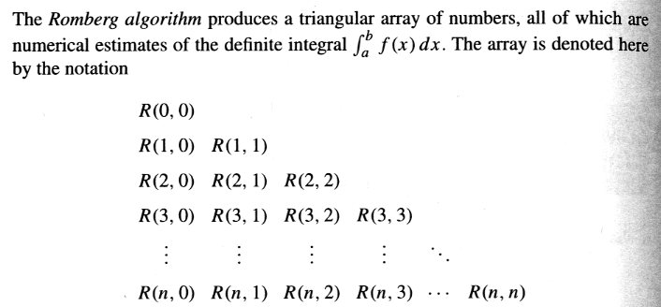
Romberg Integration Results

Slide 7
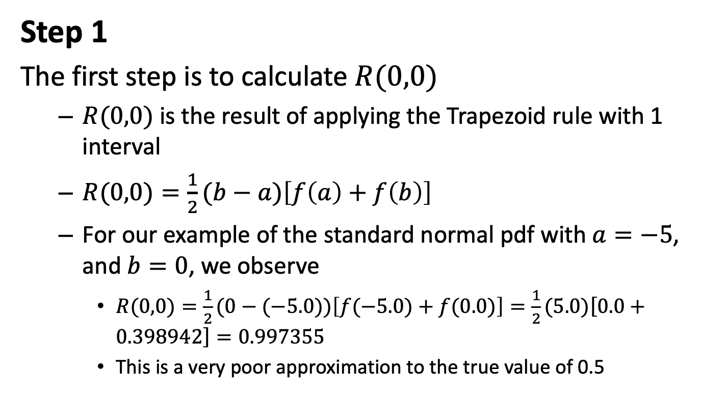
Step 1
The first step is to calculate $R(0,0)$
  $R(0,0)$ is the result of applying the Trapezoid rule with 1 interval
  $R(0,0)=\frac{1}{2}(b−a)\left[f\left(a\right)+f\left(b\right)\right]$
  For our example of the standard normal pdf with $a=−5$, and $b=0$, we observe
    $R(0,0)=\frac{1}{2}(0−(−5.0))\left[f(−5.0)+f(0.0)\right]=\frac{1}{2}(5.0)\left[0.0+0.398942\right]=0.997355$
    This is a very poor approximation to the true value of 0.5

Slide 8
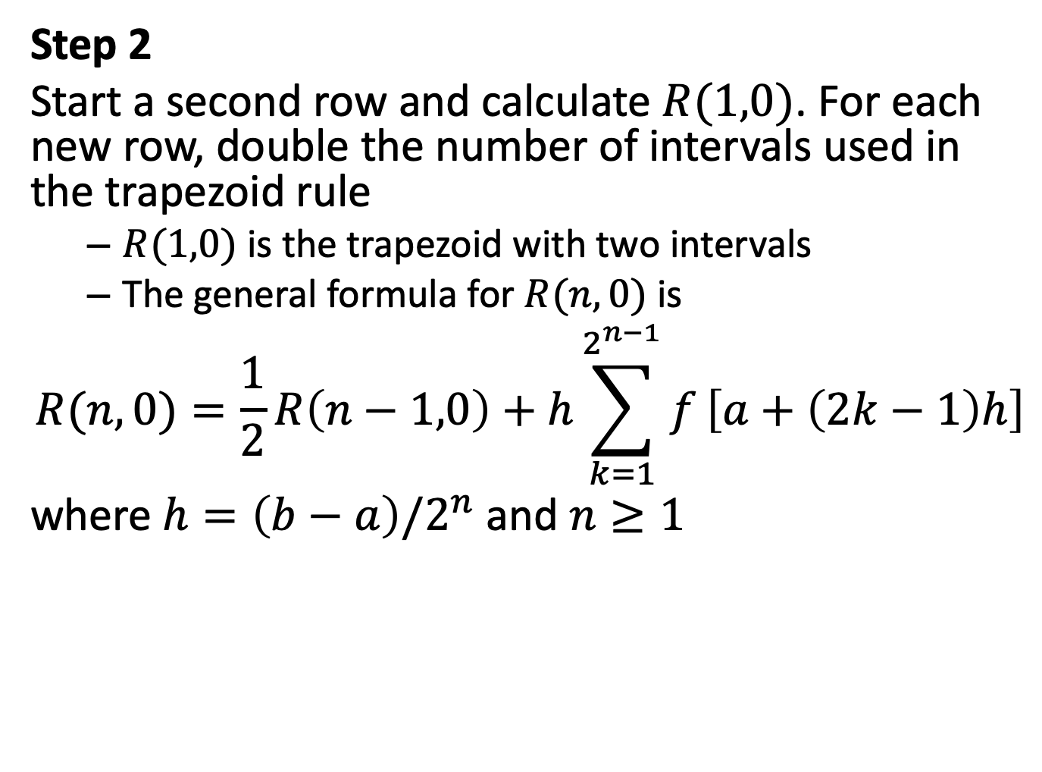
Step 2
Start a second row and calculate $R(1,0)$. For each new row, double the number of intervals used in the trapezoid rule
  $R(1,0)$ is the trapezoid with two intervals
  The general formula for $R(n,0)$ is
$$R(n,0)=\frac{1}{2}R\left(n−1,0\right)+h\sum_{k=1}^{2^{n−1}}{f}\left[a+\left(2k−1\right)h\right]$$
where $h=\left(b−a\right)/2^{n}$ and $n≥1$

Slide 9
Step 3
Complete the second row and calculate $R(1,1)$
  The calculation of $R(1,1)$ utilizes Richardson’s extrapolation, $R(1,1)=f\left[R(1,0),R(0,0)\right]$
  The general formula for $R(n,m)$ is
$$R(n,m)=R(n,m−1)+\frac{1}{4^{m}−1}\left[R(n,m−1)−R(n−1,m−1)\right]$$

Slide 10
Error Analysis
  Cheney and Kincaid (2004)² reports the following errors
    The error for the first column is $𝒪(h^{2})$
    The error for the second column is $𝒪(h^{4})$
    The error for the third column is $𝒪(h^{8})$
    and so on

Slide 11
Pseudo-code
Cheney and Kincaid (2004)³ provide the following pseudo-code

Slide 12
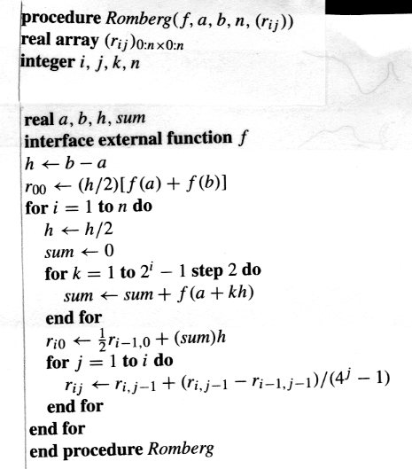
Romberg Integration Pseudo-code

Slide 13
Python Code for Romberg Integration
import math
import numpy as np
def f(z):
return (math.exp(-0.5*z**2)/((2.0*math.pi)**0.5))
#
a=float(input("Enter the lower limit of the integral: "))
b=float(input("Enter the upper limit of the integral: "))
n=int(input("enter the number of interations (n): "))
#
# initialize matrix r
r=np.zeros(shape=(n+1,n+1))
h=b-a
#find R(0,0)
r[0][0]=(h/2.0)*(f(a)+f(b))
for i in range(1,n+1):
h=h/2.0
sum=0.0
for k in range(1,2**i,2):
sum=sum+f(a+k*h)
r[i][0]=0.5*r[i-1][0]+sum*h
for j in range(1,i+1):
r[i][j]=r[i][j-1]+(r[i][j-1]-r[i-1][j-1])/(4**j-1)
print(r)

Slide 14
Romberg Integration by Hand

Slide 15
Notes
1. Cheny, W., and Kincaid, D., (2004), Numerical Mathematics and Computer, 5th edition
2. Cheny, W., and Kincaid, D., (2004), Numerical Mathematics and Computer, 5th edition
3. Cheny, W., and Kincaid, D., (2004), Numerical Mathematics and Computer, 5th edition

