Slide 1
MANE 3351

Slide 2
Lecture 17

Slide 3
Classroom Management
Agenda
Numerical Differentiation
Homework 4 (due 10/29/2025)
Homework 5 (due November 3 - no late work)
Lab 7 after lecture (due 11/3/2025)

Slide 4
Resources

Slide 5
Handouts
Lecture 17 slides
Lecture 17 slides marked
Test 2 - Fall 2024

Slide 6
Calendar
Week | Monday Lecture | Wednesday Lecture
9 | 10/27: Gaussian Quadrature | 10/29: Numerical Differentiation (not on Test 2)
10 | 11/3: Linear Algebra | 11/5: Test 2 (Root Finding and Numerical Integration)

Slide 7
Test 2
Content
  Lectures 8 - 16 (9/29 - 10/27)
  Homeworks 3 - 5
You are allowed one 4 inch by 6 inch notecard
Calculator needed
Previous test provided above

Slide 8
Lecture Topics
Lecture 8 - Root Finding, Bisection lecture
Lecture 9 - Bisection Method Error Analysis, False Position Method
Lecture 10 - No lecture - Test 1
Lecture 11 - Newton’s Method
Lecture 12 - Secant Method
Lecture 13 - Numerical Integration, Trapezoid Rule
Lecture 14 - Simpson’s 1/3 Rule, Simpson’s 3/8 Rule
Lecture 15 - Romberg Integration
Lecture 16 - Gaussian Integration

Slide 9
Derivatives
You are responsible for calculating the following derivatives:
Polynomial: $ax^{3}+bx^{2}+cx+d$ (arbitrary power)
$asin(bx)$
$acos(bx)$
$ae^{bx}$
$aln(bx)$
Product Rule: $\frac{d}{dx}f(x)g(x)=f(x)g^{′}(x)+f^{′}(x)g(x)$

Slide 10
Lecture 17
The topic for Lecture 17 is numerical differentiation. This topic will NOT be on Test 2 and the material is taken from the Chapra and Canale textbook

Slide 11
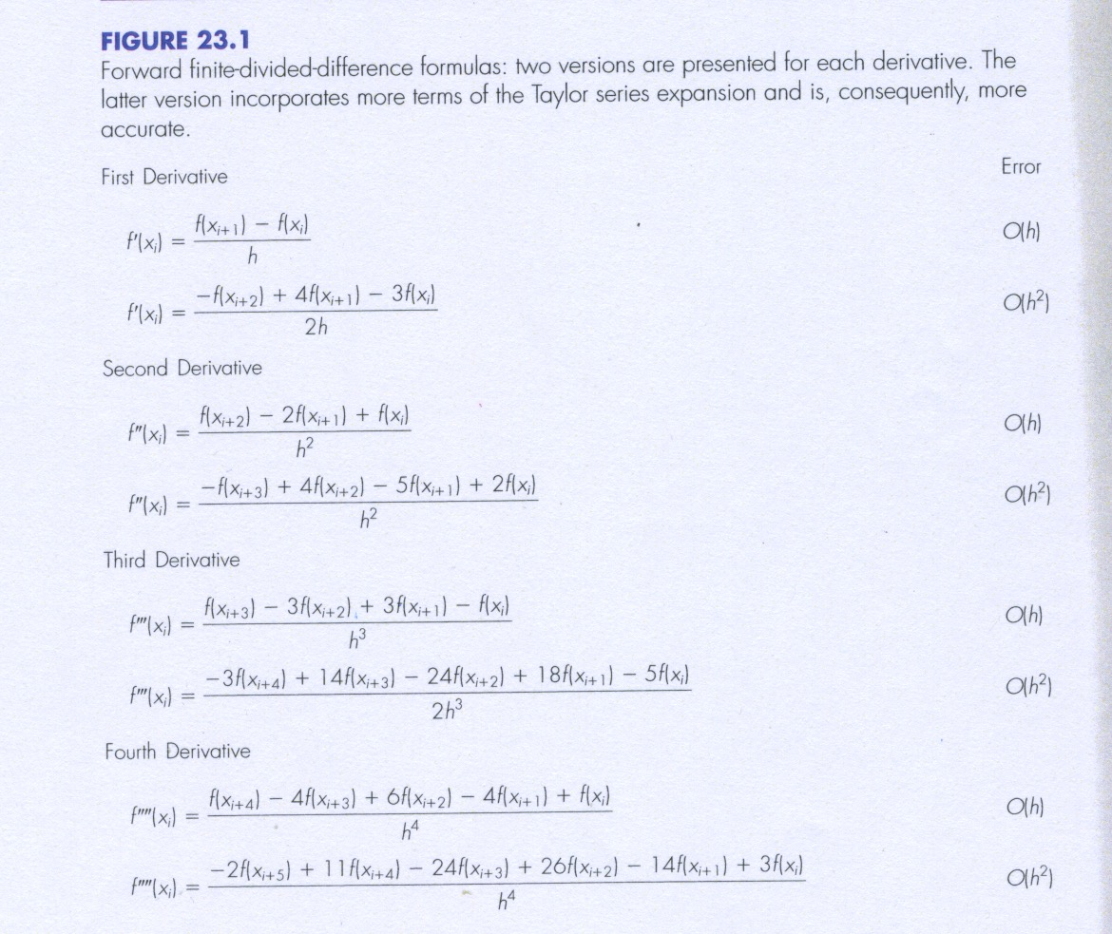
Forward finite-divided-difference formulas
Figure 23.1

Slide 12
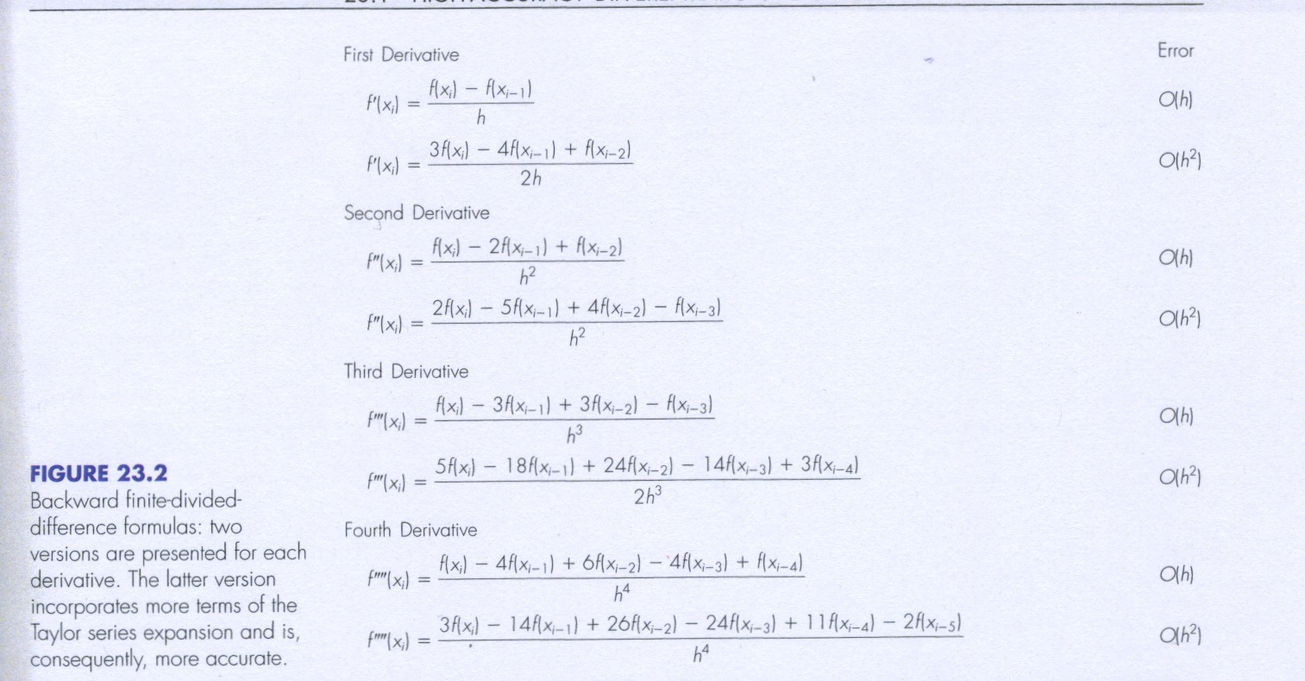
Backward finite-divided-difference formulas
Figure 23.2

Slide 13
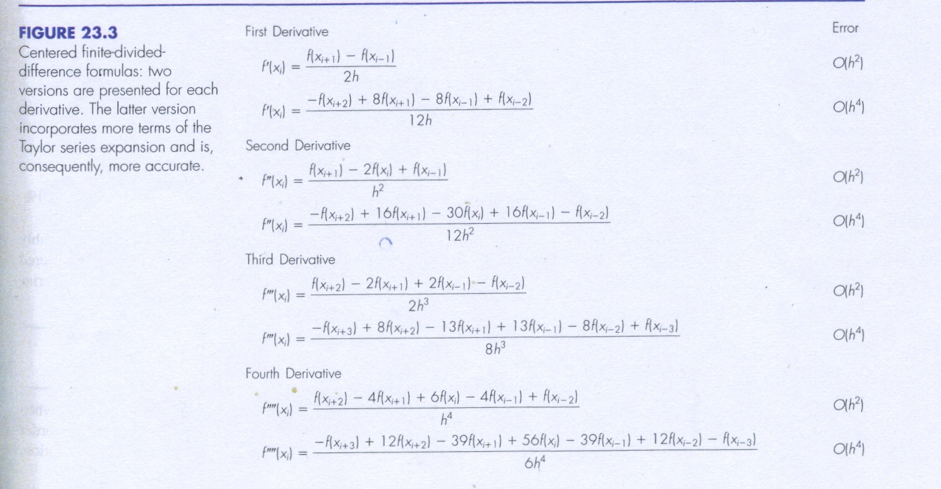
Centered finite-divided-difference formulas
Figure 23.3

Slide 14
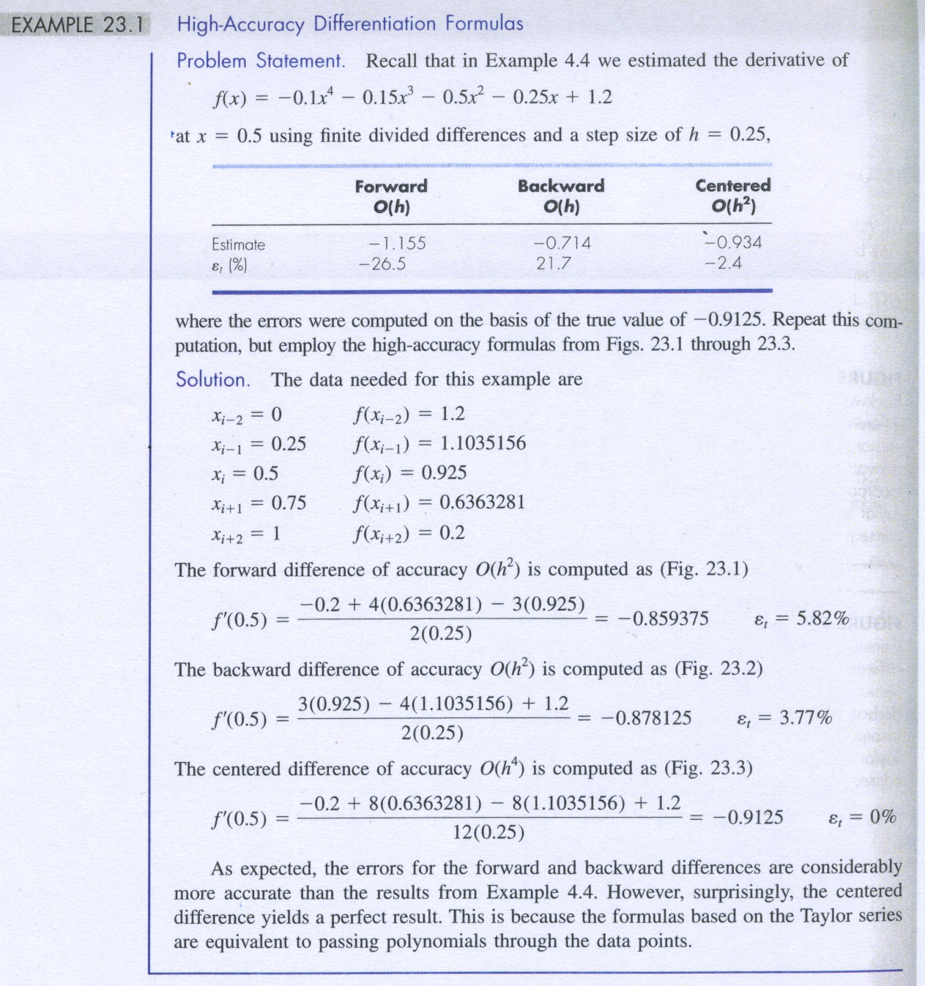
Example Problem
Example 23.1

