Slide 1
MANE 3351

Slide 2
Lecture 2

Slide 3
Classroom Management
Agenda
Questions
Review 1st day
Introduction to Python
Discuss lab today
Much of the lecture 2 material is a demonstration. Later in the course, we will learn these techniques.

Slide 4
Resources

Slide 5
Handouts
Lecture 2 Slides
Lecture 2 Marked Slides

Slide 6

Assignments
Create free GitHub account
Student accounts are free
GitHub Account Creation Checklist
GitHub Student Verification Information
GitHub Home Page

Slide 7
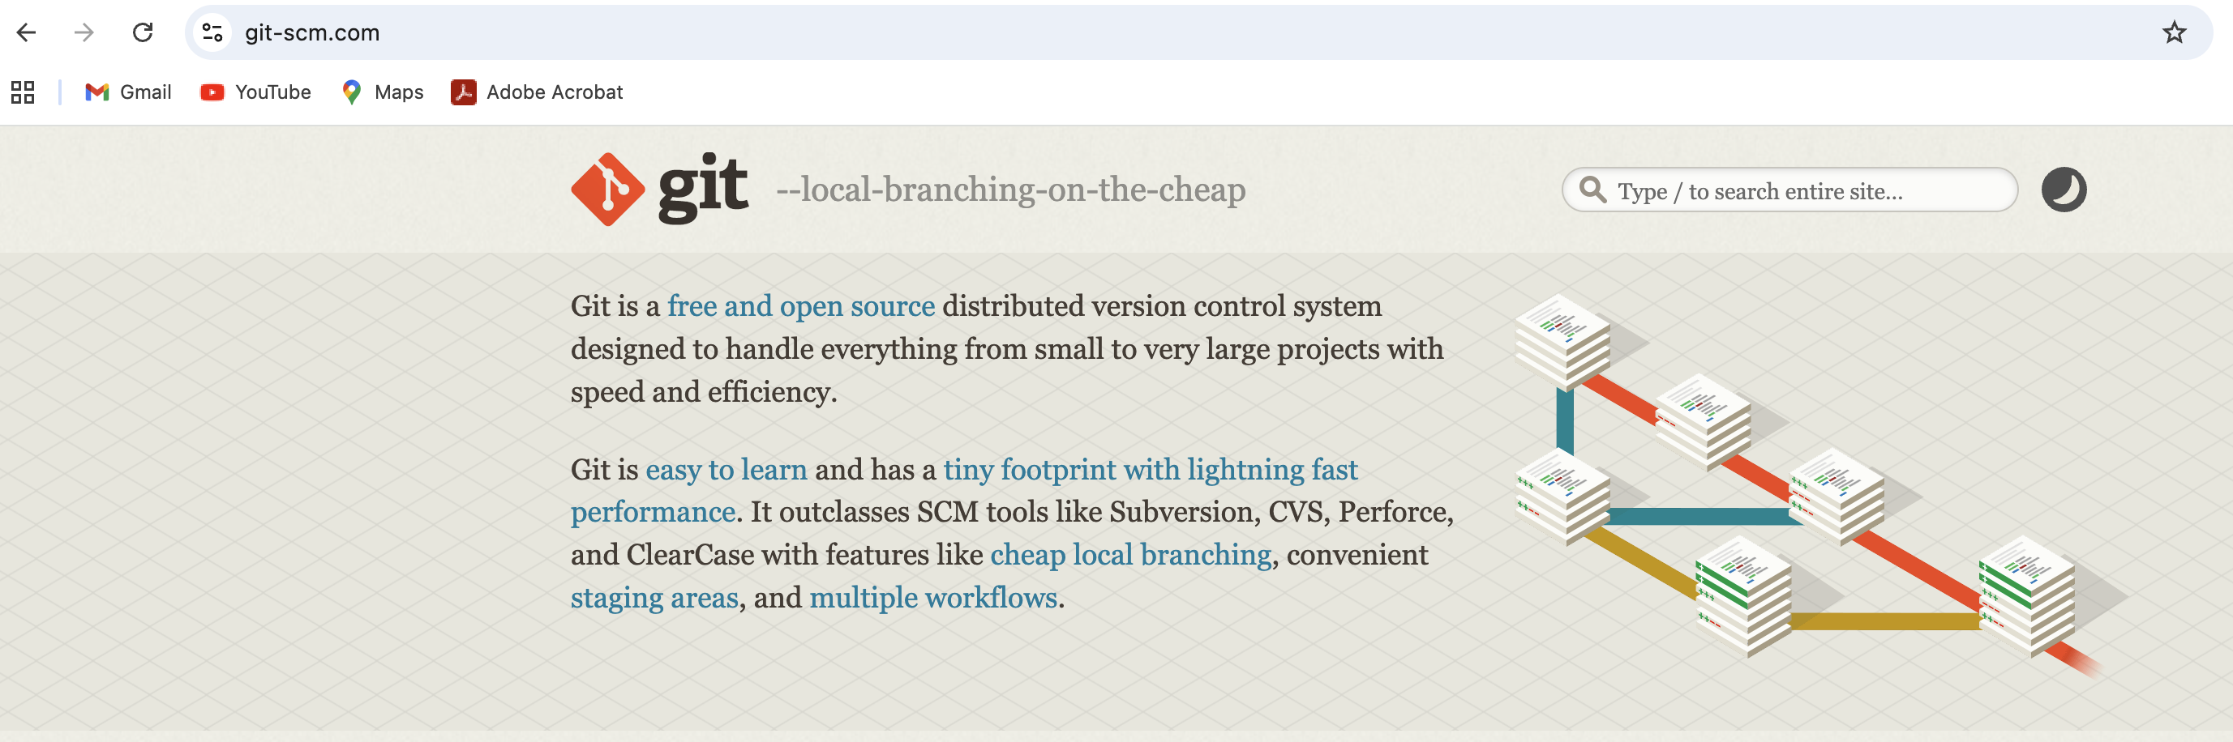
Source
Git
git

Slide 8
Source
Most laboratories will be distributed through gitHub
Classroom material may also be available through gitHub
Easiest approach is download on PC or Mac using gitHub Desktop (pre-installed in EACSB 2.102)
GitHub
gitHub

Slide 9
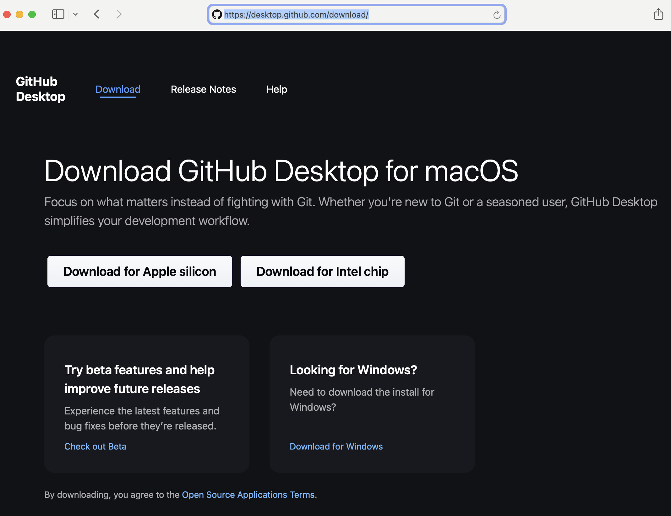
Source
Graphical interface that makes using GitHub very easy to use
Downloading MANE 3351 materials
First use: clone repository
Subsequent uses: pull repository (will update local material)
Please do not push
Demonstrate using Standard Normal Case 1 from Dr. Timmer GitHub Public Repository
GitHub Desktop
gitHub Desktop

Slide 10
Python with Jupyter Notebook
Standard Normal Case 1
import matplotlib.pyplot as plt import numpy as np import scipy.stats as sct import math a=0.5 x=np.linspace(-4,4,500) y=sct.norm.pdf(x,0,1) y2=0.0*x maske =(x<a) plt.plot(x,y,'b') plt.fill_between(x,y,color='#666666',where=maske) plt.plot(x,y2,'b') plt.show() answer=sct.norm.cdf(a,0,1) print ("%8.6f" % (answer))

Slide 11
Methods for Acquiring Python Code
Clone repository to local machine using GitHub Desktop
Copy code from MANE 3351 Fall 2025 Public Repository
Copy code from lecture notes

Slide 12
Comments about Python Installation
We will utilize Anaconda python that is pre-installed on lab computers
Discuss installing on personal computers
Dr. Timmer will utilize a conda environment so that configure for MANE 3351 is stored separately and doesn’t possible corrupt other environments
Most of the time, Dr. Timmer will work from the command line on a Mac
Quick demonstration on both Mac and Windows

Slide 13
First 4 Lines
Imports allow external packages to be used
Most standard packages are included in the Anaconda installation
Matplotlib “is a Python 2D plotting library which produces publication quality figures in a variety of hardcopy formats and interactive environments across platforms. Matplotlib can be used in Python scripts, the Python and IPython shells, the Jupyter notebook, web application servers, and four graphical user interface toolkits”
NumPy “is the fundamental package for scientific computering with Python. It contains amont other things: 1). a powerfull N-dimensional array object, 2). sophisticated (broadcasting) functions, 3. tools for integrating C/C++ and Fortran code, and 4). usefull linear algebra, Fourier transform, and random number capabilities.”
SciPy “is a Python-based ecosystem of open-source software for mathematics, science, and engineering. In particular, these are some of the core packages: NumPy, SciPy library, Matplotlib, IPython, Sympy, and pandas.”
Math “provides access to the mathematical functions defined by the C standard.”

Slide 14
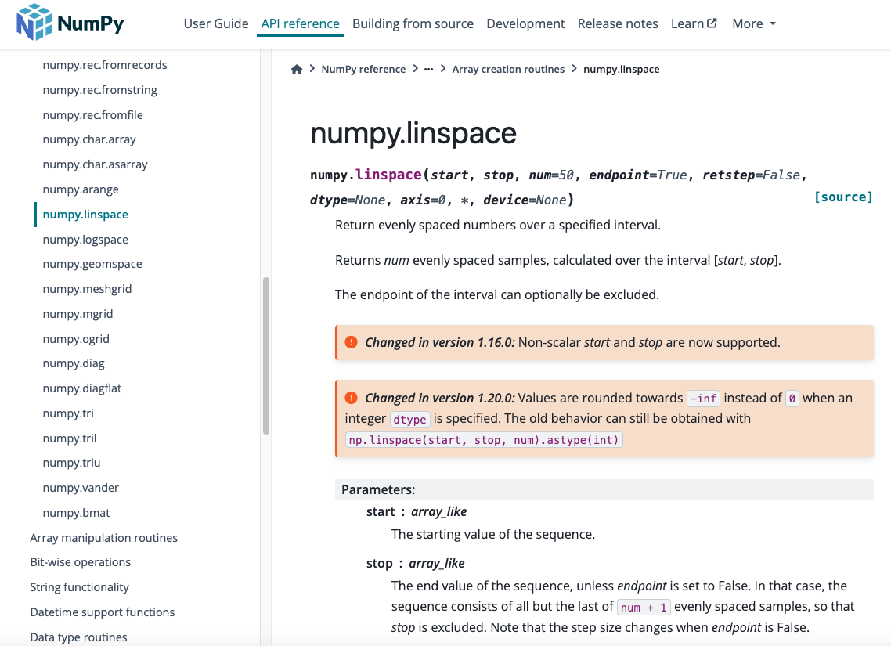
Source
Experiment with endpoint
Numpy Linspace
Numpy Linspace

Slide 15
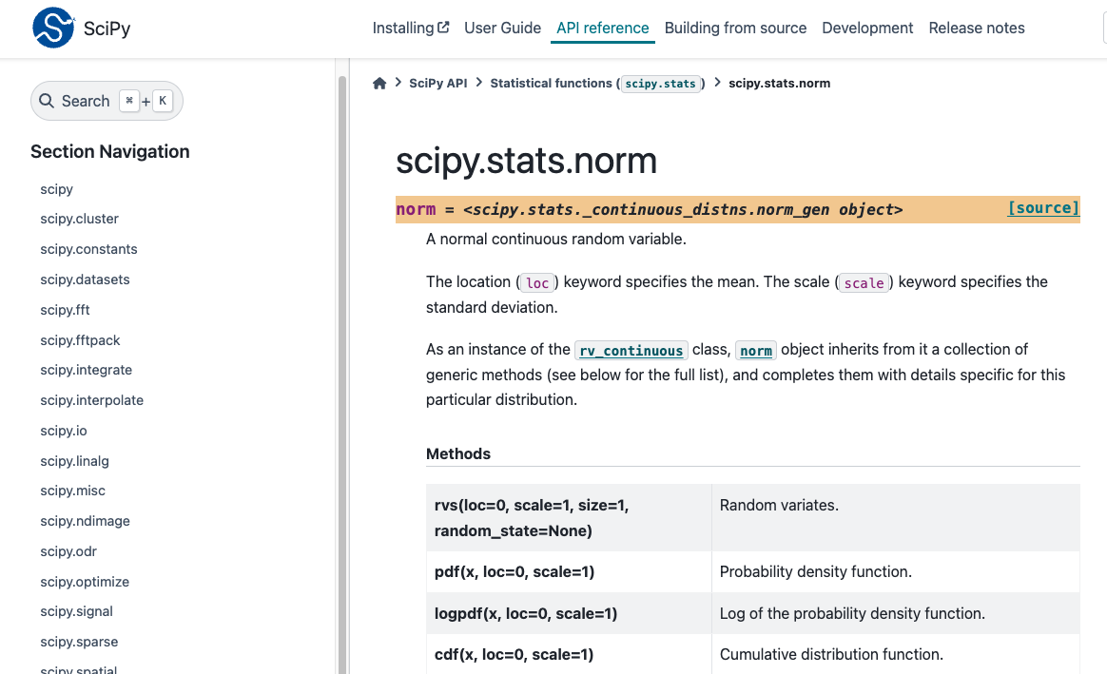
Source
scipy.stats.norm
scipy stats norm

Slide 16
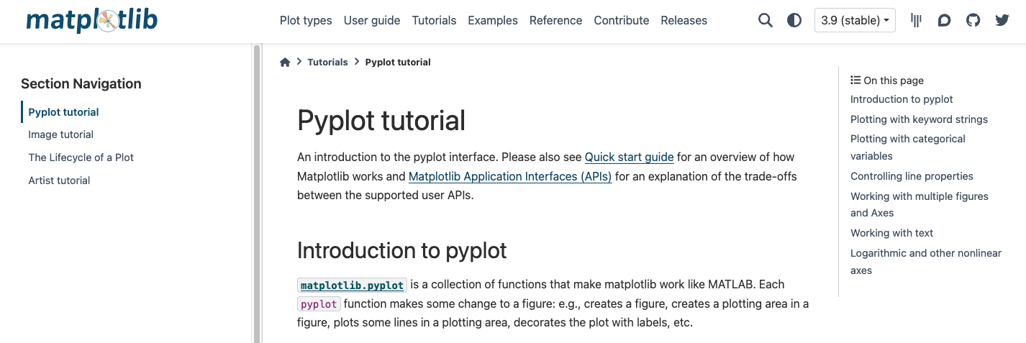
Source
Matplotlib
matplotlib

