Slide 1
MANE 3351

Slide 2
Lecture 20

Slide 3
Classroom Management
Agenda
Summary of operations on Vectors, Matrix Multiplication, Three-Dimensional Transformations
Determinants
Introduction to Inverse Matrix
Lab Assignment 8 (assigned 11/11/25, due 11/18/25 before 9:30 AM)

Slide 4
Resources

Slide 5
Handouts
Lecture 20 slides
Lecture 20 slides marked]
Linear Algebra Handouts

Slide 6
Calendar
Week | Monday Lecture | Wednesday Lecture
11 | 11/10: Test 2 | 11/12: Lecture 20
12 | 11/17: Lecture 21 | 11/19: Lecture 22
13 | 11/24: Lecture 23 | 11/26: Lecture 24
14 | 12/1: Lecture 25 | 12/3: Lecture 26
15 | 12/8: Lecture 27 | 12/10: Review

Slide 7
Final Exam is Monday 12/15/2025 8:00 - 9:45 AM
I will be off-campus participating in an ABET visit and a proctor will be arranged for the final exam.

Slide 8
Lecture 20 Overview
Vector Operations,
Determinants, and
Matrix Inversion

Slide 9
Vectors
A vector $x∈ℝ^{n}$
$$x=\left[\begin{matrix}x_{1} \\ x_{2} \\ ⋮ \\ x_{n}\end{matrix}\right]$$
can be thought of as a one-dimensional array of numbers and is written as
$x$ is often called a column vector
the dimension of $x$ is $(n×1)$

Slide 10
A row vector can be written as
$$y=\left[\begin{matrix}y_{1} y_{2} ⋯ y_{m}\end{matrix}\right]$$
the dimension of $y$ is $(1×m)$

Slide 11
Scalar Product
$$αx=\left[\begin{matrix}αx_{1} \\ α_{2}x_{2} \\ ⋮ \\ αx_{n}\end{matrix}\right]$$
for $α$ (a constant or scalar)

Slide 12
Addition/Subtraction
$$x±y=\left[\begin{matrix}x_{1}±y_{1} \\ x_{2}±y_{2} \\ ⋮ \\ x_{n}±y_{n}\end{matrix}\right]$$
Note that the dimensions of $x$ and $y$ must be identical

Slide 13
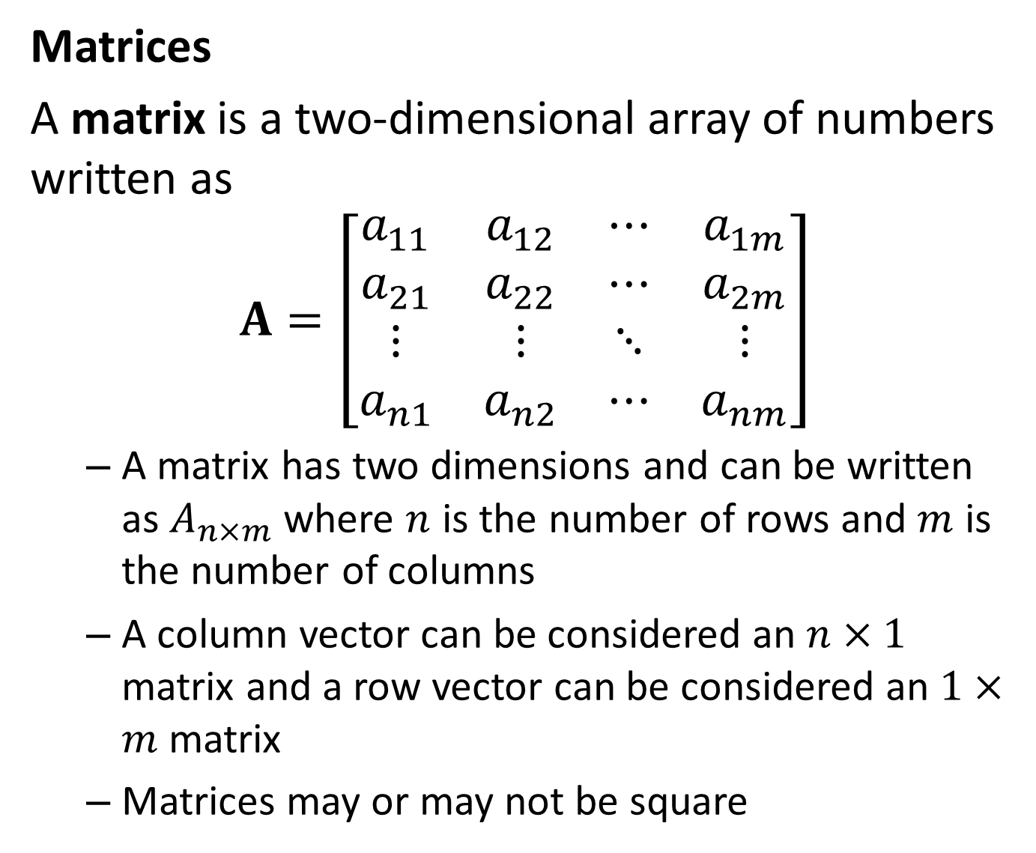
Matrices
A matrix is a two-dimensional array of numbers written as
$$A=\left[\begin{matrix}a_{11} & a_{12} & ⋯ & a_{1m} \\ a_{21} & a_{22} & ⋯ & a_{2m} \\ ⋮ & ⋮ & ⋱ & ⋮ \\ a_{n1} & a_{n2} & ⋯ & a_{nm}\end{matrix}\right]$$
A matrix has two dimensions and can be written as $A_{n×m}$ where $n$ is the number of rows and $m$ is the number of columns
A column vector can be considered an $n×1$ matrix and a row vector can be considered an $1×m$ matrix
Matrices may or may not be square

Slide 14
Determinant
The Determinant Video
Determinant of a Matrix Website

Slide 15
Ex: Determinant of a 2x2 Full Rank Matrix

Slide 16
EX: Determinant of a 2x2 Non-Full Rank Matrix

Slide 17
Ex: Shortcut for Determinant of a 3x3 Matrix

Slide 18
Ex: Method of Minors for finding determinant of 3x3 or higher dimension Matrix

Slide 19
Inverse Matrix
Inverse Matrices Video

Slide 20
Linear Algebra Handout

