Slide 1
MANE 3351

Slide 2
Lecture 23
Classroom Management
Agenda
Gauss Jordan Elimination, Partial Pivoting, Matrix Inversion using Gauss Jordan
Homework 7 (assigned 11/24/25, due 12/1/25 - no late submissions)
Lab today for those who did not finish

Slide 3
Resources
Week | Monday Lecture | Wednesday Lecture
13 | 11/24: Gauss-Jordan Elimination | 11/26: no class
14 | 12/1: Lecture 24 | 12/3: Lecture 25
15 | 12/8: Lecture 26 | 12/10: Lecture 27
Handouts
Lecture 23 slides
Lecture 23 slides marked
Calendar

Slide 4
Final Exam is Monday 12/15/2025 8:00 - 9:45 AM
I will be off-campus in an ABET visit and a proctor will be arranged for the final exam.
Assignments
Homework 6 (assigned 11/17, due 11/24)
Lab 9 (assigned 11/19/25, due 11/26/25 (before lab))
Homework 7 (assigned 11/40, due 12/1 - no late submissions)

Slide 5
Gauss-Jordan Elimination
A Step-by-Step Method for Solving Linear Systems
An extension of row-echelon form

Slide 6
Introduction to Gauss-Jordan Elimination
Gauss-Jordan elimination is a method to solve systems of linear equations.
Goal: Transform the matrix into reduced row-echelon form (RREF).
Key feature: The solution is read directly from the matrix.
Distinguish from Row Echelon Form

Slide 7
Key Steps in Gauss-Jordan Elimination
Row Operations:
  Swap two rows.
  Multiply a row by a nonzero scalar.
  Add or subtract multiples of one row to another.
Transform to RREF:
  Each leading entry is 1 (pivot).
  Pivots are the only nonzero entries in their column.

Slide 8
Example Problem
Solve the system:
$$\begin{aligned}x+y+z&=6 \\ 2x+3y+z&=14 \\ y+2z&=8\end{aligned}$$

Slide 9
Step-by-Step Solution
Convert the system to an augmented matrix.
Use row operations to make the first pivot 1.
Eliminate all other entries in the pivot column.
Repeat for each subsequent pivot.

Slide 10
Final Result
Matrix in reduced row-echelon form (RREF):
$$\left[\begin{matrix}1 & 0 & 0 & a \\ 0 & 1 & 0 & b \\ 0 & 0 & 1 & c\end{matrix}\right]$$
Solution: $x=a$, $y=b$, $z=c$.

Slide 11
Applications of Gauss-Jordan Elimination
Solving systems of linear equations.
Finding inverse matrices.
Used in engineering, physics, computer science, etc.

Slide 12
Summary of Gauss-Jordan Elimination
Gauss-Jordan elimination simplifies solving linear systems.
Three row operations ensure clarity and consistency.
Matrix RREF provides direct solutions.

Slide 13
Partial Pivoting
A pivot is the leading non-zero element in a row used to simplify the matrix.
Pivoting ensures numerical stability during elimination.
Types of pivoting:
  Partial Pivoting: Swap rows to place the largest absolute value in the pivot position.
  Complete Pivoting: Reorder rows and columns to place the largest value in the pivot position.

Slide 14
Why Pivoting is Necessary
Avoid division by small numbers (reduce round-off errors).
Improve accuracy in solving systems.
Ensure numerical stability for ill-conditioned matrices.

Slide 15
Example Problem
Solve the system of equations:
$$\begin{aligned}0.0001x+y+z&=1 \\ x+y+z&=6 \\ 2x+y+10z&=20\end{aligned}$$

Slide 16
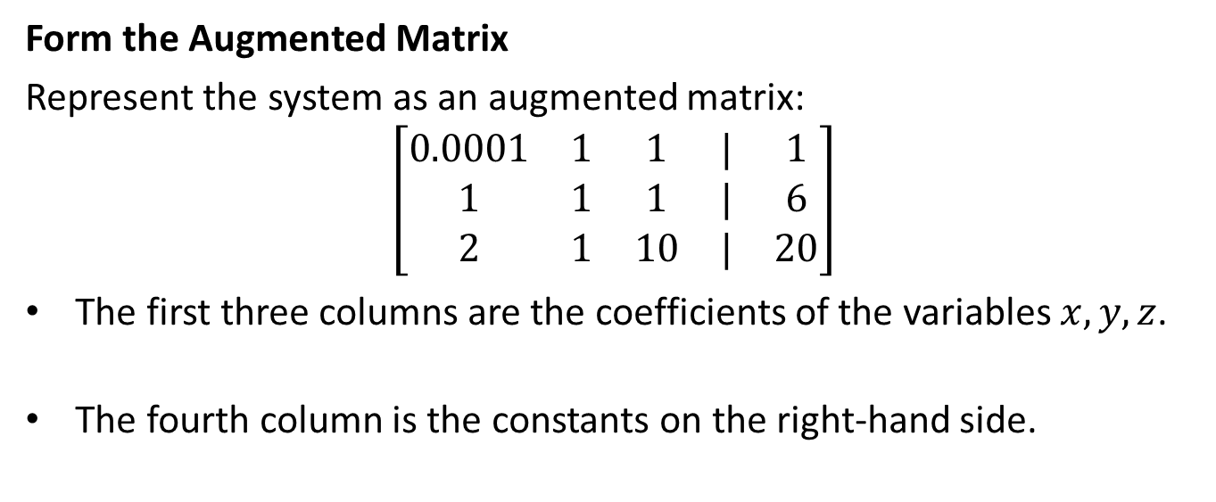
Form the Augmented Matrix
Represent the system as an augmented matrix:
$$\left[\begin{matrix}0.0001 & 1 & 1 & | & 1 \\ 1 & 1 & 1 & | & 6 \\ 2 & 1 & 10 & | & 20\end{matrix}\right]$$
The first three columns are the coefficients of the variables $x,y,z$.
The fourth column is the constants on the right-hand side.

Slide 17
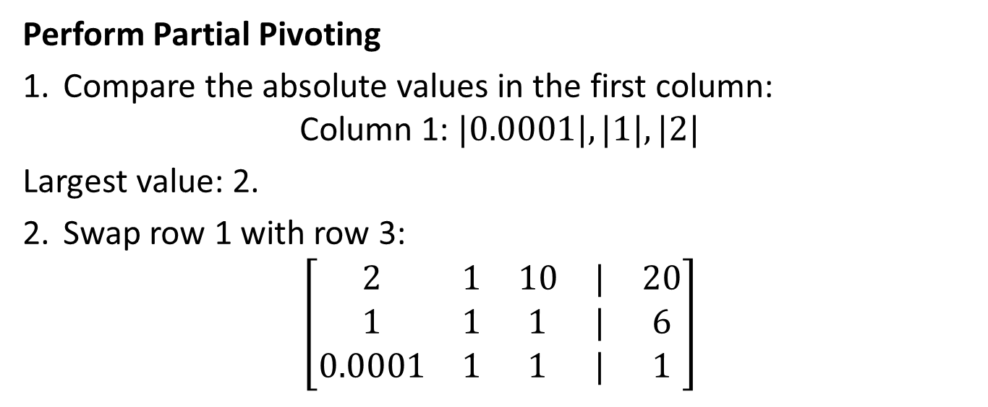
Perform Partial Pivoting
Compare the absolute values in the first column:
$$\text{Column}\text{ 1: }|0.0001|,|1|,|2|$$
Largest value: 2.
Swap row 1 with row 3:
$$\left[\begin{matrix}2 & 1 & 10 & | & 20 \\ 1 & 1 & 1 & | & 6 \\ 0.0001 & 1 & 1 & | & 1\end{matrix}\right]$$

Slide 18
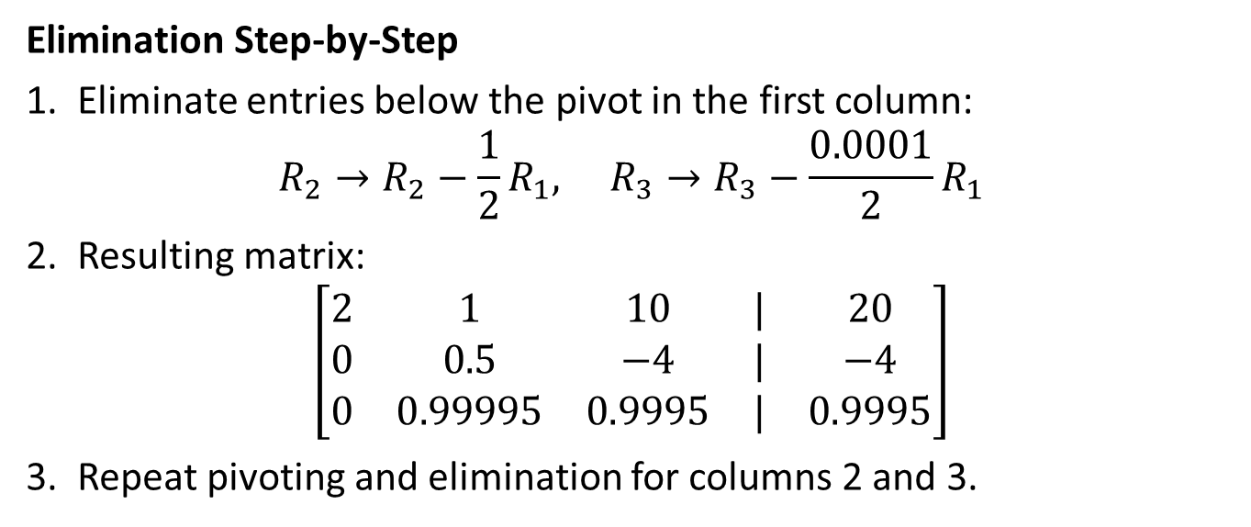
Elimination Step-by-Step
Eliminate entries below the pivot in the first column:
$$R_{2}→R_{2}−\frac{1}{2}R_{1}, R_{3}→R_{3}−\frac{0.0001}{2}R_{1}$$
Resulting matrix:
$$\left[\begin{matrix}2 & 1 & 10 & | & 20 \\ 0 & 0.5 & −4 & | & −4 \\ 0 & 0.99995 & 0.9995 & | & 0.9995\end{matrix}\right]$$
Repeat pivoting and elimination for columns 2 and 3.

Slide 19
Slide 8: Complete Solution
After performing Gauss-Jordan elimination with pivoting:
$$\left[\begin{matrix}1 & 0 & 0 & | & 2 \\ 0 & 1 & 0 & | & 1 \\ 0 & 0 & 1 & | & 1\end{matrix}\right]$$
Solution:
$$x=2, y=1, z=1$$

Slide 20
Slide 9: Challenges and Limitations
Pivoting increases computational complexity for larger matrices.
Requires additional bookkeeping for row swaps.
May not guarantee exact accuracy for ill-conditioned matrices.

Slide 21
Applications of Pivoting
Engineering: Solving large systems of linear equations.
Computer science: Numerical simulations and optimizations.
Physics: Stability in solving differential equations.

Slide 22
Summary
Pivoting improves the accuracy and stability of Gauss-Jordan elimination.
Partial pivoting is a practical and efficient choice.
Numerical stability is crucial for solving large or complex systems.

Slide 23
Using Gauss-Jordan Elimination to find Inverse Matrix
To find the inverse of a matrix $A$, we augment it with the identity matrix $I$.
Perform Gauss-Jordan elimination to transform $A$ into $I$, turning $I$ into $A^{−1}$.
Works only if the matrix $A$ is invertible (determinant $≠0$).

Slide 24
Key Steps
Write the augmented matrix $[A|I]$.
Use row operations to transform $A$ into the identity matrix $I$.
The resulting augmented matrix will be $[I|A^{−1}]$.

Slide 25
Example Problem
Find the inverse of:
$$A=\left[\begin{matrix}2 & 1 \\ 5 & 3\end{matrix}\right]$$
Form augmented matrix:
$$\left[\begin{matrix}2 & 1 & | & 1 & 0 \\ 5 & 3 & | & 0 & 1\end{matrix}\right]$$

Slide 26
Step-by-Step Solution
Scale the first row to make the pivot 1:
$$R_{1}→R_{1}/2$$
Result:
$$\left[\begin{matrix}1 & 0.5 & | & 0.5 & 0 \\ 5 & 3 & | & 0 & 1\end{matrix}\right]$$

Slide 27
Eliminate the first column of $R_{2}$:
$$R_{2}→R_{2}−5⋅R_{1}$$
Result:
$$\left[\begin{matrix}1 & 0.5 & | & 0.5 & 0 \\ 0 & 0.5 & | & −2.5 & 1\end{matrix}\right]$$

Slide 28
Scale the second row to make the pivot 1:
$$R_{2}→R_{2}/0.5$$
Result:
$$\left[\begin{matrix}1 & 0.5 & | & 0.5 & 0 \\ 0 & 1 & | & −5 & 2\end{matrix}\right]$$

Slide 29
Eliminate the second column of $R_{1}$:
$$R_{1}→R_{1}−0.5⋅R_{2}$$
Result:
$$\left[\begin{matrix}1 & 0 & | & 3 & −1 \\ 0 & 1 & | & −5 & 2\end{matrix}\right]$$

Slide 30
Final Result
The final augmented matrix is:
$$\left[\begin{matrix}1 & 0 & | & 3 & −1 \\ 0 & 1 & | & −5 & 2\end{matrix}\right]$$
Inverse of $A$:
$$A^{−1}=\left[\begin{matrix}3 & −1 \\ −5 & 2\end{matrix}\right]$$

Slide 31
Conditions for Invertibility
A matrix $A$ is invertible if:
It is square ($n×n$).
Determinant of $A≠0$.
For $2×2$:
$$\text{det}(A)=ad−bc≠0$$

Slide 32
Summary
Gauss-Jordan elimination transforms $A$ into $I$, revealing $A^{−1}$.
Method highlights the importance of row operations.
Verifiable through matrix multiplication: $A⋅A^{−1}=I$.

Slide 33
Discussion of ChatGPT
These slides were prepared using ChatGPT
  The partial pivoting slides contained an error that required a prompt to be modified

