Slide 1
MANE 3351

Slide 2
Lecture 25

Slide 3
Classroom Management
Agenda
  Final Review
  Return Raspberry Pis and Arduinos (bring to class or take to my office)
  No class next week - I will be in my office during class times

Slide 4
Resources

Slide 5
Handouts
  Lecture 25 slides
  Lecture 25 slides marked

Slide 6
Calendar
Week | Monday Lecture | Wednesday Lecture
14 | 12/1: Lecture 24 - Software | 12/3: Lecture 25 - Review
15 | 12/8: Lecture 26 - no class | 12/10: Lecture 27 - no class

Slide 7
Final Exam is Monday 12/15/2025 8:00 - 9:45 AM
I will be off-campus on an ABET visit and a proctor will be arranged for the final exam.

Slide 8
Final Exam Details
  Monday December 15, 2025, 8:00 - 9:45 AM
  Covers material since last test (linear algebra)
    Part 3 (Days 17 - 25, Homeworks 6 and 7)
  One four inch by six inch notecard allowed
  Scratch paper will be provided
  Calculator needed
  An old final exam is not provided
  Final Exams are not returned
    You are welcome to schedule an appointment to review your final exam with Dr. Timmer

Slide 9
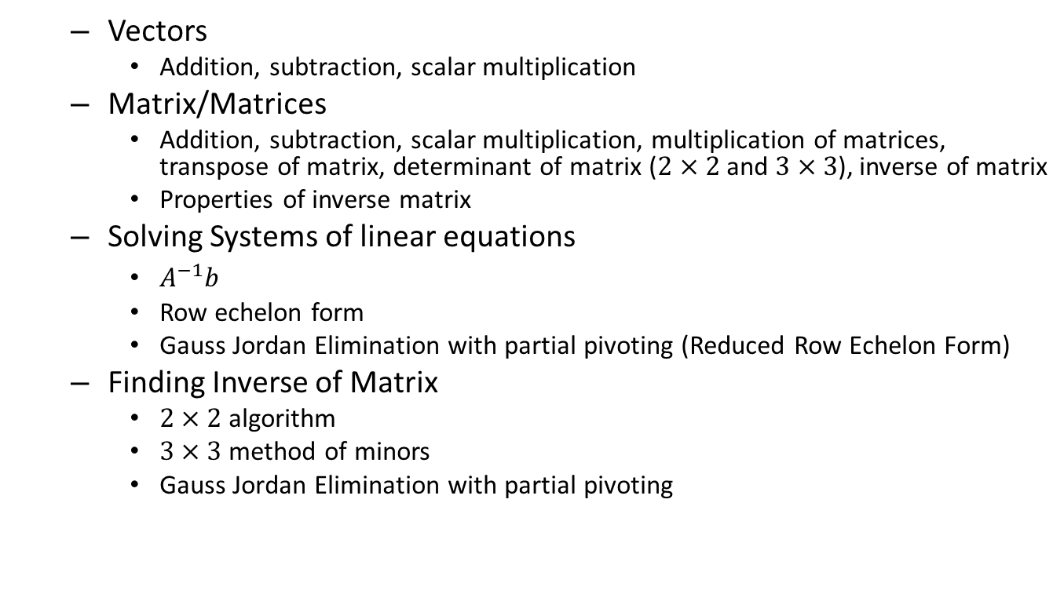
Final Exam Topics
  Vectors
    Addition, subtraction, scalar multiplication
  Matrix/Matrices
    Addition, subtraction, scalar multiplication, multiplication of matrices, transpose of matrix, determinant of matrix ($2×2$ and $3×3$), inverse of matrix
    Properties of inverse matrix
  Solving Systems of linear equations
    $A^{−1}b$
    Row echelon form
    Gauss Jordan Elimination with partial pivoting (Reduced Row Echelon Form)
  Finding Inverse of Matrix
    $2×2$ algorithm
    $3×3$ method of minors
    Gauss Jordan Elimination with partial pivoting

Slide 10
Grading
  I’m trying to catch up! Keep checking Brightspace
  I’ll enforce the syllabus rules on late work
  Stay connected and if you have questions, send me an email

Slide 11
Solutions
  Solutions for Homework 6 and 7 will be posted on Thursday December 4, 2025
  You can use Octave or linalg to find solutions to all the homework 6 and 7 problems

Slide 12
Grades
  Please login to Brightspace and check your grades often
  If you have any questions, please contact me
  Grades are due Monday, December 22, 2025 at 3:00 pm
  Grades will be posted as soon as they become available (including course grade)

Slide 13
Late Work
  Syllabus
    10% penalty per day for work submitted after the deadline,
    After one week, no credit will be given for late work
    No late work will be accepted after study day
    Certain assignments where late work will not be accepted will be announced

Slide 14
Turning In Equipment
  Please return the Raspberry Pi’s and Arduinos as soon as possible
  Let me know if there will be any problems returning equipment before grades are due

Slide 15
Final Comments
  You should be able to perform any analysis that I did in class or that was in the last two homework assignments
  The final exam covers linear algebra and the last two homework assignments
  You have been a good class, study hard and perform well!

