Slide 1
MANE 3351

Slide 2
Lecture 3

Slide 3
Classroom Management
Agenda
GitHub Classroom Setup
GitHub Account Creation
Raspberry Pi Programming
Circuits
Laboratory Session will meet today

Slide 4
Resources

Slide 5
Handouts
Lecture 3 Slides
Lecture 3 Marked Slides

Slide 6
Assignments
Link personal GitHub account with GitHub Classroom

Slide 7
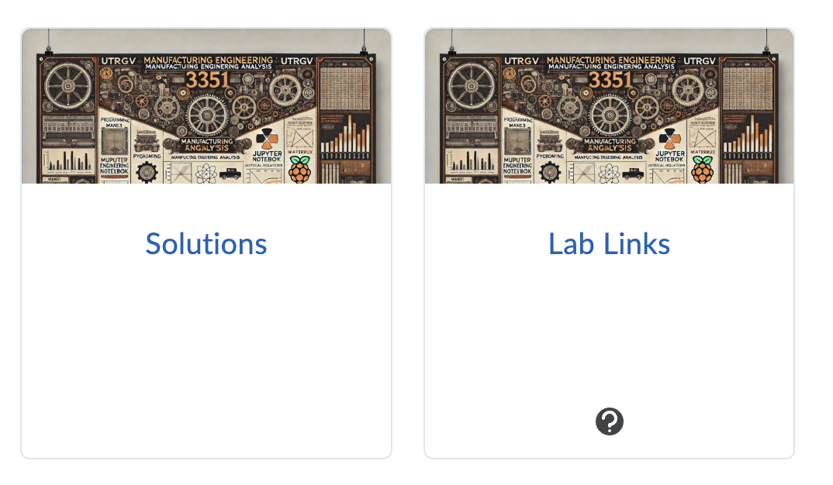
Linking GitHub Account
Must be done once per semester
Click on the Lab Links Content Area

Slide 8
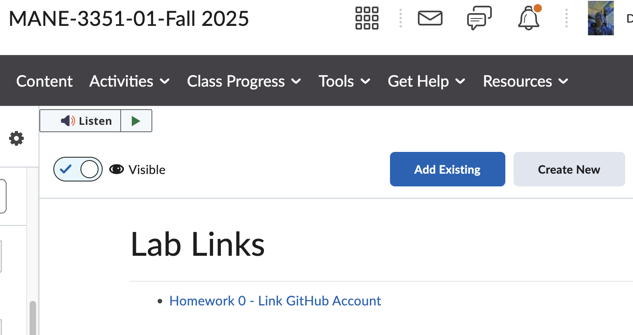
Homework 0
Click on the Homework 0 web link

Slide 9
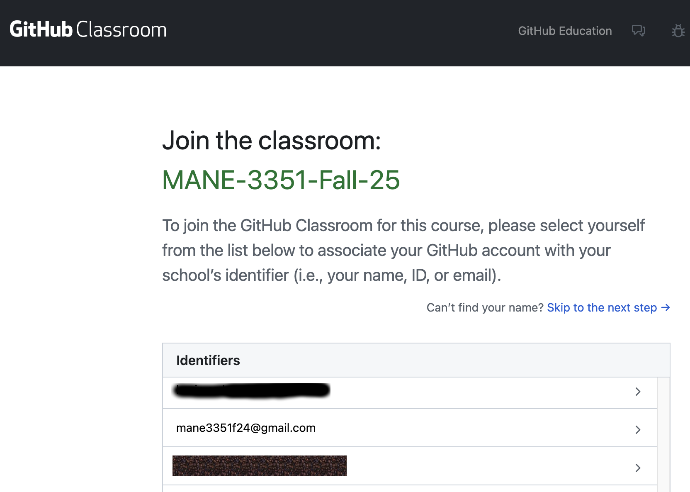
GitHub Classroom
A GitHub Classroom screen will appear allowing you to join the classroom
Your GitHub classroom identifier is your UTRGV email account name
Select your email address from the list
Dr. Timmer created mane3351f24@gmail.com as his user account

Slide 10
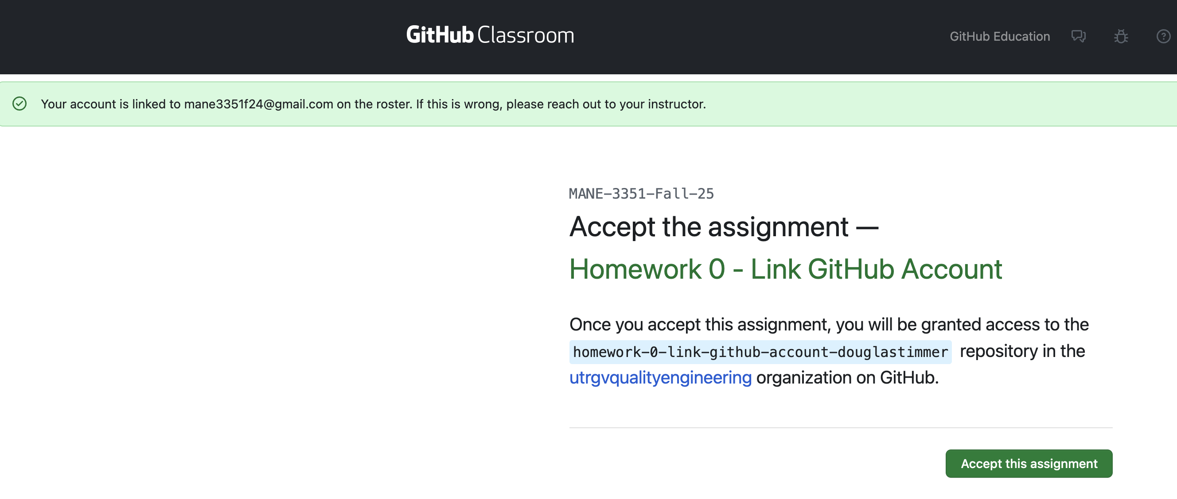
Accept the Assignment
A screen will appear asking you to accept the assignment
Click on Accept this assignment

Slide 11
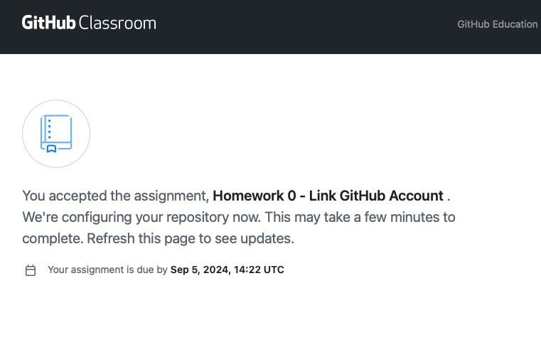
Acceptance Confirmation
After accepting the assignment, the following screen will appear
Eventually, a link will be provided to the repository created using GitHub Classroom
For Homework 0, this completes the assignment
  In future assignments, you will have to clone the repository to your local computer and complete the assignment
  The purpose of Homework 0 is to link your GitHub account to GitHub classroom and your UTRGV email address

Slide 12

GitHub Authorization
Once the link is clicked, you will be asked to sign up for GitHub or verify your GitHub account if you have already logged into email on your computer (my case)
  If you have not created a GitHub account, do so before proceeding. Notes are provided below.
  It is recommended to use your UTRGV email but not required
  Additional notes for creating GitHub account is provided after GitHub Classroom notes

Slide 13
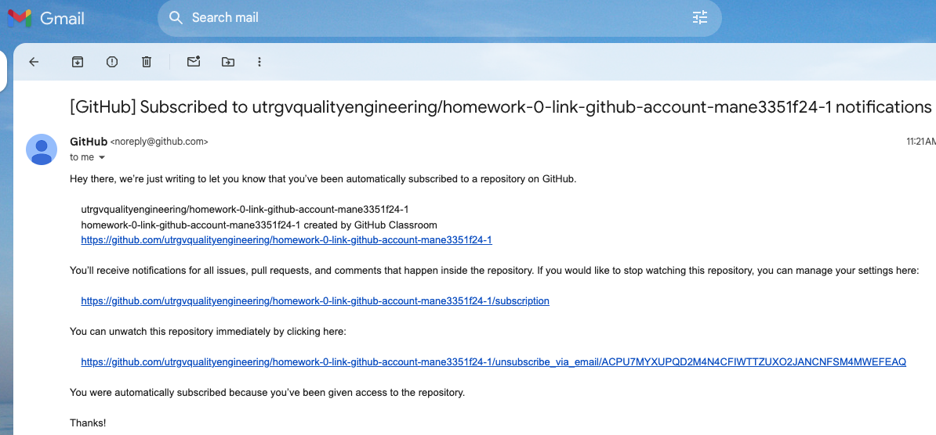
Email Confirmation
You will receive an email confirmation that contains a link to the repository to be downloaded

Slide 14
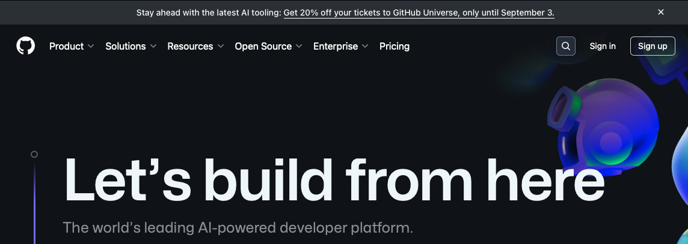
GitHub Account Creation
Click on Sign up to create a new account

Slide 15
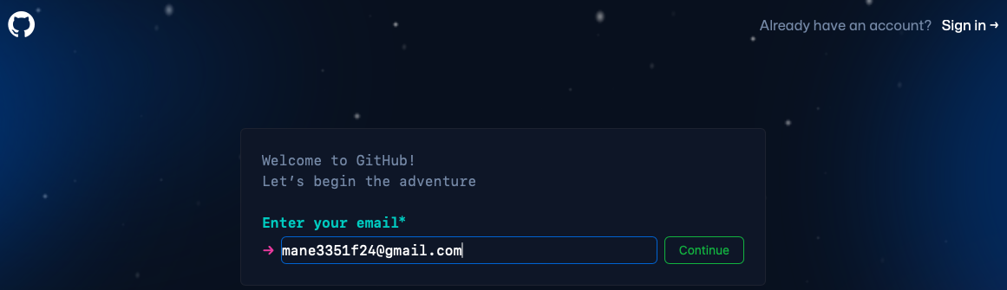
Email Entry
Enter your email address (preferably UTRGV) and click continue
For this example, I am using a Gmail account I created for the course

Slide 16
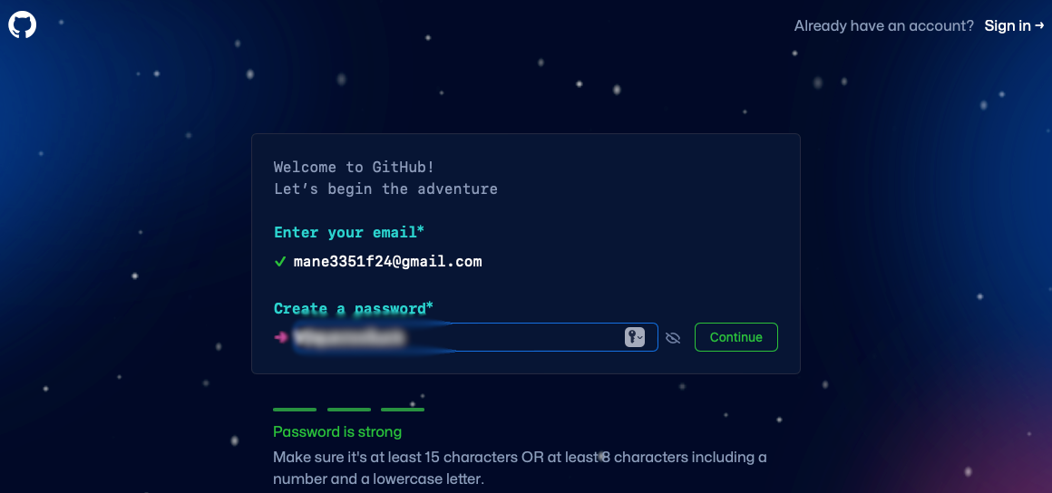
GitHub Account Password
You will be asked to create a strong password
Click Continue when done

Slide 17
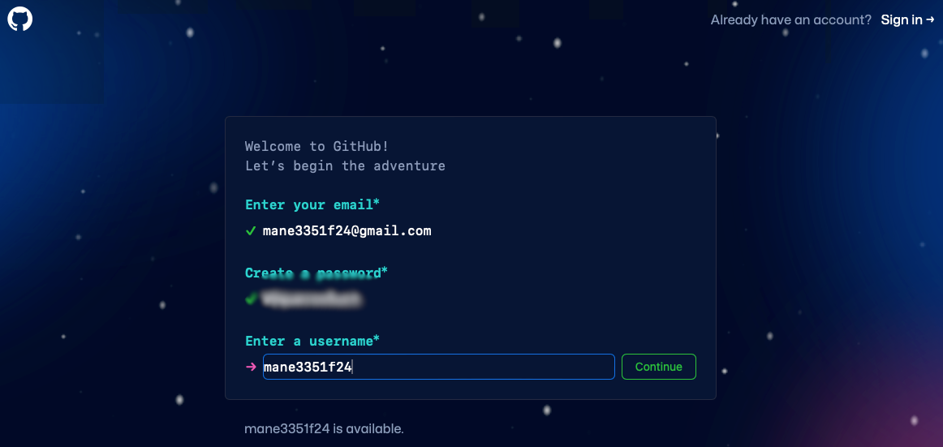
GitHub Username
Create a username that is available
Your username will be incorporated into the repository name along with the assignment name

Slide 18
GitHub Email Preferences
you will be provided an opportunity to sign-up to receive occasional product updates and announcement.
Signing up for email updates is optional
No screen capture is provided of this step

Slide 19
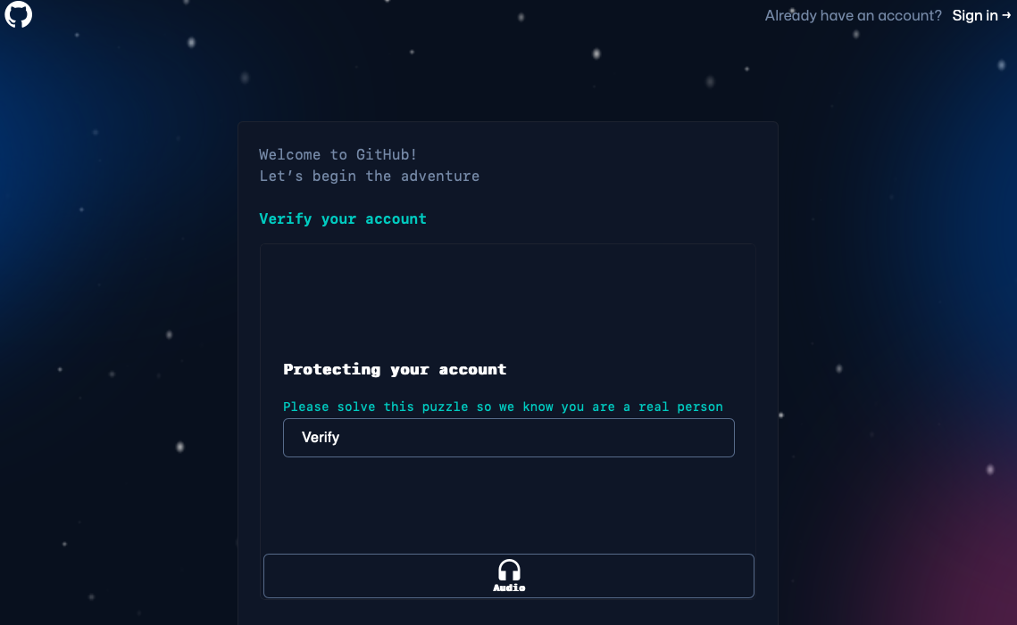
GitHub Verify Account
You will be prompted to verify your account by solving a puzzle
After verifying, a code will be sent to your email account that is needed

Slide 20
What is a Circuit?
A circuit is a loop through which current can flow
A power source, such as a battery, provides the energy for the circuit to work
Electrons flow from the negative side of the power source, through the circuit and back to the positive slide of the power source
Once the electrons return to the power source, the circuit is complete
View example at web site
Source

Slide 21
Components of a Circuit
Circuits consist of three parts:
Voltage Source: this provides the electrons that flow through the circuit in order to power it. Common voltage sources are batteries and electrical connections such as outlets,
Load: this consumes the power created by the voltage source. Loads are what make a circuit light up, make noise, run a program and more. In simple circuits, the load may be a single light bulb, but in more complex circuits, the load may be made up of a combination of resistors, capacitors, light bulbs, buzzers and more,
Conductive Path: this is the route the current follows through the circuit. It must be made of conductive materials in order to allow electricity to flow. The path starts at the voltage source, travels through the load and returns to the voltage source. In order to create a closed circuit, this path must form a loop
An open circuit is one in which there is an interruption in the loop. The term “open circuit” is an oxymoron since the very definition of a circuit requires a closed loop.
Source

Slide 22
Short Circuits
When the conductive path of a circuit connects directly from one end of the voltage source to the other without first powering a load, the result is a short circuit
Current flows everywhere it can, and if it can find a shorter path, it will take it. This is why conductive wires are coated in an insulator - to prevent accidental short-circuiting through wires touching.
Short circuits can be very dangerous and cause wires to burn up, damage the power supply, drain the battery, start a fire and more. Most of the time your power supply will have some sort of safety mechanism built into it to limit the maximum current in the event of a short circuit, but not always. This is the reason all homes and buildings have circuit breakers, to prevent fires from starting in the event of a short circuit somewhere in the wiring. If you notice a part of your circuit suddenly becoming hot or a part suddenly burns out, immediately turn off the power and look for possible short circuits
It is important to note that current does not limit itself to choosing just one path, it will take every available path it can find. Which means that even if a short circuit is present, a small amount of power may still be supplied to your load
Source

Slide 23
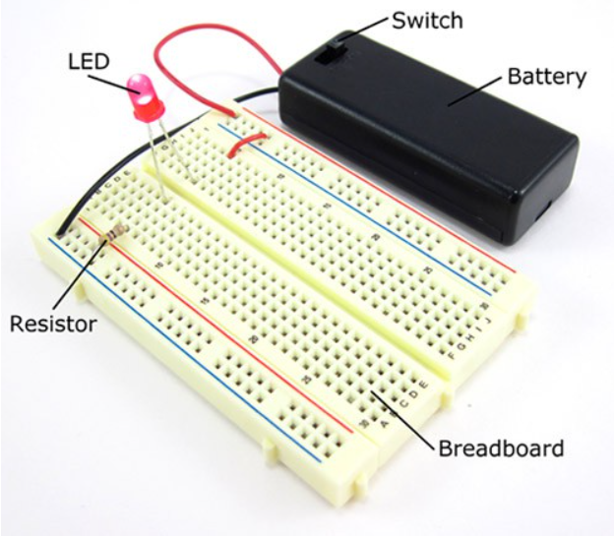
Breadboard
Source
A breadboard is a rectangular plastic board with a bunch of tiny holes in it
These holes let you easily insert electronic components to prototype
See illustration below
Breadboard

Slide 24
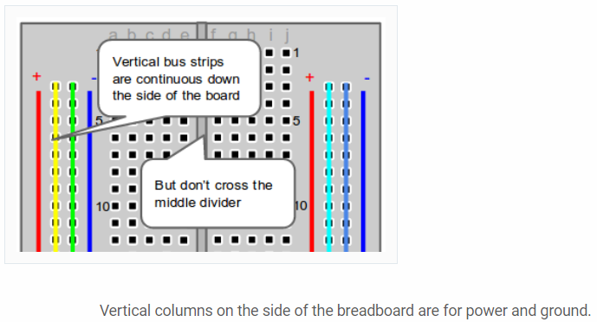
Breadboard Columns
Source
Columns

Slide 25
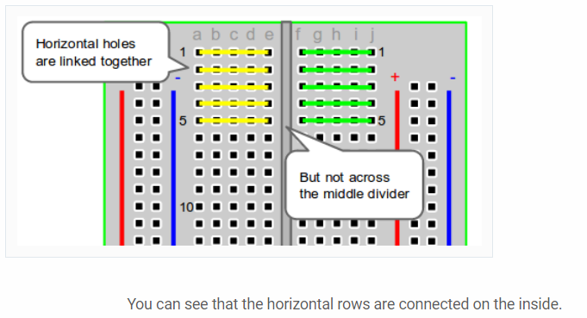
Breadboard Rows
Rows

Slide 26
Source

Slide 27
Breadboard Demonstration
Simple circuit: LED

Slide 28
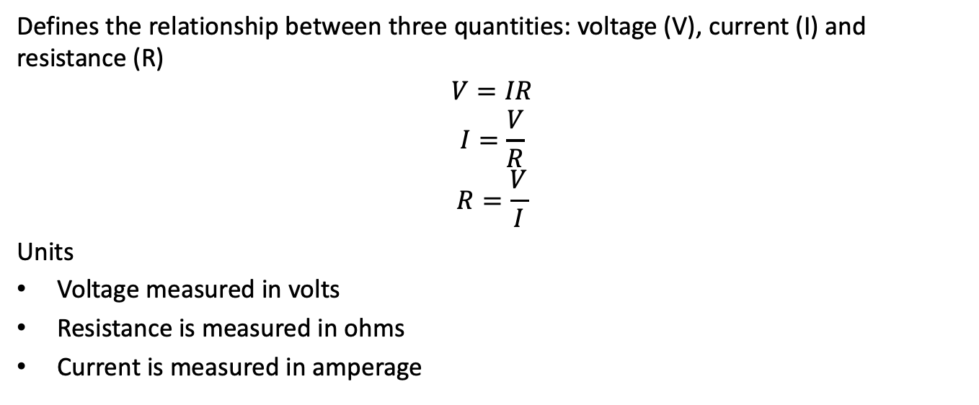
Ohm’s Law
Defines the relationship between three quantities: voltage (V), current (I) and resistance (R)
$$V=IR$$
$$I=\frac{V}{R}$$
$$R=\frac{V}{I}$$
Units
Voltage measured in volts
Resistance is measured in ohms
Current is measured in amperage

Slide 29
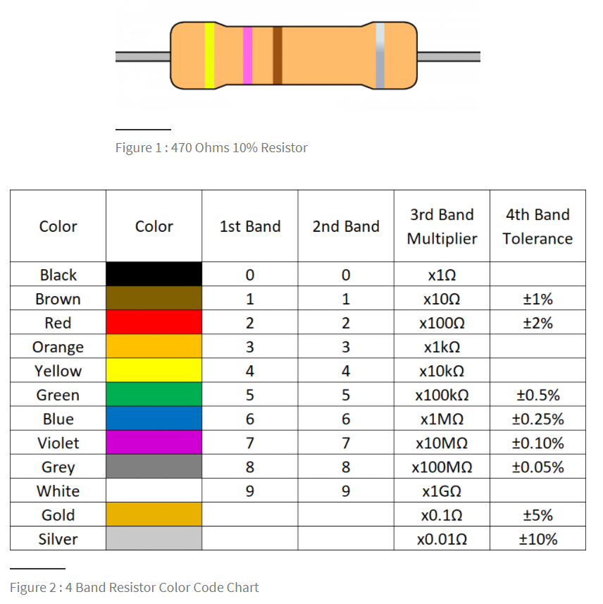
Resistor Color Codes
Source
Resistor Color Codes

Slide 30
Breadboard Demonstration 2
What happens when we change resistors in the circuit?
Does your observation agree with Ohm’s Law?

Slide 31
Raspberry Pi GPIO Pins
GPIO pins are digital: on or off
GPIO pins can receive (input) current or send (output) current
Operating voltage of the GPIO pins is 3.3 V
Used for low current applications, not powering motor
GPIO pins are programmable using Python, JavaScript, non-RED, etc.
Other types of pins will not be considered
Source

Slide 32
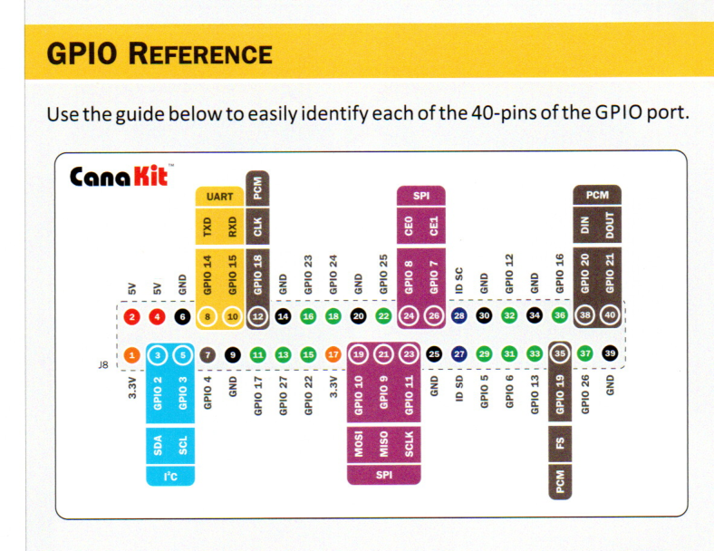
Raspberry Pi Pin Assignments
GPIO2

Slide 33
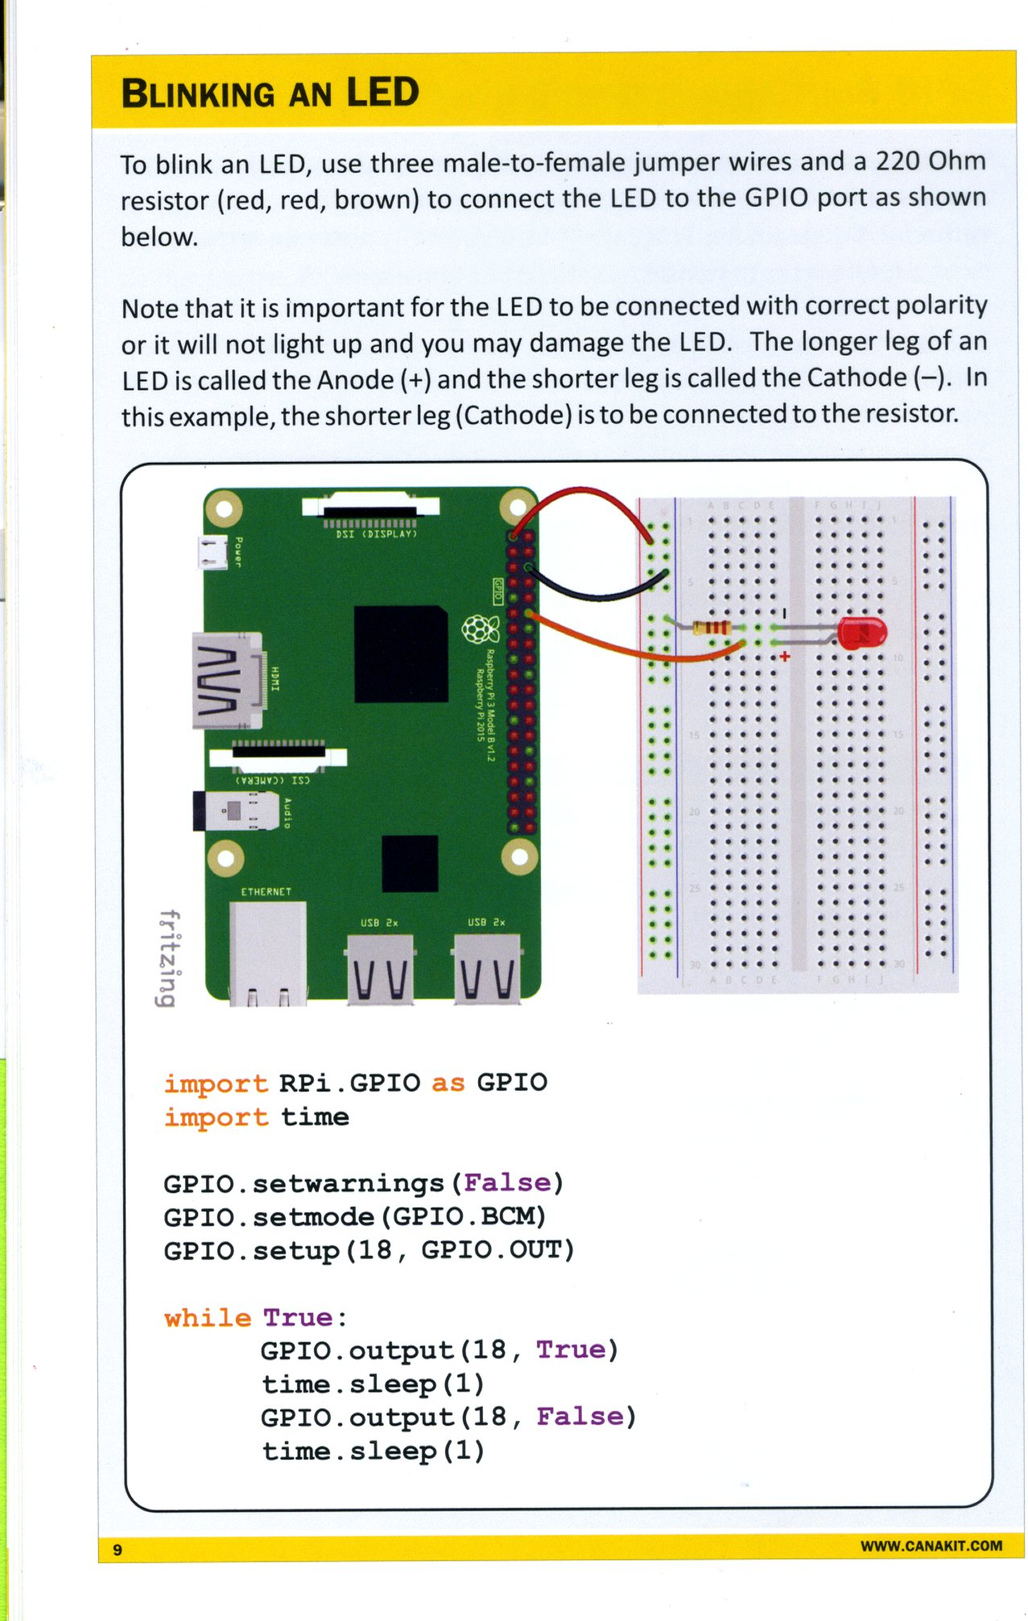
Blinking an LED Demonstration
Blink

Slide 34
Blinking an LED Code
import RPi.GPIO as GPIO
import time
GPIO.setwarnings(False)
GPIO.setmode(GPIO.BCM)
GPIO.setup(18, GPIO.OUT)
while True:
GPIO.output(18,True)
time.sleep(1)
GPIO.output(18,False)
time.sleep(1)

Slide 35
Raspberry Pi Demonstration
Circuit construction
Connecting circuit to Raspberry Pi
Python programming
Blinking an LED demonstration
Can anyone identify the unused connector in the circuit?
Raspberry Pi demonstrations will be recorded using a HD Video Capture box typically used for recording computer games.

