Slide 1
MANE 3351

Slide 2
Lecture 4

Slide 3
Classroom Management
Agenda
Numerical Representations in a computer
Lab 1 due September 17
4 students have not linked GitHub account through Homework 0
1 student has not picked up their Raspberry Pi
Laboratory session will not meet, I will be in my office awaiting lab 1

Slide 4
Resources

Slide 5
Handouts
Lecture 4 Slides
Lecture 4 Marked Slides

Slide 6
Lecture 4 Content

Slide 7
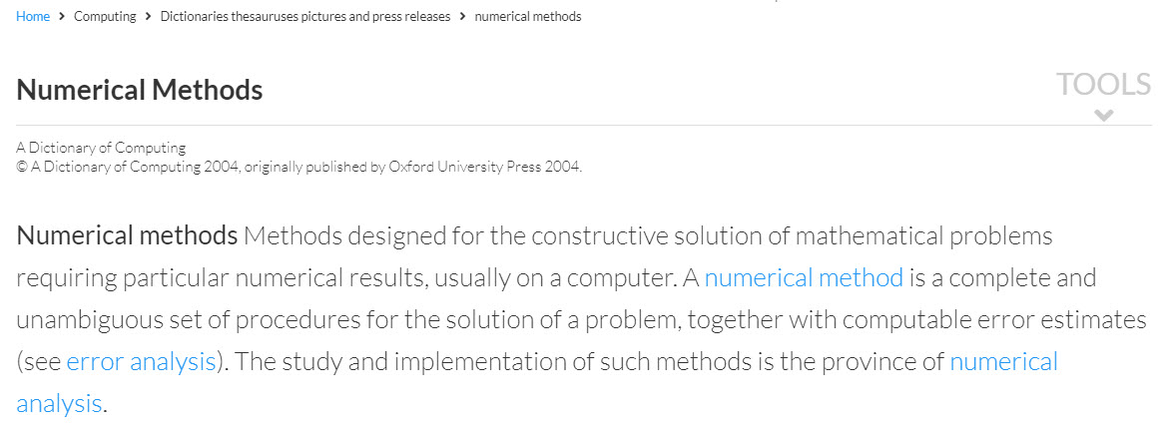
Embrace Your Inner Skeptic
Definition: Numerical Methods
Numerical Methods, definition

Slide 8
¹

Slide 9
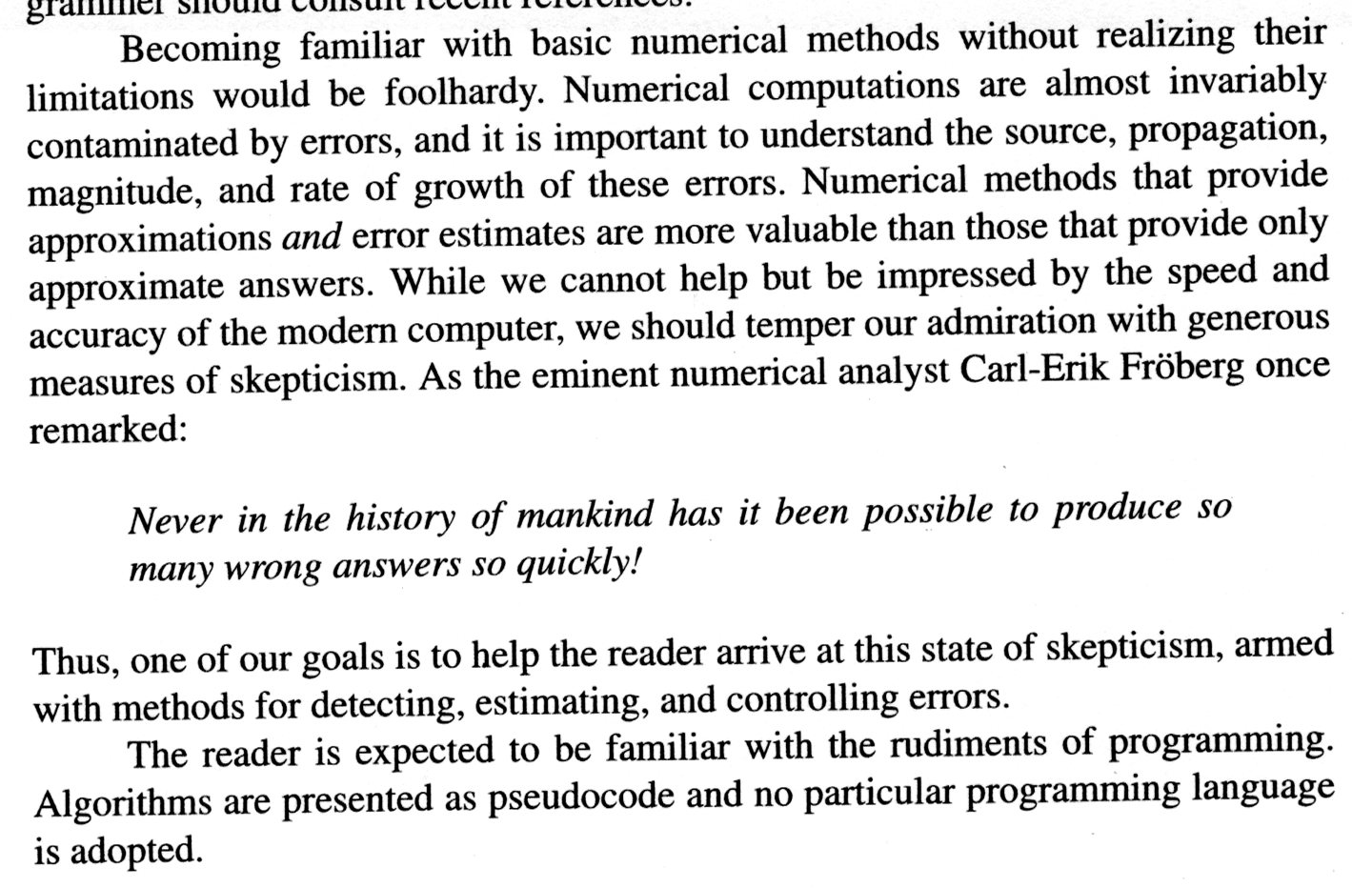
Embrace your Inner Skeptic
embrace your inner skeptic

Slide 10
²

Slide 11
Evaluating Numerical Methods
Numerical methods should consider these two evaluation criterion :
Accuracy (or error) analysis
Speed

Slide 12
Introduction to Error Analysis
Error Measurements
Let $v_{A}$ be the approximate value and $v_{E}$ be the exact value
Absolute error: $\left|v_{A}−v_{E}\right|$
Relative error: $\frac{\left|v_{A}−v_{E}\right|}{v_{E}}$
Percentage error: $\frac{\left|v_{A}−v_{E}\right|}{v_{E}}×100\%$

Slide 13
Sources of Error
Sources of Errors
Round-off errors are due to the fact that the computers represent numbers in a finite number of bits and bytes
Truncation errors are errors that emerge from the approximation of the mathematical model
Model errors are due to the fact that the mathematical model usually is an approximation of the physical reality

Slide 14
Number Types in Python
Python supports int, float, and complex.
Integers can be represented exactly
Float and complex variables can be represented approximately
“Floating-point numbers are usually implemented using double in C”³

Slide 15
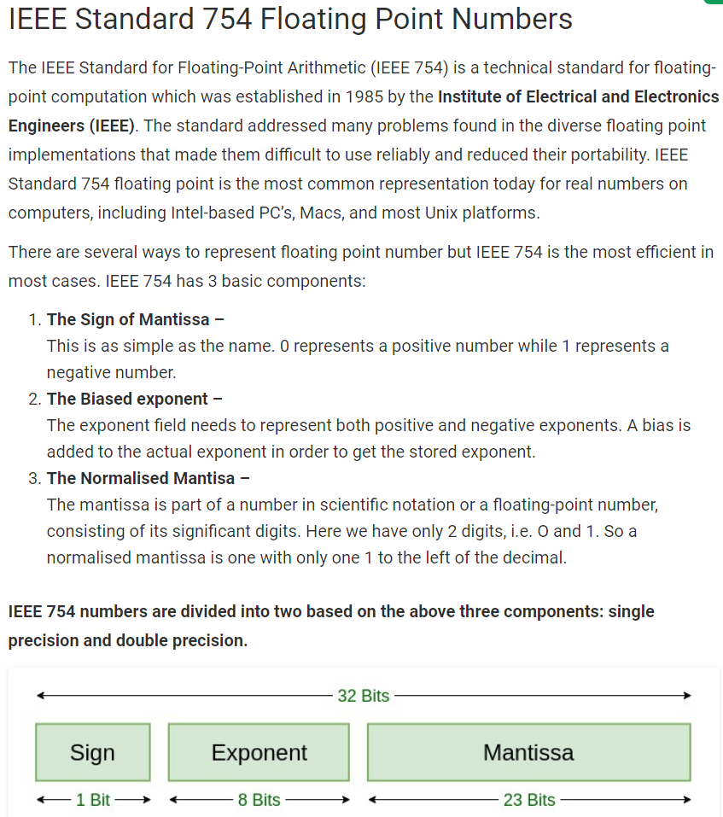
Computer Implementation of Floats
IEEE Standard 754 Floating Point Numbers
IEEE Standard 754 floating point numbers

Slide 16
⁴

Slide 17
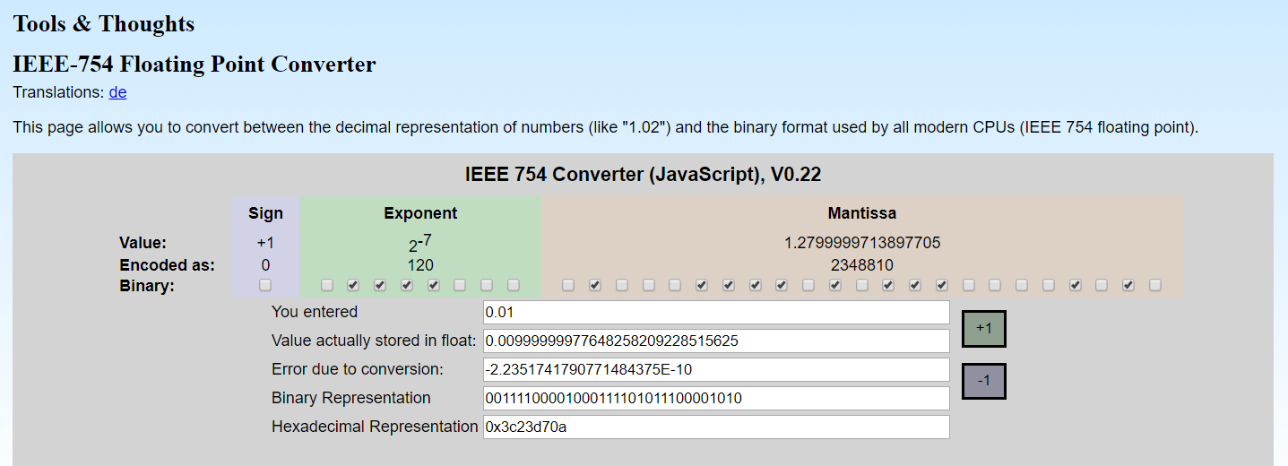
Floating Point Representation
floating point convertor

Slide 18
⁵

Slide 19
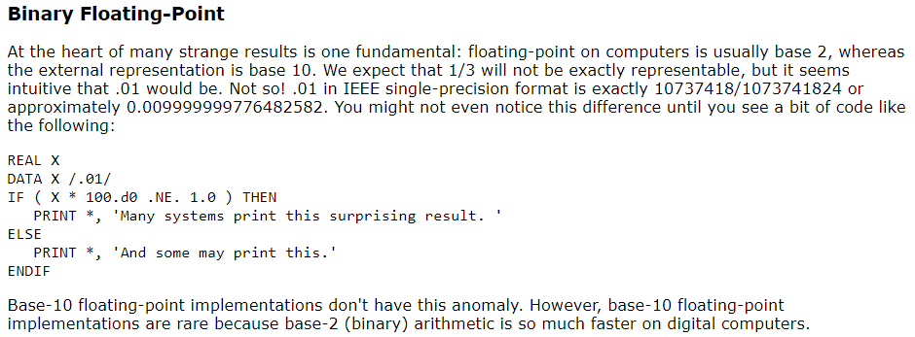
Perils of Floating Point
binary floating point

Slide 20
⁶

Slide 21
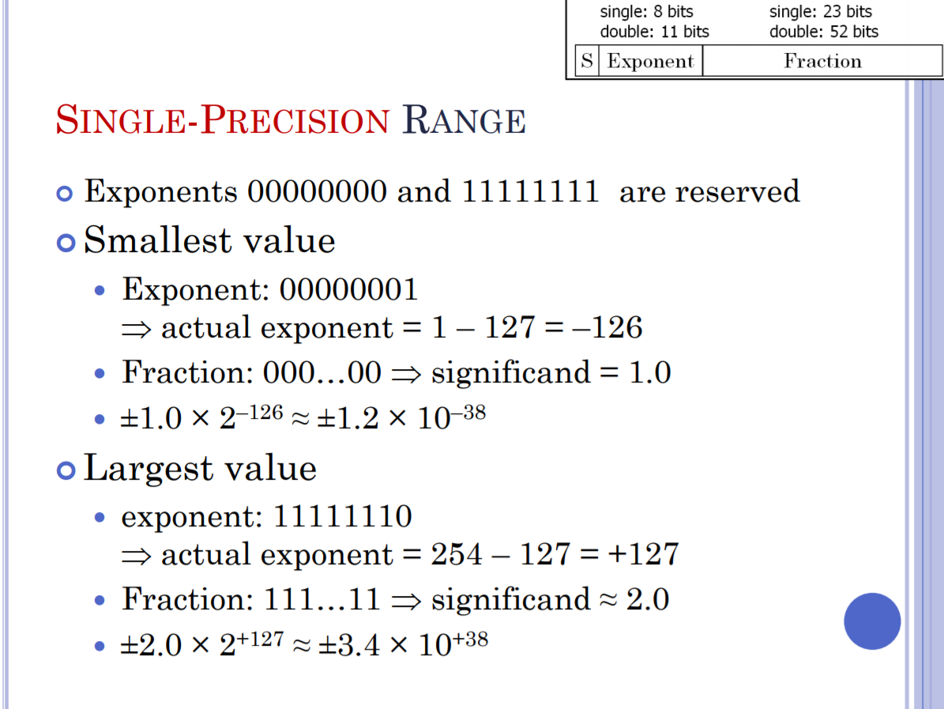
Single Precision Range
range of single-precision numbers

Slide 22
⁷

Slide 23
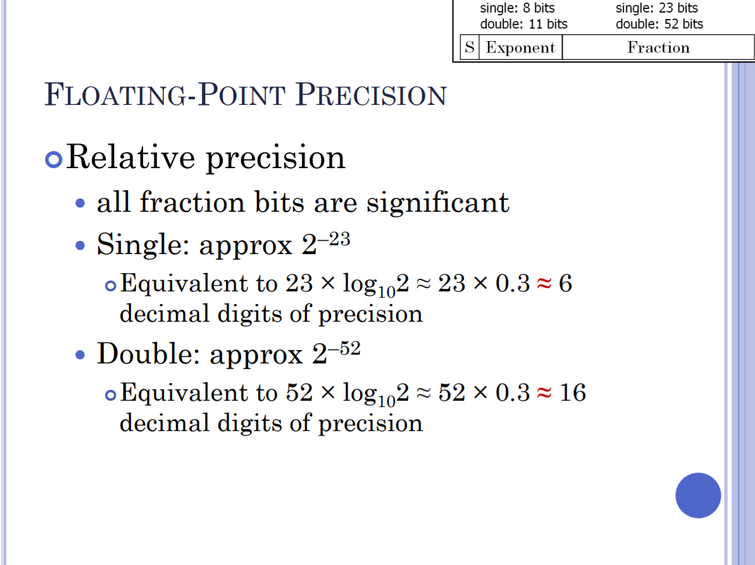
Single Floating-Point Precision
precision of single-precision numbers

Slide 24
⁸

Slide 25
Double Precision Range

Slide 26
Double Floating-Point Precision

Slide 27
Notes
1. “numerical methods.” A Dictionary of Computing. Retrieved August 27, 2019 from Encyclopedia.com: https://www.encyclopedia.com/computing/dictionaries-thesauruses-pictures-and-press-releases/numerical-methods
2. Cheney and Kincaid (2004), Numerical Mathematics and Computing, 5th edition.
3. Python 3.12.5 Documentation » The Python Standard Library » Built-in Types. Retrieved September 6, 2024 from: https://docs.python.org/3/library/stdtypes.html
4. Geeks for Geeks. Retrieved August 28, 2019 from: https://www.geeksforgeeks.org/ieee-standard-754-floating-point-numbers/
5. FloatConvertor. Retrieved August 28, 2019 from: https://www.h-schmidt.net/FloatConverter/IEEE754.html
6. Perils of Floating Point. Retrieved August 28, 2019 from: http://www.lahey.com/float.htm
7. IEEE 754 Floating Point Representation. Retrieved August 28, 2019 from: http://cs.boisestate.edu/~alark/cs354/lectures/ieee754.pdf
8. IEEE 754 Floating Point Representation. Retrieved August 28, 2019 from: http://cs.boisestate.edu/~alark/cs354/lectures/ieee754.pdf

