Slide 1
MANE 3351

Slide 2
Lecture 5

Slide 3
Classroom Management
Agenda
Arduinos
Reminder: Lab One - due 9/17 before 9:30 AM
There will be a short laboratory session following the lecture

Slide 4
Resources

Slide 5
Handouts
Lecture 5 Slides
Lecture 5 Marked Slides

Slide 6
Assignments
Lab 2 (assigned 9/17/2025, due 9/24/2024 (before 9:30 AM))

Slide 7
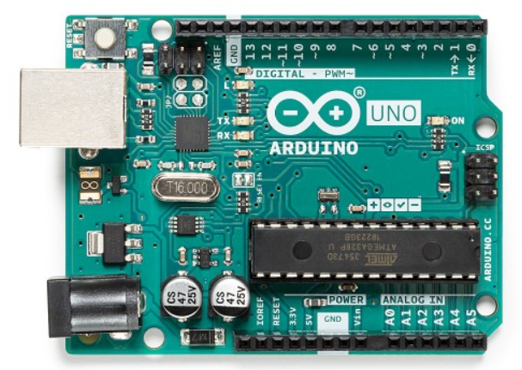
Arduino Uno
Source: Arduino Uno Website
Arduino Uno

Slide 8
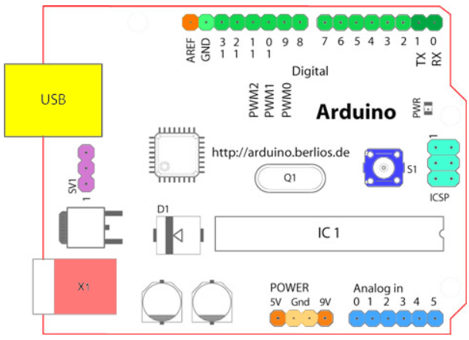
Source: Arduino Website
Arduino I/O

Slide 9
Input/Output
Voltages - 5V pin and 9V pin are present on the board as well as ground pins (0v)
Digital Pins - multiple digital pins are provided on an Arduino board that can be used for general purpose input and output via the pinMode(), digitalRead(), and digitalWrite() commands
Analog Pins- the analog input pins suport 10-bit analog-to-digital conversion using the analogRead() function
Other Pins - A reference voltage and reset functionality are also available

Slide 10
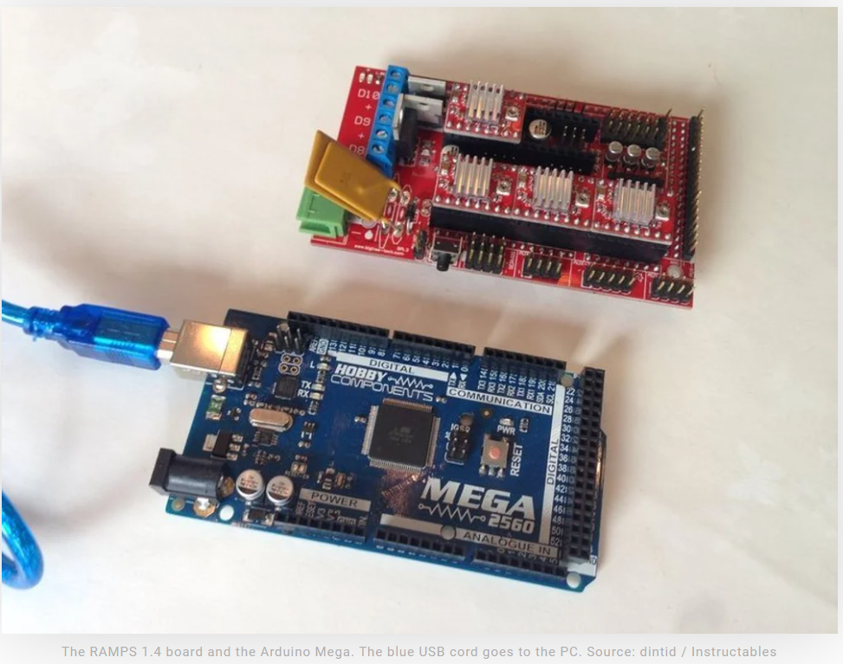
Source: all3dp
Arduino Mega
There are multiple versions of Arduino boards.
The Arduino Mega is often combined with a RAMPS shield to construct homemade Reprap 3D-printers
Arduino Mega and Ramp

Slide 11
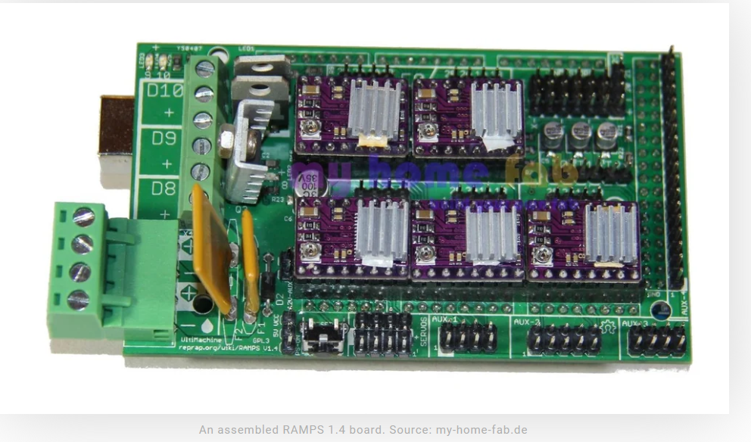
RAMPS Shield
Circuit board that plugs into Arduino Mega for build 3D printers
Typically includes drivers for stepper motors shown below
Schematic for 3D printer is also provided below
Both images taken from All3DP website
RAMPS

Slide 12
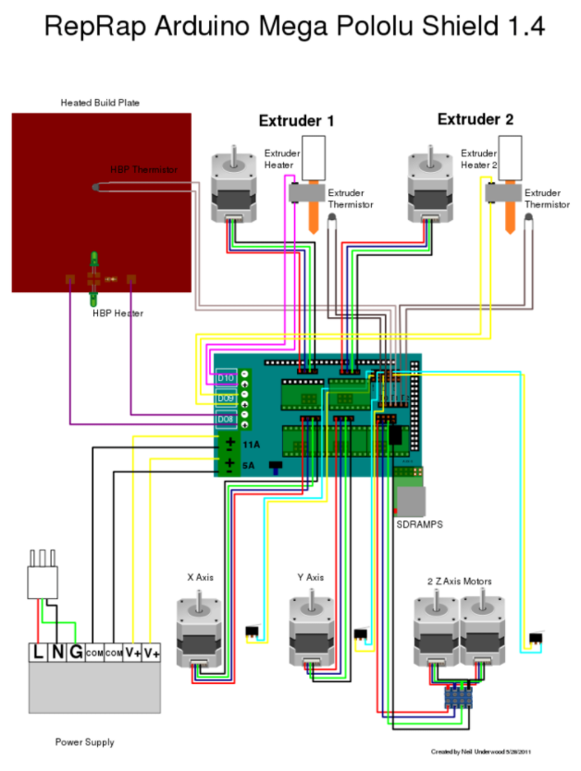
3D printer schematic

Slide 13
Programming Arduino
Written in the Arduino Integrated Development Environment
Arduino programming language is based on a very simple hardware programming language called processing, which is similar to the C language
Programs for Arduinos are called sketches
Sketches must be uploaded to Arduino (via USB cable)
Arduino IDE installed on Raspberry Pi
Source: Programming Arduinos

Slide 14
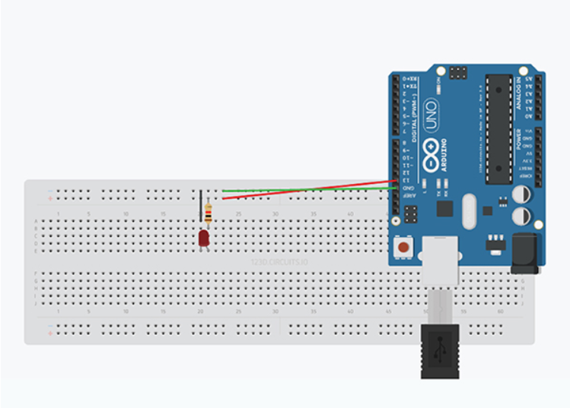
Example 1: Blinking an LED
First example is to an LED (same as with the Raspberry Pi)
Arduino LED Circuit

Slide 15
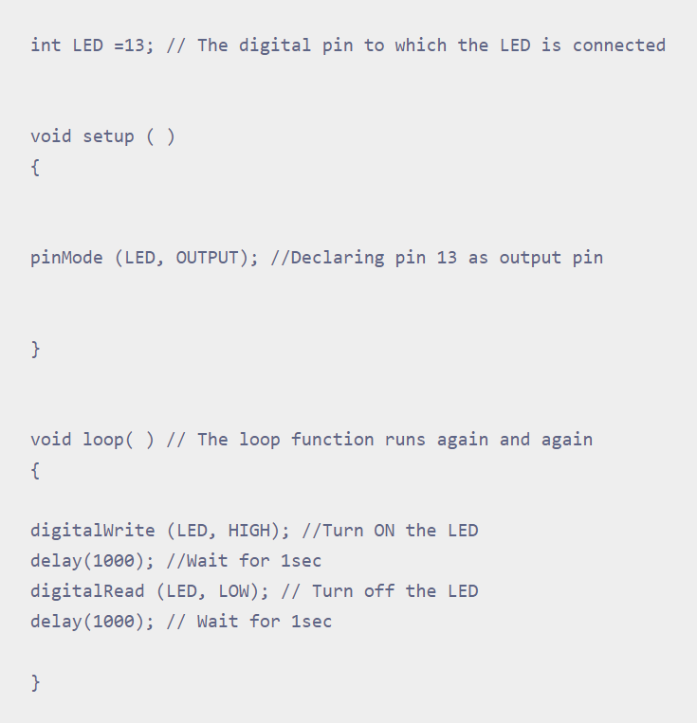
Example 1: Sketch
Note: there is an error in the sketch. Change digitalRead to digitalWrite
Arduino LED Code

Slide 16
Code for Blinking an LED
int LED = 13; // the digital pin to which the LED is connected void setup () { pinMode (LED,OUTPUT); //Declaring pin 13 as output ping } void loop () //The loop function runs again and again { digitalWrite (LED,HIGH); //Turn ON the LED delay (1000); //wait for 1 second digitalWrite(LED,LOw); //Turn OFF the LED delay(1000); //wait for one second }

Slide 17
Warning
Arduinos store the last program in EEPROM and will start running that program as soon as the power is provided
Cautious Approach:
Do not connect circuit board to Arduino until after the Sketch is loaded
Afterwards, connect hardware

Slide 18
Arduino Demonstration 1

Slide 19
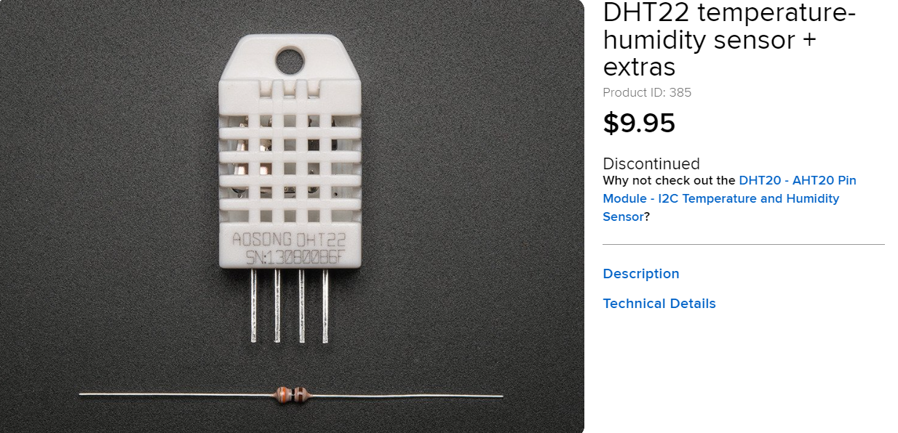
DHT22 Sensor
Source:
dht2sensor

Slide 20
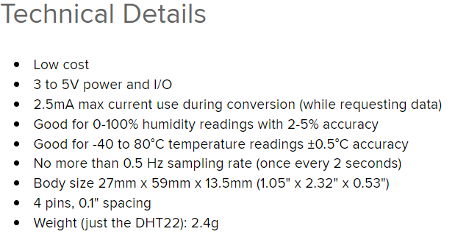
Technical Details of DHT11 Sensor
Source:
dht22 details

Slide 21
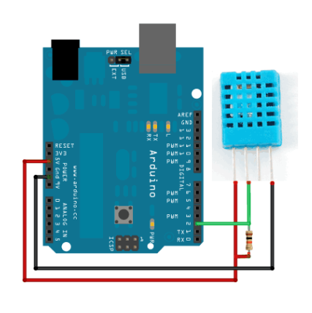
Arduino Circuit
Source:
arduino

Slide 22
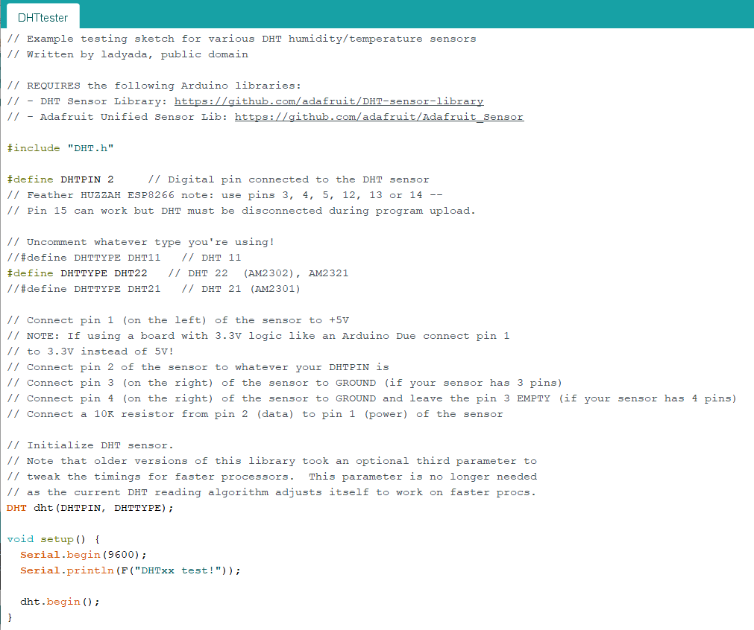
Arduino Sketch
Source: Example Code
part 1

Slide 23
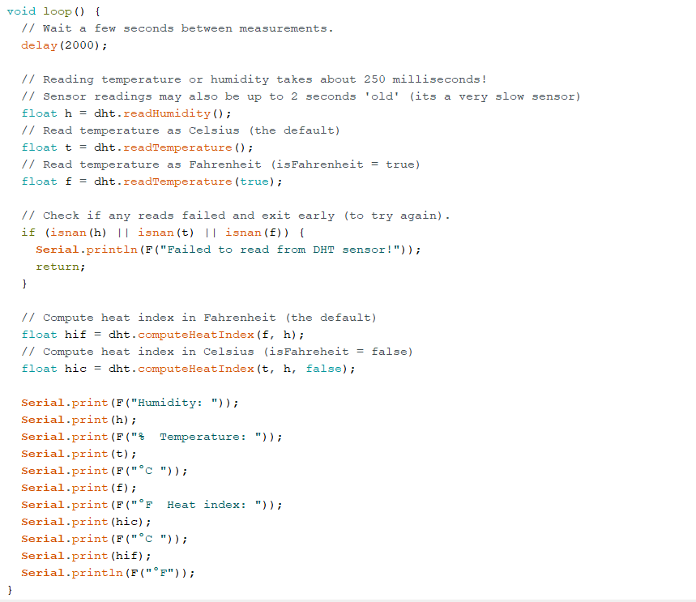
Arduino Sketch, continued
Source: Example Code
part 2

Slide 24
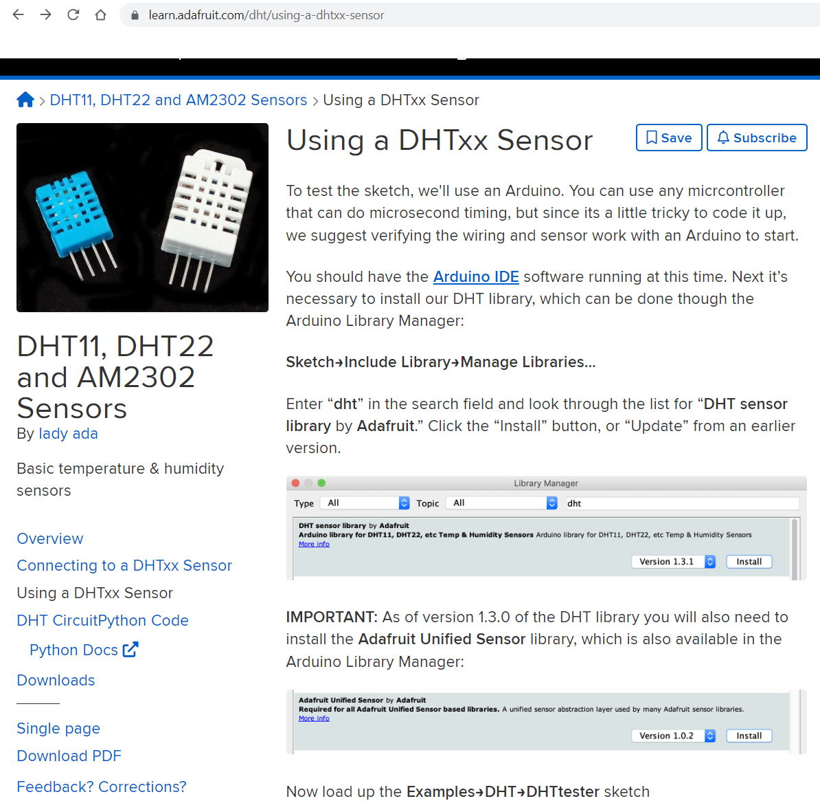
DHT Library
Source:
dht Sensor Library

Slide 25
DHTest Code
// Example testing sketch for various DHT humidity/temperature sensors // Written by ladyada, public domain // REQUIRES the following Arduino libraries: // - DHT Sensor Library: https://github.com/adafruit/DHT-sensor-library // - Adafruit Unified Sensor Lib: https://github.com/adafruit/Adafruit_Sensor #include "DHT.h" #define DHTPIN 2 // Digital pin connected to the DHT sensor // Feather HUZZAH ESP8266 note: use pins 3, 4, 5, 12, 13 or 14 -- // Pin 15 can work but DHT must be disconnected during program upload. // Uncomment whatever type you're using! //#define DHTTYPE DHT11 // DHT 11 #define DHTTYPE DHT22 // DHT 22 (AM2302), AM2321 //#define DHTTYPE DHT21 // DHT 21 (AM2301) // Connect pin 1 (on the left) of the sensor to +5V // NOTE: If using a board with 3.3V logic like an Arduino Due connect pin 1 // to 3.3V instead of 5V! // Connect pin 2 of the sensor to whatever your DHTPIN is // Connect pin 3 (on the right) of the sensor to GROUND (if your sensor has 3 pins) // Connect pin 4 (on the right) of the sensor to GROUND and leave the pin 3 EMPTY (if your sensor has 4 pins) // Connect a 10K resistor from pin 2 (data) to pin 1 (power) of the sensor // Initialize DHT sensor. // Note that older versions of this library took an optional third parameter to // tweak the timings for faster processors. This parameter is no longer needed // as the current DHT reading algorithm adjusts itself to work on faster procs. DHT dht(DHTPIN, DHTTYPE); void setup() { Serial.begin(9600); Serial.println(F("DHTxx test!")); dht.begin(); } void loop() { // Wait a few seconds between measurements. delay(2000); // Reading temperature or humidity takes about 250 milliseconds! // Sensor readings may also be up to 2 seconds 'old' (its a very slow sensor) float h = dht.readHumidity(); // Read temperature as Celsius (the default) float t = dht.readTemperature(); // Read temperature as Fahrenheit (isFahrenheit = true) float f = dht.readTemperature(true); // Check if any reads failed and exit early (to try again). if (isnan(h) || isnan(t) || isnan(f)) { Serial.println(F("Failed to read from DHT sensor!")); return; } // Compute heat index in Fahrenheit (the default) float hif = dht.computeHeatIndex(f, h); // Compute heat index in Celsius (isFahreheit = false) float hic = dht.computeHeatIndex(t, h, false); Serial.print(F("Humidity: ")); Serial.print(h); Serial.print(F("% Temperature: ")); Serial.print(t); Serial.print(F("°C ")); Serial.print(f); Serial.print(F("°F Heat index: ")); Serial.print(hic); Serial.print(F("°C ")); Serial.print(hif); Serial.println(F("°F")); }

Slide 26
Demonstration 2 - Temperature/Humidity Sensor

