Slide 1
MANE 3351

Slide 2
Lecture 6
Classroom Management
Agenda
Markdown
Schedule
Homework 1

Slide 3
Resources
Handouts
Lecture 6 Slides
Lecture 6 Marked Slides

Slide 4
Schedule
Lecture/Lab | Date | Topic
6 | 9/22 | Markdown, Homework 1 (due 9/29)
7 | 9/24 | Taylor Series, Homework 2 (due 10/1 - no late work), Lab 3
8 | 9/29 | Roots of Equations, bisection method (not on Test 1)
9 | 10/1 | Bisection Method Error Analysis, False Position (not on Test 1)
10 | 10/6 | Test 1 (lectures 1-7)
Latest class schedule

Slide 5
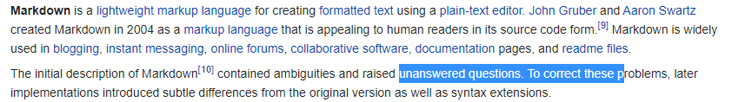
Source
Introduction to Markdown
Markdown is another mark-up language like hyper text mark-up language (HTML) used for document creation. Markdown is used in Jupyter Notebooks for cells with text. All of the classroom handouts and the course website are made using Markdown.
markdown

Slide 6
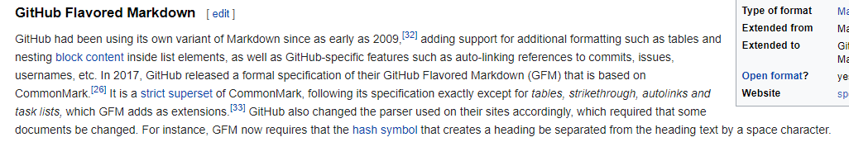
Source
Markdown
github markdown

Slide 7
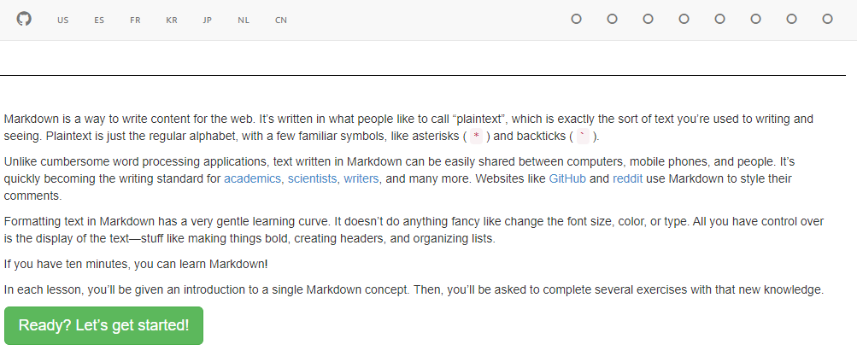
Source
Markdown Tutorial
markdown tutorial

Slide 8
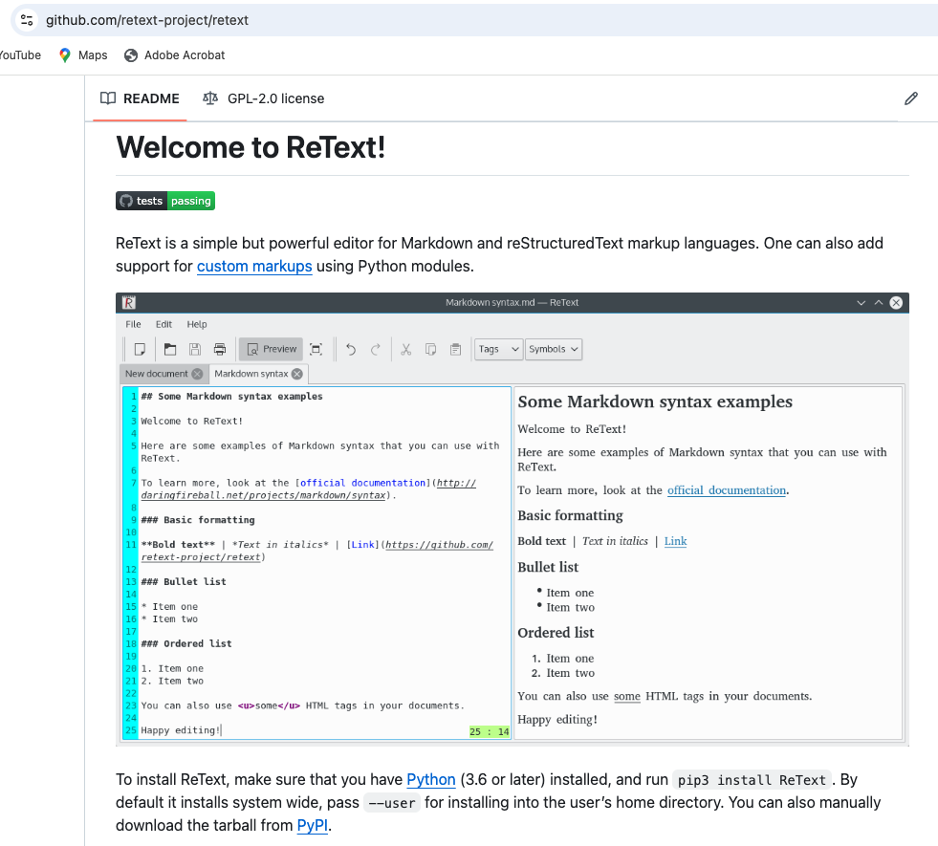
Source:
ReText
ReText is a free Python package for editing Markdown files.
reText

Slide 9
LaTeX
LaTeX is another programming language for scientific and engineering document preparation. This material will not be covered in any test in the course. All of the equations that appear in the handouts were written using LaTeX commands within Markdown. Other faculty may require the use of LaTeX but it is not required in MANE 3351.
$$e=mc^{2}$$

Slide 10
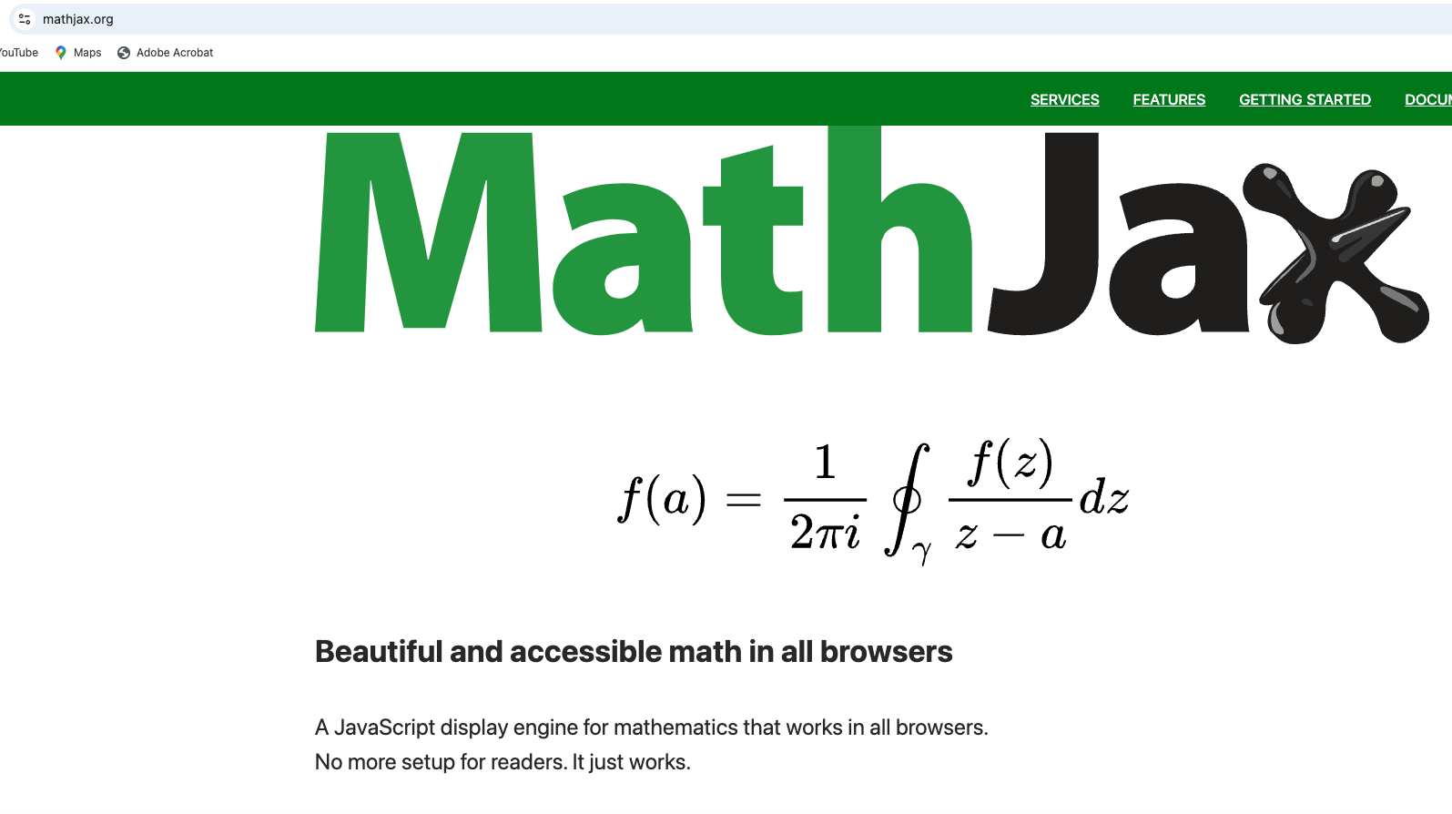
Source:
MathJax
Javascript display engine to display mathematical equations in LaTex or MathML on browsers.
MathJax

Slide 11
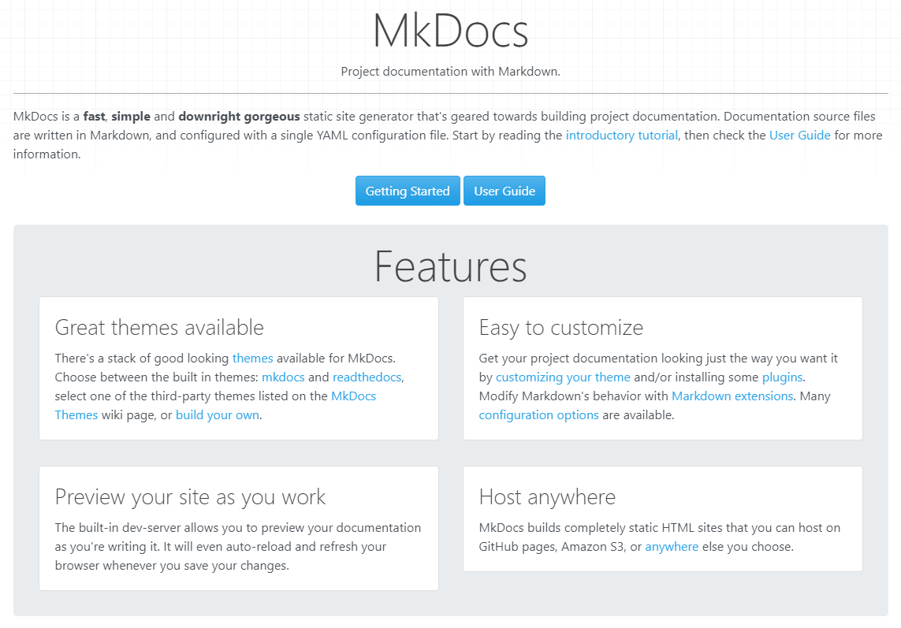
Source
MkDocs
mkdocs

Slide 12

Source
Material for MkDocs
material6

Slide 13
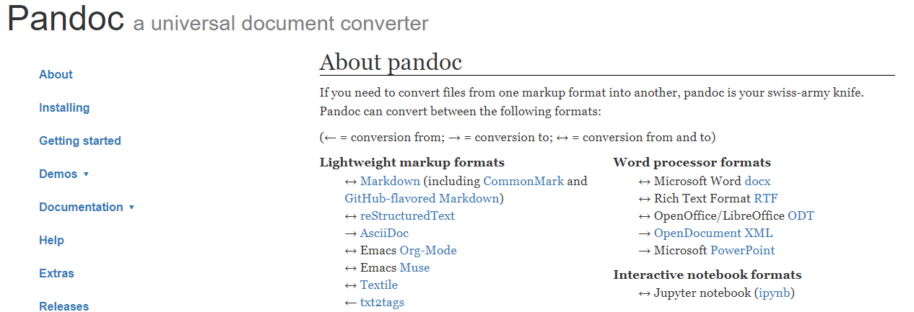
Source
Pandoc
pandoc

Slide 14
R Markdown
R Markdown is a file format for making dynamic documents with R. An R Markdown document is written in markdown (an easy-to-write plain text format) and contains chunks of embedded R code, like the document below.
Source

Slide 15
Demonstrations

