Slide 1
MANE 3351

Slide 2
Lecture 7
Classroom Management
Agenda
Taylor Series Expansion
Homework 2
Schedule
Lab session at 9:30

Slide 3
Resources
Handouts
Lecture 7 Slides
Lecture 7 Marked Slides
Assignments
Homework 1 (assigned 9/22/2025, due 9/29/2025 (before 11:59 PM)
Homework 2 (assigned 9/24/2025, due 10/1/2025 (before 9:30 AM - no late submissions)
Lab 3 (assigned 9/24/2025, due 10/1/2025 (before 9:30 AM))
Read textbook pages 1 - 16

Slide 4
Schedule
Lecture/Lab | Date | Topic
7 | 9/24 | Taylor Series, Homework 2 (due 10/1 - no late work), Lab 3 (due 10/1)
8 | 9/29 | Roots of Equations, bisection method (not on Test 1)
9 | 10/1 | Bisection Method Error Analysis, False Position (not on Test 1)
10 | 10/6 | Test 1 (lectures 1-7)

Slide 5
Lecture Content
Taylor Series Expansion

Slide 6
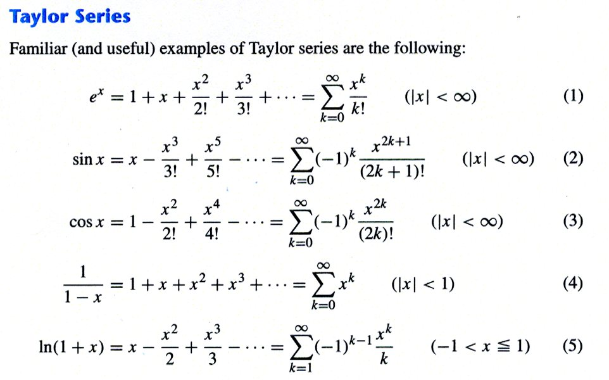
Taylor Series
Introduction to Taylor Series
Cheney and Kincaid [^1] provide some commonly used Taylor series.
Taylor Series

Slide 7
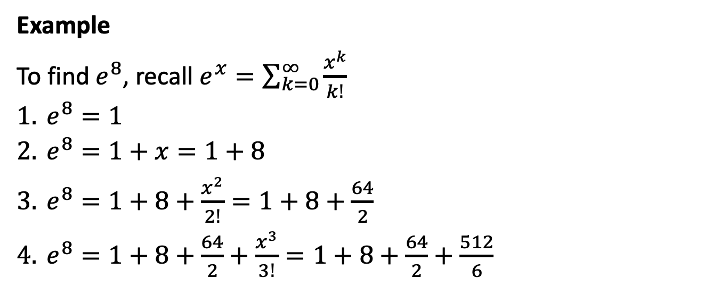
Example
To find $e^{8}$, recall $e^{x}=\sum_{k=0}^{∞}{\frac{x^{k}}{k!}}$
$e^{8}=1$
$e^{8}=1+x=1+8$
$e^{8}=1+8+\frac{x^{2}}{2!}=1+8+\frac{64}{2}$
$e^{8}=1+8+\frac{64}{2}+\frac{x^{3}}{3!}=1+8+\frac{64}{2}+\frac{512}{6}$

Slide 8
Python Code for Jupyter Notebook
import math import numpy as np import matplotlib.pyplot as plt def eTaylor(x,k): y=0.0 for i in range(k): #print(i) y=y+(x**i)/math.factorial(i) #print("i=",i," y=",y," i!= ",math.factorial(i)," x^i=",x**i) return y k=np.arange(21) print(k) print(k[0]) y=0.0*k for i in np.nditer(k): #print(i) y[i]=eTaylor(8,i) #print(y) #plotting code fig, ax = plt.subplots() ax.plot(k, y) ax.set(xlabel='k', ylabel='e^8(k)', title='Taylor Series Approximation') plt.show()

Slide 9
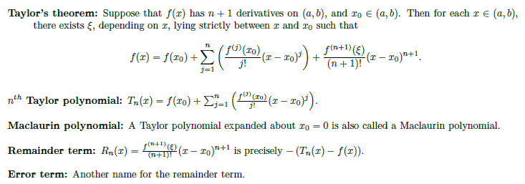
Source: textbook, page 14
Taylor Series Expansion about a Point
Taylor Series Polynomial

Slide 10
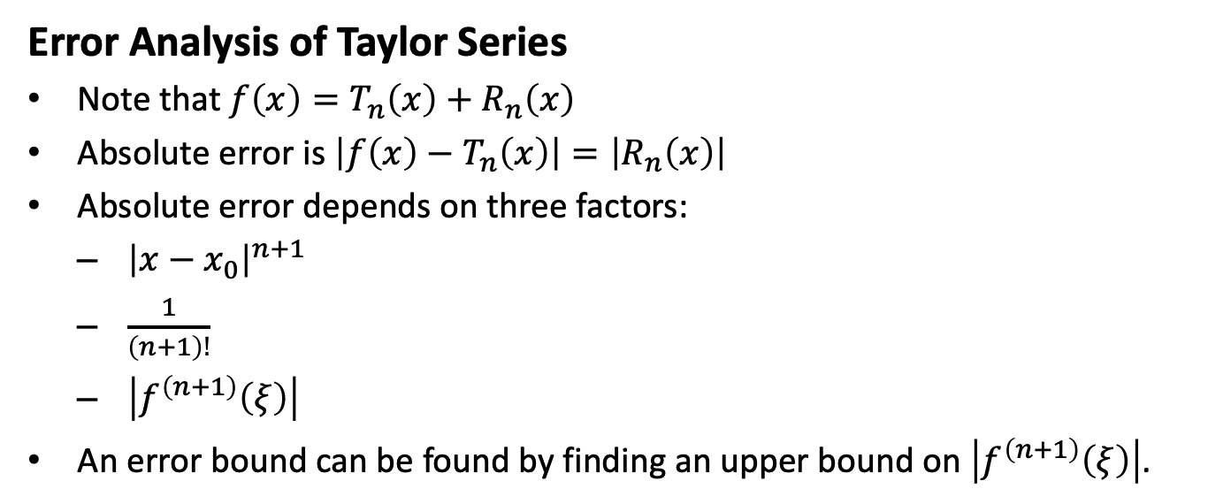
Error Analysis of Taylor Series
Note that $f\left(x\right)=T_{n}\left(x\right)+R_{n}\left(x\right)$
Absolute error is $\left|f\left(x\right)−T_{n}\left(x\right)\right|=\left|R_{n}\left(x\right)\right|$
Absolute error depends on three factors:
${\left|x−x_{0}\right|}^{n+1}$
$\frac{1}{\left(n+1\right)!}$
$\left|f^{\left(n+1\right)}\left(ξ\right)\right|$
An error bound can be found by finding an upper bound on $\left|f^{\left(n+1\right)}\left(ξ\right)\right|$.

Slide 11
Error Analysis for Exponential Example
# Cell 3 # error analysis of Taylor Series approximation of e^8 # assumes cell two has been run er=0.0*k for i in np.nditer(k): er[i]=math.exp(8)-y[i] fig, ax = plt.subplots() ax.plot(k, er) ax.set(xlabel='k', ylabel='error', title='Taylor Series Approximation') plt.show()

Slide 12
Error for sine
# cell 4 # Demonstration of T1, T2 and T3 for sine def T1(x): return x def T2(x): return x - x**3/6.0 def T3(u): return T2(u)+u**5/120.0 x=np.linspace(-math.pi,math.pi,101) t1=0.0*x t2=0.0*x t3=0.0*x sin_x=0.0*x for i in range(0,len(x)): t1[i]=T1(x[i]) t2[i]=T2(x[i]) t3[i]=T3(x[i]) sin_x[i]=math.sin(x[i]) fig, ax = plt.subplots() ax.plot(x, sin_x,label="sine(x)") ax.plot(x,t1,label="T1") ax.plot(x,t2,label="T2") ax.plot(x,t3,label="T3") ax.set(xlabel='x', ylabel='f(x)', title='Taylor Series Approximation of sine') ax.legend() plt.show()

Slide 13
Derivative Calculator
Very helpful site
Do not become dependent on it; it won’t be available for the test
Derivative Calculator Website

Slide 14
[1]: Cheney and Kincaid (2004), Numerical Mathematics and Computing, 5th edition.

