Slide 1
MANE 3351

Slide 2
Lecture 8
Classroom Management
Agenda
Part 2: Bisection Search lecture
Test 1 2024 - available in Solutions
Test 1 - scheduled 10/6/2025
Lab Section is submitting Lab 3

Slide 3
Resources
Handouts
Lecture 8 Slides
Lecture 8 Marked Slides
Assignments
Homework 1 (assigned 9/22/2025, due 9/29/2025 (before 11:59 PM)
Homework 2 (assigned 9/24/2025, due 10/1/2025 (before 9:30 AM - no late submissions)
Lab 3 (assigned 9/24/2025, due 10/1/2025 (before 9:30 AM))
Read textbook pages 41-46

Slide 4
Schedule
Lecture/Lab | Date | Topic
7 | 9/24 | Taylor Series, Homework 2 (due 10/1 - no late work), Lab 3 (due 10/1)
8 | 9/29 | Roots of Equations, bisection method (not on Test 1)
9 | 10/1 | Bisection Method Error Analysis, False Position (not on Test 1)
10 | 10/6 | Test 1 (lectures 1-7)

Slide 5


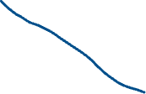
Roots of Equations
Introduction
Value x such that f(x)=0
Extremely useful operations
Engineering Economic Examples
Break-even analysis
Payback period
Rate of return

Slide 6
Quadratic Equation
Consider a second-order polynomial $ax^{2}+bx+c=0$
The quadratic formula finds the value(s) of x
$$\frac{−b±\sqrt{b^{2}−4ac}}{2a}$$

Slide 7
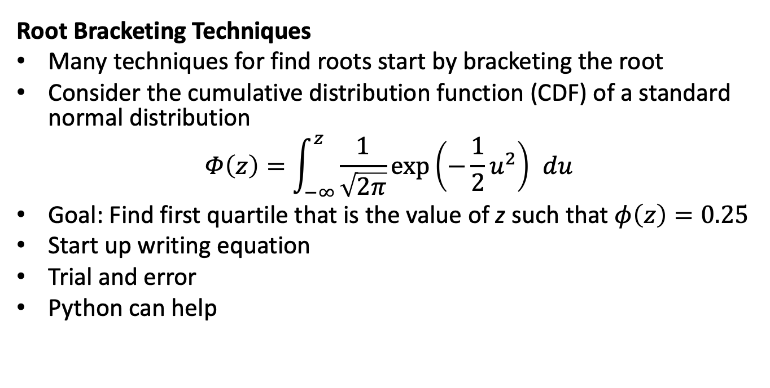
Root Bracketing Techniques
Many techniques for find roots start by bracketing the root
Consider the cumulative distribution function (CDF) of a standard normal distribution
$$Φ\left(z\right)=\int_{−∞}^{z}{\frac{1}{\sqrt{2π}}}exp\left(−\frac{1}{2}u^{2}\right) du$$
Goal: Find first quartile that is the value of z such that $φ\left(z\right)=0.25$
Start up writing equation
Trial and error
Python can help

Slide 8
Statistical Functions in Python
General Statistical Functions
Normal Distribution

Slide 9






Python Code for Statistical Functions
from scipy import stats p=0.25 x=float(input("Enter the value of x: ")) fx=stats.norm.cdf(x) print("for x={}, f({})={}".format(x,x,fx)) print("{}-th percentile={}".format(p,stats.norm.ppf(p)))

Slide 10






Bisection Method
Identify an interval [a,b] such that either a or b overshoots the mark while the other undershoots it.
Calculate the midpoint, m, of the identified interval
If a and m both overshoot or both undershoot the mark, the desired value lies in [m,b]
If b and m both overshoots or both undershoot the mark, the desired value lies in [a,m]
Return to step 2 using the newly identified interval
Source: textbook, page 41

Slide 11


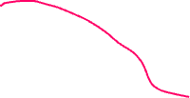









Slide 12


Simple Pseudocode

Slide 13
Source: textbook, page 43

Slide 14
Python code for Simple Pseudocode
#from scipy import stats def f(x): return stats.norm.cdf(x)-.25 # initialize code a=-0.9 b=0.9 i=1 L=f(a) m=(a+b)/2.0 # discuss divisor M=f(m) while True: if L*M<0.0: b=m else: a=m L=M m=(a+b)/2.0 M=f(m) i=i+1 print("iteration {}, root is located at {}".format(i,m)) print("{} iterations processed".format(i)) print("the root is {} with f({})={}".format(m,m,M))

Slide 15
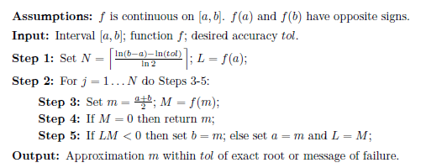
Pseudocode 2

Slide 16
Source: textbook, page 43

Slide 17




Python Code for Pseudocode 2
# Pseudo-code 2 from scipy import stats import math def f(x): return stats.norm.cdf(x)-.25 # initialize code a=-3.0 b=0.0 tol=0.0005 N=100 err=math.fabs(b-a) L=f(a) for i in range(0,N+1): m=(a+b)/2.0 M=f(m) err=err/2.0 if (M==0) or (err<tol): print("stopping inside for loop at iteration {}".format(i)) break if (L*M<0): b=m else: a=m L=M print("the root is {} with f({})={}".format(m,m,M))

