Slide 1
MANE 3351

Slide 2
Lecture 9
Classroom Management
Agenda
  Part 2: Bisection Search Error Analysis
  False Position Method
  Review Test 1
  Lab 4
  LANL visit - I will be out of my office for most of today
    One day extension on Lab 3

Slide 3
Resources
Handouts
  Lecture 9 Slides
  Lecture 9 Marked Slides
Assignments
  Homework 1 (assigned 9/22/2025, due 9/29/2025 (before 11:59 PM)
  Homework 2 (assigned 9/24/2025, due 10/1/2025 (before 9:30 AM - no late submissions)
  Lab 3 (assigned 9/24/2025, due 10/1/2025 (before 9:30 AM))
  Read textbook pages 41-46

Slide 4
Schedule
Lecture/Lab | Date | Topic
7 | 9/24 | Taylor Series, Homework 2 (due 10/1 - no late work), Lab 3 (due 10/1)
8 | 9/29 | Roots of Equations, bisection method (not on Test 1)
9 | 10/1 | Bisection Method Error Analysis, False Position (not on Test 1)
10 | 10/6 | Test 1 (lectures 1-7)

Slide 5
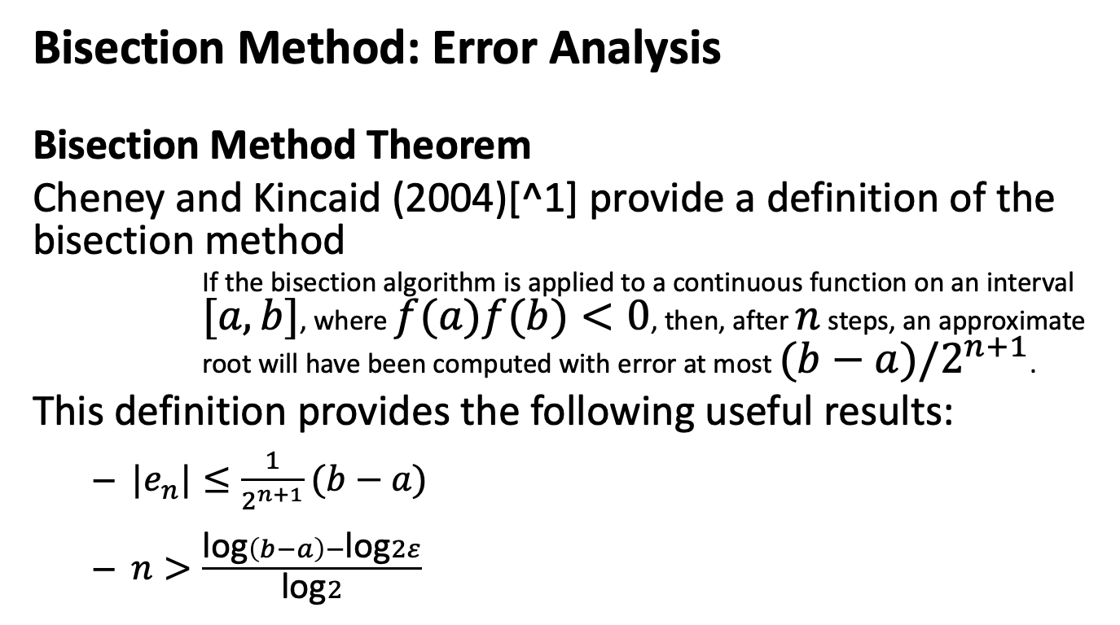
Bisection Method: Error Analysis
Bisection Method Theorem
Cheney and Kincaid (2004)[^1] provide a definition of the bisection method
If the bisection algorithm is applied to a continuous function on an interval $[a,b]$, where $f(a)f(b)<0$, then, after $n$ steps, an approximate root will have been computed with error at most $(b−a)/2^{n+1}$.
This definition provides the following useful results:
  $|e_{n}|≤\frac{1}{2^{n+1}}(b−a)$
  $n>\frac{\text{log}\left(b−a\right)−\text{log}2ε}{\text{log}2}$

Slide 6
Percent Relative Error
Chapra and Canale (2015) [^2] provide a formula for the approximate percent relative error
  $ε_{a}=\left|\frac{x_{r}^{new}−x_{r}^{old}}{x_{r}^{new}}\right|×100\%$ where $x_{r}^{new}$ is the root for the present iteration and $x_{r}^{old}$ is the root from the previous iteration

Slide 7
False Position
  Attempts to converge faster than bisection method by using functional information
  The new root is found by
$$x_{r}=x_{u}−\frac{f(x_{u})(x_{l}−x_{u})}{f(x_{l})−f(x_{u})}$$

Slide 8
  Figure 5.12 (Chapra and Canale(2015)[^2] illustrates the false position method False Position Method

Slide 9
False Position Code
The pseudocode, shown below was taken from [^3]

Slide 10
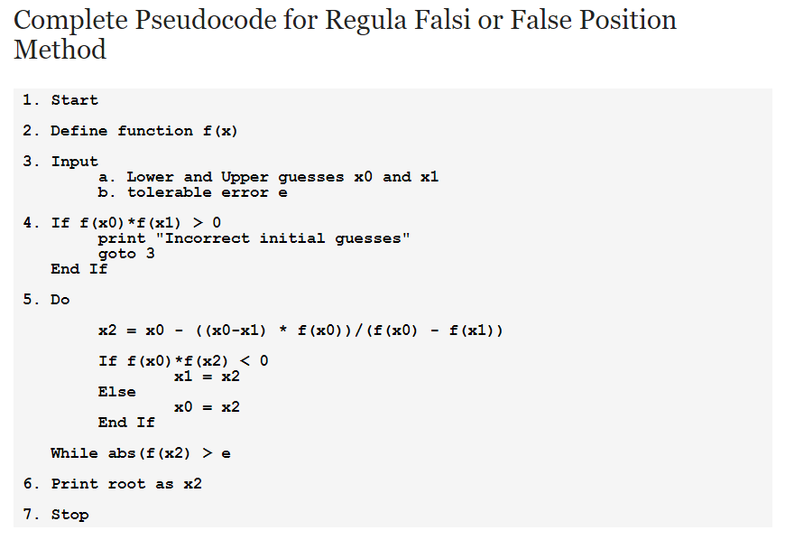
False Position Pseudocode

Slide 11
False Position Error Analysis
  Much harder to analyze than bisection method
  Convergence to root depends on shape of $f(x)$
  At times, false position may converge slowly!, Example from textbook[^4], shown below

Slide 12
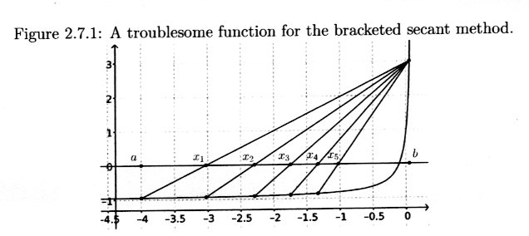
False Position troublesome function

Slide 13
Loops in Python
  Python only supports two types of loops: for and while
  Pseudocode used do/while loop

Slide 14
Python Code for False Position
# False Position
from scipy import stats
import math
def f(x):
return stats.norm.cdf(x)-.25
# input a & b
while True:
a=float(input("enter the lower bound: "))
b=float(input("enter the upper bound: "))
if f(a)*f(b)<0.0:
break
print("incorrect bounds, please re-enter")
print("the lower bound is {}".format(a))
print("the upper bound is {}".format(b))
counter=0
# process loop
while True:
m= a - ((a-b)*f(a))/(f(a)-f(b))
if f(a)*f(b)<0.0:
b=m
else:
a=m
counter=counter+1
if math.fabs(f(m)) <0.0005:
break
print("the root is {}".format(m))
print("the value at the root is {}".format(f(m)))
print("the number of steps were {}".format(counter))

Slide 15
Test One
  You are allowed one 4 inch by 6 inch notecard containing handwritten notes
  Calculator is needed; no programmable calculators that can calculate derivatives
  Covers material from Lectures 1 - 7
  Review Homework 1 and 2 and solutions
  Review Test 1
  Resistor information will be provided

Slide 16
References
[1]: Cheney, W. and Kincaid, D. (2004), Numerical Mathematics and Computing, 5th edition
[2]: Chapra, S. and Canale, R. (2015), Numerical Methods for Engineering, 7th edition
[4]: Brin, L., (2020), Tea Time Numerical Analysis: Experiences in Mathematics, 3rd edition

